Slide 1


HOIST CRATE
FROM
CMR COLLEGE OF ENGINEERING & TECHNOLOGY

Slide 2
HOIST CRATE
HOIST
CRATE
Addressing the problem
Functional Requirement: The iron box lifts automatically when the handle is released and lower it when the handle is held. This automation is triggered by detecting whether the handle is held or released.
Reliability and Safety: The system should be reliable in detecting handle contact, smoothly control the lifting and lowering actions, and avoid risks of unintended movements or failures.
Uniqueness of the solution
Automated, Contact-Based Activation: Unlike conventional lifting systems that may rely on manual switches or buttons, the Hoist Crate uses a touch sensor to detect handle engagement.
Power Optimization for Sustainability: Power management features make the system sustainable for longer use. By using sensors and microcontrollers with efficient power consumption, the system minimizes battery drain, ideal for settings where frequent access is required without frequent recharging.
Proposed Solution
The Hoist Crate system is designed as a smart lifting mechanism that activates
automatically when the handle is released from an iron box.
This is made using four servomotors connected to a microcontroller, which
controls the lifting based on input from a touch sensor attached to the handle.
When the touch sensor detects that the handle is being held, it signals the microcontroller to keep the servomotor in a neutral position, allowing the iron box to be used as usual. When the handle is released, the sensor detects the lack of contact and signals the servomotor, by lifting the crate.
This action allows easy access to items indicating that the hoist crate is not in active use. The microcontroller runs continuously to check the sensor's status and adjusts the servomotor’s position accordingly.

Slide 3
TECHNICAL APPROACH
HOIST
CRATE
Hardware Components:
Microcontroller-Arduino nano : Controls the system by receiving input from sensors and sending
commands to the servomotor. It runs the logic for lifting and lowering based on handle engagement.
Servomotors(x4):Powers the lifting mechanism, allowing the Iron box to be raised and lowered as
needed. A high-torque motor is essential to handle the weight of the iron crate.
Touch Sensor : Detects when the handle is held or released. The sensor signals the microcontroller to engage or disengage the motor based on user interaction with the handle.
Iron box : The most prominent component in Hoist Crate
Connectors , jumper wires.

Slide 4
HOIST CRATE Smart Safety, Effortless Ironing
System Business Model Canvas . minimal maintenance for diverse industries.
Key Partners | Key Activities | Value Proposition |  | Customer Relationships | Customer Segments
.Iron Manufacturers: Integrate the safety mechanism into existing iron product lines. .Sensor Technology Providers: Supply advanced sensors for presence detection. .Engineering and Design Firms: Design and prototype the lifting mechanism for seamless integration. .Retailers: Distribute the product widely through major retail channels. | .Design, prototype, and rigorously test the iron safety mechanism for safety and performance. .Oversee production processes and maintain high-quality standards. .Promote the product and ensure efficient delivery and availability in retail channels. .Provide after-sales service and ensure the product meets safety and regulatory standards. | .Enhanced safety with an automatic lifting mechanism that minimizes the risk of burns and fabric damage when not in use. User-friendly design for easy integration into existing irons, requiring minimal user intervention. .Advanced sensor technology for reliable user presence detection, ensuring safe and effective operation. . Cost-effective solution that offers significant value to manufacturers and consumers alike. |  | Provide personalized customer support to address inquiries and issues effectively. Engage with customers through social media and online platforms to build a community around the product. Offer tutorials and resources to help customers understand and utilize the safety mechanism effectively. Gather feedback from users to continuously improve the product and enhance customer satisfaction. | Homeowners looking for safe and convenient ironing solutions for personal use. Families with children or pets that require extra safety measures to prevent accidents during ironing. Companies seeking to enhance their product offerings with innovative safety features. Stores and online platforms interested in stocking safety- enhanced irons.
 | Key Resources |  |  | Channels
 | Advanced sensor technology for the automatic lifting mechanism. Manufacturing facilities and supply chain partnerships for production. Skilled workforce for design, development, and customer support. Marketing and sales channels, including e-commerce platforms and retail partnerships. Research and development capabilities for continuous product improvement and innovation. |  |  | Direct sales through appliance retailers and online marketplaces. Partnerships with fire safety contractors and insurance providers for broader outreach. Enhance visibility via an informative website and social media. Presentations at fire safety events to showcase the product.
Cost Structure |  |  | Revenue Stream 4

Slide 5
FEASIBILITY AND VIABILITY
HOIST
CRATE
Proven Technology: The core components (such as servomotors, microcontrollers, touch sensor) are established and widely available, making the technology straightforward to implement.
Low Complexity: Since Hoist Crate relies on relatively simple automation mechanics, the design and functionality are technically feasible. It requires only basic control logic for lifting and lowering, which reduces development complexity.
Testing and Validation: Prototype testing in real-world settings is feasible and necessary to ensure that the system operates safely and effectively in different environments.

Slide 6
IMPACT AND BENEFITS
HOIST
CRATE
Potential Impact on the Target Audience
Reduced Physical Strain: Hoist Crate automates the lifting of heavy or bulky items, minimizing manual handling and the risk of physical injuries
Time Savings: The Hoist Crate system can speed up operations by enabling quick, easy lifting and lowering of items without manual effort.
Lower Healthcare Costs: Reducing physical strain on employees can lead to lower rates of injury, which may result in reduced healthcare costs and fewer workers’ compensation claims.
Benefits of the solution
Enhanced Workplace Safety
Increased Efficiency and Productivity
Cost Savings

Slide 7
REQUIRED COMPONENTS
HOIST
CRATE
Iron box
Servomotors(x4)
Touch Sensor
Jumper wires
Arduino nano microcontroller

Slide 8
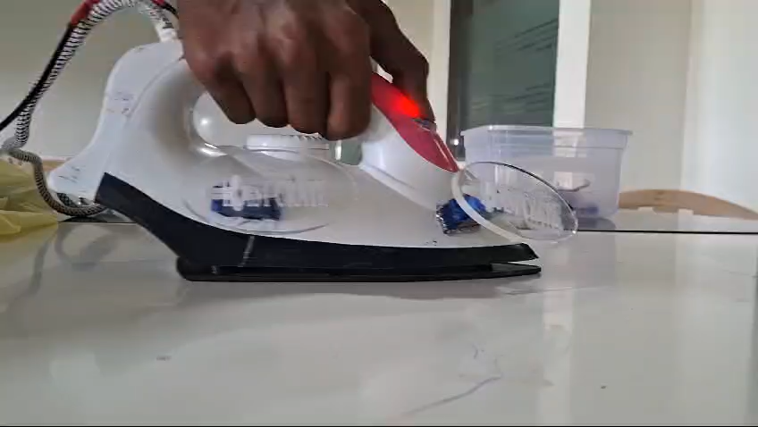
FINAL PROTOTYPE
HOIST
CRATE

Slide 9
THANK YOU

