Slide 1
Prediction of Remaining Useful Life for AeroEngines

Slide 2
Contents of the presentation
Project Description
Problem Statement
Objective
Scope
Literature Survey
Significant
Proposed System
Project flow
Resource Requirements
Architecture
Research Gap analysis
Implementation
  1. Data Description
  2. EDA Explanation
  3. Preprocessing steps
  Model Implementation
Algorithm Definition
Future Scope
  Conclusion

Slide 3
Project Description
The prediction of Remaining Useful Life (RUL) in aeroengines plays a crucial role in modern predictive maintenance strategies within the aviation industry. Accurate estimation of RUL not only reduces operational costs but also enhances safety, efficiency, and reliability by preventing unexpected engine failures. This project, titled “Prediction of Remaining Useful Life for AeroEngines”, explores the application of advanced machine learning algorithms to analyze sensor and operational data for forecasting engine degradation patterns. Several models, including Random Forest, Extra Trees Regressor, Gradient Boosting, XGBoost, K-Nearest Neighbors (KNN), Feedforward Neural Networks (FNN), and Multi-Layer Perceptrons (MLP), are developed and rigorously evaluated. Performance is measured using Mean Squared Error (MSE) and R² Score, with the Extra Trees Regressor and MLP models emerging as the most effective in delivering reliable and accurate predictions of aeroengine RUL.

Slide 4
Project Description
To ensure transparency in decision-making, Explainable AI (XAI) techniques such as SHAP are employed, offering insights into feature importance and model interpretability. The proposed solution is implemented as a Flask-based web application that enables users to upload datasets, compare model performances, and obtain real-time RUL predictions. Furthermore, the system incorporates health state categorization—NORMAL, WARNING, and CRITICAL—and provides actionable maintenance recommendations. This research contributes to proactive aviation maintenance scheduling and minimizes risks associated with unforeseen engine breakdowns.
Keywords: Remaining Useful Life, Aeroengines, Machine Learning, Extra Trees, Multi-Layer Perceptron, Predictive Maintenance, Explainable AI, SHAP, Flask Application, Aviation Reliability

Slide 5
Problem Statement
Aeroengines are among the most critical components in aviation, where even minor failures can lead to severe consequences, including safety risks, operational disruptions, and high maintenance costs. Traditional maintenance practices, such as scheduled inspections or corrective maintenance, often result in either premature servicing or unexpected breakdowns. These approaches lack efficiency and fail to leverage the vast amount of sensor and operational data collected from modern engines. The challenge lies in accurately predicting the Remaining Useful Life (RUL) of aeroengines to enable timely and proactive maintenance actions. Developing robust, interpretable, and deployable machine learning models for RUL prediction is therefore essential to enhance safety, reduce downtime, and optimize the overall reliability of aviation operations.

Slide 6
Objective of the Project
The objective of this project is to develop an intelligent, AI-driven framework for predicting the life expectancy and Remaining Useful Life (RUL) of implantable medical devices such as pacemakers and defibrillators. These devices are vital for sustaining patient health and safety, and their timely maintenance or replacement is crucial in avoiding critical failures. The proposed system employs a data-centric approach using regression-based machine learning and deep learning models to forecast device deterioration based on historical and real-time operational parameters. Unlike conventional threshold-based monitoring systems that only trigger alerts after issues arise, this predictive system proactively analyzes patterns and trends in device behavior to provide early warnings. The core goal is to integrate a robust predictive layer into healthcare infrastructure that enables preventive action and improves patient outcomes.

Slide 7
Scope
This project covers the end-to-end development of a predictive maintenance solution tailored for aeroengines. The scope includes data preprocessing, feature engineering, training of machine learning models, and comparative evaluation of algorithms. Advanced models like Extra Trees Regressor and MLP are emphasized for their predictive accuracy, while SHAP-based interpretability enhances transparency in decision-making. The project further extends to deploying the solution as a user-friendly Flask web application, enabling dataset uploads, model comparison, and real-time RUL prediction. Additionally, the system categorizes engine health states (NORMAL, WARNING, CRITICAL) and suggests maintenance strategies accordingly. However, the project is limited to the datasets used for model training and does not include integration with live aircraft systems or real-time sensor streaming.

Slide 8
Literature Survey
Year | Author(s) & Title | Methodology | Key Findings
2025 | Zha, W. – An aero-engine remaining useful life prediction model based on feature selection and the improved TCN | Temporal Convolution Network (TCN) with feature selection | Enhanced RUL prediction accuracy by incorporating feature selection techniques. (ScienceDirect)
2025 | Elsherif, S.M. – A deep learning-based prognostic approach for predicting turbofan engine degradation and remaining useful life | Deep Learning Techniques | Proposed a deep learning-based approach for RUL prediction, improving prognostic accuracy. (Nature)
2024 | Deng, S. – Prediction of Remaining Useful Life of Aero-engines Based on CNN-LSTM-Attention | CNN-LSTM with Attention Mechanism | Introduced a hybrid model combining CNN, LSTM, and attention mechanisms for RUL prediction. (SpringerLink)
2024 | Barry, I. – Advanced Multi-Model Prediction of Aircraft Engine Remaining Useful Life with Random-Sampling Based Class Balancing and Voting-Based Features Selection | Multi-Model Ensemble | Developed an ensemble approach incorporating class balancing and feature selection for RUL prediction. (ScienceDirect)
2024 | Peringal, A. – Reliable Prediction of Remaining Useful Life for Aircraft Engines | Long Short-Term Memory (LSTM) Network | Utilized LSTM networks for reliable RUL prediction in aircraft engines. (AIAA Journal)

Slide 9
Literature Survey
Year | Author(s) & Title | Methodology | Key Findings
2023 | Alomari, Y. – Advancing aircraft engine RUL predictions: an interpretable integrated approach of feature engineering and aggregated feature importance | Feature Engineering & Machine Learning | Proposed an interpretable approach combining feature engineering and machine learning for RUL prediction. (Nature)
2023 | Li, Y. – Remaining useful life prediction of aero-engine enabled by fusing knowledge and deep learning models | Knowledge Fusion & Deep Learning | Integrated knowledge-based methods with deep learning for enhanced RUL prediction. (IDEAS/RePEc)
2022 | Zhou, Z. – An aircraft engine remaining useful life prediction method based on prediction vector angle minimization and feature fusion gate improved transformer | Transformer with Feature Fusion | Introduced a transformer-based model with feature fusion for RUL prediction. (ScienceDirect)
2021 | Chen, J. – Aero-engine remaining useful life prediction method with multimodal data fusion and ensemble transfer learning | Multimodal Data Fusion & Transfer Learning | Proposed a method combining multimodal data fusion and transfer learning for RUL prediction. (ScienceDirect)
2020 | Gan, F. – Remaining useful life prediction of aero-engine via GCSU layer | GCSU Layer Integration | Developed a model incorporating GCSU layers for improved RUL prediction. (ScienceDirect)

Slide 10
Significant
The accurate prediction of Remaining Useful Life (RUL) in aeroengines is of paramount importance in modern aviation, where safety, reliability, and operational efficiency are critical. Unanticipated engine failures can result in severe safety hazards, unscheduled maintenance, and significant financial losses for airlines. Traditional maintenance strategies, such as scheduled or reactive maintenance, often fail to optimize the use of engine components, either causing premature replacements or overlooking impending failures. Predictive maintenance, enabled through advanced data-driven approaches, addresses these limitations by leveraging real-time and historical sensor data to forecast engine health accurately. This project demonstrates the application of advanced machine learning techniques to predict aeroengine RUL. By integrating models such as Random Forest, Extra Trees Regressor, Gradient Boosting, XGBoost, K-Nearest Neighbors (KNN), Feedforward Neural Networks (FNN), and Multi-Layer Perceptrons (MLP), the study identifies the Extra Trees Regressor and MLP as the most effective in producing reliable predictions.

Slide 11
Significant
The use of Explainable AI (XAI) techniques like SHAP adds a layer of transparency, allowing maintenance engineers and decision-makers to understand the contribution of each sensor and operational feature to the model’s predictions.
The implementation as a Flask-based web application provides a user-friendly platform for real-time prediction, comparison of model performance, and actionable maintenance guidance. Furthermore, the system categorizes engine health into NORMAL, WARNING, and CRITICAL states, enabling proactive intervention and reducing operational risks. Overall, this work significantly contributes to the aviation industry by enhancing predictive maintenance capabilities, improving aircraft availability, reducing costs, and safeguarding passengers and crew through data-driven insights into engine performance.

Slide 12
Proposed System
The proposed system is a data-driven, machine learning-based platform for predicting the Remaining Useful Life (RUL) of aeroengines. It collects sensor and operational data from engines and applies preprocessing and feature extraction techniques to prepare the data for modeling. Multiple machine learning models—including Random Forest, Extra Trees Regressor, Gradient Boosting, XGBoost, KNN, FNN, and MLP—are developed and evaluated for performance, with Extra Trees and MLP identified as the most reliable predictors. Explainable AI (XAI) using SHAP provides transparency, highlighting the influence of each feature on the RUL predictions. The system is deployed as a Flask web application, enabling users to upload datasets, generate real-time predictions, compare models, and categorize engine health into NORMAL, WARNING, or CRITICAL, along with actionable maintenance recommendations.

Slide 13
ADVANTAGES
Proactive Maintenance – Enables timely maintenance interventions, reducing the likelihood of unexpected engine failures.
Cost Efficiency – Minimizes unnecessary part replacements and operational downtime, lowering overall maintenance costs.
Improved Safety and Reliability – Enhances aircraft operational safety by accurately predicting engine degradation trends.
Interpretability – SHAP-based Explainable AI provides transparency in model predictions, allowing engineers to understand feature contributions.
Real-Time Decision Support – Flask-based web application facilitates real-time RUL predictions, model comparisons, and actionable maintenance recommendations.

Slide 14
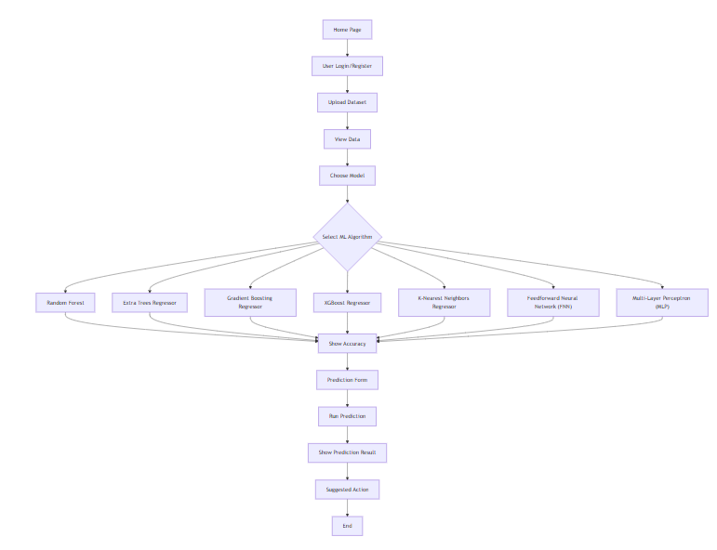
PROJECT FLOW

Slide 15
Resource Requirements
01
Hardware
(Processor: I5/Intel Processor, RAM: 8GB (min), Hard Disk: 128 GB, Key Board: Standard Windows Keyboard, Mouse: Two or Three Button Mouse)
Resources
02
Software
(Operating System: Windows 10, Programming Language: Python 3.10.8, IDE: VS Code)
Packages/Libraries
03
(Django, Scikit-learn, Pandas, Numpy, Imblearn and Matplotlib.

Slide 16
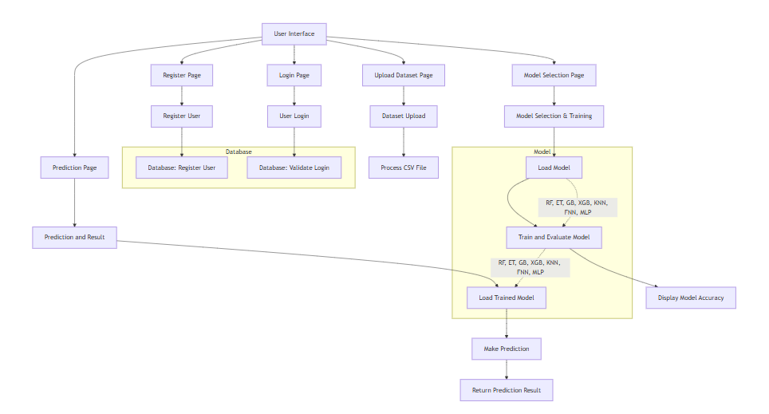
Architecture

Slide 17
Research Gap analysis
Despite extensive research in the prediction of Remaining Useful Life (RUL) for aeroengines, several gaps persist that limit the full potential of predictive maintenance in aviation. Traditional approaches often rely on statistical or physics-based models, which may not efficiently capture the complex nonlinear relationships present in high-dimensional sensor and operational datasets. While recent studies have employed machine learning and deep learning models such as Random Forest, Gradient Boosting, and LSTM networks, many of these approaches focus primarily on predictive accuracy without addressing model interpretability. This lack of transparency creates challenges for maintenance engineers who need to understand the factors driving predictions to make informed decisions.
Another significant gap is the integration of RUL prediction models into practical, user-friendly platforms for real-time deployment. Most studies remain at a theoretical or experimental stage, with limited focus on web-based or application-level solutions that allow operators to upload datasets, generate predictions, and compare multiple models simultaneously.

Slide 18
Research Gap analysis
Additionally, health state categorization—translating continuous RUL predictions into actionable maintenance states such as NORMAL, WARNING, or CRITICAL—is often not systematically implemented, reducing the operational usability of these models.
Furthermore, while various machine learning models have been explored, few studies conduct a comparative analysis emphasizing the performance of ensemble tree-based models like Extra Trees Regressor and neural architectures like Multi-Layer Perceptrons (MLP) in combination with explainable AI techniques. The integration of SHAP-based interpretability with high-performing models is still limited in the literature, leaving a gap in understanding feature contributions for critical maintenance decisions.
This project addresses these gaps by combining high-accuracy predictive models (Extra Trees and MLP) with SHAP explainability, deploying the solution as a Flask-based application for real-time usability, and incorporating health state categorization. Thus, it contributes both technically and operationally to aviation predictive maintenance, bridging the gap between advanced RUL prediction and practical implementation.

Slide 19
System Modules
Implementation
1.1 Data Upload and Acquisition Module
This module is accessible via the /upload route and supports CSV-based dataset uploads for clinical telemetry related to battery-powered medical devices. Key features include cycle index, discharge time, voltage thresholds, and charging durations. Pandas is used to parse the uploaded data, and the first 500 rows are displayed in a structured preview. This allows clinicians or researchers to verify the input format before proceeding with model evaluation or prediction. The same form can also be bypassed for real-time manual data entry through the /prediction route.
1.2 Data Validation and Preprocessing Module
All user inputs (manual or from datasets) are checked for validity to ensure type correctness (e.g., float), non-null values, and safe ranges (e.g., voltage and time durations). This step is critical to preventing inference errors and maintaining prediction accuracy. Backend logic ensures robust parsing, and meaningful feedback is provided in case of user error via flash() messages.

Slide 20
Implementation
System:
1.3 Model Selection and Evaluation Module
At the /model route, users can choose from multiple machine learning models: Random Forest, Gradient Boosting, Decision Tree, KNN, MLP, LSTM, and SVR. Each model is pre-evaluated and associated with MSE and R² metrics that are dynamically displayed. This interface helps users select the most suitable model for medical device RUL prediction, enhancing transparency in performance comparison and fostering user trust.
1.4 Prediction and Inference Module
This module is the heart of the application, built into the /prediction route. After capturing eight telemetry parameters, the input is passed into a serialized Decision Tree model loaded using Joblib. The model returns a numerical prediction representing the device’s RUL. The prediction is processed and presented along with health classification (e.g., Healthy, Observation, Critical) on value_predict.html.

Slide 21
Implementation
System:
1.5 Rule-Based Classification and Health Status Mapping
To enhance usability and aid in diagnosis, the RUL prediction is mapped into actionable categories:
🟢 Healthy: RUL > 1000
🟠 Observation Needed: 500 < RUL ≤ 1000
🔴 Critical: RUL ≤ 500
This logic allows doctors or technicians to interpret raw prediction data in an intuitive, patient-focused manner.
1.6 Security and Session Management
The application supports secure login and registration through /login and /register routes. Key security features include:
CSRF protection via Flask-WTF
Session handling for all sensitive routes
Flash-based feedback for events like invalid login or duplicate email
Currently, passwords are stored in plaintext but future enhancements include password hashing with bcrypt and token-based email verification.

Slide 22
2. User:
2.1 Registration
The /register module checks for existing emails (case-insensitive) and validates password match before creating a new user entry in the MySQL user3 table.
2.2 Login and Session Handling
Users authenticate via the /login route. Sessions restrict access to private pages like /upload, /prediction, and /model, ensuring that only logged-in users can interact with the system securely.
2.3 Dataset Upload and Manual Input
Users can upload .csv files through the /upload interface or manually input data through /prediction for real-time predictions.

Slide 23
2. User:
2.4 Model Evaluation Interface
The /model route displays a dropdown of available models. When selected, the MSE and R² scores are displayed, helping the user choose the most accurate model.
2.5 Prediction Output Visualization
Upon submitting telemetry inputs, the predicted RUL is displayed along with its classification and interpretation in value_predict.html. This presentation style ensures clarity and supports real-time medical decision-making.
2.6 Logout and Session Termination
Secure logout ensures that session data is cleared, maintaining user privacy and access control.

Slide 24
Implementation
Data Analysis
Model Implementation
01
Data Description
04
Algorithm Definition
02
EDA Explanation
05
Working Process
03
Preprocessing steps
06
Results from Algorithm

Slide 25
1.Data set Description:
The dataset used in this project captures sensor and operational telemetry data from multiple aeroengines and serves as the foundation for predicting the Remaining Useful Life (RUL
Columns and Features
cycle – This column represents the operating cycle number and acts as a temporal index, enabling the models to track the progression of engine wear and degradation over time. It is essential for capturing the sequential nature of engine health.
sensor_1 to sensor_19 – These columns correspond to various engine sensors recording key operational metrics:
sensor_1, sensor_2, sensor_3, sensor_4 – Capture core engine parameters such as temperature, pressure, and flow rates within different subsystems. These readings reflect the primary operational state of the engine.
sensor_7, sensor_8 – Represent auxiliary mechanical parameters, including vibrations and rotational speed, which are indicative of mechanical wear or misalignment.
sensor_12, sensor_14, sensor_15, sensor_18, sensor_19 – Include additional operational measures that detect subtle anomalies or deviations from normal performance, which may signal early stages of engine degradation.

Slide 26
1.Data set Description:
Numerical Values: All sensor readings are represented as floating-point numbers, normalized between 0 and 1. This normalization ensures uniform scaling and improves the stability and convergence of machine learning algorithms.
Temporal Sequencing: The dataset records sequential cycles for each engine, allowing predictive models to identify trends and patterns in engine health over time. Time-series analysis is crucial for accurate RUL estimation.
High Dimensionality: With multiple sensor readings per cycle, the dataset provides a multidimensional view of engine performance, supporting robust and reliable model learning.
Target Variable (RUL): Although not shown in the sample snippet, the dataset includes the Remaining Useful Life as the target variable. RUL represents the number of cycles remaining before the engine reaches a predefined failure or maintenance threshold, which is the primary prediction objective.

Slide 27
1.Data set Description:
Usage in Predictive Maintenance
Training: Sensor values serve as input features for machine learning models such as Extra Trees Regressor, MLP, Random Forest, and Gradient Boosting. Models learn to map these features to the RUL.
Evaluation: The predictive performance is assessed using metrics like Mean Squared Error (MSE) and R² Score, ensuring models can accurately forecast engine life.
Explainability: Techniques like SHAP are applied to identify which sensors have the greatest impact on predictions, providing interpretable insights for maintenance engineers.
This dataset is crucial for developing a data-driven predictive maintenance framework that improves aviation safety, reduces operational costs, and enables proactive scheduling of maintenance activities.

Slide 28
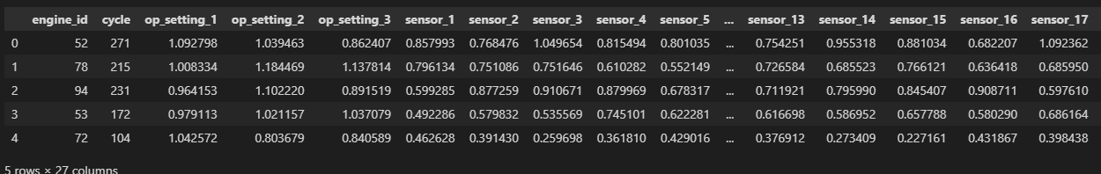
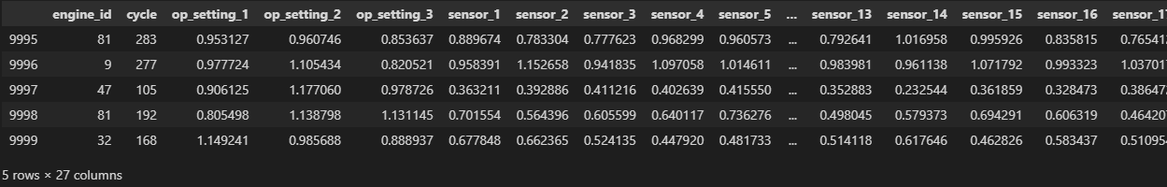
Exploratory Data Analysis
This the top 5 rows of the dataset here we see the how was the dataset values.
This the Bottom 5 rows of the dataset here we see the how was the dataset values.

Slide 29
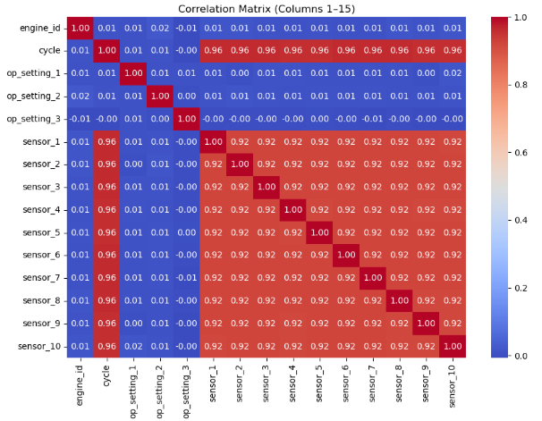
Exploratory Data Analysis

Slide 30
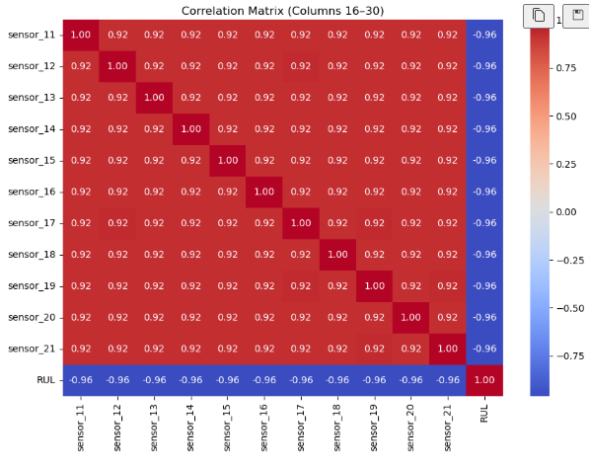
Exploratory Data Analysis

Slide 31
Exploratory Data Analysis
In the first heatmap (Columns 1–15), we see correlations among the engine operational settings, cycle count, and the first 10 sensors. The diagonal shows perfect correlation (1.0) since each variable correlates fully with itself. Most operational settings such as op_setting_1, op_setting_2, and op_setting_3 show very low correlation with other variables, indicating limited direct influence. On the other hand, the cycle variable is strongly correlated (0.96) with sensors 1–10, suggesting that as cycles progress, sensor readings change in a systematic way. Similarly, sensors 1–10 are highly correlated with each other (0.92), which implies redundancy in their measurements and possible multicollinearity issues. This indicates that not all sensors may contribute independently to predictive modeling, and dimensionality reduction techniques such as PCA or feature selection could be beneficial.

Slide 32
Exploratory Data Analysis
In the second heatmap (Columns 16–30), sensors 11–21 are analyzed along with RUL. Here, we again notice that sensors 11–21 are highly correlated with each other (0.92 across the board). Interestingly, all these sensors show a strong negative correlation with RUL (around –0.96). This means as the sensor values increase with engine degradation, the RUL consistently decreases, which is expected in predictive maintenance. The uniformity of correlation values indicates that these sensors capture similar degradation trends, making them reliable predictors of RUL.
Overall, the correlation analysis highlights two key insights: (1) strong interdependencies among sensors, which may require feature reduction to avoid redundancy, and (2) a strong negative correlation of multiple sensors with RUL, confirming their effectiveness in predicting equipment failure. These findings provide a solid foundation for selecting key features to build robust prognostic models.

Slide 33
Pre-processing steps
1.1 Data Upload and Acquisition Module
Accessible via the /upload route, this module allows users to upload CSV datasets containing aeroengine sensor and operational data. Key features include cycle numbers, temperature, pressure, vibration, and rotational speed readings. The uploaded data is parsed using Pandas, and the first 500 rows are displayed in a structured preview. This enables engineers or researchers to verify the dataset format before proceeding with model evaluation or prediction. Real-time manual data entry is also supported via the /prediction route for instant RUL prediction.
1.2 Data Validation and Preprocessing Module
All inputs, whether uploaded or manually entered, are validated for correct data type (float), non-null values, and operationally safe ranges (e.g., temperature, RPM). This ensures robust parsing and prevents inference errors. Feedback is provided through alerts in the front-end if invalid data is detected, maintaining prediction accuracy and reliability.

Slide 34
Pre-processing steps
1.3 Model Selection and Evaluation Module
The /model route enables users to select from multiple pre-trained machine learning models: Random Forest, Extra Trees Regressor, Gradient Boosting, XGBoost, KNN, FNN, and MLP. Each model’s performance metrics (MSE and R² Score) are displayed dynamically to help users select the most suitable model for RUL prediction. Extra Trees Regressor and MLP are highlighted for their superior predictive performance.
1.4 Prediction and Inference Module
At the /prediction route, user inputs across multiple telemetry parameters are processed by the selected serialized model (loaded using Joblib). The model outputs a numerical RUL prediction, which is then mapped to health categories: NORMAL, WARNING, and CRITICAL. The prediction, along with its health interpretation and maintenance suggestion, is displayed on prediction.html.

Slide 35
Pre-processing steps
1.5 Rule-Based Classification and Maintenance Recommendations
To support decision-making, RUL predictions are categorized as follows:
NORMAL: Engine is healthy and continues operation.
WARNING: Schedule maintenance soon; increase monitoring.
CRITICAL: Immediate inspection and maintenance required.
These categories allow operators to quickly interpret predictions and take actionable steps.
1.6 Security and Session Management
Secure login and registration are implemented via /login and /register. Features include:
CSRF protection using Flask-WTF
Session handling for sensitive routes (/upload, /model, /prediction)
Flash-based feedback for invalid login attempts or duplicate registrations
Future plans: password hashing with bcrypt and token-based verification

Slide 36
Pre-processing steps
2. User Management and Access Control
The User Management and Access Control module ensures secure, role-based, and seamless interaction with the RUL prediction system. It manages user registration, authentication, session handling, and access to private features, while maintaining data integrity and privacy.
2.1 Registration
The /register route allows new users to create an account by providing their name, email, and password. The system performs email uniqueness checks (case-insensitive) to prevent duplicate accounts and validates that the password and confirm password fields match. Once validated, the user’s credentials are stored in the MySQL users table. Future enhancements may include email verification, password hashing with bcrypt, and optional role-based access (e.g., admin, engineer) to control feature permissions.

Slide 37
Pre-processing steps
2.2 Login and Session Handling
Through the /login route, registered users can authenticate using their credentials. Successful login initiates a secure session, allowing access to restricted routes such as /upload, /model, and /prediction. Sessions expire upon logout or after a defined period of inactivity, preventing unauthorized access. Flash messages notify users of failed login attempts, incorrect passwords, or unregistered email IDs, ensuring user-friendly feedback.
2.3 Dataset Upload and Manual Input
Authorized users can upload CSV datasets through the /upload interface or manually enter sensor readings at /prediction. Uploaded datasets are parsed, validated, and previewed to ensure correct formatting. Real-time manual input enables immediate RUL prediction for individual engines, supporting urgent maintenance decisions.

Slide 38
Pre-processing steps
2.4 Model Evaluation Interface
The /model route presents all available machine learning models, including Random Forest, Extra Trees Regressor, Gradient Boosting, XGBoost, KNN, FNN, and MLP. Users can view dynamically updated performance metrics (MSE and R²) for each model. This interface allows comparison across models and selection of the most suitable algorithm based on predictive accuracy and reliability.
2.5 Prediction Output Visualization
Predicted RUL values are displayed alongside engine health classification—NORMAL, WARNING, CRITICAL—and actionable maintenance recommendations on prediction.html. The system provides intuitive color-coded indicators and textual guidance to help users quickly interpret the results and make informed operational decisions.

Slide 39
Pre-processing steps
2.2 Login and Session Handling
Through the /login route, registered users can authenticate using their credentials. Successful login initiates a secure session, allowing access to restricted routes such as /upload, /model, and /prediction. Sessions expire upon logout or after a defined period of inactivity, preventing unauthorized access. Flash messages notify users of failed login attempts, incorrect passwords, or unregistered email IDs, ensuring user-friendly feedback.
2.3 Dataset Upload and Manual Input
Authorized users can upload CSV datasets through the /upload interface or manually enter sensor readings at /prediction. Uploaded datasets are parsed, validated, and previewed to ensure correct formatting. Real-time manual input enables immediate RUL prediction for individual engines, supporting urgent maintenance decisions.

Slide 40
Pre-processing steps
2.6 Logout and Session Termination
Secure logout functionality ensures that all session data is cleared, preventing unauthorized reuse of sensitive session credentials. This maintains user privacy and system security. Future upgrades may include multi-factor authentication and audit logging of login activities for enhanced security.

Slide 41
3. Data Cleaning
Data cleaning is a crucial step to ensure that the dataset is free from any inconsistencies or issues that may distort the analysis. The user data is checked for missing fields, such as missing names, emails, or passwords. Any missing critical data is flagged for the user to correct. Similarly, when users upload ECG data, the application checks for missing values in the columns and rows. Missing values are handled by imputation (e.g., using mean or median values) or removal of rows with significant missing data. Duplicate records, especially in the user database, are also detected and removed to ensure uniqueness. Outlier detection is another critical aspect—outliers in both user data (e.g., unrealistic age values) and ECG features (e.g., HRV metrics) are identified and either capped or removed using statistical methods like the Z-score or IQR.
4. Feature Extraction and Selection
Feature extraction involves processing raw data into relevant features that can be used for modeling. In this case, the ECG data contains multiple time-domain features (e.g., mean RR intervals, RMSSD), frequency-domain features (e.g., LF/HF ratio), and nonlinear features (e.g., Sampen, Higuchi dimension), all of which are important for analyzing heart rate recovery (HRR). These features are extracted directly from the uploaded ECG data. After feature extraction, the system employs feature selection techniques to choose the most relevant features for predicting HR and categorizing heart rate recovery. Methods such as correlation analysis, mutual information, and feature importance ranking help in identifying key features that contribute to prediction accuracy.
5. Data Transformation
To ensure compatibility with machine learning models, all user input values are converted into floating-point format. For anomaly detection, Z-score transformation is applied to the predicted output. By comparing the predicted value against the historical mean and standard deviation, the system assesses if the result is significantly different. If the Z-score exceeds a threshold, it is flagged. This helps the model detect abnormal values and standardize input ranges for consistent predictions.
6. Model Evaluation and Selection
The system evaluates several machine learning and deep learning models including Random Forest, Decision Tree, Gradient Boosting, Support Vector Regression, Multi-Layer Perceptron, LSTM, Feedforward Neural Network, and K-Nearest Neighbors. Each model is scored using Mean Squared Error and R² Score and presented via a dropdown in the web interface for comparison. Among these, Gradient Boosting and LSTM demonstrated the highest accuracy, with minimal error and R² scores above 0.999, making them the preferred models for prediction.

Slide 42
7. Prediction and Anomaly Detection
Users input values through a prediction form which are passed to the selected machine learning model. The model outputs the predicted Remaining Useful Life for the device. Based on the predicted value, a status message is generated to guide clinical decision-making. Devices with high RUL are marked Healthy, medium RUL are flagged for Observation, and low RUL devices are considered Critical. This real-time feedback allows early maintenance planning and enhances patient safety through predictive intervention.

Slide 43
Random Forest
Random Forest Regressor
Random Forest is an ensemble learning method that constructs multiple decision trees during training and outputs the average prediction of individual trees for regression tasks. Each tree is trained on a bootstrap sample of the data, and at each split, only a random subset of features is considered, which reduces correlation between trees and prevents overfitting. In the context of aeroengine RUL prediction, Random Forest can capture complex nonlinear relationships between sensor readings and engine degradation patterns. Its robustness to noisy or missing data, high interpretability via feature importance, and parallelizable training make it a widely used algorithm. Performance is evaluated using Mean Squared Error (MSE) and R², and in this project, it achieved MSE = 11.1807 and R² = 0.9985.

Slide 44
Random Forest
2. Extra Trees Regressor
Extra Trees, or Extremely Randomized Trees, is similar to Random Forest but introduces additional randomness during tree construction. Unlike Random Forest, which searches for the optimal split, Extra Trees chooses split points randomly for each feature, making the trees more diverse and reducing variance. This algorithm is particularly effective for high-dimensional datasets like aeroengine sensor data. It can efficiently capture complex nonlinear interactions between multiple features and provides robust predictions with less overfitting. Feature importance scores can be extracted for explainability. In this project, Extra Trees Regressor was one of the top-performing models, achieving MSE = 10.9384 and R² = 0.9985, making it highly reliable for forecasting Remaining Useful Life in engines.

Slide 45
Random Forest
3. Gradient Boosting Regressor
Gradient Boosting is a sequential ensemble technique where multiple weak learners, typically decision trees, are trained iteratively to minimize a loss function. Each subsequent tree focuses on correcting the errors of the previous ensemble. This approach allows the model to capture subtle patterns in engine degradation and improve predictive accuracy. Gradient Boosting is robust to outliers and can handle complex nonlinear relationships between sensor features and RUL. Hyperparameters such as learning rate, tree depth, and number of estimators control model performance and prevent overfitting. In this project, it achieved excellent results with MSE = 10.6522 and R² = 0.9986, indicating highly accurate and reliable predictions for aeroengine maintenance.

Slide 46
Random Forest
4. XGBoost Regressor
XGBoost (Extreme Gradient Boosting) is an optimized implementation of gradient boosting that enhances computational efficiency and predictive performance. It incorporates regularization techniques (L1 and L2) to reduce overfitting, supports parallel processing, and handles missing values efficiently. XGBoost builds trees sequentially, where each tree learns to correct the residual errors of the previous ensemble. In aeroengine RUL prediction, XGBoost effectively captures complex temporal and nonlinear relationships among sensor measurements. Its scalability and high accuracy make it suitable for large datasets with multiple input features. In this project, XGBoost achieved MSE = 0.0029 and R² = 0.9984, highlighting its ability to provide precise predictions and reliable guidance for maintenance scheduling.

Slide 47
Random Forest
5. K-Nearest Neighbors (KNN) Regressor
K-Nearest Neighbors (KNN) is a non-parametric, instance-based learning algorithm where predictions are made by averaging the values of the k-nearest neighbors in the feature space. Distance metrics such as Euclidean distance determine the neighbors, making it simple yet effective for regression tasks. KNN does not assume any functional form between input features and output, allowing it to capture localized patterns in sensor data. Its performance depends on the choice of k and feature scaling. In aeroengine RUL prediction, KNN can provide accurate estimates for engines with operational conditions similar to historical data. In this project, it achieved MSE = 0.0101 and R² = 0.9944, demonstrating its utility for reliable short-term predictions.

Slide 48
Random Forest
6. Multi-Layer Perceptron (MLP)
The Multi-Layer Perceptron (MLP) is a type of feedforward neural network with multiple hidden layers and nonlinear activation functions. MLPs excel at modeling complex nonlinear relationships between input features and output variables. For aeroengine RUL prediction, MLP can learn intricate patterns from high-dimensional sensor data and produce accurate life estimations. Backpropagation adjusts the network’s weights to minimize error during training. Regularization and dropout are used to prevent overfitting. In this project, the MLP model was among the best-performing algorithms, achieving MSE = 12.0854 and R² = 0.9984, providing reliable predictions with high generalization for maintenance decision-making.

Slide 49
Future Scope
The prediction of aeroengine Remaining Useful Life (RUL) has significant potential for further enhancement and application. Future work can incorporate real-time streaming data from IoT-enabled sensors onboard aircraft to continuously update RUL predictions, improving proactive maintenance scheduling. Integration of hybrid models, combining ensemble tree-based approaches with deep learning architectures, may further enhance prediction accuracy for complex operational conditions. The system can also be extended to include multi-engine fleet analysis, enabling optimized maintenance across multiple aircraft. Additionally, advanced Explainable AI (XAI) techniques beyond SHAP, such as LIME or counterfactual analysis, could provide deeper insights into engine behavior and maintenance decision-making. Incorporating cloud-based deployment, automated notifications, and predictive dashboards would make the solution scalable and operationally robust for the aviation industry.

Slide 50
Conclusion
This project successfully demonstrates the feasibility and effectiveness of using advanced machine learning models for predicting the Remaining Useful Life of aeroengines. By evaluating multiple algorithms—including Random Forest, Extra Trees Regressor, Gradient Boosting, XGBoost, KNN, FNN, and MLP—it was determined that Extra Trees Regressor and MLP offer the most reliable and accurate predictions. The integration of SHAP-based Explainable AI provides transparency in feature contributions, fostering trust in model decisions. The deployment of the system as a Flask-based web application enables real-time data input, model comparison, and actionable maintenance recommendations. Overall, this research contributes to enhanced aviation safety, reduced operational costs, and improved reliability, offering a scalable framework for predictive maintenance in the aerospace sector.

Slide 51
REFERENCES
[1] Elsherif, S. M., et al. (2025). "A deep learning-based prognostic approach for predicting the remaining useful life of aero-engines." Scientific Reports. Available: https://www.nature.com/articles/s41598-025-09155-z
[2] Zha, W. (2024). "An aero-engine remaining useful life prediction model based on feature extraction and improved temporal convolution network." ScienceDirect. Available: https://www.sciencedirect.com/science/article/pii/S2773186324000148
[3] Zhou, Z. (2024). "An aircraft engine remaining useful life prediction method based on prediction vector angle minimization and feature fusion gate improved transformer." ScienceDirect. Available: https://www.sciencedirect.com/science/article/abs/pii/S0278612524001870
[4] Alomari, Y., et al. (2023). "Advancing aircraft engine RUL predictions: An interpretable integrated approach of feature engineering and aggregated feature importance." Scientific Reports. Available: https://www.nature.com/articles/s41598-023-40315-1

Slide 52
REFERENCES
[5] Deng, S., et al. (2024). "Prediction of remaining useful life of aero-engines based on CNN-LSTM-attention." International Journal of Computational Intelligence Systems. Available: https://link.springer.com/article/10.1007/s44196-024-00639-w
[6] Chen, J., et al. (2023). "Aero-engine remaining useful life prediction method with multimodal data fusion and ensemble transfer learning." ScienceDirect. Available: https://www.sciencedirect.com/science/article/abs/pii/S0951832023000662
[7] Liu, Q., et al. (2024). "Enhancing aircraft engine remaining useful life prediction via transfer learning." Oxford Academic Journal of Computational Design and Engineering. Available: https://academic.oup.com/jcde/article/11/1/343/7610897
[8] Shi, J., et al. (2023). "Adaptively lightweight spatiotemporal information extraction for aero-engine RUL prediction using Involution GRU." PMC. Available: https://pmc.ncbi.nlm.nih.gov/articles/PMC10346437/

Slide 53
REFERENCES
[9] Wang, H., et al. (2024). "Aeroengine remaining life prediction using feature aggregation and evaluation metrics." Wiley Online Library. Available: https://onlinelibrary.wiley.com/doi/10.1155/2024/6465566
[10] Wu, F., et al. (2024). "Remaining useful life prediction based on deep learning: A survey." PMC. Available: https://pmc.ncbi.nlm.nih.gov/articles/PMC11174398/
[11] Biggio, L., et al. (2021). "Uncertainty-aware remaining useful life predictor." arXiv. Available: https://arxiv.org/abs/2104.03613
[12] Khan, T., et al. (2022). "An explainable regression framework for predicting remaining useful life of machines." arXiv. Available: https://arxiv.org/abs/2204.13574

Slide 54
THANK YOU

