Slide 1
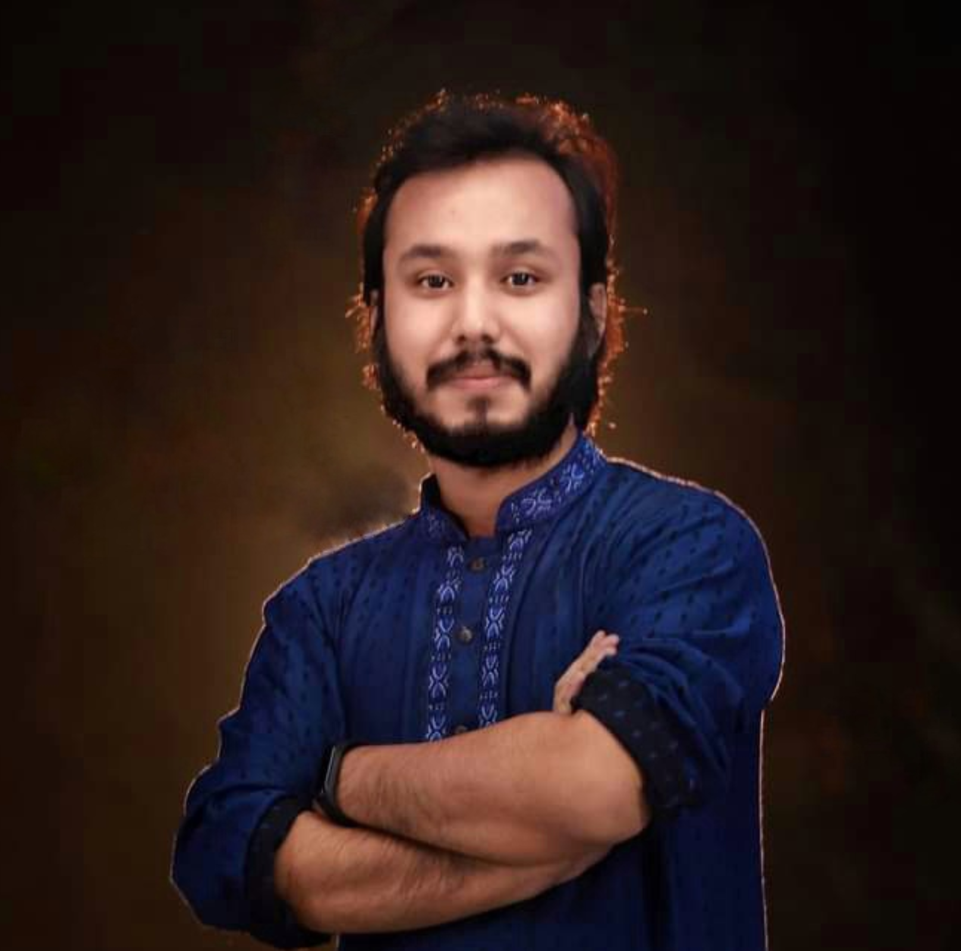
Kowshique Roy
Working at Shikho.Tech
Studying MSc in Computer Science at Jahangirnagar University
Whatsapp: 01765236683 Mail: kowshiqueroy@gmail.com Youtube: Dadar Class দাদার ক্লাস

Slide 2


Slide 3


Slide 4


Slide 5


