Slide 1
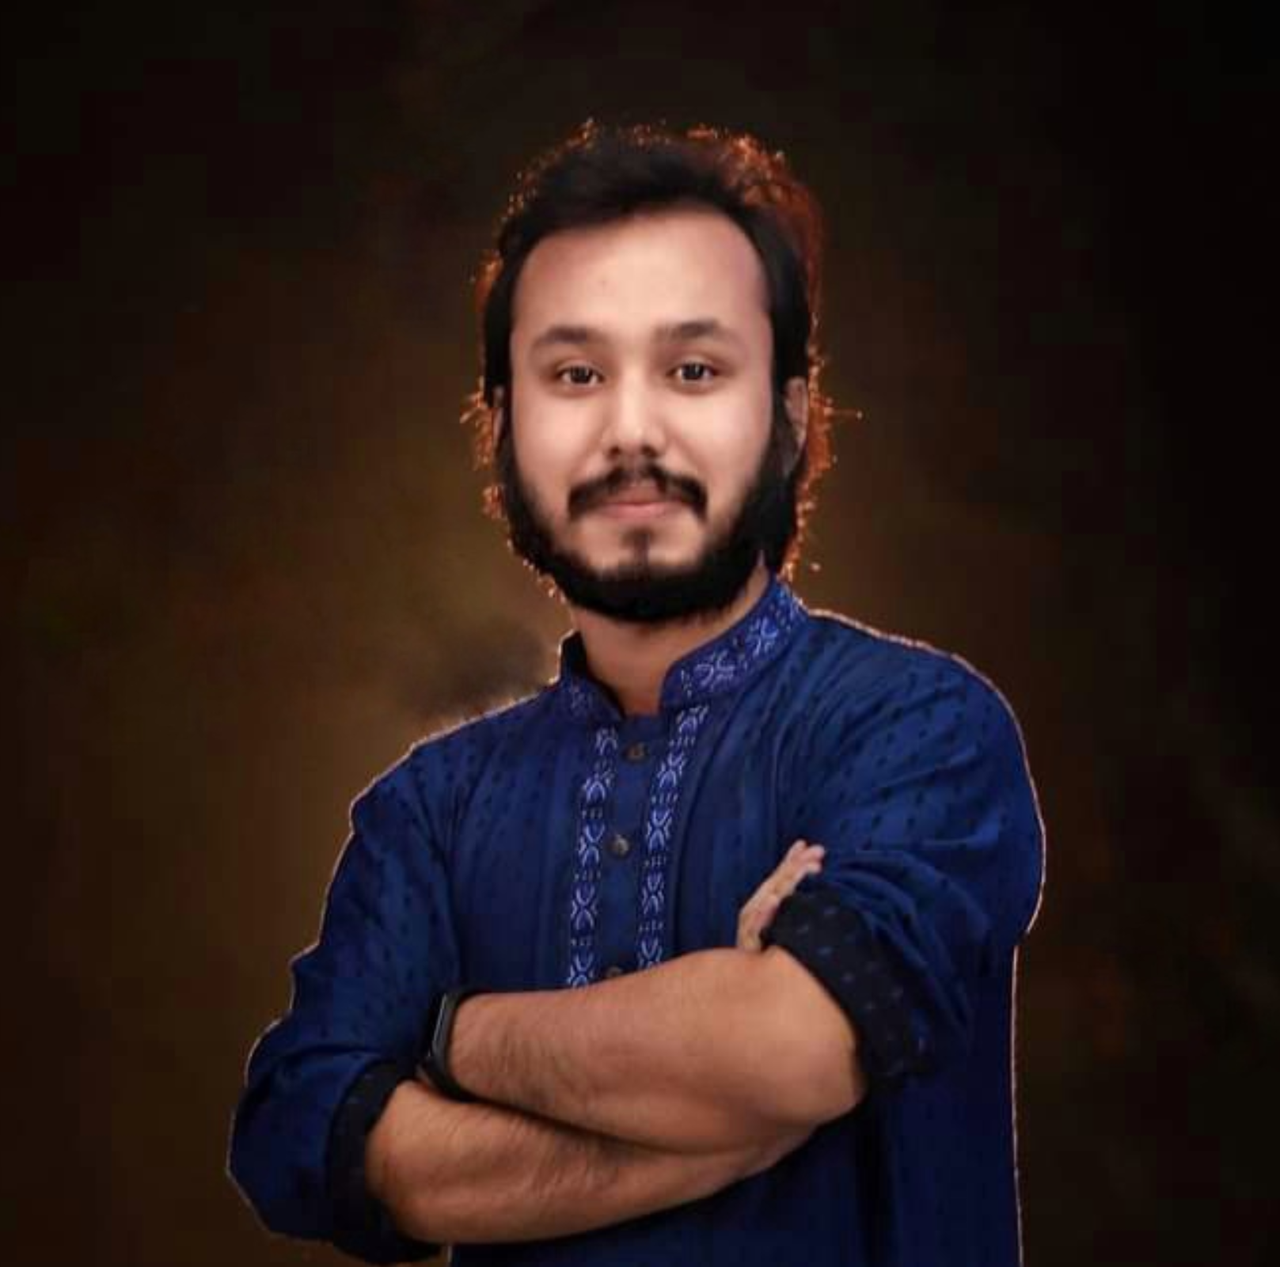
Kowshique Roy
Online Class
printf ( “Hello World” ) ;
Studying MSc in Computer Science (PMSCS) at
Jahangirnagar University
Whatsapp: 01765236683 Mail: kowshiqueroy@gmail.com Youtube: Dadar Class দাদার ক্লাস

Slide 2


Slide 3


Slide 4


Slide 5


Slide 6


Slide 7
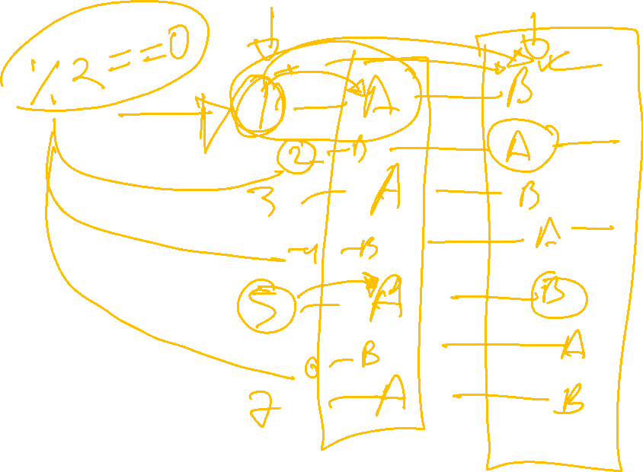

Slide 8
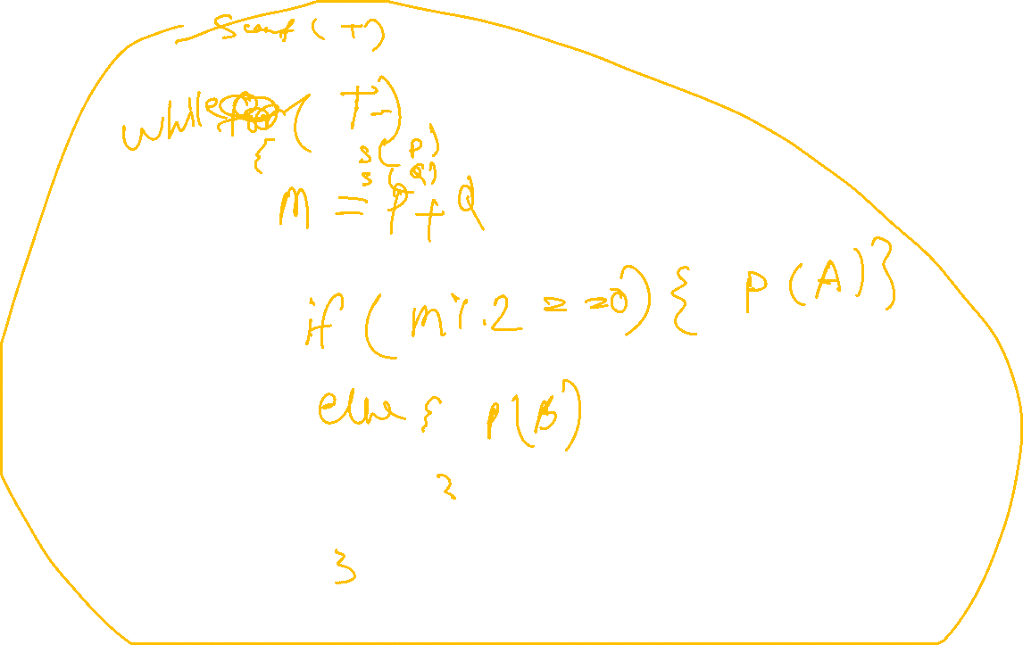

Slide 9
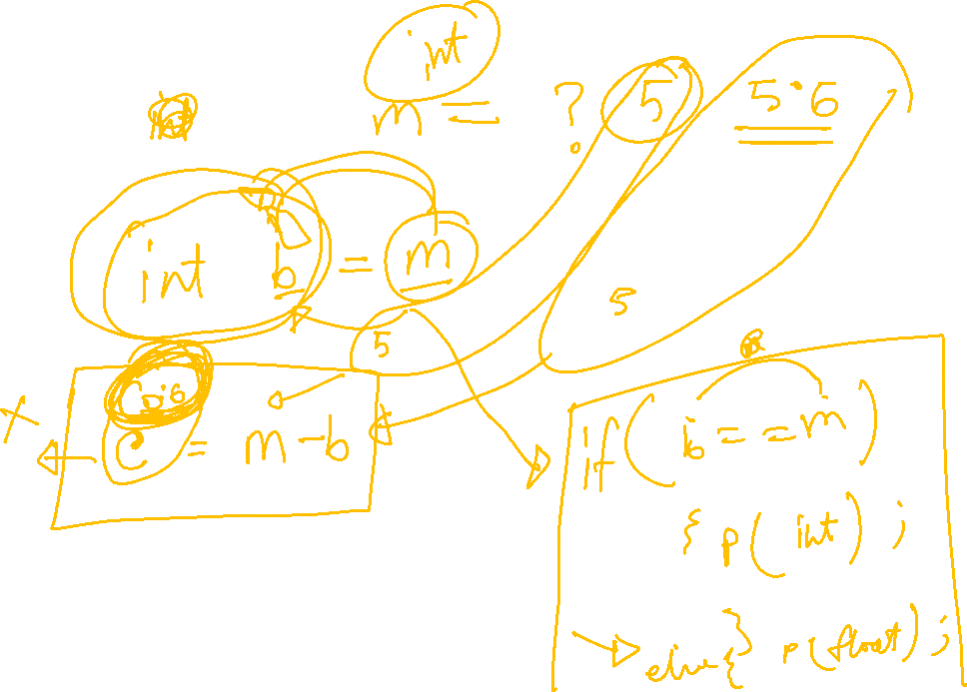

Slide 10
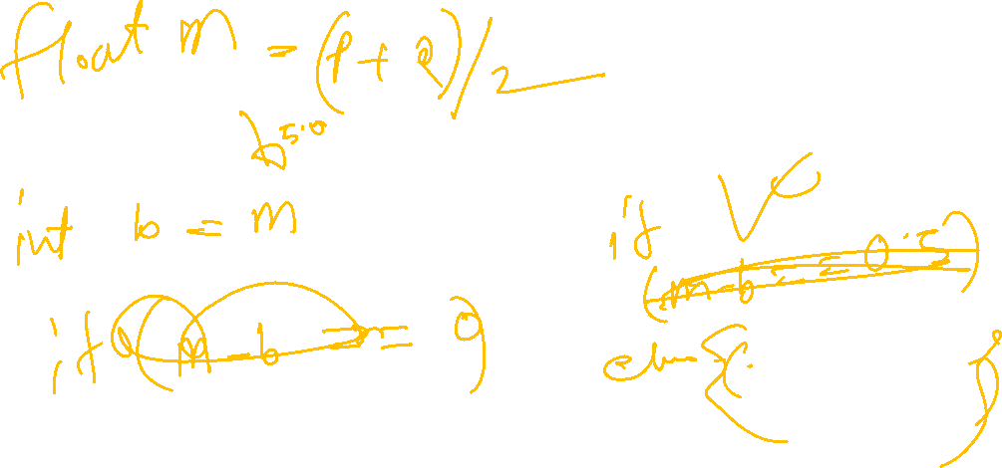

Slide 11
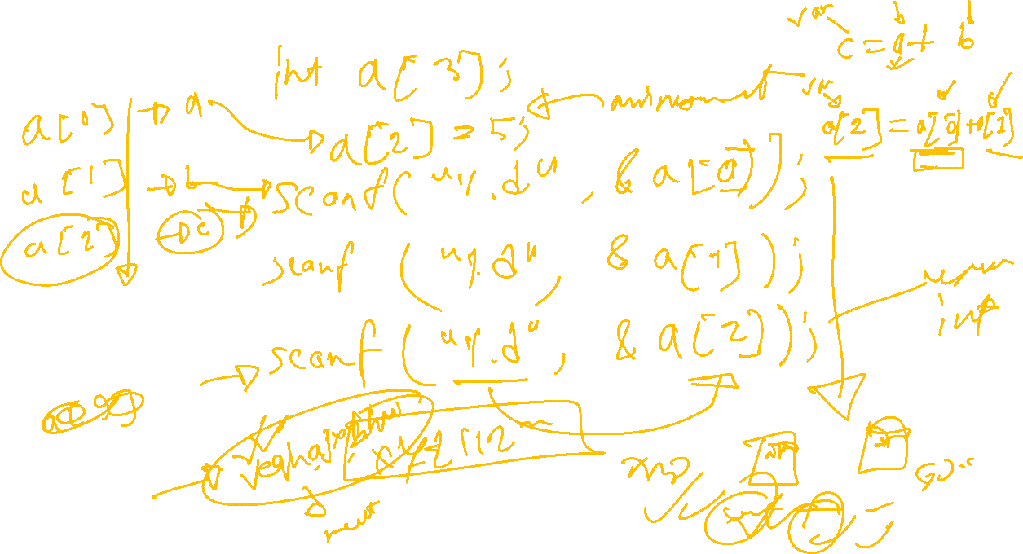

Slide 12


