Slide 1
string.h
Online Class

Slide 2


Slide 3


Slide 4
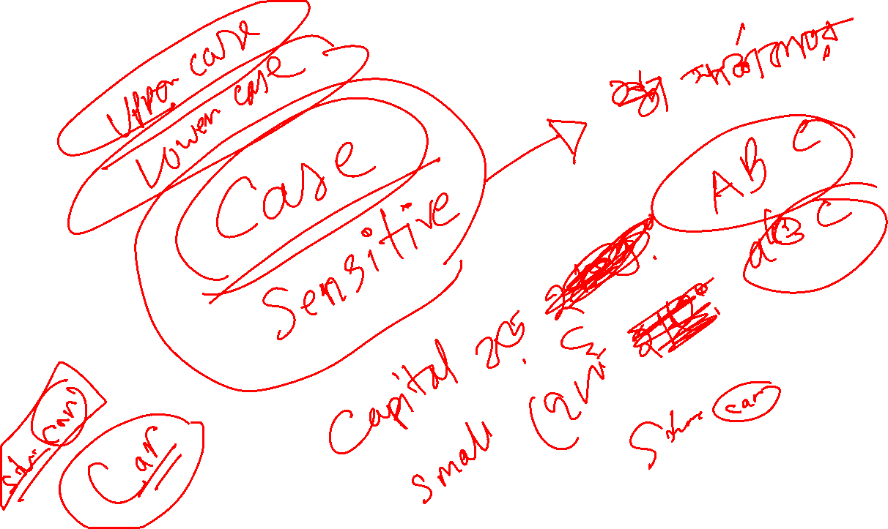

Slide 5


Slide 6


