Slide 1
String.h
C1

Slide 2

Stdio.h
Printf()
Scanf()

Slide 3

string.h
https://www.programiz.com/c-programming/library-function/string.h

Slide 4

strcat()

Slide 5

strcmp()

Slide 6

strcpy()

Slide 7

strlen()

Slide 8


Slide 9


Slide 10


Slide 11


Slide 12


Slide 13
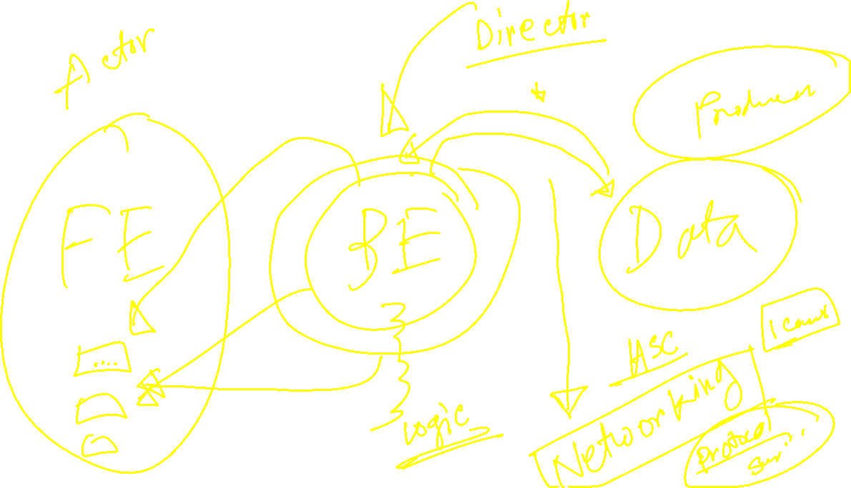

Slide 14
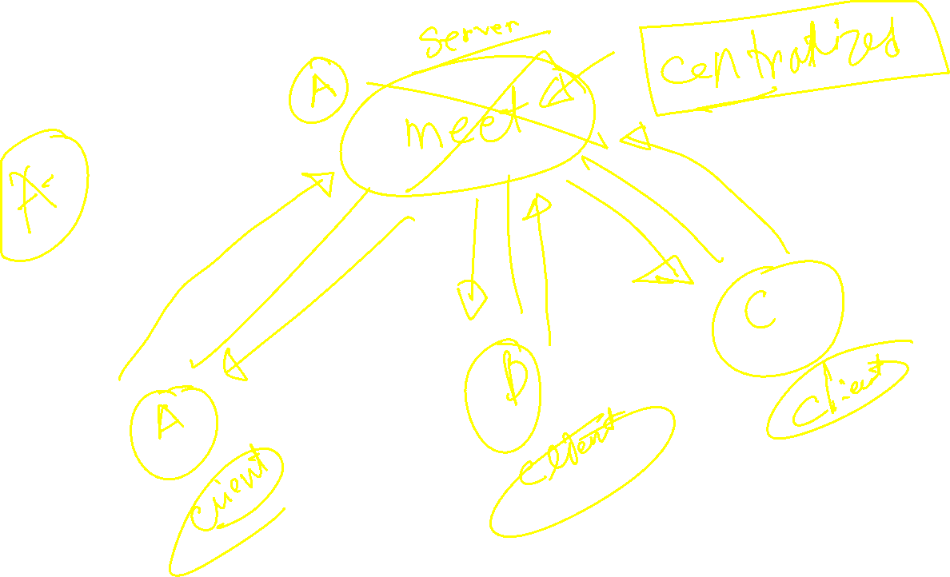

Slide 15


Slide 16


Slide 17


Slide 18


Slide 19


Slide 20


Slide 21


Slide 22


Slide 23


