Slide 1
#দাদার_ক্লাস
Facebook & Youtube :
#দাদার_ক্লাস #Dadar_Class
Dadar_Class

Slide 2

Conductivity
Transfer Something
Materials that Transfer Something through themselves
Conductor
Dadar_Class

Slide 3
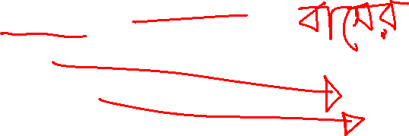
Conductivity
Passenger
Heat
Electricity
Dadar_Class

Slide 4
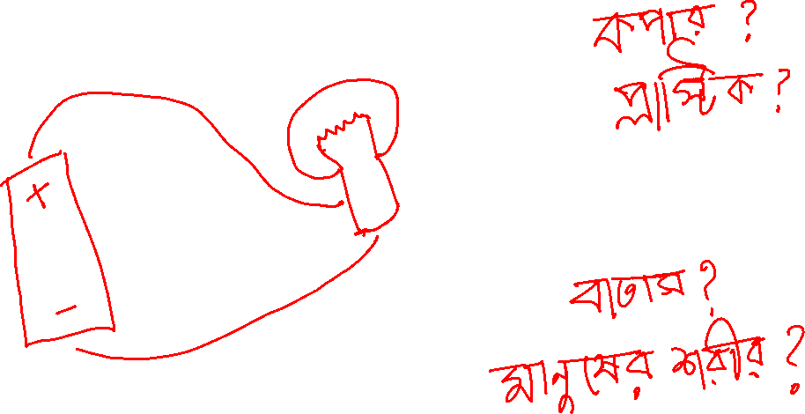
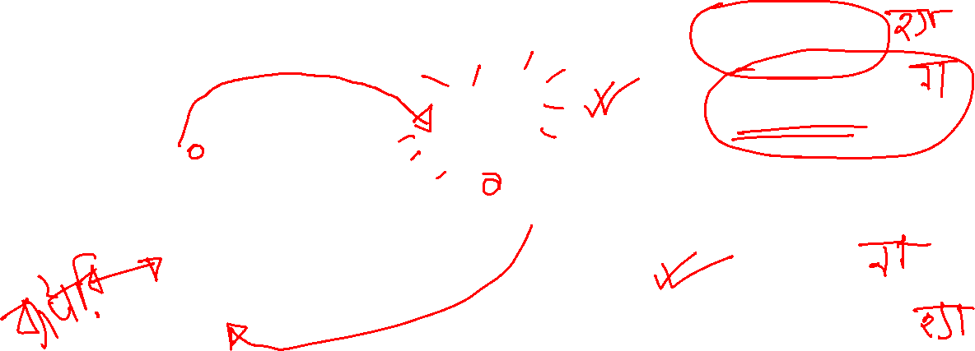
Dadar_Class

Slide 5
Conductors
Copper
Silver
Gold
Aluminum
Iron
Insulators
Air
Plastic
Rubber
Cotton
Wood
Dadar_Class

Slide 6
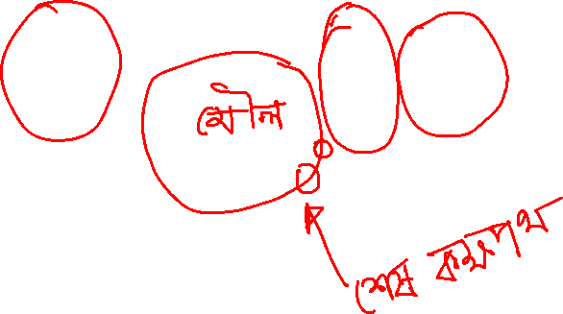

Conductivity of Electrons
Dadar_Class

Slide 7
Conductivity of Electricity
Conductor
Insulator
Semi-Conductor
Dadar_Class

Slide 8
#দাদার_ক্লাস
Facebook & Youtube :
#দাদার_ক্লাস #Dadar_Class
Dadar_Class

