Slide 1
Hello
Class

Slide 2

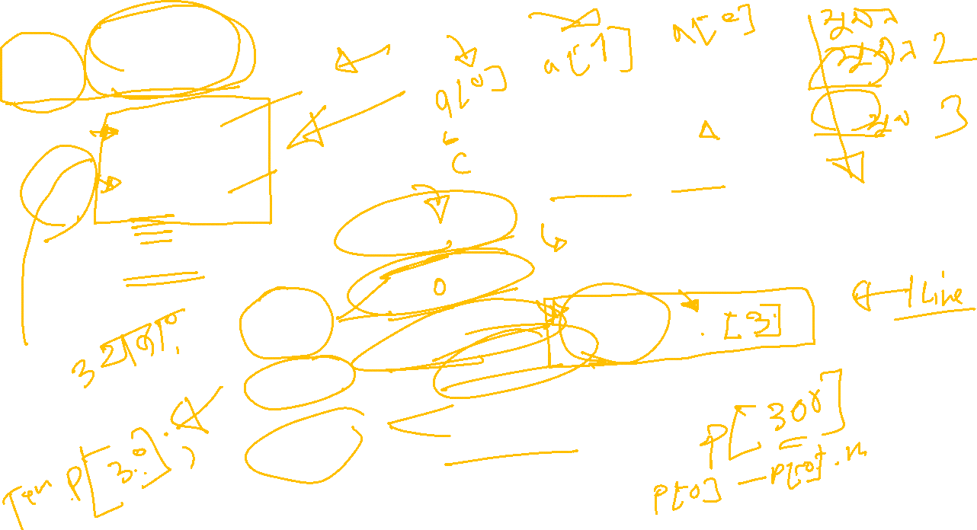

Slide 3


Slide 4

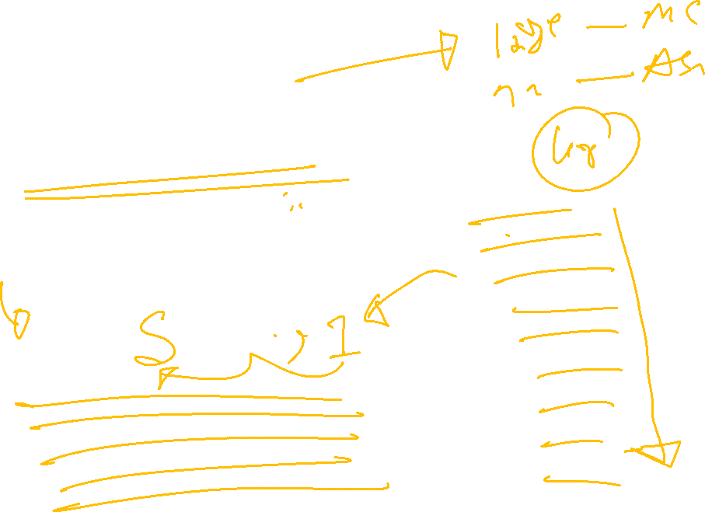

Slide 5


Slide 6


