Slide 1
Welcome
Please wait and Call others to join on time

Slide 2
Kowshique Roy
Working at Shikho.Tech
Studying MSc in Computer Science at Jahangirnagar University
&
There will be another mentor.

Slide 3

Outline
Course String.h
Array
String
Struct
Problem Solving
Project
Course Beginning to C
Function
Variable
Operation
Condition
Loop
Switch
Array
String
Struct
etc

Slide 4
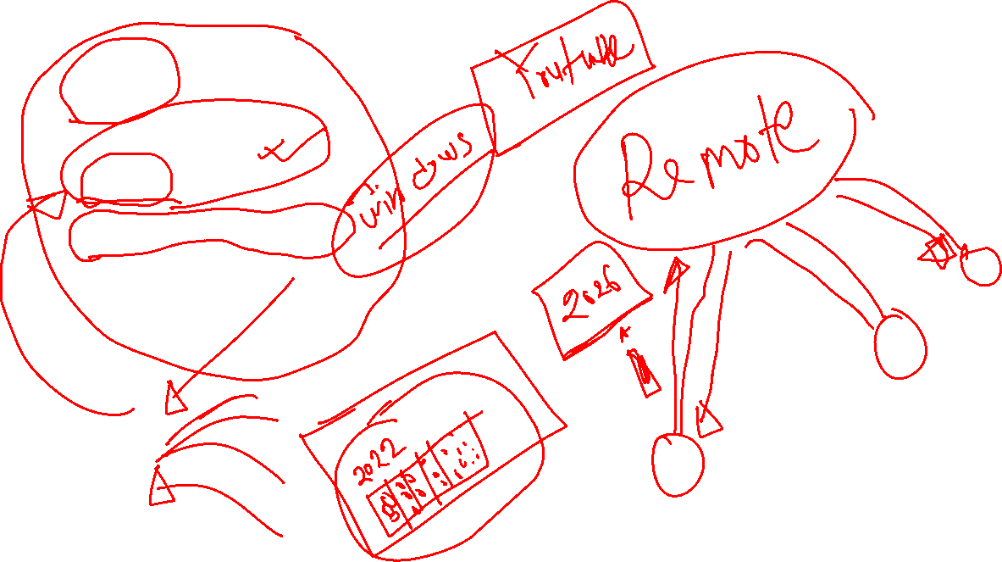
Git
Github Account
Github Desktop App

Slide 5
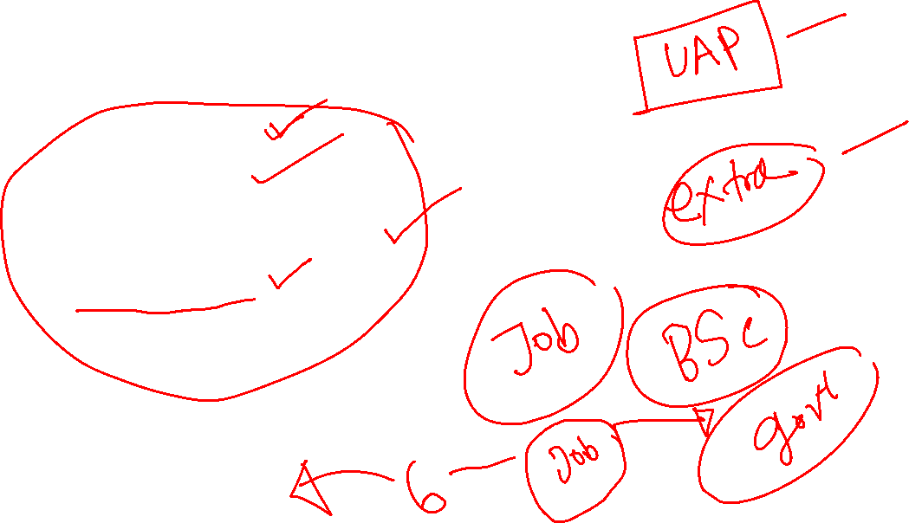
Responsibilities
Join on time
Interaction
Questions & Answers
Home works

Slide 6


Slide 7


Slide 8


Slide 9


Slide 10


Slide 11


Slide 12


Slide 13


Slide 14
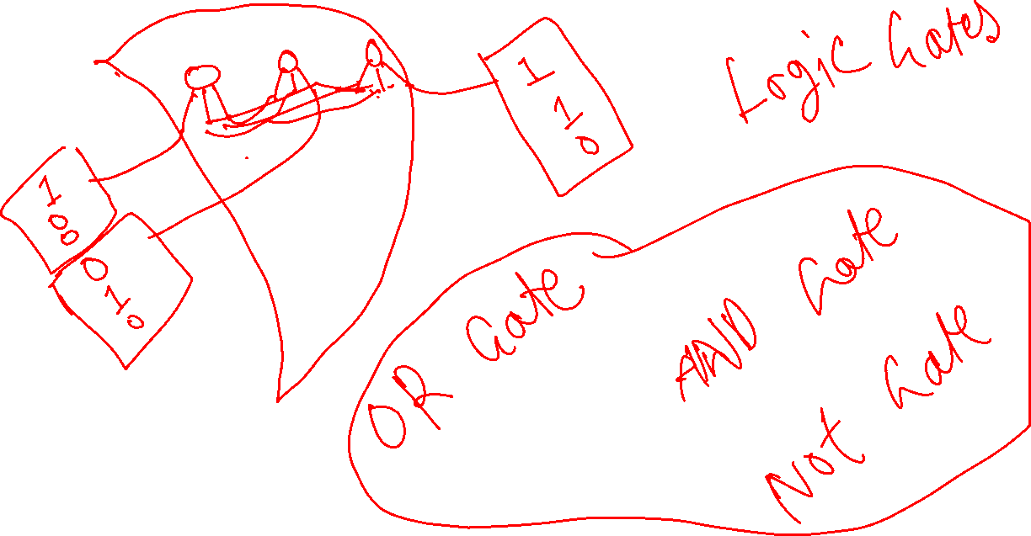

Slide 15


Slide 16


Slide 17
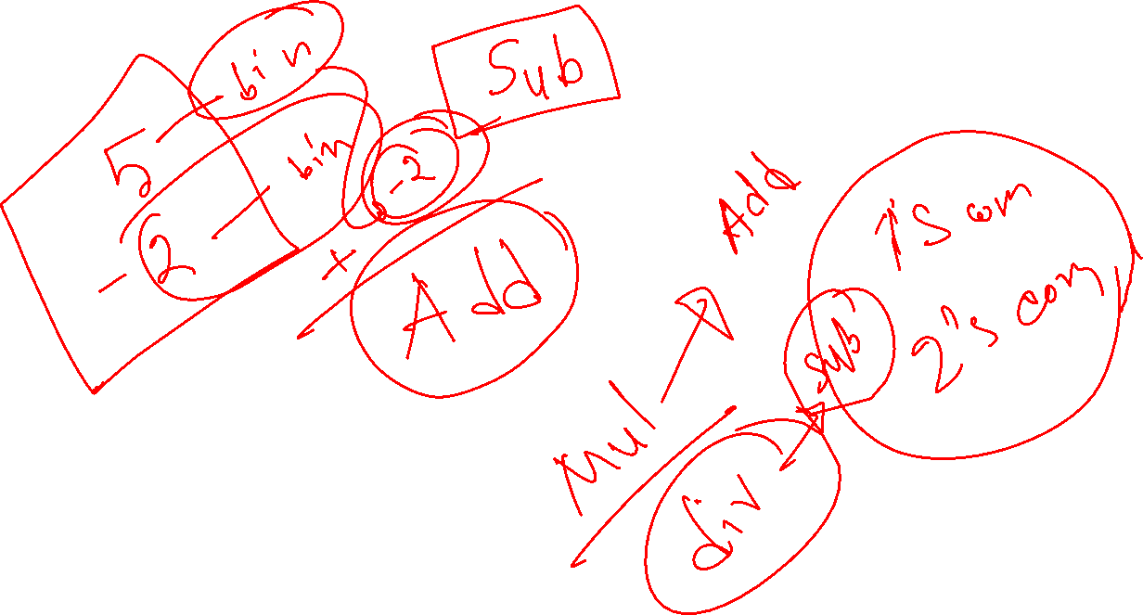

Slide 18
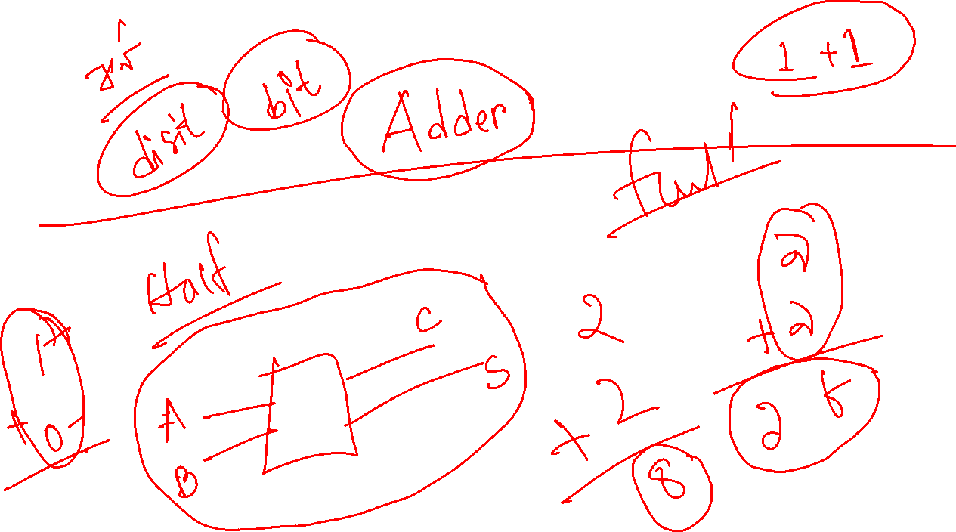

Slide 19
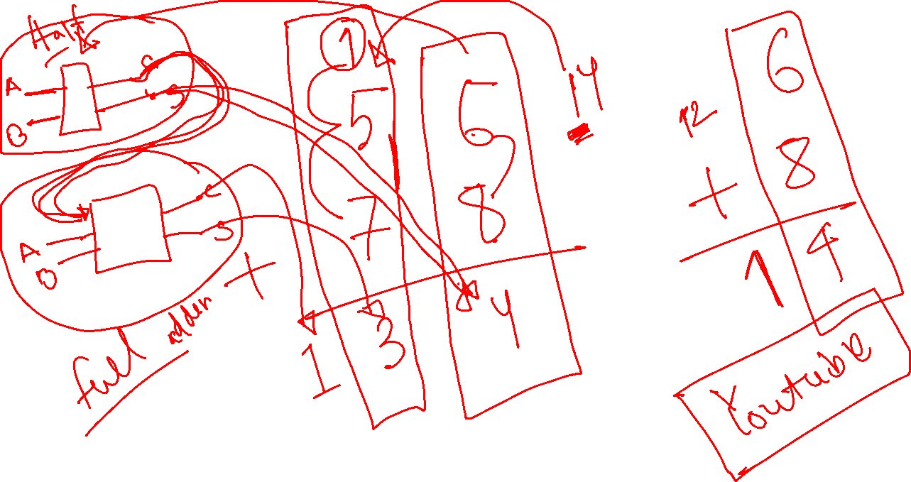


Slide 20


Slide 21


Slide 22


Slide 23


Slide 24
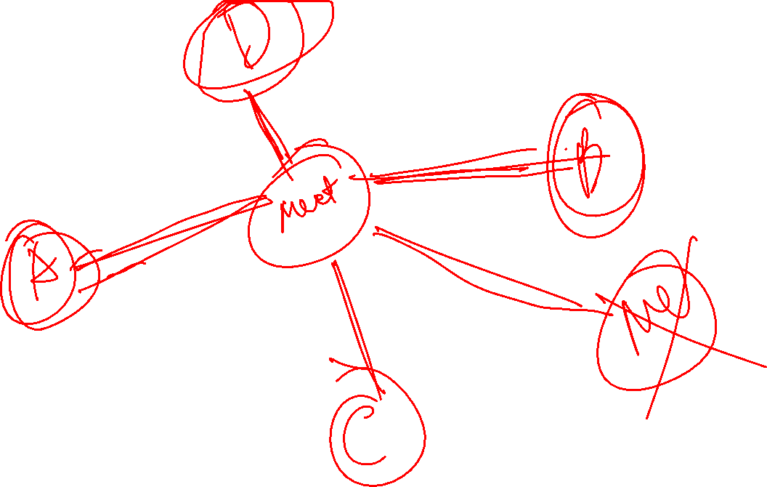

Slide 25


Slide 26


