Slide 1
Automatic Query Response System for RIT Housing
Goutham Nadig
Kowsic Jayachandiran
Suchith Chandrashekhara Arodi

Slide 2
Introduction
RIT Housing operations have a wide range of housing options
RIT Housing information available online
Live chat with human representative
IBM Watson on Bluemix is used to build a system which answers the queries with appropriate answers

Slide 3
Data Collection
RIT Housing official documents with information about
Housing Selection
Semester Break
Arrival Guides
End of Year Preparation Guide
Frequently asked questions with answers provided by RIT Housing

Slide 4
Data Cleaning and Preparation
Data in textual format
Multiple columns text to single column text
Different formats for header and description
Removed redundant texts

Slide 5
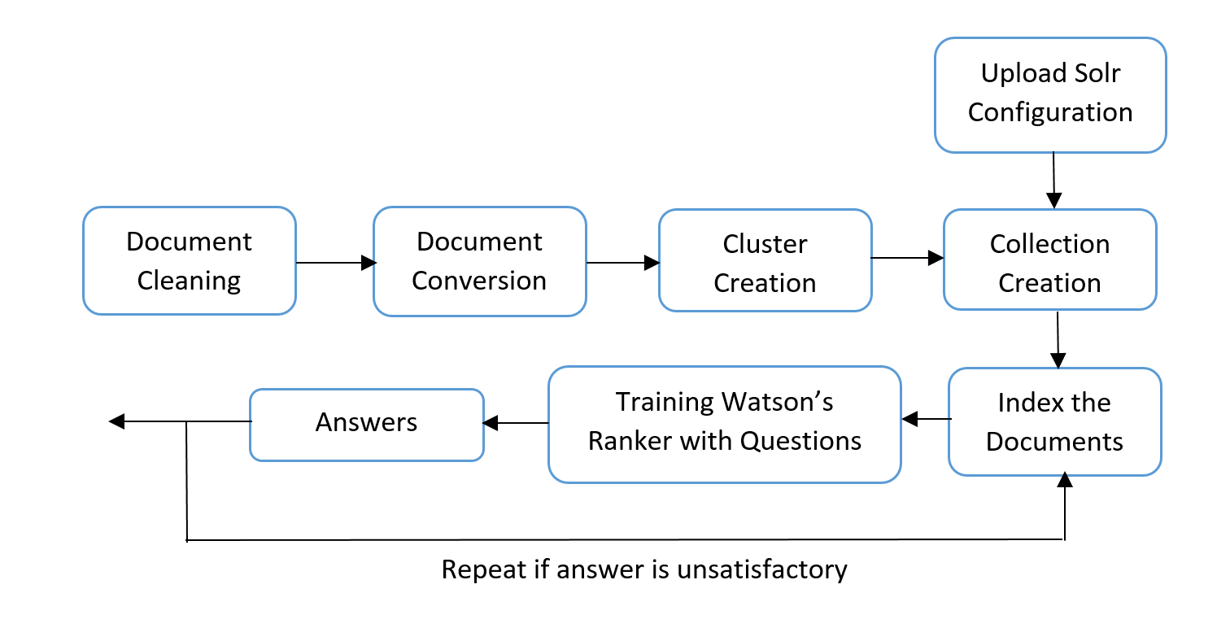
Implementation

Slide 6
Implementation
Document conversion:
Cleaned data is fed to the service
Customized configuration
Output in JSON format
Each document uniquely identified by doc_id

Slide 7
Implementation
Cluster and collection creation:
Cluster manages search collections
Collection is a logical index of data
Collection maintains all the documents added to retrieve and rank

Slide 8
Implementation
Index/Searching
Solr configuration uploaded to configure the cluster
Solr configuration indexes document

Slide 9
Implementation
Training the data model:
Question and answers used to train the model
Each question can have multiple answers
Relevance factor added to each answer
Trained around 500 questions

Slide 10
Implementation
Results (Answers)
Query returns a list of ranked answers
List of answers are ranked
Re-train the data model to improve accuracy

Slide 11
Ethical Issues
Maintain anonymity
Provide correct information

Slide 12
Conclusion
Natural Language processing and Cognitive computing is revolutionizing the industry saving a lot of time and mimicking the human. IBM Watson is one of the state of the art cognitive computing tool
The backbone of our application is IBM Watson
It a state of the art cognitive computing tool.
Various applications worldwide are using different services of IBM Watson.

Slide 13
Future Work
A bit more training can be done on the system.
User interface can be created and improved.
A Live chat can be developed for answering user queries.

Slide 14
DEMO

Slide 15
References
Apache Solr Quickstart.
Document conversion - api reference| IBM Watson Developer Cloud.
How to use the ”Retrieve and Rank” service in IBM Bluemix.
How to use the ”Retrieve and Rank” service in IBM Bluemix 2.
IBM Watson Developer Cloud Github.
Natural Language QA system with IBM WatsonFartash.
Retrieve rank - API Reference| IBM Watson Developer Cloud.
RIT Housing. https://www.rit.edu/fa/housing/.

Slide 16
References
RIT Housing - Arrival Guides. https://www.rit.edu/fa/housing/content/fall-move-2016#arrival%20guides/.
RIT Housing - End of Year Closing. https://www.rit.edu/fa/housing/content/end-year-closing.
RIT Housing Selection.

Slide 17
Thank you !!

