Slide 1
Design and Verification of AXI-Lite Protocol
Project Presentation
ECE 571: Introduction to System Verilog Prof. Jean Paul Mugisha
Group - 4 :
Hanisha Dhananjaya Produtur
Sajida Sayyad
Venkat Sai Sumanth Koyada
Nikhil Swarna

Slide 2
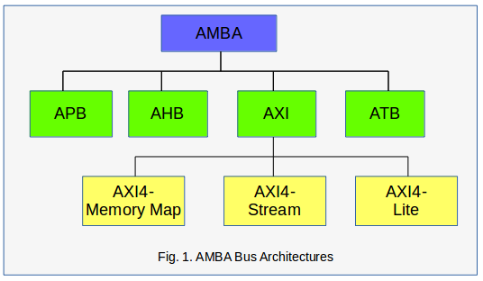
INTRO
What is AMBA?
Advanced Microcontroller Bus Architecture
Developed by ARM
Why AMBA?
Connects CPU, memory, and peripherals
Improves modularity and scalability
Enables high-performance communication

Slide 3
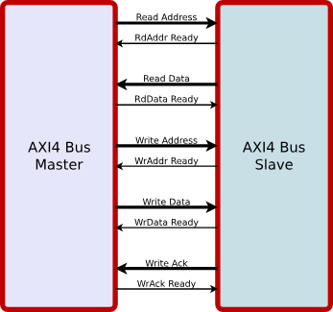
AXI- Lite
The AXI4-Lite protocol is a subset of the AXI4 protocol. Key features of the AXI4-Lite interface include:
All transactions are burst length of one.
All data accesses are the same size as the width of the data bus.
Exclusive accesses are not supported.

Slide 4
AXI Lite Channel Signals
Write Address (AW)
Read Address (AR)
• AWVALID / AWREADY
• ARVALID / ARREADY
• AWADDR [31:0]
• ARADDR [31:0]
• AWPROT [2:0]
• ARPROT [2:0]
Write Data (W)
Read Data (R)
• WVALID / WREADY
• RVALID / RREADY
• WDATA [31:0]
• RDATA [31:0]
• WSTRB [3:0]
• RRESP [1:0]
Write Resp (B)
• BVALID / BREADY
• BRESP [1:0]

Slide 5
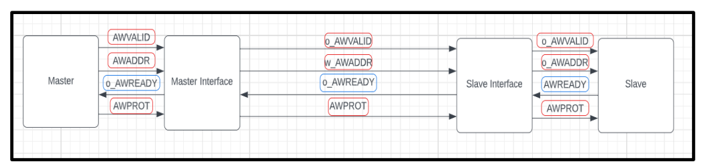
Transaction Channels
Write Address Channel:
AWVALID: Write address valid. Master generates this signal when Write Address and control signals are valid Direction is from master to slave.
AWREADY: Write address ready. Slave generates this signal when it can accept Write Address and control signals Direction is from Slave to master. AWADDR: Write address, usually 32-bits wide. Direction is from master to slave.
AWPROT: Protection type.3 bit signal which defines the protection type Direction is from master to slave.

Slide 6
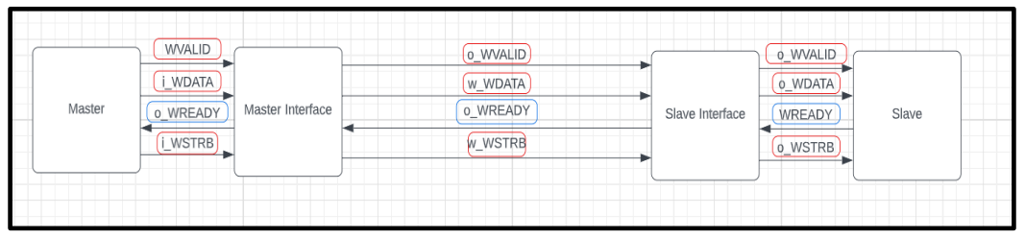
Write Data Channel:
WVALID: Write data valid. Master generates this signal when Write data and control signals are valid . Direction is from master to slave.
WREADY: Write data ready. Slave generates this signal when it can accept Write data and control signals Direction is from Slave to master.
WDATA: Write data, usually 32-bits wide. Direction is from master to slave.
WSTRB: Write strobes. 4-bit signal indicating which of the 4-bytes of Write Data. Slaves can choose assume all bytes are valid Direction is from master to slave

Slide 7
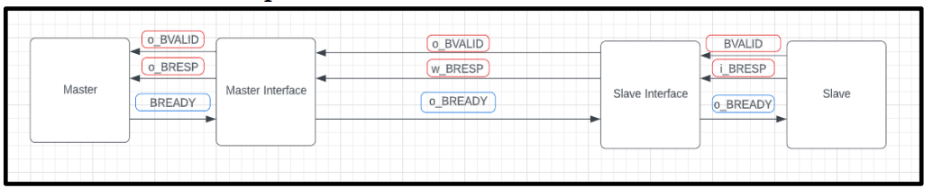
Write Response Channel:
BVALID: Write response. This signal indicates the status of the write transaction. Direction is from slave to master.
BREADY: Write response valid. Slave generates this signal when the write response on the bus is valid. Direction is from master to slave.
BRESP: Write response. This signal indicates the status of the write transaction. Direction is from slave to master

Slide 8
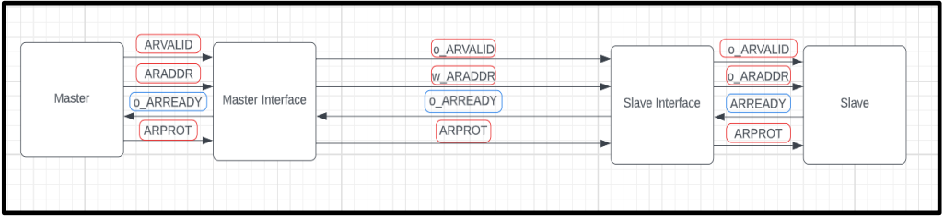
Read Address Channel:
ARVALID: Read address valid. Master generates this signal when Read Address and the control signals are valid. Direction is from master to slave.
READY: Read address ready. Slave generates this signal when it can accept the read address and control signals. Direction is from Slave to master.
ARADDR: Read address, usually 32-bit wide. Direction is from master to slave.
ARPROT: A 3 bit signal used to define the protection type Direction is from master to slave.

Slide 9
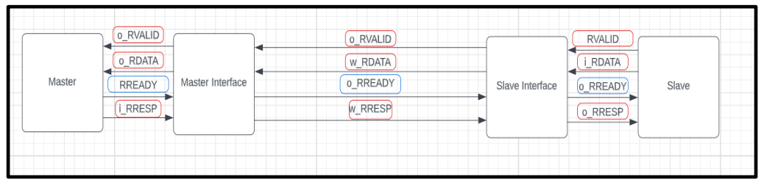
Read Data Channel
RVALID: Read valid. Slave generates this signal when Read Data is valid Direction is from slave to master.
RREADY: Read ready. Master generates this signal when it can accept the Read Data and response. Direction is from master to slave.
RDATA: Read Data (32-bit only). Direction is from slave to master.
RRESP: Read response. This signal indicates the status of data transfer. Direction is from slave to master.

Slide 10
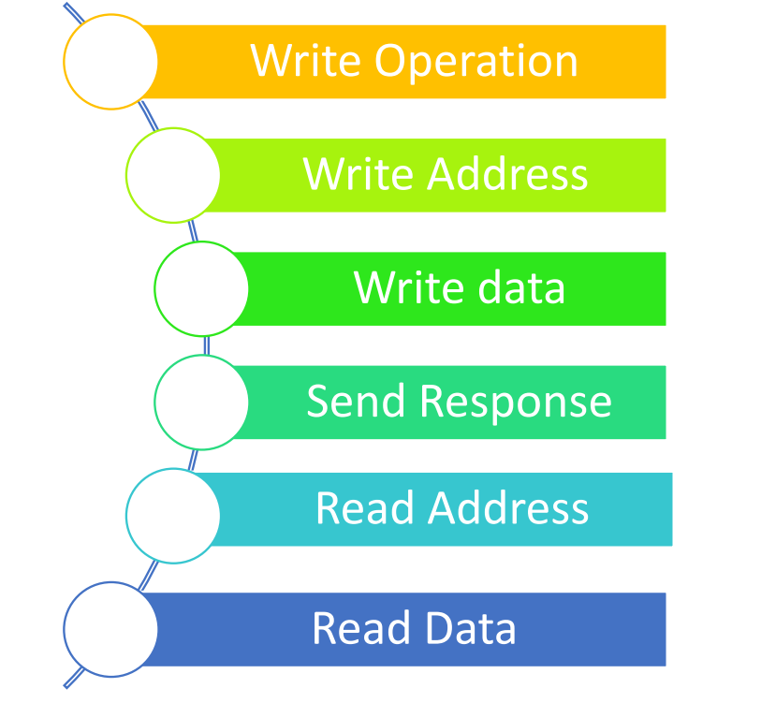
Handshake Protocol
AXI4-Lite Handshake Basics
Uses VALID and READY signals for communication
Ensures reliable data transfer without data loss
Transfer occurs only when both VALID and READY are HIGH
Master drives VALID
Slave drives READY
Once VALID goes high, master cannot deassert until transfer completes
Key Handshake Rule
VALID = 1 → Sender has valid data/address
READY = 1 → Receiver is ready to accept
Data transfer happens when VALID && READY = 1 (same clock cycle)

Slide 11
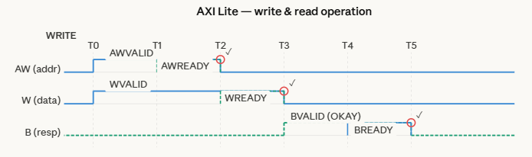
Write Operation
1.The Master puts an address on the Write Address channel and data on the Write data channel. At the same time it asserts AWVALID and WVALID indicating the address and data on the respective channels is valid. BREADY is also asserted by the Master, indicating it is ready to receive a response.
2. The Slave asserts AWREADY and WREADY on the Write Address and Write Data channels, respectively.
3. Since Valid and Ready signals are present on both the Write Address and Write Data channels, the handshakes on those channels occur and the associated Valid and Ready signals can be deasserted. (After both handshakes occur, the slave has the write address and data)
4. The Slave asserts BVALID, indicating there is a valid reponse on the Write response channel. (in this case the response is 2’b00, that being ‘OKAY’).
5. The next rising clock edge completes the transaction, with both the Ready and Valid signals on the write response channel high.

Slide 12
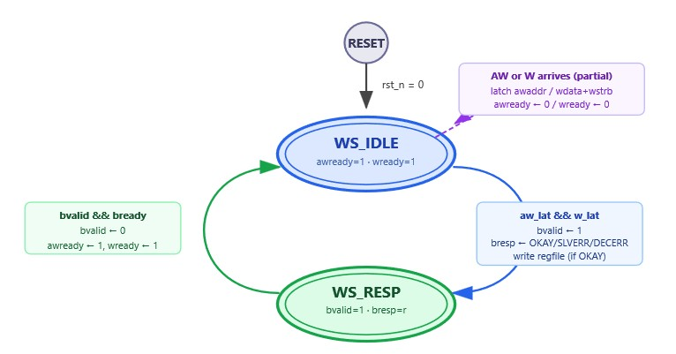
Fig. Write Operation FSM

Slide 13
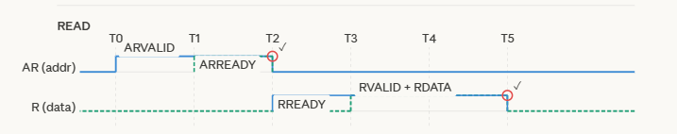
Read Operation
1. The Master puts an address on the Read Address channel as well as asserting ARVALID,indicating the address is valid, and RREADY, indicating the master is ready to receive data from the slave.
2. The Slave asserts ARREADY, indicating that it is ready to receive the address on the bus.
3. Since both ARVALID and ARREADY are asserted, on the next rising clock edge the handshake occurs, after this the master and slave deassert ARVALID and the ARREADY, respectively. (At this point, the slave has received the requested address).
4. The Slave puts the requested data on the Read Data channel and asserts RVALID, indicating the data in the channel is valid. The slave can also put a response on RRESP, though this does not occur here.
5. Since both RREADY and RVALID are asserted, the next rising clock edge completes the transaction. RREADY and RVALID can now be deasserted.

Slide 14
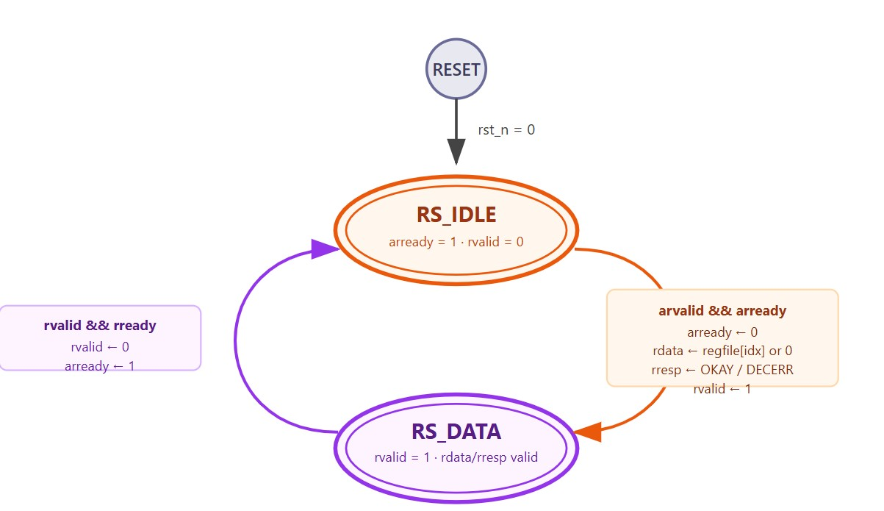
Fig. Read Operation FSM

Slide 15
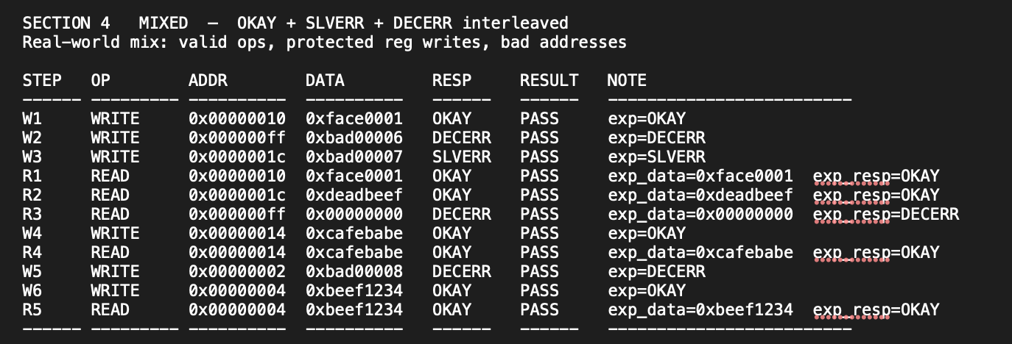
OUTPUT
Fig. Transcript

Slide 16
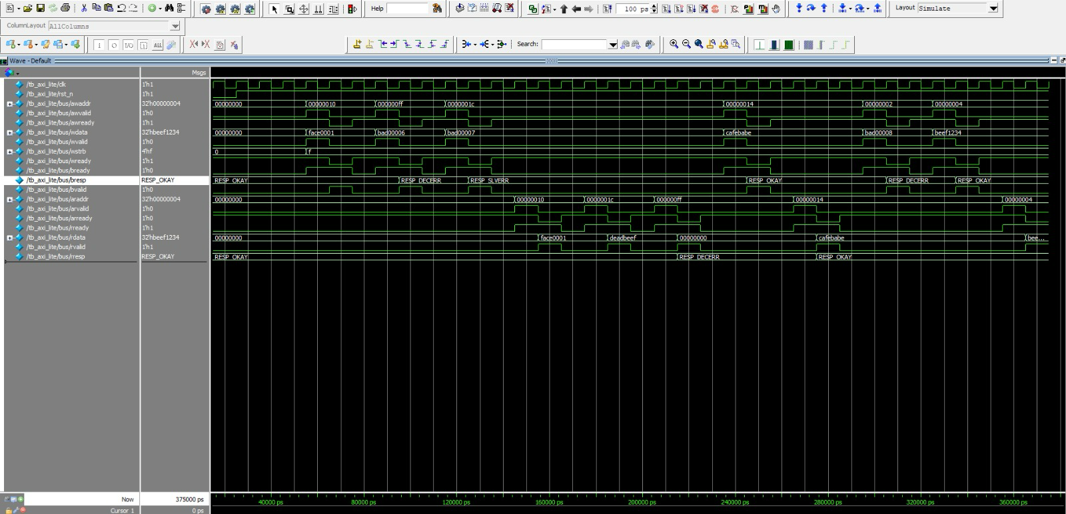
Output Waveform

Slide 17
Roles and Responsibilities
Sajida Sayyad: Interface & Master Write Channel
Designs and maintains the AXI Lite interface, ensuring correct signal definitions and connectivity between master and slave.
Implements write address and data channels by controlling AWVALID, WVALID, and handling handshake signals properly.
Handles write response channel by receiving BRESP and completing transactions using BREADY.
Debugs write-side issues and ensures protocol-compliant data transfer with coordination from the slave write logic.
Nikhil Swarna: Master Read Channel & Slave Read Path
Implements read address and data channels by managing ARVALID, RREADY, and ensuring correct handshake behaviour.
Develops slave-side read logic to decode addresses and return appropriate data through RDATA.
Ensures proper sequencing between address and data phases to maintain correct read transactions.
Debugs read path functionality and verifies correctness of returned data with testbench support.

Slide 18
Hanisha Dhananjaya Produtur: Slave Write Logic & Package
Implements slave write channels by handling AWREADY, WREADY, and updating registers/memory correctly.
Generates write responses using BVALID and BRESP to complete transactions reliably.
Maintains the package file by defining parameters, typedefs, and ensuring consistency across modules.
Verifies data integrity after writes and coordinates with master write logic for correctness.
Venkat Sai Sumanth Koyada: Testbench & Integration
Developed a comprehensive testbench by integrating all modules, generating clock/reset, and ensuring correct system level connectivity.
Implemented reusable automatic tasks for read and write operations to modularize stimulus generation and improve verification efficiency.
Designed and executed multiple test scenarios including OKAY, SLVERR, and DECERR responses, validating protocol behaviour under normal and error conditions.
Identified and debugged critical issues during simulation, resolving handshake mismatches and data inconsistencies through iterative fixes and analysis.

Slide 19
Thank You!

