Slide 1

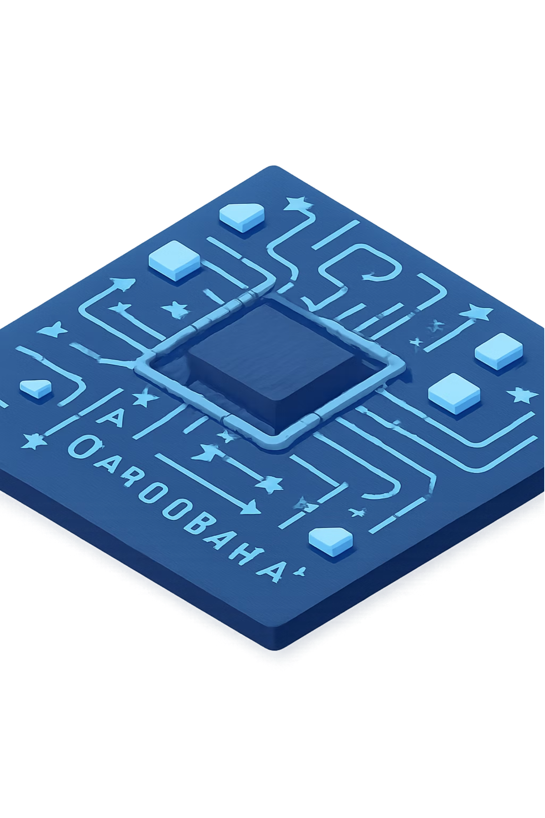
Design and Simulation of an 8-Bit Signed Arithmetic Unit
Add and subtract 8-bit positive and negative numbers.
Team Members
K. Naadhiyah – Roll No. [2620030325]
G. Vinay – Roll No. [2620030322]
S. Karthikeya – Roll No. [2620030335]
G. Bharath – Roll No. [2620030326]

Slide 2
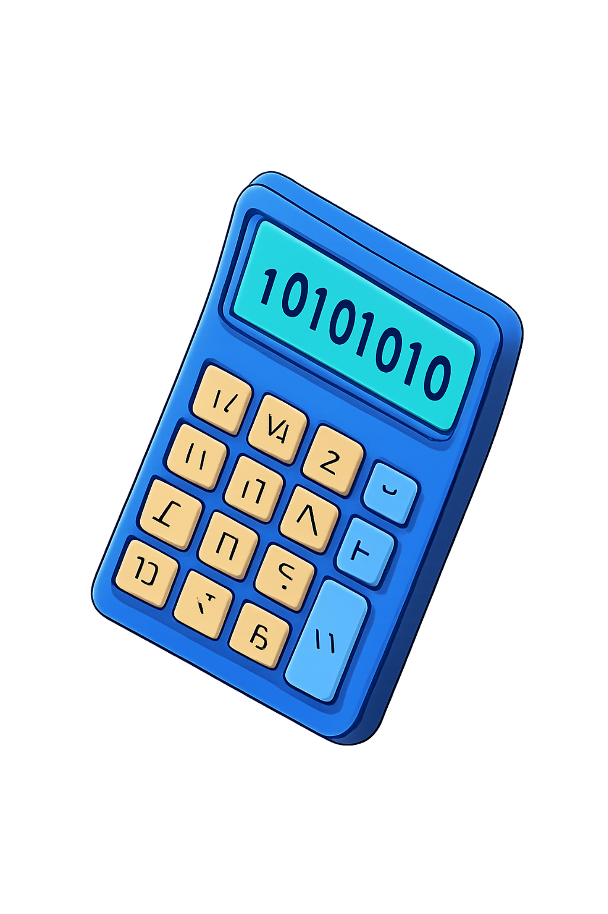
Abstract
Calculation Unit
A small system that does basic math operations
Takes two numbers as input
Performs addition or subtraction
Gives the correct answer as output
8-Bit
Numbers are stored as 8 binary digits (0s and 1s)
Can handle numbers from −128 to +127
Positive: 1, 2, 3… | Negative: −1, −2, −3…

Slide 3
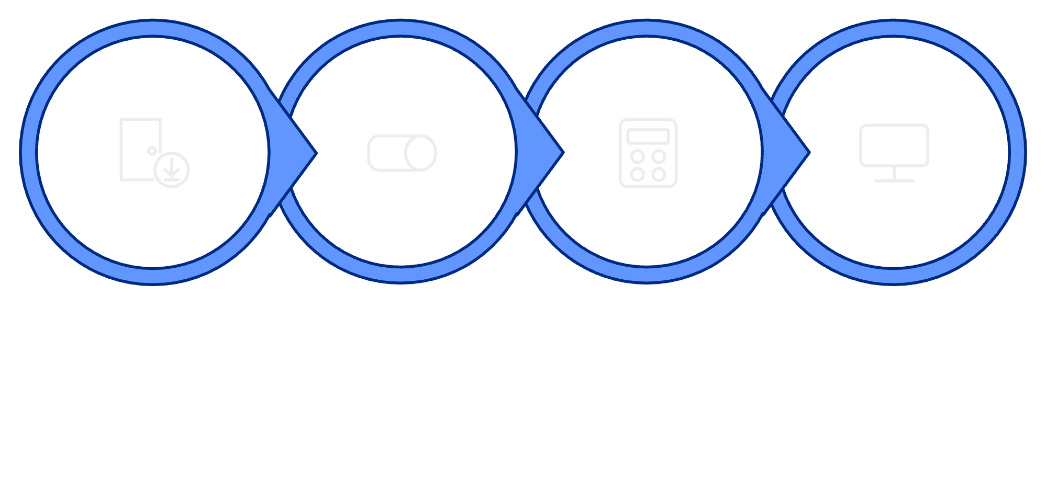
Arthemetic Structure
Every arithmetic unit has four main sections working together in a simple flow:
Input
Control
Processing
Output
📥 Input Section
🎛️ Control Section
Receives the two 8-bit numbers from the user
User decides: Add or Subtract
⚙️ Processing Section
📤 Output Section
The arithmetic unit performs the actual math
Displays the final 8-bit result

Slide 4
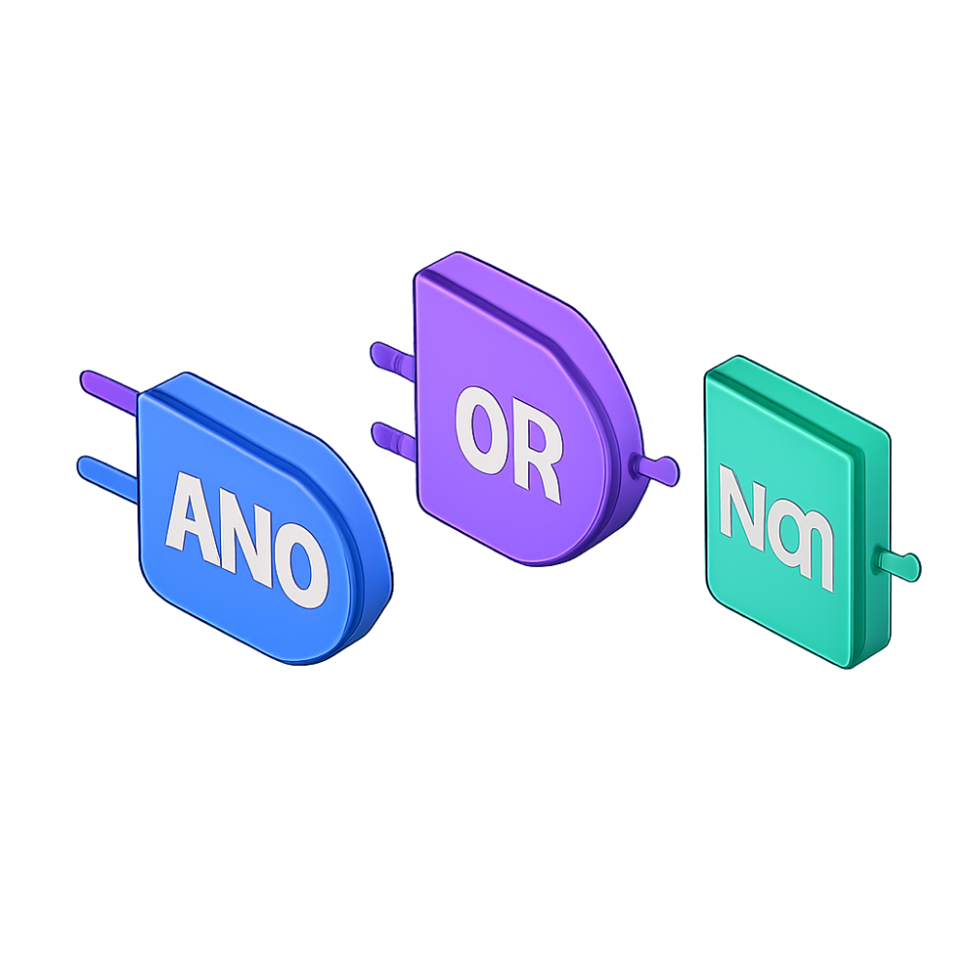

Implimentation
Simple Parts Used
Handling Negative Numbers — Two's Complement
A clever method to store negative numbers in binary
The first bit tells if the number is positive (0) or negative (1)
Lets the same adder circuit handle both positive and negative numbers
Adders
Logic Gates
Multiplexers
Small circuits that add two binary numbers together
Basic components — AND, OR, NOT gates
Choose between addition or subtraction

Slide 5
Working process
Addition Example
What Happens Inside the System
1
Convert to Binary
Number 1
Number 2
5
3
Numbers are converted into 0s and 1s
2
Adder Circuits Work
Answer
5 + 3 = 8 ✓
The circuits add or subtract the binary values
3
Display Answer
Subtraction with Negative Number
Result is converted back and shown as output
Number 1
Number 2
5
−3
Answer
5 + (−3) = 2 ✓

Slide 6

Computer Testing & Results
Software Used: [Add the simulation software name, e.g., Xilinx, ModelSim, Logisim]
We tested the system with positive numbers, negative numbers, and mixed operations to verify every answer is correct.
Number 1 | Number 2 | Operation | Expected Answer | Status
5 | 3 | Add | 8 | ✓ Correct
10 | 4 | Subtract | 6 | ✓ Correct
7 | −5 | Add | 2 | ✓ Correct
−8 | 3 | Add | −5 | ✓ Correct
All tests passed! The system works correctly for all positive, negative, and mixed test cases.

Slide 7






Uses & Conclusion
Where This System is Used
What We Learned
Computers
How computers perform basic math
How to design digital circuits
How positive and negative numbers work in binary
How to test and verify our design
CPU uses similar units for all calculations
Calculators
Basic calculators rely on arithmetic units
Future Improvements
Extend to 16-bit or 32-bit numbers
Add multiplication and division
Make it faster and more efficient
Mobile Phones
Phone processors use these exact units
Thank You! We welcome any questions from the audience.
Digital Devices
Microwaves, washing machines, and more

Slide 8
Thank you

