Slide 1
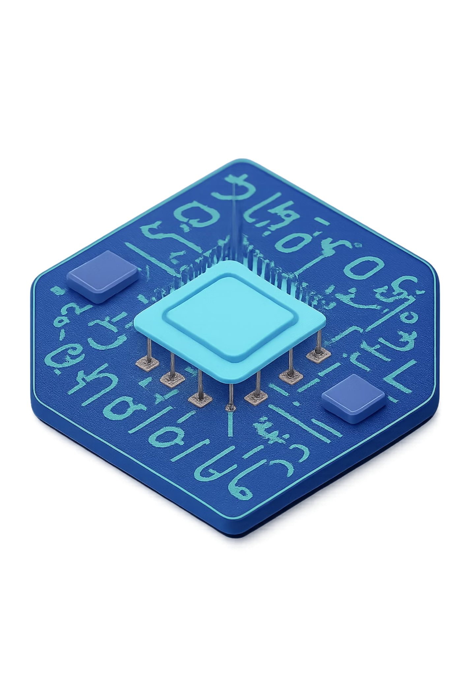
Design and Simulation of an 8-Bit Signed Arithmetic Unit
1st-Year B.Tech DDCA project
Team Members
K.Naadhiyah-(Roll No. 2620030325)
G.Vinay-(Roll No. 2620030322)
S.Karthikeya- (Roll No. 2620030335)
G.Bharath- (Roll No. 2620030326)
Department and Institution
KLHB-University
Dept of Computer science and Eng.
Academic year 2026

Slide 2
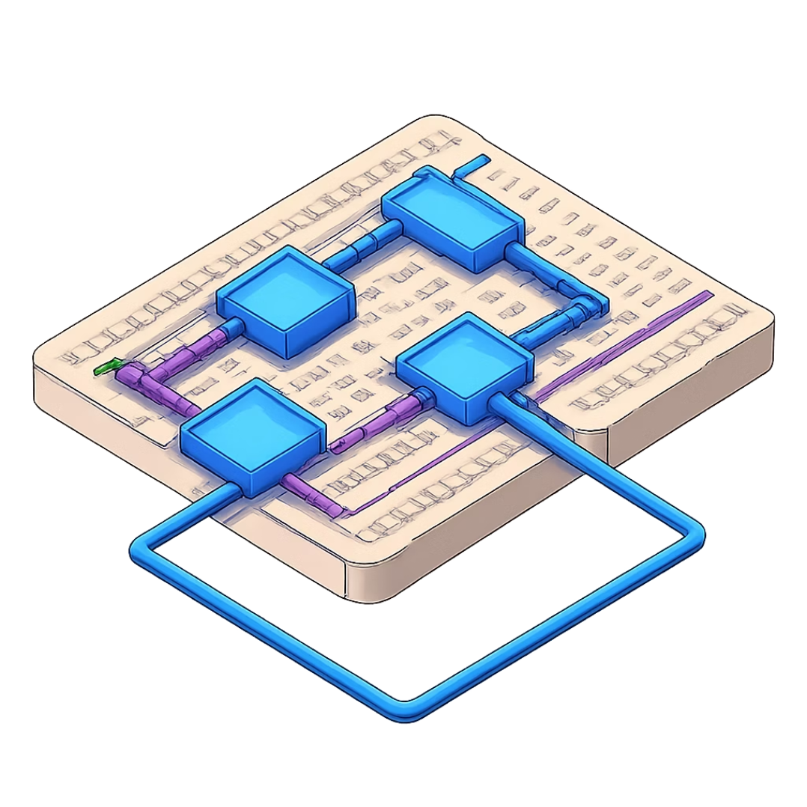
Problem Statement & Abstract
What Problem Does This Project Solve?
Computers need to do math calculations very quickly
They must handle both positive and negative numbers
The system must be small and use less power
Why Do We Need This Project?
Basic calculators cannot handle negative numbers easily
Microprocessors are too complex for beginners to understand
We need a simple, educational system to learn digital design
To design a fast and efficient arithmetic system from scratch

Slide 3
Objectives
1
Design
Create an 8-bit signed arithmetic unit using logic gates and adders
2
Implement
Build the circuit design using digital design tools
3
Simulate
Test the system using computer simulation software
4
Verify
Check that the system works correctly for all test cases
5
Document
Write clear explanations so anyone can understand the project

Slide 4
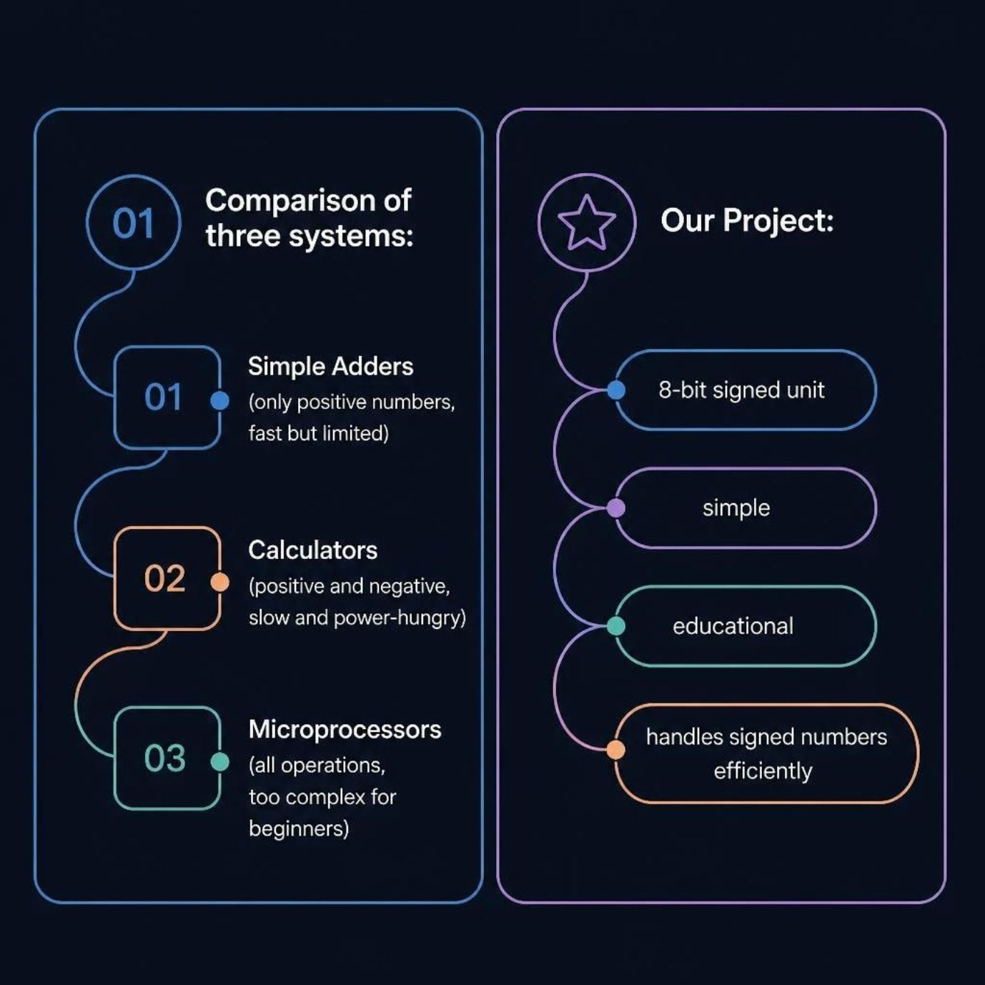
Literature Survey & Existing Systems
What Makes Our Project Different?
Handles both positive and negative numbers
Simpler than microprocessors — easy to understand
Fast and efficient operation
Perfect for learning digital design basics
Gap We Are Filling
No simple educational system existed to learn from
We bridge the gap between basic adders and complex CPUs

Slide 5




Overview & What is 8-Bit ?
Arithmetic Unit
8-Bit Means
A small system that does basic math — addition and subtraction. Found inside every computer and calculator.
Works with 8 binary digits (0s and 1s). Handles numbers from −128 to +127.
Signed Numbers
Project Aim
Positive: 0 to 127
Negative: −1 to −128
Handled using Two's Complement method.
Design, simulate, and verify an arithmetic unit that adds and subtracts 8-bit signed numbers.

Slide 6





System Architecture & Block Diagram
Main Components
Input Module
Receives two 8-bit numbers and operation selection
Input Module
Control Unit
Control Unit
Decides whether to add or subtract
ALU Processing
ALU
Output Module
Uses adders & logic gates to process numbers
Output Module
Displays the final 8-bit result

Slide 7






Methodology & Implementation
Step 1
Step 2
Step 3
Design 1-bit full adder using AND, OR, XOR gates
Combine 8 full adders to build the 8-bit adder
Add control unit with multiplexers to choose add or subtract
Step 4
Step 5
Implement Two's Complement for negative numbers using inverters
Test and verify the complete system with all test cases
Key Concept: Subtraction is done as A − B = A + (−B). The second number is inverted and 1 is added to get its negative. Example: +5 = 00000101, −5 = 11111011

Slide 8

How It Works — Step by Step
Addition Example
Subtraction Example
The system handles both positive and negative numbers automatically using the Two's Complement method.
Give Numbers
Choose Operation
System Processes
Get Answer
5 + 3 = 8 ✓
Input: 00000101 + 00000011
Output: 00001000
5 + (−3) = 2 ✓
B is inverted using Two's Complement, then added to A

Slide 9
Simulation & Testing Results
Our 8-bit signed arithmetic unit underwent rigorous simulation and testing using various positive and negative number combinations for both addition and subtraction. All test cases passed successfully, demonstrating the unit's accuracy and robustness.
Test Case | Operation | Input (Binary) | Expected Output | Actual Output | Status
1 | 5 + 3 = 8 | 00000101 + 00000011 | 00001000 | 00001000 | ✓
2 | -5 + 3 = -2 | 11111011 + 00000011 | 11111110 | 11111110 | ✓
3 | 10 - 7 = 3 | 00001010 - 00000111 | 00000011 | 00000011 | ✓
4 | 15 + (-8) = 7 | 00001111 + 11111000 | 00000111 | 00000111 | ✓
5 | 3 - 10 = -7 | 00000011 - 00001010 | 11111001 | 11111001 | ✓
These results confirm that the arithmetic unit correctly handles both positive and negative integer operations within the 8-bit signed range using the Two's Complement representation.

Slide 10

Conclusion & Future Scope
What We Achieved
What We Learned
Designed a working 8-bit signed arithmetic unit
Successfully handled positive and negative numbers
Verified correct results using simulation
How computers do math at the basic level
How logic gates combine to build larger systems
How Two's Complement represents negative numbers
Future Scope
Extend to 16-bit or 32-bit operations
Add multiplication and division
Implement on actual hardware (FPGA)
Thank You!

