Slide 1
Computational Complexity CSC 5173
Professor: Tom Altman
Peg solitaire
K.SAI VASUDHA
CH.PRAGNA

Slide 2
contents
Peg solitaire
Peg solitaire triangle
Standard peg solitaire
Intresting features
Insolvability of games
Introduction of groups
Implementation
Pagoda function
Symmetrics
conclusion

Slide 3
Peg solitaire
Peg solitaire is a board game for one player involving movement of pegs on a board with holes.
It was first introduced in the court of Louis XIV during the year 1697.
There are different types of peg solitaire such as
Peg solitaire triangle
Standard peg solitaire

Slide 4
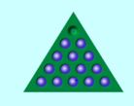
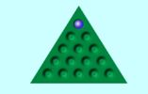
PEG SOLITAIRE TRIANGLE
The standard game fills the entire board except one hole.
The main objective is making valid moves to empty the entire board.

Slide 5
Standard peg solitaire
This board is cross shaped and contains of 33 holes.
The starting configuration is a full board except for an empty place in the center.
0 1 2 3 4 5 6
0
1
2
3
4
5
6

Slide 6
Contd….
A peg is allowed to jump vertically or horizontally over an adjacent peg to an empty hole
The peg that was jumped over is removed.
Before
After

Slide 7
Cntd…
The objective of this game is to invert the starting configuration
i.e to end up with one peg in the center of the board.
0 1 2 3 4 5 6
0
1
2
3
4
5
6

Slide 8
Interesting features
A challenging search problem.
It is highly symmetric.
Symmetries of the board, symmetries of the moves.
Planning-style problem
Not usually tackled directly with integer programming.

Slide 9
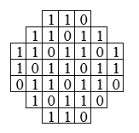
Insolvability of game
Color our board with numbers 0 and 1
N_{c} start=24 (N_{c} is the sum of colors of the filled spaces)

Slide 10
Cntd…
By performing an elementary move might change N, or leave it unchanged.
If move is valid it decreases by 2
N_{start} =24 which is even, and since the center is marked by 1,N_{win}=1 which is odd.So we cannot get from one configuration to the other.We cannot win this game

Slide 11
Introduction of groups
Our group ,K ,will consist of 4 elements : a,b,c and e.
Doing a and then a . a or just a² ,is like doing nothing at all.We express this by the equation a² = e.
The same goes with all the elements.
Doing a and then b leads to move the peg, so
a . b=c.

Slide 12
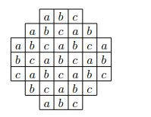
Cntd….
We shall now color our board with elements of K(abelian), instead of 0’s and 1’s.
let M_{c} be the product of all markings of full squares

Slide 13

CNTD…
M_{c} is invariant,notice that elementary moves don’t change the product.
M_{start} = e but none of the squares is marked e.
So not only can we never win this game.

Slide 14
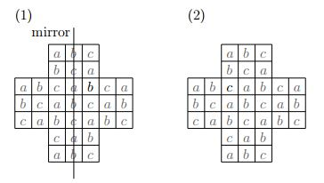
CNTD…
Let M_{start =} b. Therefore ,if we end up with one peg on the board it will be marked b.But there is another obstruction.
But by our previous consideration,the configuration on the right is impossible , since it is marked by C . Hence , the configuration on the left is also unattainable.

Slide 15
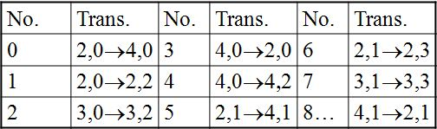
implementation
We can record the sequence of moves required.
Each transition is assigned a unique number:

Slide 16
Cntd…
Positions are stored in an array and these are compared with the valid moves.
Problem constraints can be stated on moves[] alone.
If the comparison is not valid it comes back and check the other possibilities
Main drawback is it needs many such constraints needed. Some of very large size.

Slide 17

Pagoda functions
Used to spot dead-ends early.
Value assigned to each board position such that:
Given positions a, b, c in a horizontal/vertical line: a+b ≥ c.
Pagoda value of a board state:
Sum of values at positions where there is a peg.
Monotonically decreasing as moves made:

Slide 18
Cntd…
Pagoda condition:
If pagoda value for an intermediate position is less than that of final position, backtrack.
For a single-peg Solitaire reversal at position i, j, want pagoda functions with non-zero entries at i, j.
Otherwise no pruning.
A rotation of one of these three gives a useful pagoda function for every board position:

Slide 19
Cntd….
A rotation of one of these three gives a useful pagoda function for every board position:
1
1
1
1
1
1
1
1
1
1
1
1
1
1
1
1
1
1
1
1
1
1
1
1
1

Slide 20
symmetrics
Rotation.
Reflection

Slide 21
Cntd…
Break rotational symmetry by selecting 1st move:
Reflection symmetry persists. Remove 5,2 → 3,2:

Slide 22
Cntd…
Further into the search are both broken and re-established, depending on the moves made.

Slide 23
coclusion
Here we implement by storing the valid moves in an array and we find each move is in array or not.
These arrays are stored using symmetric process.

Slide 24
reference
Beasley, J. D. The Ins and Outs of Peg Solitaire. Oxford, England: Oxford University Press, 1992.
Beeler, M. Item 76 in Beeler, M.; Gosper, R. W.; and Schroeppel, R. HAKMEM. Cambridge, MA: MIT Artificial Intelligence Laboratory, Memo AIM-239, p. 29, Feb. 1972.http://www.inwap.com/pdp10/hbaker/hakmem/games.html#item76.
Bell, G. I. "Solving Triangular Peg Solitaire." J. Integer Seq. 11, Article 08.4.8, 1-21, 2008.
Berlekamp, E. R.; Conway, J. H; and Guy, R. K. Ch. 23 in Winning Ways for Your Mathematical Plays, Vol. 2: Games in Particular. London: Academic Press, 1982.

Slide 25
THANK YOU

