Slide 1
Citizen Data Science in Action: Fabric Notebooks to Power BI in Minutes
Empowering users to create data insights rapidly
Notes:
AI-generated content may be incorrect. ---

Slide 2
Introduction
Notes:
Citizen Data Science in Action

Slide 3
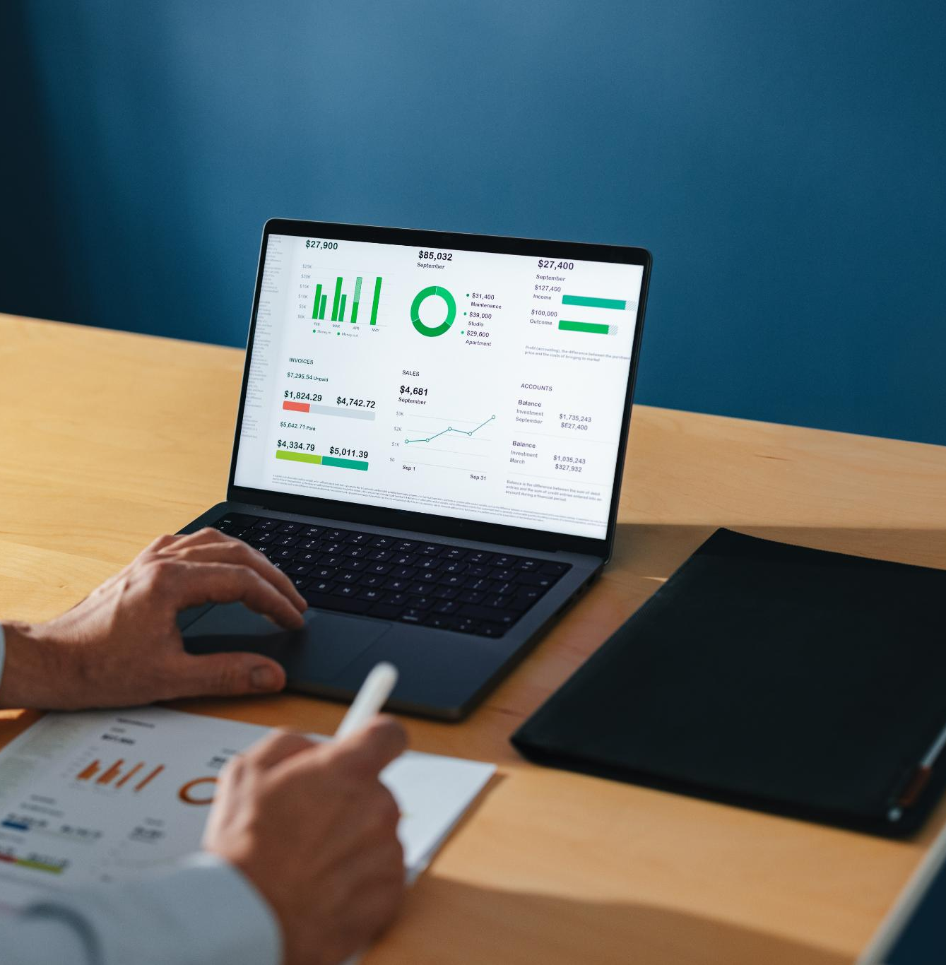
Citizen Data Science in Action
Empowering Business Users
Citizen data scientists can independently analyze and visualize data without heavy technical support.
Leveraging Microsoft Fabric
Microsoft Fabric provides low-code tools for data ingestion, analysis, and visualization to simplify data science tasks.
Seamless Integration with Power BI
Insights from Fabric Notebooks can be easily converted into interactive Power BI dashboards for real-time decisions.
Notes:
The presentation titled 'Citizen Data Science in Action: Fabric Notebooks to Power BI in Minutes' introduces a transformative approach to data analytics within modern organizations. It emphasizes the strategic advantage of empowering business users—often referred to as citizen data scientists—to independently derive insights without relying heavily on technical teams. This initiative leverages Microsoft Fabric, a comprehensive analytics platform, to enable non-technical professionals to ingest, analyze, and visualize data using low-code tools. The session showcases how Fabric Notebooks can be used to perform data science tasks such as customer segmentation and how these insights can be seamlessly transitioned into interactive Power BI dashboards for real-time decision-making.

Slide 4
Project Overview and Objectives
Notes:
Project Overview, Objectives

Slide 5
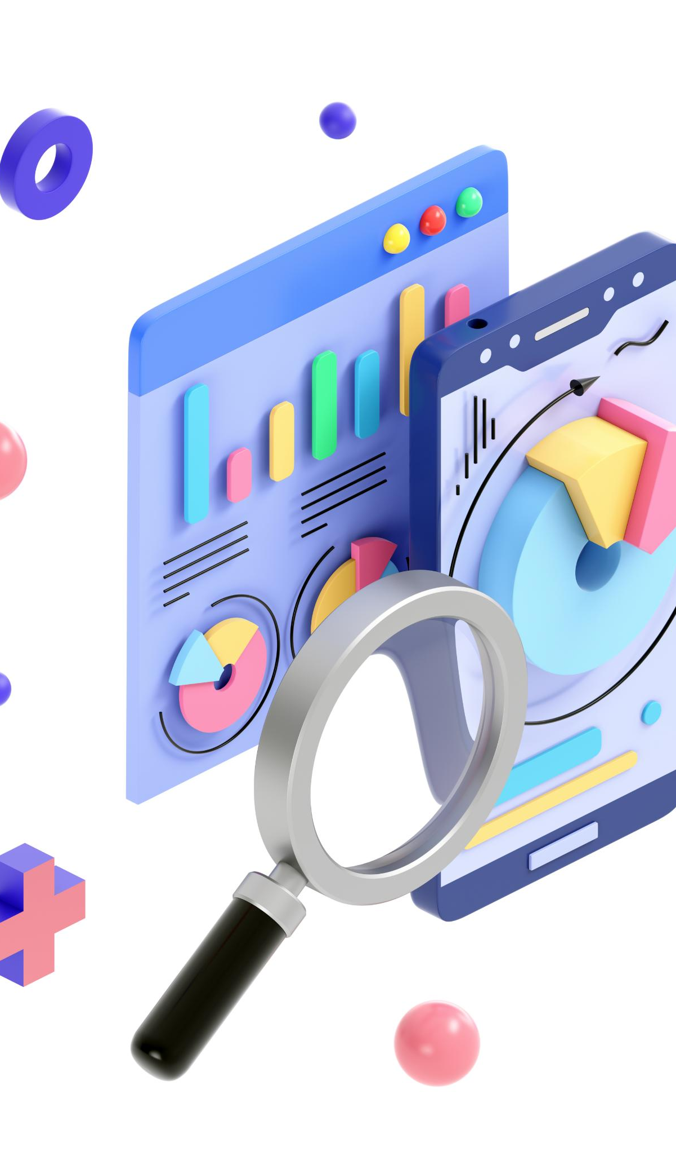
Project Overview
Minimal Coding Data Science
Microsoft Fabric enables business users to perform data science with minimal coding effort.
Data Ingestion and Analysis
Fabric Notebooks facilitate customer data ingestion and analysis for actionable insights.
Machine Learning for Segmentation
Applied machine learning models segment customer data to enhance decision making.
Integrated Visualization
Power BI visualizes results providing intuitive and accessible insights for users.
Notes:
This project demonstrates the capabilities of Microsoft Fabric in enabling business users to perform data science tasks with minimal coding. The core idea is to use Fabric Notebooks to ingest and analyze customer data, apply machine learning models for segmentation, and visualize the results in Power BI. The workflow is designed to be intuitive and accessible, allowing users to derive actionable insights quickly. By integrating data science and business intelligence tools, the project promotes a collaborative environment where technical and non-technical teams can work together effectively.

Slide 6

Objectives
Empowering Citizen Data Scientists
Enable business users with limited technical skills to build and operate machine learning workflows using Microsoft Fabric.
Customer Segmentation with Clustering
Apply clustering methods like K-Means to identify patterns and segment customers effectively.
Insight Visualization in Power BI
Use Power BI to create real-time visual storytelling dashboards that aid informed decision making.
Notes:
The primary objectives of this project are threefold: First, to enable citizen data scientists—business users with limited technical expertise—to build and operationalize machine learning workflows using Microsoft Fabric. Second, to perform customer segmentation using clustering techniques such as K-Means, thereby uncovering patterns in customer behavior. Third, to visualize these insights in Power BI, facilitating real-time storytelling and informed decision-making. These objectives align with the broader goal of democratizing data science and fostering a data-driven culture within organizations.

Slide 7
Dataset and Tools
Notes:
--- This slide references information from the following file: https://api.asm.skype.com/v1/objects/0-wus-d3-d56f0270933578ddd82acaa1db486aea/views/original/README.md Dataset Description, Tools Used

Slide 8
Dataset Description
Customer Data Attributes
The dataset contains key customer fields like Age, Gender, Income, Spending Score, and Region for segmentation analysis.
Synthetic Dataset Purpose
A synthetic dataset is used to simulate real customer data for effective clustering and segmentation modeling.
Data Preparation Environment
Data is ingested and cleaned within a Lakehouse environment using notebooks to ensure quality and relevance.
Notes:
--- This slide references information from the following file: https://api.asm.skype.com/v1/objects/0-wus-d3-d56f0270933578ddd82acaa1db486aea/views/original/README.md The dataset used in this project is a synthetic customer dataset designed for segmentation analysis. It includes fields such as CustomerID, Age, Gender, Annual Income (in thousands), Spending Score (ranging from 1 to 100), and Region. These attributes provide a comprehensive view of customer demographics and behavior, making them suitable for clustering models. The dataset is ingested into Microsoft Fabric's Lakehouse environment, where it is cleaned and prepared for analysis using Fabric Notebooks. This structured approach ensures data quality and relevance for the subsequent machine learning tasks.

Slide 9
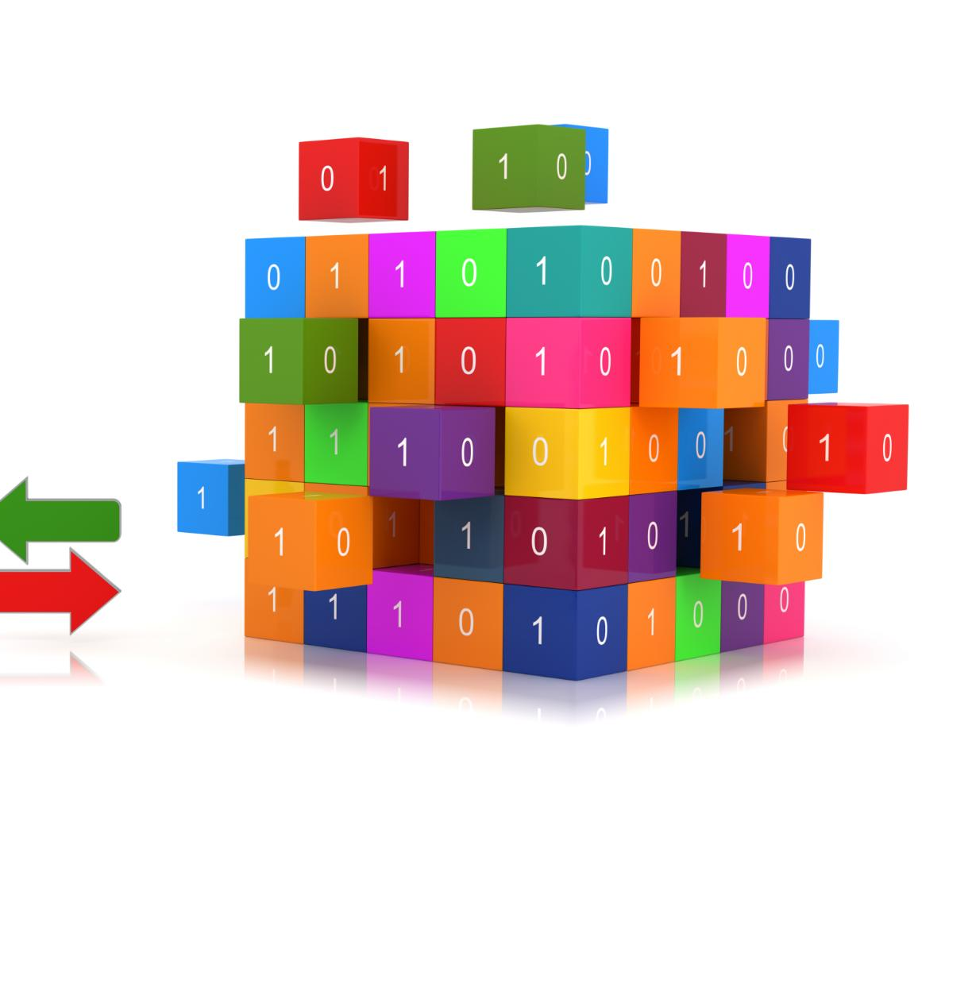
Tools Used
Fabric Components
Microsoft Fabric Lakehouse stores data while Fabric Notebooks enable data processing and model building.
Visualization with Power BI
Power BI is used for creating visualizations that help interpret and communicate data insights effectively.
Python Libraries Usage
Python libraries like pandas, matplotlib, seaborn, and scikit-learn support data cleaning, analysis, and clustering tasks.
Notes:
--- This slide references information from the following file: https://api.asm.skype.com/v1/objects/0-wus-d3-d56f0270933578ddd82acaa1db486aea/views/original/README.md The project utilizes a combination of Microsoft Fabric components and Python libraries to execute the data science workflow. Key tools include Fabric Lakehouse for data storage, Fabric Notebooks for data processing and model building, and Power BI for visualization. Python libraries such as pandas, matplotlib, seaborn, and scikit-learn are employed within the notebook to perform data cleaning, exploratory analysis, and clustering. This toolset provides a robust and flexible environment for both technical and non-technical users to engage in data science activities.

Slide 10
Implementation Steps
Notes:
--- This slide references information from the following file: https://api.asm.skype.com/v1/objects/0-wus-d8-a5aae118093c980d7e2873567b94a253/views/original/segmented_customers.csv,https://api.asm.skype.com/v1/objects/0-wus-d5-8266df797d4748002b7e069f391560c1/views/original/generated_image.png Workflow Execution

Slide 11
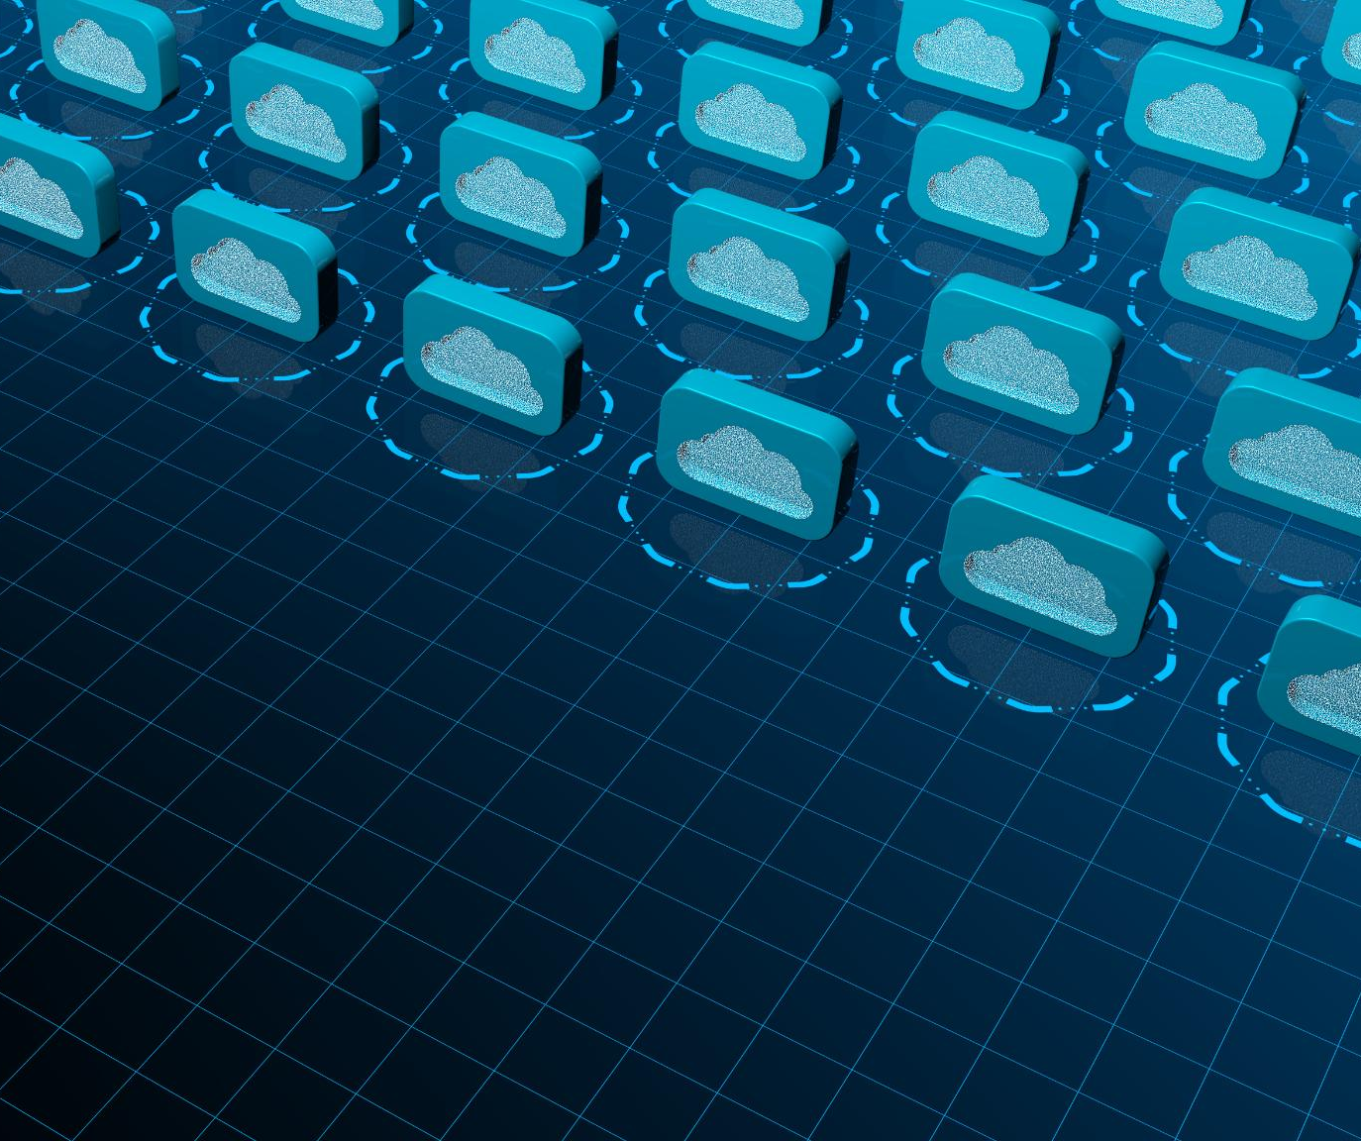
Workflow Execution
Data Upload to Lakehouse
The sample customer dataset is uploaded to Microsoft Fabric's Lakehouse as the first step in the workflow.
Data Preprocessing with Python
Python Notebook is used to load, encode categorical variables, and scale numerical features for analysis.
K-Means Clustering Analysis
K-Means clustering segments customers based on attributes like age, income, and spending score.
Visualization and Integration
Cluster results are visualized via scatter plots and saved to CSV for Power BI integration and reporting.
Notes:
--- This slide references information from the following file: https://api.asm.skype.com/v1/objects/0-wus-d8-a5aae118093c980d7e2873567b94a253/views/original/segmented_customers.csv,https://api.asm.skype.com/v1/objects/0-wus-d5-8266df797d4748002b7e069f391560c1/views/original/generated_image.png The implementation begins with uploading the sample customer dataset to Microsoft Fabric's Lakehouse. A Python Notebook is then used to load and preprocess the data, including encoding categorical variables and scaling numerical features. K-Means clustering is applied to segment customers based on attributes such as age, income, and spending score. The results are visualized using scatter plots and saved to a CSV file for use in Power BI. This workflow demonstrates the ease with which business users can perform complex data science tasks using low-code tools in Fabric.

Slide 12
Power BI Dashboard
Notes:
--- This slide references information from the following file: https://api.asm.skype.com/v1/objects/0-wus-d8-a5aae118093c980d7e2873567b94a253/views/original/segmented_customers.csv,https://api.asm.skype.com/v1/objects/0-wus-d5-8266df797d4748002b7e069f391560c1/views/original/generated_image.png Dashboard Features

Slide 13

Dashboard Features
Clustered Bar Chart
Bar chart visualizes the number of customers in each segment clearly and effectively.
Scatter Plot Analysis
Scatter plot displays the relationship between annual income and spending score by cluster color.
Interactive Filters
Slicers enable filtering data by region and gender for focused insights and exploration.
Summary Cards and Table
Cards show average income and spending per cluster; table lists detailed customer info and segments.
Notes:
--- This slide references information from the following file: https://api.asm.skype.com/v1/objects/0-wus-d8-a5aae118093c980d7e2873567b94a253/views/original/segmented_customers.csv,https://api.asm.skype.com/v1/objects/0-wus-d5-8266df797d4748002b7e069f391560c1/views/original/generated_image.png The Power BI dashboard built from the segmented customer data includes several key visualizations. A clustered bar chart displays the number of customers per segment, while a scatter plot shows the relationship between annual income and spending score, colored by cluster. Slicers for region and gender allow users to filter the data interactively. Cards present average income and spending scores for each cluster, and a detailed table lists customer information along with their assigned segment. These features provide a comprehensive and interactive view of customer segmentation, enabling real-time exploration and decision-making.

Slide 14
Direct Lake Connectivity
Notes:
Connecting Power BI to Fabric

Slide 15
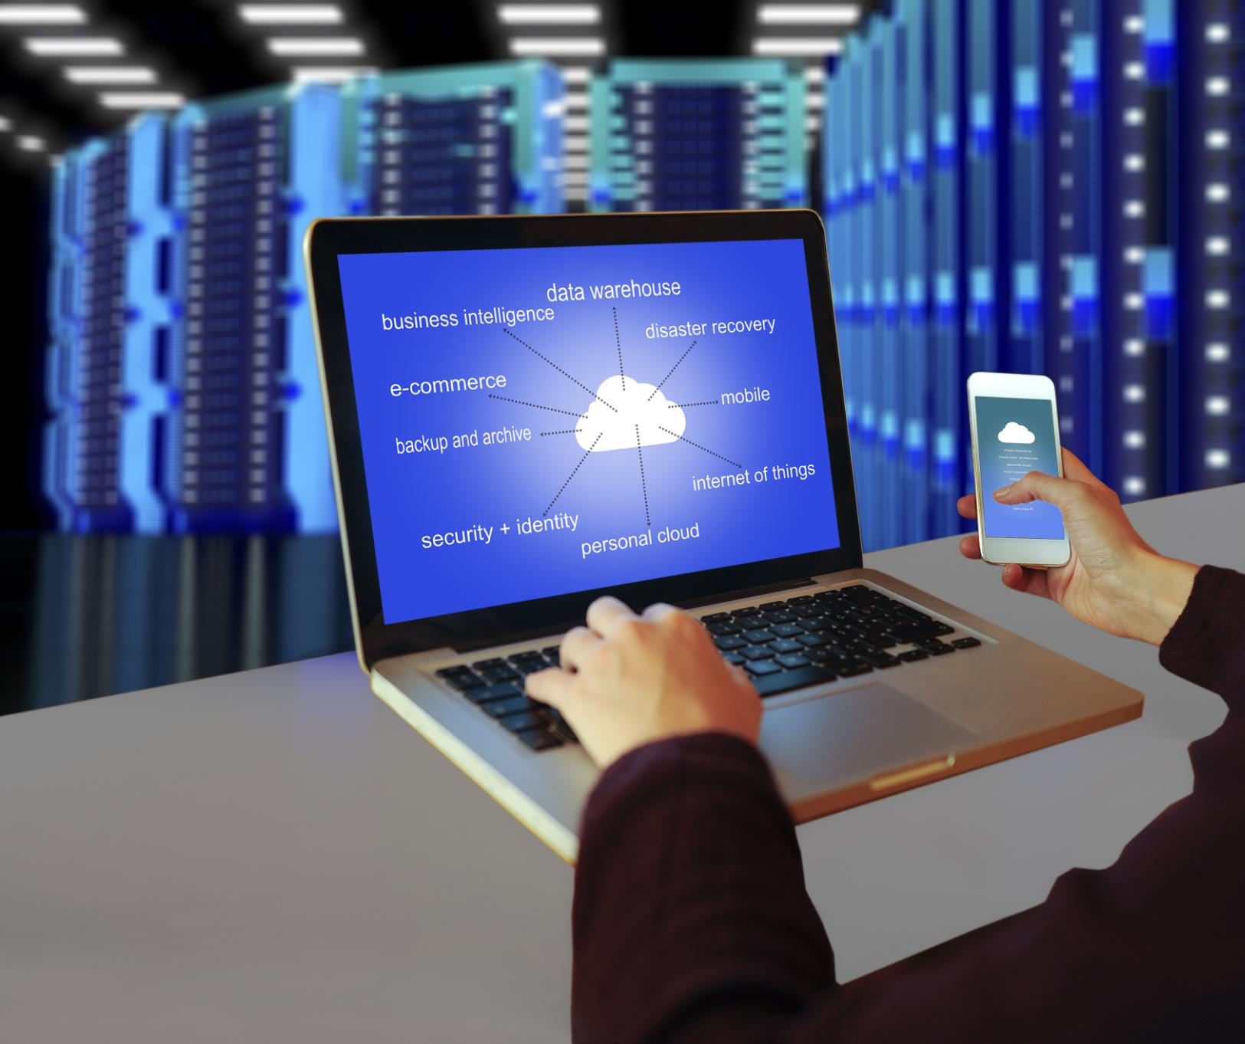
Connecting Power BI to Fabric
Initiating Connection
Users start by opening Power BI Desktop or service and selecting the Lakehouse connector for Fabric integration.
Authentication Process
Authentication is done using Microsoft 365 credentials to securely connect Power BI with Fabric Lakehouse.
Loading Data
Users select the workspace and Lakehouse, then load the segmented customer table for analysis.
Direct Lake Connectivity Benefits
Direct Lake enables real-time querying without data import, ideal for large datasets and interactive reports.
Notes:
To establish Direct Lake connectivity between Power BI and Microsoft Fabric, users begin by opening Power BI Desktop or the Power BI service within Fabric. They select the Lakehouse connector and authenticate using their Microsoft 365 credentials. After choosing the appropriate workspace and Lakehouse, they load the segmented customer table. This connection mode allows Power BI to query data directly from the Lakehouse without importing it, ensuring real-time updates and optimized performance. Direct Lake connectivity is ideal for large datasets and supports dynamic, interactive reporting.

Slide 16
Conclusion
Notes:
Summary and Impact

Slide 17

Summary and Impact
Democratizing Data Science
Microsoft Fabric enables business users to independently derive insights through accessible data science tools.
Integrated Analytics Environment
Combining Fabric Notebooks with Power BI allows seamless customer segmentation and data visualization.
Enhanced Collaboration and Productivity
Integration fosters teamwork between technical and non-technical teams, boosting productivity and data-driven culture.
Empowering Organizations
This approach models how organizations can empower their workforce with accessible analytics tools and insights.
Notes:
This project illustrates the power of Microsoft Fabric in democratizing data science and enabling business users to derive insights independently. By combining Fabric Notebooks with Power BI, users can perform customer segmentation, visualize results, and make data-driven decisions—all within a low-code environment. The seamless integration between Fabric and Power BI fosters collaboration between technical and non-technical teams, enhances productivity, and supports a data-driven culture. The approach showcased here serves as a model for organizations seeking to empower their workforce with accessible analytics tools.

