Slide 1

ADA23CY202– MACHINE LEARNING LABORATORY
Final Lab Project
Project Title: AI STOCK PREDICTION & ANALYSIS
Presented By: Mohith Koyi - E0324076
Kishore .M - E0324081

Slide 2
ABSTRACT
The NIFTY AI Stock Prediction Dashboard is a machine learning-based financial forecasting system designed to predict stock trends using historical and real-time market data. It combines offline SQLite historical records with live yfinance tick data to ensure continuous operation even during network failure, while technical indicators such as RSI and MACD help analyze market momentum. The system uses advanced AI models including LSTM, GRU, ARIMA, and Prophet to learn time-series patterns and generate future price predictions. To improve adaptability across different tickers, it applies dynamic scaling with temporary MinMaxScalers and supports an ensemble approach for more reliable forecast results.The project is deployed as an interactive dashboard using Streamlit and also supports a Flask-based web API with a JavaScript frontend, allowing users to view charts, monitor live prices, and explore AI-generated predictions in real time.

Slide 3
PROBLEM STATEMENTS:
• Financial stock markets are highly volatile, making it difficult for investors to accurately predict future price
movements using traditional methods.
• Most existing prediction systems depend heavily on continuous internet access and live APIs, which
can fail due to network issues, rate limits, or service interruptions.
• Static forecasting models often struggle when stock data changes in scale across different companies, leading to
inaccurate predictions.
The NIFTY AI Stock Prediction Dashboard aims to solve the challenge of unreliable and inaccurate stock forecasting by building a hybrid machine learning system that works with both offline historical data and live market updates. The project focuses on creating a robust, scalable, and interactive prediction platform that can continue functioning even when internet access is unstable, while using AI models and technical indicators to generate more reliable stock trend forecasts.

Slide 4
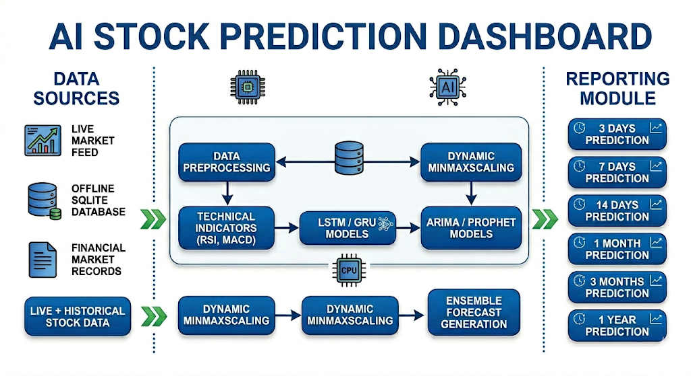
WORK FLOWDIAGRAM:
This dashboard collects live and historical stock data from multiple sources for analysis. The data is preprocessed, scaled, and analyzed using technical indicators and AI models like LSTM, GRU, ARIMA, and Prophet.

Slide 5
METHODOLOGY:
•Stock data is collected from two sources: a local SQLite database for offline historical data
andthe yfinance live feed for real-time updates.
• The collected data is cleaned by handling missing values, preparing sequences, and applying dynamic
MinMax scaling.
•For non-NIFTY stocks, the historical NIFTY data is adjusted using mathematical scaling so the model can work
for different tickers
•The predictions from all models are combined using an ensemble approach, which improves accuracy and
reduces the risk of relying on one model alone.

Slide 6
Tools and techniques:
Programming Language: Python Framework: Streamlit
Libraries Used:
Pandas, NumPy (data handling)
Matplotlib, Plotly (visualization)
Scikit-learn (ML models & preprocessing)
TensorFlow / Keras (deep learning models)
Techniques:
Data preprocessing (encoding, scaling, imputation)
Handling imbalance using SMOTE
Ensemble learning approach
Evaluation methods: Accuracy, Precision, Recall, F1-score, ROC Curve

Slide 7
Implementation:
Data Preprocessing and Model Code
from sklearn.preprocessing import MinMaxScaler
from tensorflow.keras.models import Sequential
from tensorflow.keras.layers import LSTM, Dense
import numpy as np
scaler = MinMaxScaler(feature_range=(0, 1))
scaled_data = scaler.fit_transform(data)
X, y = [], []
for i in range(60, len(scaled_data)):
X.append(scaled_data[i-60:i, 0])
y.append(scaled_data[i, 0])
X, y = np.array(X), np.array(y)
X = X.reshape((X.shape[0], X.shape[1], 1))
Data Collection Code:
import yfinance as yf
import pandas as pd
df = yf.download("^NSEI", period="5y")
data = df[["Close"]].dropna()
Prediction and Display Code
model = Sequential([
LSTM(64, return_sequences=True, input_shape=(60, 1)),
LSTM(64),
Dense(1)
])model.compile(optimizer="adam", loss="mse")
model.fit(X, y, epochs=10, batch_size=32)
pred = model.predict(X)
pred = scaler.inverse_transform(pred)
import streamlit as st
st.write("Predicted Stock Prices:", pred)

Slide 8
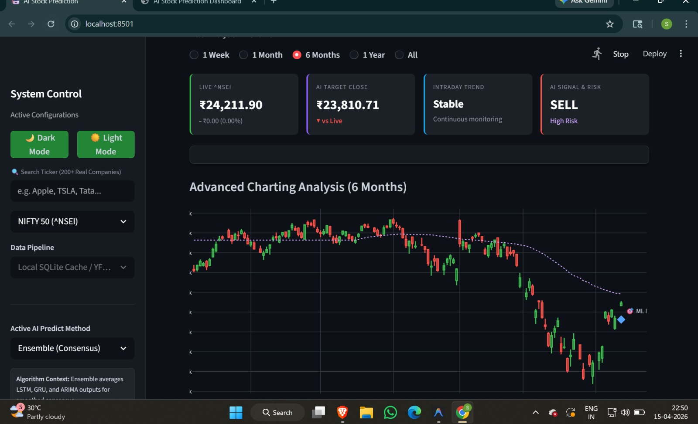
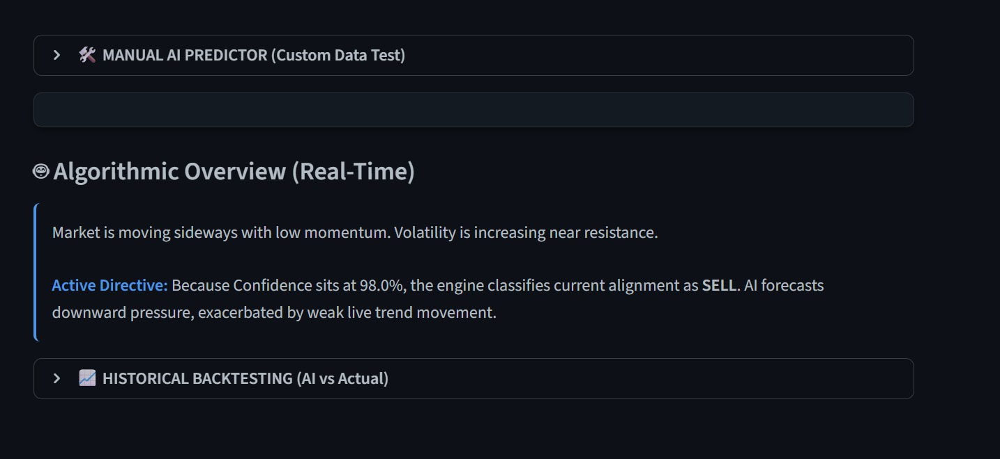
RESULT:

Slide 9
Future scope:
The project can be expanded to include more stock indices and companies such as Bank Nifty, Sensex, Nasdaq, and other global markets
.
Advanced AI models like XGBoost, LightGBM, and Transformer-based forecasting models can be added to improve prediction accuracy.
The system can be enhanced with sentiment analysis from news, social media, and financial reports to capture market behavior better.
A mobile app can be developed so users can view live predictions, alerts, and market insights on the go.
The dashboard can be upgraded with cloud deployment, real-time notifications, and portfolio management features for better scalability and usefulness.

Slide 10
CONCLUSION:
The AI Stock Prediction Dashboard is a robust and intelligent financial forecasting system that combines historical market data, live price updates, and advanced AI models to generate reliable stock predictions. By using a hybrid offline-online architecture, the project ensures continuous performance even when internet connectivity is unstable.
The system successfully integrates techniques such as data preprocessing, dynamic scaling, technical indicators, and ensemble learning to improve prediction quality. Its dual interface through Streamlit and Flask makes it interactive, user-friendly, and suitable for both technical analysis and real-time decision support.
Overall, this project demonstrates how machine learning and financial technology can work together to build an effective stock prediction platform. It provides a strong foundation for future enhancements such as sentiment analysis, mobile access, and cloud deployment.

