Slide 1
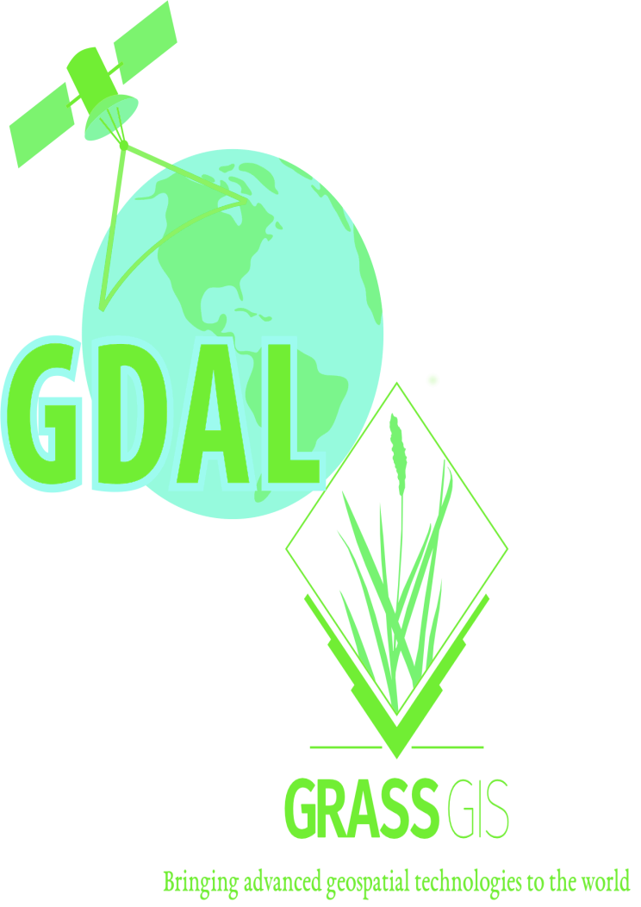

Slide 2
AN INTRODUCTION TO GDAL AND GRASS GIS
by Brian Pondi and Da Vince

Slide 3
Speakers:
Brian Pondi(@PondiB)
your host
Da Vince Koyo(@koyo_jakanees)
Background: Geospatial and remote sensing.
formerly: Market and reasearch associate with focus on predictive modelling, location & Business intelligence and forecasting products.
currently: Consulting, VGI and student
Generally: A tinkerer and a virtuoso
Affiliation: None, Free agent

Slide 4
Introduction.
WHAT IS GRASS GIS AND GDAL ANYWAY? WHY CARE ABOUT THEM?
> Let's get the abbreviations out of the way.
>> GDAL: Geospatial Data Abstraction Library [released in 1998]
>> GRASS GIS: Geographic Resource Analysis Support System [released in 1984]
>> OGR: OGR Simple Feature Library, comes with GDAL (OpenGIS Simple Feature Reference Implementation)
> Both GDAL and GRASS GIS are member/projects under the Open Source Geospatial Foundation(OSGeo)
> Free and open source cross-platform and runs on major operating systems written in C, C++ with great python api bindings and wrappers
> Not as popular as QGIS and ArcGIS is with desktop users. Maybe cause they are more CLI oriented? Although grass offers a GUI through WxWidgets python api
> Provide tools for both raster and vector data reading, manipulation and processing

Slide 5
> You probably have been using them.
>> Fast, free, open, flexible and extensible software
>> Support and Interoperable with other OSGeo member projects such as QGIS, PostGIS among others.
>> Supported by some GIS service providers and incorporated in their solution stack.
>> Feature rich scriptable using CLI utilities
>> Run batch and bulk processes, a plus if familiar with any cli scripting language. Bash, Python, tcl, perl, php
> What the talk is not about.
>> A comparison between the two software
>> Promoting their use compared to others stack
> Who is without a flaw(s)?
>> Not really many articles/docs on the direct usage. The most common ones are using bindings or wrappers using other languages python, R, java, javascript
>> The CLI/text based interfaces can be daunting to beginners
>> Grass GUI and workflow can be involving if not used to it.

Slide 6
> Expected outcome.
>> To be comfortable with some of the common cmd
>> Perform some of basic spatial operations using both tool
>> Understanding of the various workflow.
>> Be dangerous enough to make your colleague think you're a hacker
>> Desirable: start chaining your analysis and processing into reproducible programs or scripts
> What the talk is not about.
>> A comparison between the two software
>> Promoting their use compared to others stack
> What to bring or consider:
>> Be aware of others >> Be open to all questions and viewpoints
>> Be friendly and patient >> Be understanding of differences
>> Be welcoming and respectful >> Be Kind and considerate to others
>> Have Gdal, grass, grass gui and grass-gdal-plugin alreasy installed to try some examples

Slide 7
> Outline GDAL:
>> Introduction and installation gotchas
>> ``Hello World`` in Gdal
>> Common Gdal commands and operations with examples
>> Common ogr & osr commands
>> Extras and api in other language {osgeo, rgdal, rasterio etc}
>> Further resources
> Outline Grass GIS.
>> introduction and installation
>> Start your first grass session from Grass dataset ``Location and mapset`` using GUI
>> Creating your own Mapsets using GUI and through CLI
>> Loading datasets to your new mapset
>> Nice to have: an actual modelling case study

Slide 8


> A translator library for raster and vector data formats released under X/MIT style Open Source License by the Open Source Geospatial Foundation.
> As a library, it presents a single raster abstract data model and single vector abstract data model to the calling application for all supported formats. It also comes with a variety of useful command line utilities for data translation and processing( https://gdal.org/) latest release GDAL/OGR 3.2.1
> the capabilities are also accessible programmatically using the api.
> support for a variety of raster formats(147 drivers) and vector formats(90 drivers) at the time of writing
Installation:
Methods vary based on your operating system.
Conda: conda install -c conda-forge gdal=[version] should work across
OSX: you know better than I do. (https://medium.com/planet-stories/a-gentle-introduction-to-gdal-part-1-a3253eb96082)
Windows: through OSGeo4W graphical installer or follow (https://sandbox.idre.ucla.edu/sandbox/tutorials/installing-gdal-for-windows) rem to use the right versions.
Linux distro: pacman -S gdal, sudo apt install gdal-bin libgdal-dev “better try googling the solution that'll work for you”

Slide 9
Common commands:
> ogrinfo Get information about a vector dataset
> gdalinfo Get information about a raster dataset
> ogr2ogr Convert vector data between file formats
> gdal_translate
> gdal_merge
Vector Data:
> ogrinfo --formats To see full list of supported vector formats
>ogrinfo [yourData] To get basic information about your data
> ogrinfo -so [yourData] [yourLayer] To get more info about your date
>ogrinfo -al [yourData] To list out all feature
> ogr2ogr --formats To get full list of output formats
> ogr2ogr -f [outputFormat] [Destination fileName] [source fileName] To convert between vector data formats
> query data using ogr: supports sqlite and OGR SQL dialect
> ogr2ogr -where”query” [output filename] [input filename] or ogr2ogr -sql “Sql query”
> ogr2ogr -t_srs [epsg:code] [output filename] [input filename]
>ogr2ogr -append -update [source file] [file to append] -nln [new file]

Slide 10
Raster data:
> gdalinfo --formats To get full list of supported raster formats
> gdal_translate --formats valid list of output formats
> gdalbuildvrt
> gdal_rasterize, gdal_calc
Ref:
Go through the resources below to explore further:
Geogirl's ogr tutorial series.
https://developers.planet.com/planetschool/getting-started-with-gdal/
https://www.youtube.com/watch?v=2Q1T96NJmuc&ab_channel=MakingSenseRemotely
https://courses.spatialthoughts.com/gdal-tools.html
https://ocw.un-ihe.org/mod/book/view.php?id=6228

Slide 11
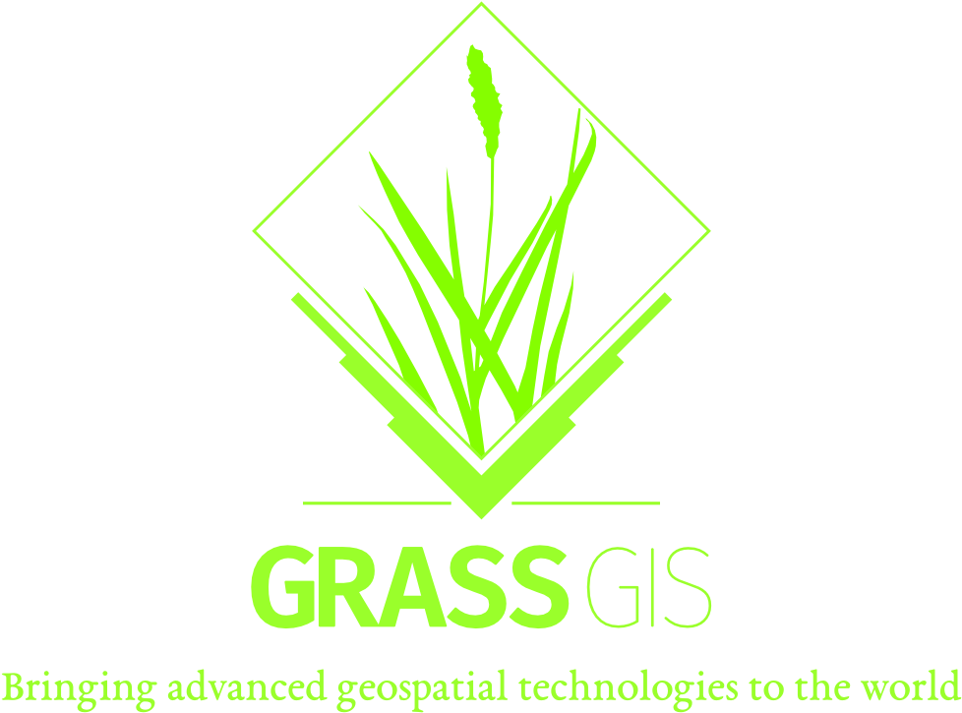
Grass GIS:
Installation:
https://grasswiki.osgeo.org/wiki/Installation_Guide
Windows: The easiest way is through OSGeo4W installer or winGrass stand alone installer
OSX: probably mac users know better. Check above link for the official *.dmg package
Linux distro: Debian based -> if you installed qgis using the official docs you probably have grass else: sudo apt install grass libgrass-dev grass-gui grass-doc
grass learn:
https://grass.osgeo.org/learn/
https://ncsu-geoforall-lab.github.io/grass-intro-workshop/intro.html
https://baharmon.github.io/watersheds-in-grass

Slide 12
Q&A

