Slide 1
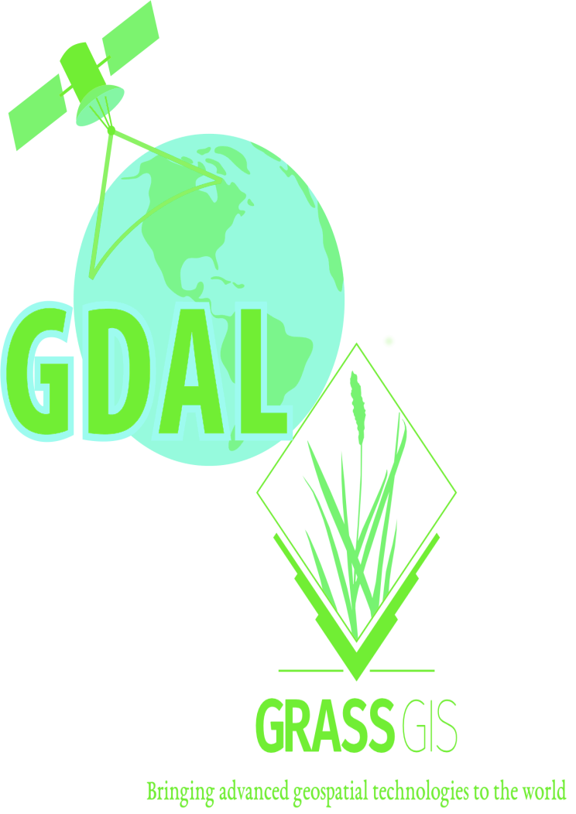

Slide 2
AN INTRODUCTION TO GDAL AND GRASS GIS
by Brian Pondi and Da Vince

Slide 3
Speakers:
Brian Pondi:
Da Vince Koyo(@koyo_jakanees)
Background: Geospatial and remote sensing.
formerly: Market and reasearch associate with focus on predictive modelling, location & Business intelligence and forecasting products.
currently: Consulting, VGI and studying
Generally: A tinkerer and a virtuoso

Slide 4
Introduction.
WHAT IS GRASS GIS AND GDAL ANYWAY? WHY CARE ABOUT THEM?
> Let's get the abbreviations out of the way.
>> GRASS GIS: Geospatial Data Abstraction Library [released in 1984]
>> GDAL: Geographic Resource Analysis Support System [released in 1998]
>> OGR: OGR Simple Feature Library, comes with GDAL (OpenGIS Simple Feature Reference Implementation)
> Both GDAL and GRASS GIS are member/projects under the Open Source Geospatial Foundation(OSGeo)
> Free and open source cross-platform and runs on major operating systems written in C, C++ with great python api bindings and wrappers
> Not as popular as QGIS and ArcGIS is with desktop users. Maybe cause they are more CLI oriented? Although grass offers a GUI through WxWidgets python api
> Provide tools for both raster and vector data reading, manipulation and processing

Slide 5
> You probably have been using them.
>> Fast, free, open, flexible and extensible software
>> Support and Interoperable with other OSGeo member projects such as QGIS, PostGIS among others.
>> Supported by some GIS service providers and incorporated in their solution stack.
>> Feature rich scriptable using CLI utilities
>> Run batch and bulk processes, a plus if familiar with any cli scripting language. Bash, Python, tcl, perl, php
> What the talk is not about.
>> A comparison between the two software
>> Promoting their use compared to others stack
> Who is without a flaw(s)?
>> Not really many articles/docs on the direct usage. The most common ones are using bindings or wrappers using other languages python, R, java, javascript
>> The CLI/text based interfaces can be daunting to beginners
>> Grass GUI and workflow can be involving if not used to it.

Slide 6
cont'd.
> Expected outcome.
>> To be comfortable with some of the common cmd
>> Perform some of basic spatial operations using both tool
>> Understanding of the various workflow.
>> Be dangerous enough to make your colleague think you're a hacker
>> Desirable: start chaining your analysis and processing into reproducible programs or scripts
> What the talk is not about.
>> A comparison between the two software
>> Promoting their use compared to others stack
> What to bring or consider:
>> Be aware of others >> Be open to all questions and viewpoints
>> Be friendly and patient >> Be understanding of differences
>> Be welcoming and respectful >> Be Kind and considerate to others

Slide 7
cont'd.
> Expected outcome.
>> To be comfortable with some of the common cmd
>> Perform some of basic spatial operations using both tool
>> Understanding of the various workflow.
>> Be dangerous enough to make your colleague think you're a hacker
>> Desirable: start chaining your analysis and processing into reproducible programs or scripts
> What the talk is not about.
>> A comparison between the two software
>> Promoting their use compared to others stack
> What to bring or consider:
>> Be aware of others >> Be open to all questions and viewpoints
>> Be friendly and patient >> Be understanding of differences
>> Be welcoming and respectful >> Be Kind and considerate to others
Traditionally, the name "GDAL" was used to refer to the raster-related half of the library, while "OGR" referred to the vector part. You may commonly hear people use both "GDAL" and "GDAL/OGR" to refer to this library - but in all cases, the toolset being referenced is the same.
Installation
Visit this page for installation & setup instructions. When you're finished, come back to this page to learn more.
Commonly-used commands
Once you've verified GDAL has been installed successfully, let's take a look at the different CLI commands you will use in this tutorial:
ogrinfo Get information about a vector dataset
gdalinfo Get information about a raster dataset
ogr2ogr Convert vector data between file formats
gdal_translate Convert raster data between file formats
There are other commands available, but these four are the most common. We'll start by learning some of the most-common ways you might use these commands.
Examples
Because GDAL is a CLI, all of your interaction with it will be via your command line (or Terminal). For Windows users who followed this tutorial's installation instructions, you'll use the OSGeo4W Shell here.
If you need a refresher course on types of geospatial data, check out this tutorial.
Working with vector data
GDAL can read dozens of file types. To see a full list of the vector data filetypes supported by your current GDAL installation, do:
ogrinfo --formats
In the following examples, we'll use GeoJSON files -- but you could also read KML, Shapefile, Geopackage, and more.
Exploring data
To get basic information about your dataset, do:
ogrinfo mydata.geojson
Which will return something like this:
INFO: Open of `mydata.geojson'
using driver `GeoJSON' successful.
1: mydata (Polygon)
What this tells you:
Your dataset, mydata.geojson, has one layer of data, called mydata, which contains Polygon features.
To learn more about that layer of Polygon features, do:
ogrinfo -so mydata.geojson mydata
Which will return something like his:
INFO: Open of `mydata.geojson'
using driver `GeoJSON' successful.
Layer name: mydata
Geometry: Polygon
Feature Count: 1
ExtentV: (-86.484375, 18.979026) - (-14.414062, 52.482780)
Layer SRS WKT:
GEOGCS["WGS 84",
DATUM["WGS_1984",
SPHEROID["WGS 84",6378137,298.257223563,
AUTHORITY["EPSG","7030"]],
AUTHORITY["EPSG","6326"]],
PRIMEM["Greenwich",0,
AUTHORITY["EPSG","8901"]],
UNIT["degree",0.0174532925199433,
AUTHORITY["EPSG","9122"]],
AUTHORITY["EPSG","4326"]]
What this tells you:
There is 1 feature (a single polygon) in this dataset's layer
The Extent (bounding box) of the dataset is given as a coordinate pair
The SRS (spatial reference) of this dataset, printed as WKT (Well-Known Text)
Converting data
One of the most convenient features of GDAL is its ability to quickly and painlessly convert data between file types. In fact, even if you use GDAL for nothing else, data conversion alone is worth the price of admission.
To convert a vector dataset from one format to another, the basic command pattern is:
ogr2ogr -f <output format> <destination filename> <source filename>
To see a list of valid output formats, do:
ogr2ogr --formats
Note: the formats supported by a given GDAL instance can vary, depending on the installation process -- but generally, support for common filetypes like Shapefile, GeoJSON, etc. will always be available.
Let's say we have a shapefile, mydata.shp, which we'd like to convert to a GeoJSON dataset. To do this, we would run:
ogr2ogr -f GeoJSON myconverteddata.geojson mydata.shp
Working with raster data
Just as we learned that GDAL can read and write dozens of vector data types, the same is true for raster data. To see a full list of the raster data filetypes supported by your current GDAL installation, do:
gdalinfo --formats
For the following examples, we'll use GeoTIFF data for demonstration purposes.
Exploring data
To get information about your dataset, do:
ogrinfo mydata.tif
Which will return something like this:
Driver: GTiff/GeoTIFF
Files: mydata.tif
Size is 8879, 4392
Coordinate System is:
PROJCS["WGS 84 / UTM zone 38N",
GEOGCS["WGS 84",
DATUM["WGS_1984",
SPHEROID["WGS 84",6378137,298.257223563,
AUTHORITY["EPSG","7030"]],
AUTHORITY["EPSG","6326"]],
PRIMEM["Greenwich",0,
AUTHORITY["EPSG","8901"]],
UNIT["degree",0.0174532925199433,
AUTHORITY["EPSG","9122"]],
AUTHORITY["EPSG","4326"]],
PROJECTION["Transverse_Mercator"],
PARAMETER["latitude_of_origin",0],
PARAMETER["central_meridian",45],
PARAMETER["scale_factor",0.9996],
PARAMETER["false_easting",500000],
PARAMETER["false_northing",0],
UNIT["metre",1,
AUTHORITY["EPSG","9001"]],
AXIS["Easting",EAST],
AXIS["Northing",NORTH],
AUTHORITY["EPSG","32638"]]
Origin = (494265.000000000000000,2729640.000000000000000)
Pixel Size = (3.000000000000000,-3.000000000000000)
Metadata:
AREA_OR_POINT=Area
TIFFTAG_DATETIME=2017:10:03 06:53:18
Image Structure Metadata:
COMPRESSION=LZW
INTERLEAVE=PIXEL
Corner Coordinates:
Upper Left ( 494265.000, 2729640.000) ( 44d56'35.92"E, 24d40'52.01"N)
Lower Left ( 494265.000, 2716464.000) ( 44d56'36.12"E, 24d33'43.62"N)
Upper Right ( 520902.000, 2729640.000) ( 45d12'23.78"E, 24d40'51.54"N)
Lower Right ( 520902.000, 2716464.000) ( 45d12'23.07"E, 24d33'43.14"N)
Center ( 507583.500, 2723052.000) ( 45d 4'29.72"E, 24d37'17.79"N)
Band 1 Block=256x256 Type=UInt16, ColorInterp=Red
NoData Value=0
Overviews: 2960x1464, 987x488, 329x163
Band 2 Block=256x256 Type=UInt16, ColorInterp=Green
NoData Value=0
Overviews: 2960x1464, 987x488, 329x163
Band 3 Block=256x256 Type=UInt16, ColorInterp=Blue
NoData Value=0
Overviews: 2960x1464, 987x488, 329x163
Band 4 Block=256x256 Type=UInt16, ColorInterp=Undefined
NoData Value=0
Overviews: 2960x1464, 987x488, 329x163
What this tells you:
Converting data
We can also use GDAL to convert raster data from one file format to another, just as we learned to do with vector data.
To convert a raster dataset from one format to another, the basic command pattern is:
gdal_translate -of <output format> <source filename> <destination filename>
Note! this command is similar, but not quite the same, as ogr2ogr: notice the output format is indicated by -of, and the ordering of source & destination filenames is reversed from the ogr2ogr command.
To see a list of valid output formats, do:
gdal_translate --formats
As an example, let's transform a GeoTIFF raster dataset mydata.tif into a georeferenced PNG. To do that, we would run:
gdal_translate -of png mydata.tif myconverteddata.png

Slide 8
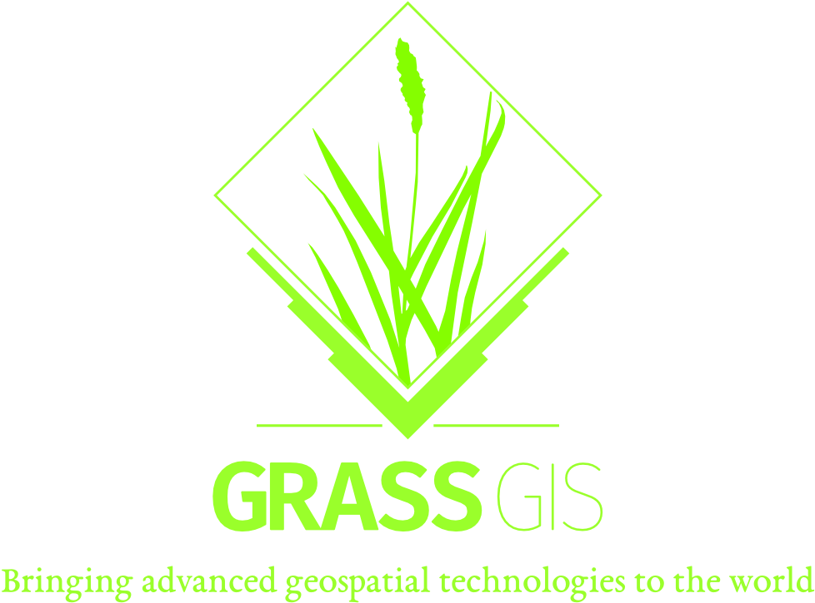
Grass temp:
Brian Pondi:
Da Vince Koyo:
Background: Geospatial and remote sensing.
formerly: Market and reasearch associate with focus on predictive modelling, location & Business intelligence and forecasting products.
currently: Consulting and studying
Generally: A tinkerer and a virtuoso

Slide 9


Gdal temp:
Brian Pondi:
Da Vince Koyo:
Background: Geospatial and remote sensing.
formerly: Market and reasearch associate with focus on predictive modelling, location & Business intelligence and forecasting products.
currently: Consulting and studying
Generally: A tinkerer and a virtuoso

Slide 10
