Slide 1
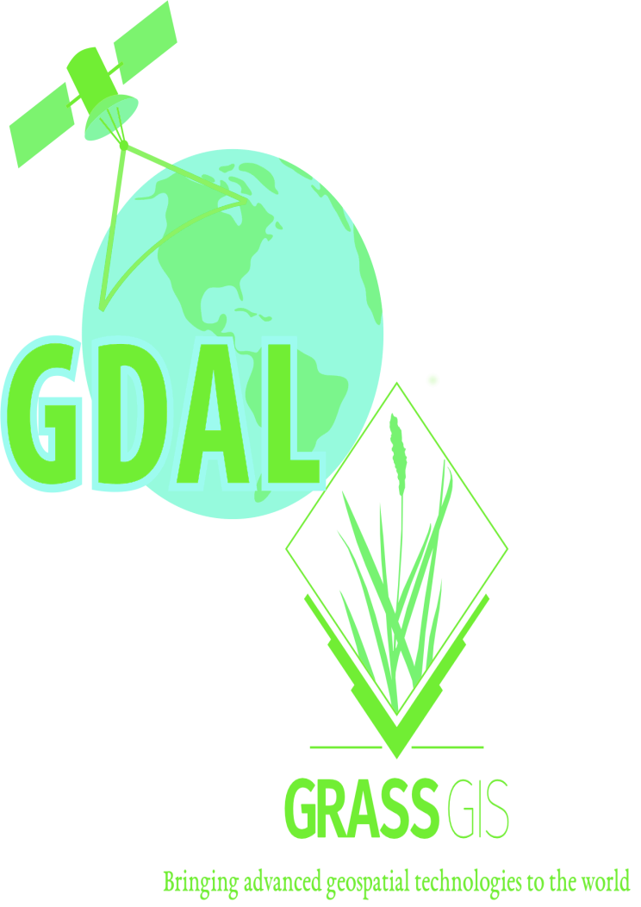

Slide 2
AN INTRODUCTION TO GDAL AND GRASS GIS
by Brian Pondi and Da Vince

Slide 3
Speakers:
Brian Pondi(@PondiB)
Da Vince Koyo(@koyo_jakanees)
Background: Geospatial and remote sensing.
formerly: Market and reasearch associate with focus on predictive modelling, location & Business intelligence and forecasting products.
currently: Consulting, VGI and student
Generally: A tinkerer and a virtuoso
Affiliation: None

Slide 4
Introduction.
WHAT IS GRASS GIS AND GDAL ANYWAY? WHY CARE ABOUT THEM?
> Let's get the abbreviations out of the way.
>> GDAL: Geospatial Data Abstraction Library [released in 1998]
>> GRASS GIS: Geographic Resource Analysis Support System [released in 1984]
>> OGR: OGR Simple Feature Library, comes with GDAL (OpenGIS Simple Feature Reference Implementation)
> Both GDAL and GRASS GIS are member/projects under the Open Source Geospatial Foundation(OSGeo)
> Free and open source cross-platform and runs on major operating systems written in C, C++ with great python api bindings and wrappers
> Not as popular as QGIS and ArcGIS is with desktop users. Maybe cause they are more CLI oriented? Although grass offers a GUI through WxWidgets python api
> Provide tools for both raster and vector data reading, manipulation and processing

Slide 5
> You probably have been using them.
>> Fast, free, open, flexible and extensible software
>> Support and Interoperable with other OSGeo member projects such as QGIS, PostGIS among others.
>> Supported by some GIS service providers and incorporated in their solution stack.
>> Feature rich scriptable using CLI utilities
>> Run batch and bulk processes, a plus if familiar with any cli scripting language. Bash, Python, tcl, perl, php
> What the talk is not about.
>> A comparison between the two software
>> Promoting their use compared to others stack
> Who is without a flaw(s)?
>> Not really many articles/docs on the direct usage. The most common ones are using bindings or wrappers using other languages python, R, java, javascript
>> The CLI/text based interfaces can be daunting to beginners
>> Grass GUI and workflow can be involving if not used to it.

Slide 6
> Expected outcome.
>> To be comfortable with some of the common cmd
>> Perform some of basic spatial operations using both tool
>> Understanding of the various workflow.
>> Be dangerous enough to make your colleague think you're a hacker
>> Desirable: start chaining your analysis and processing into reproducible programs or scripts
> What the talk is not about.
>> A comparison between the two software
>> Promoting their use compared to others stack
> What to bring or consider:
>> Be aware of others >> Be open to all questions and viewpoints
>> Be friendly and patient >> Be understanding of differences
>> Be welcoming and respectful >> Be Kind and considerate to others
>> Have Gdal, grass, grass gui and grass-gdal-plugin alreasy installed to try some examples

Slide 7
> Outline GDAL:
>> Introduction and installation gotchas
>> ``Hello World`` in Gdal
>> Common Gdal commands and operations with examples
>> Common ogr & osr commands
>> Extras and api in other language {osgeo, rgdal, rasterio etc}
>> Further resources
> Outline Grass GIS.
>> introduction and installation
>> Start your first grass session from Grass dataset ``Location and mapset`` using GUI
>> Creating your own Mapsets using GUI and through CLI
>> Loading datasets to your new mapset
>> Nice to have: an actual modelling case study

Slide 8


> A translator library for raster and vector data formats released under X/MIT style Open Source License by the Open Source Geospatial Foundation.
> As a library, it presents a single raster abstract data model and single vector abstract data model to the calling application for all supported formats. It also comes with a variety of useful command line utilities for data translation and processing( https://gdal.org/) latest release GDAL/OGR 3.2.1
> the capabilities are also accessible programmatically using the api.
> support for a variety of raster formats(147 drivers) and vector formats(90 drivers) at the time of writing
Installation:
Methods vary based on your operating system.
Conda: conda install -c conda-forge gdal=[version] should work across
OSX: you know better than I do. (https://medium.com/planet-stories/a-gentle-introduction-to-gdal-part-1-a3253eb96082)
Windows: through OSGeo4W graphical installer or follow (https://sandbox.idre.ucla.edu/sandbox/tutorials/installing-gdal-for-windows) rem to use the right versions.
Linux distro: pacman -S gdal, sudo apt install gdal-bin libgdal-dev “better try googling the solution that'll work for you”

Slide 9
Because GDAL is a CLI, all of your interaction with it will be via your command line (or Terminal). For Windows users who followed this tutorial's installation instructions, you'll use the OSGeo4W Shell here.
> ogrinfo Get information about a vector dataset
gdalinfo Get information about a raster dataset
ogr2ogr Convert vector data between file formats
What this tells you:
Converting data
We can also use GDAL to convert raster data from one file format to another, just as we learned to do with vector data.
To convert a raster dataset from one format to another, the basic command pattern is:
gdal_translate -of <output format> <source filename> <destination filename>
Note! this command is similar, but not quite the same, as ogr2ogr: notice the output format is indicated by -of, and the ordering of source & destination filenames is reversed from the ogr2ogr command.
To see a list of valid output formats, do:
gdal_translate --formats
As an example, let's transform a GeoTIFF raster dataset mydata.tif into a georeferenced PNG. To do that, we would run:
gdal_translate -of png mydata.tif myconverteddata.png
gdal_translate Convert raster data between file formats> As a library, it presents a single raster abstract data model and single vector abstract data model to the calling application for all supported formats. It also comes with a variety of useful command line utilities for data translation and processing( https://gdal.org/) latest release GDAL/OGR 3.2.1
> the capabilities are also accessible programmatically using the api.
> support for a variety of raster formats(147 drivers) and vector formats(90 drivers) at the time of writing
Installation:
Methods vary based on your operating system.
Conda: conda install -c conda-forge gdal=[version] should work across
OSX: you know better than I do. (https://medium.com/planet-stories/a-gentle-introduction-to-gdal-part-1-a3253eb96082)
Windows: through OSGeo4W graphical installer or follow (https://sandbox.idre.ucla.edu/sandbox/tutorials/installing-gdal-for-windows) rem to use the right versions.
Linux distro: pacman -S gdal, sudo apt install gdal-bin libgdal-dev “better try googling the solution that'll work for you”

Slide 10
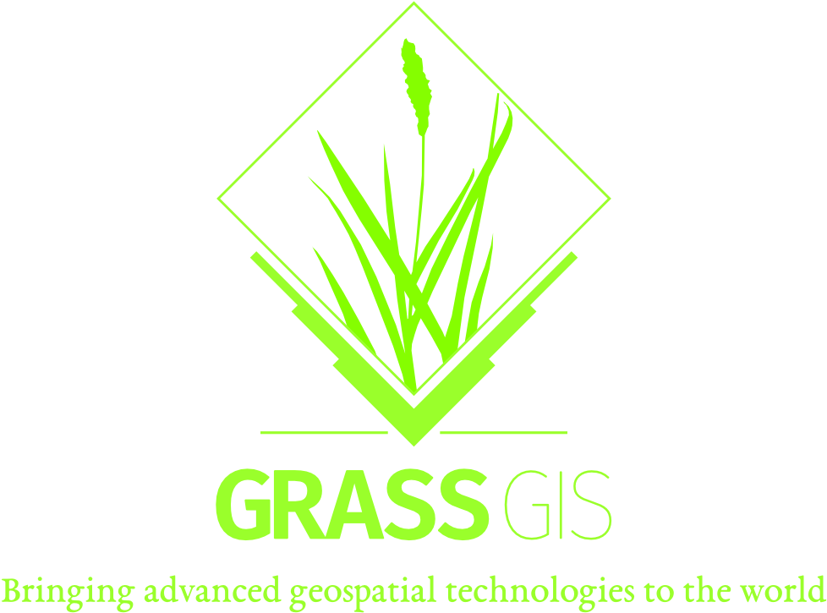
Da Vince Koyo:
Background: Geospatial and remote sensing.
formerly: Market and reasearch associate with focus on predictive modelling, location & Business intelligence and forecasting products.
currently: Consulting and studying
Generally: A tinkerer and a virtuoso

Slide 11
