Slide 1
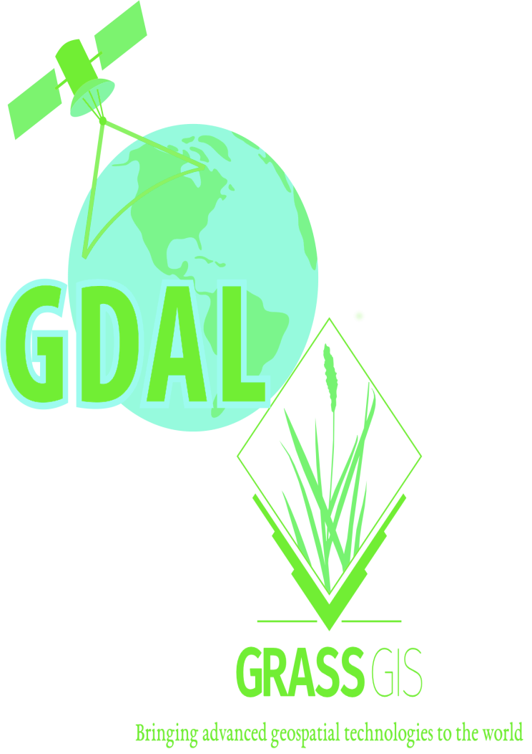

Slide 2
AN INTRODUCTION TO GDAL AND GRASS GIS
by Brian Pondi and Da Vince

Slide 3
Speakers:
Brian Pondi:
Da Vince Koyo(@koyo_jakanees)
Background: Geospatial and remote sensing.
formerly: Market and reasearch associate with focus on predictive modelling, location & Business intelligence and forecasting products.
currently: Consulting, VGI and studying
Generally: A tinkerer and a virtuoso

Slide 4
Introduction.
WHAT IS GRASS GIS AND GDAL ANYWAY? WHY CARE ABOUT THEM?
> Let's get the abbreviations out of the way.
>> GRASS GIS: Geospatial Data Abstraction Library [released in 1984]
>> GDAL: Geographic Resource Analysis Support System [released in 1998]
>> OGR: OGR Simple Feature Library, comes with GDAL (OpenGIS Simple Feature Reference Implementation)
> Both GDAL and GRASS GIS are member/projects under the Open Source Geospatial Foundation(OSGeo)
> Free and open source cross-platform and runs on major operating systems written in C, C++ with great python api bindings and wrappers
> Not as popular as QGIS and ArcGIS is with desktop users. Maybe cause they are more CLI oriented? Although grass offers a GUI through WxWidgets python api
> Provide tools for both raster and vector data reading, manipulation and processing

Slide 5
cont'd.
> You probably have been using them.
>> Fast, free, open, flexible and extensible software
>> Support and Interoperable with other OSGeo member projects such as QGIS, PostGIS among others.
>> Supported by some GIS service providers and incorporated in their solution stack.
>> Feature rich scriptable using CLI utilities
>> Run batch and bulk processes, a plus if familiar with any cli scripting language. Bash, Python, tcl, perl, php
> What the talk is not about.
>> A comparison between the two software
>> Promoting their use compared to others stack
> Who is without a flaw(s)?
>> Not really many articles/docs on the direct usage. The most common ones are using bindings or wrappers using other languages python, R, java, javascript
>> The CLI/text based interfaces can be daunting to beginners
>> Grass GUI and workflow can be involving if not used to it.

Slide 6
cont'd.
> Expected outcome.
>> To be comfortable with some of the common cmd
>> Perform some of basic spatial operations using both tool
>> Understanding of the various workflow.
>> Be dangerous enough to make your colleague think you're a hacker
>> Desirable: start chaining your analysis and processing into reproducible programs or scripts
> What the talk is not about.
>> A comparison between the two software
>> Promoting their use compared to others stack
> What to bring or consider:
>> Be aware of others >> Be open to all questions and viewpoints
>> Be friendly and patient >> Be understanding of differences
>> Be welcoming and respectful >> Be Kind and considerate to others

Slide 7
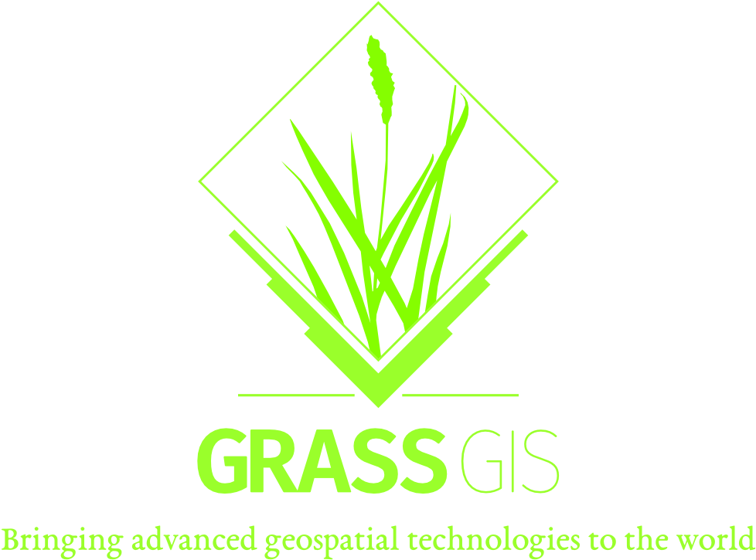
Grass temp:
Brian Pondi:
Da Vince Koyo:
Background: Geospatial and remote sensing.
formerly: Market and reasearch associate with focus on predictive modelling, location & Business intelligence and forecasting products.
currently: Consulting and studying
Generally: A tinkerer and a virtuoso

Slide 8


Gdal temp:
Brian Pondi:
Da Vince Koyo:
Background: Geospatial and remote sensing.
formerly: Market and reasearch associate with focus on predictive modelling, location & Business intelligence and forecasting products.
currently: Consulting and studying
Generally: A tinkerer and a virtuoso

Slide 9
