Slide 1
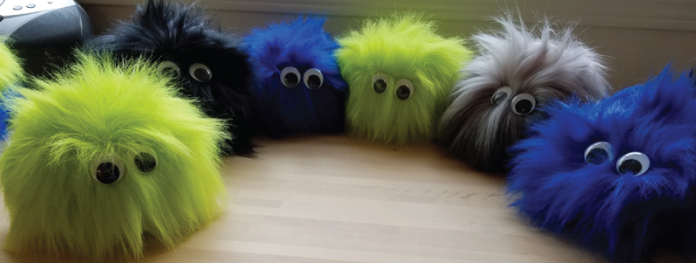
Fuzzing

Slide 2
What is fuzzing?
Sending input to an application, that the application is not expecting, to try to make it crash
Long strings of characters that might overflow a memory buffer
Weird characters that the application isn’t expecting
Malformed input files
Etc

Slide 3
Why fuzz?
I wanted to learn about fuzzing, to assist with my learning about exploit development
Exploitable code is commonly found via fuzzing
Especially if you don’t have access to the source code
We will be focusing on binary fuzzing
Web app fuzzing is another topic (although very common)

Slide 4
Why fuzz?
Some deep-in-code bugs are being found, that have been present for many years
I was curious about how they were being found
And why they weren’t found sooner
Basically, the only way to find these deep-in-code bugs is thru fuzzing
It is all but impossible to manually test all of the input combinations

Slide 5
Why fuzz?
Many security testers and researchers use fuzzing to find these deep-in-code vulnerabilities
Many software companies fuzz their products before they are released to market
3RD parties also fuzz companies products, to catch remaining bugs
Google Project Zero is famous
Other organizations as well
Many open-source projects are also being fuzzed by security researchers, to find and fix bugs in them

Slide 6
Disclaimer
Note that this is a very basic primer of fuzzing
You can go much deeper and further, expanding code coverage, etc
But my goal right now was just to learn the basics

Slide 7
Malformed input file fuzzing
Using the Zzuf tool, make random small changes to a file. The resulting file can then be fed into an application, to try to make it crash.
Image files
Documents, Pdf files
Etc

Slide 8
Malformed input file fuzzing
1) Modify some pictures a bunch of times
cat.* is cat pictures, not the linux cat command
2) Feed the modified pictures into an image converter, save error messages to log file
Image Magick, any others

Slide 9
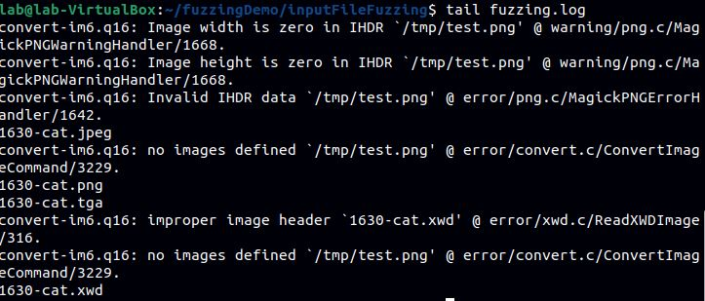
Malformed input file fuzzing
3) Look in the log file for segmentation faults

Slide 10
Malformed text entry fuzzing
Using AFL (American Fuzzy Lop)
Also the name of a rabbit breed, if you search for help for the tool
It takes text input via input files, and then morphs it to try to break things
It also tries to spider out through the code to hit all paths and get good coverage

Slide 11
Malformed text entry fuzzing
Warnings:
It requires at least 1 input that does not cause an error
And if an input causes an error, it will not try to morph that input further
bad json file = won’t try to further morph that json

Slide 12
Malformed text entry fuzzing
Run AFL on the binary
Specifying the directory that contains the input files
And the directory that AFL should put the output files to

Slide 13
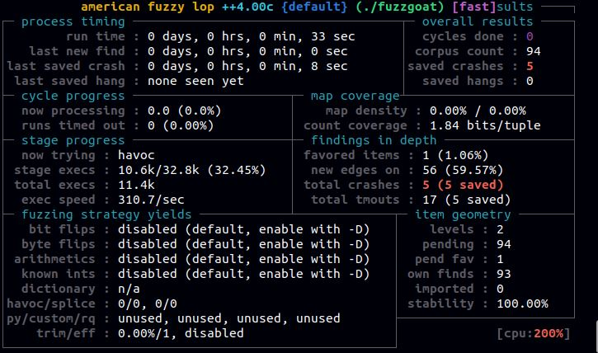
Malformed text entry fuzzing
AFL will show its progress
Note the total crashes counter in red on the right

Slide 14
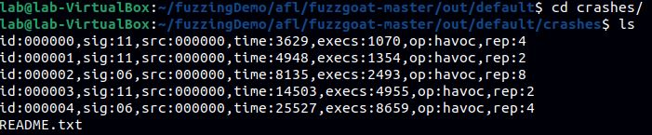
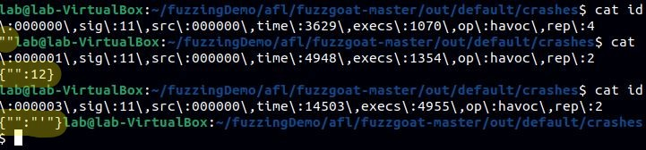
Malformed text entry fuzzing
AFL will put the crashes in files in the out/default/crashes directory
Each file will contain an input that caused a crash

Slide 15
Gui fuzzing
Not straight-forward like sending a command line argument or input file to an application
Instead have to simulate mouse clicks and keyboard strokes
To random places
Or to specific spots
No standard fuzzing tools available, since it needs to be so customized

Slide 16
Gui fuzzing – Demo
I made a simple python-based fuzzer
That clicks at random places within an application’s window
And tabs through the application’s gui elements, and sends random characters
Poc vulnerable c program
That does a segfault when the left button is clicked 3x
Or when “3” is entered into the middle textbox

Slide 17
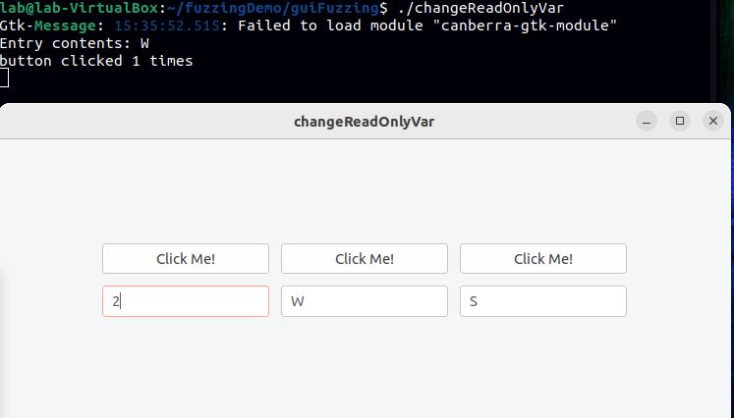
Gui fuzzing - Demo

Slide 18
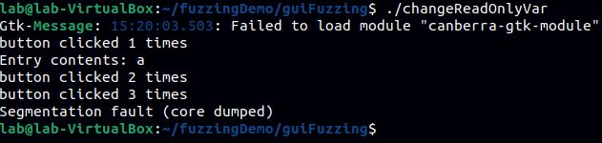
Gui fuzzing - Demo

Slide 19
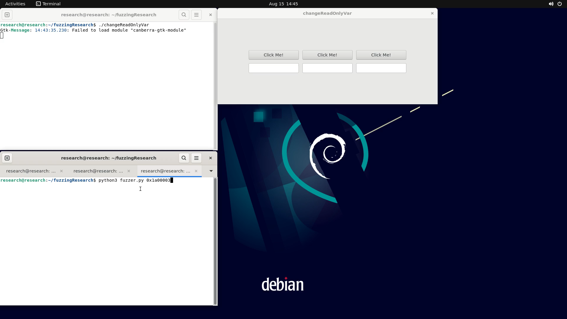
Gui fuzzing - Demo

Slide 20
Debugging
Not every crash / segfault is exploitable
There could be runtime or memory protections that prevent you from taking further control
The next step is to run the application through a debugger
To see what code section the application crashes in
To then see how you may be able to further exploit the code
Use the malformed input that caused the crash

Slide 21
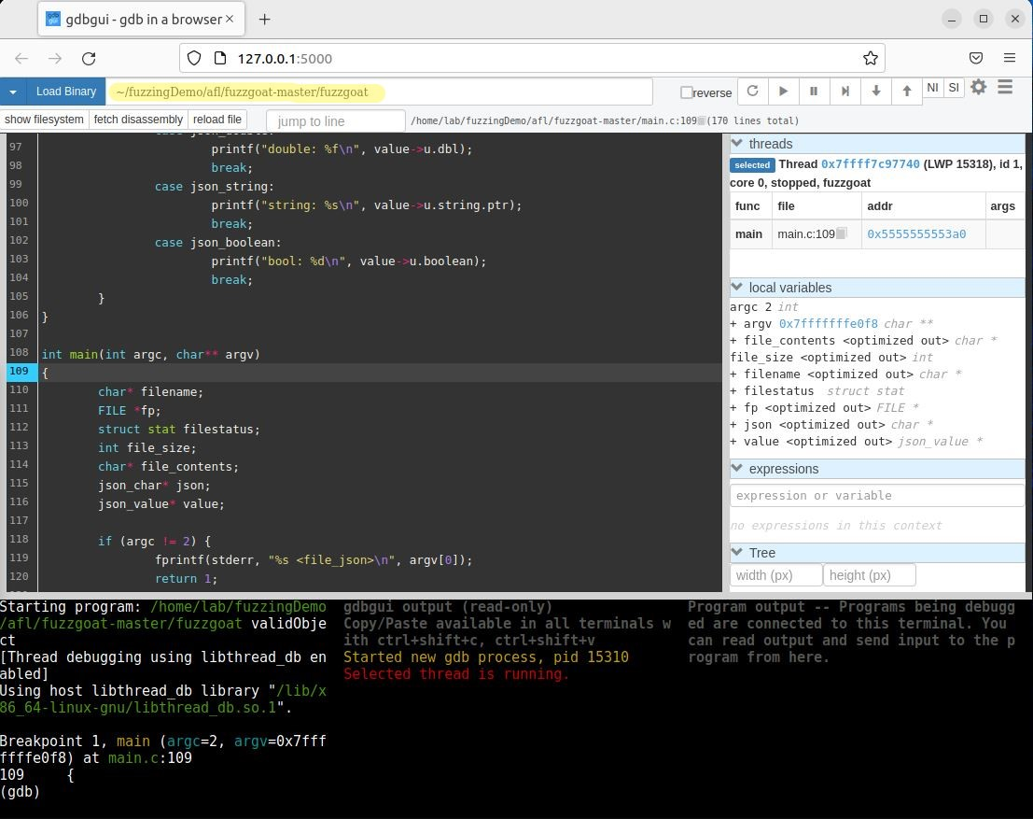
Debugging
Load the target binary

Slide 22
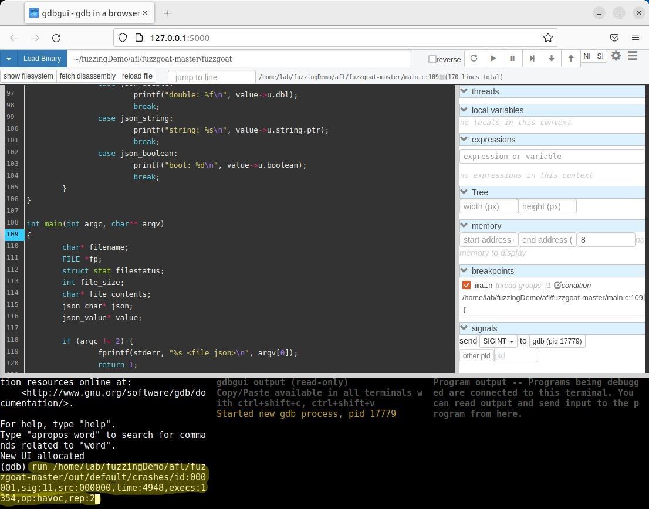
Debugging
Run the target binary, with the arguments that cause the crash

Slide 23
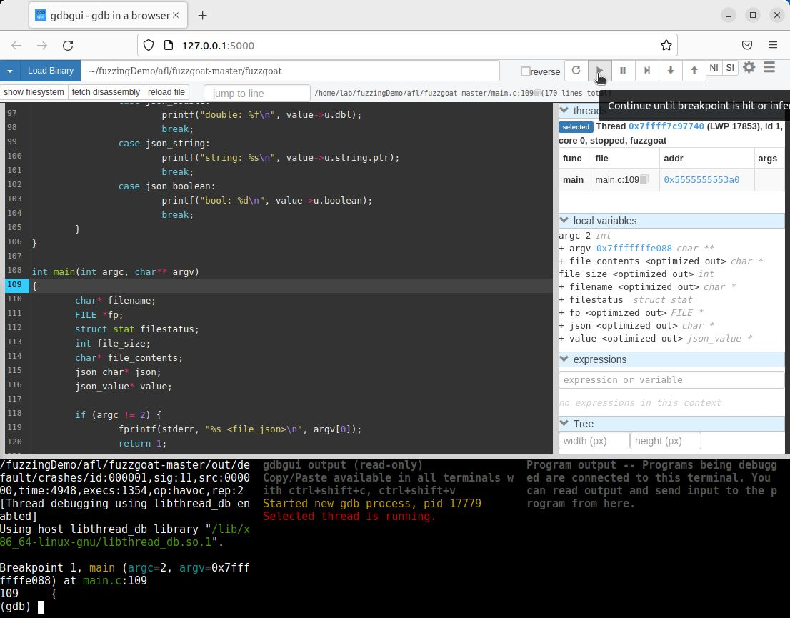
Debugging
Click the play button, and let it run

Slide 24
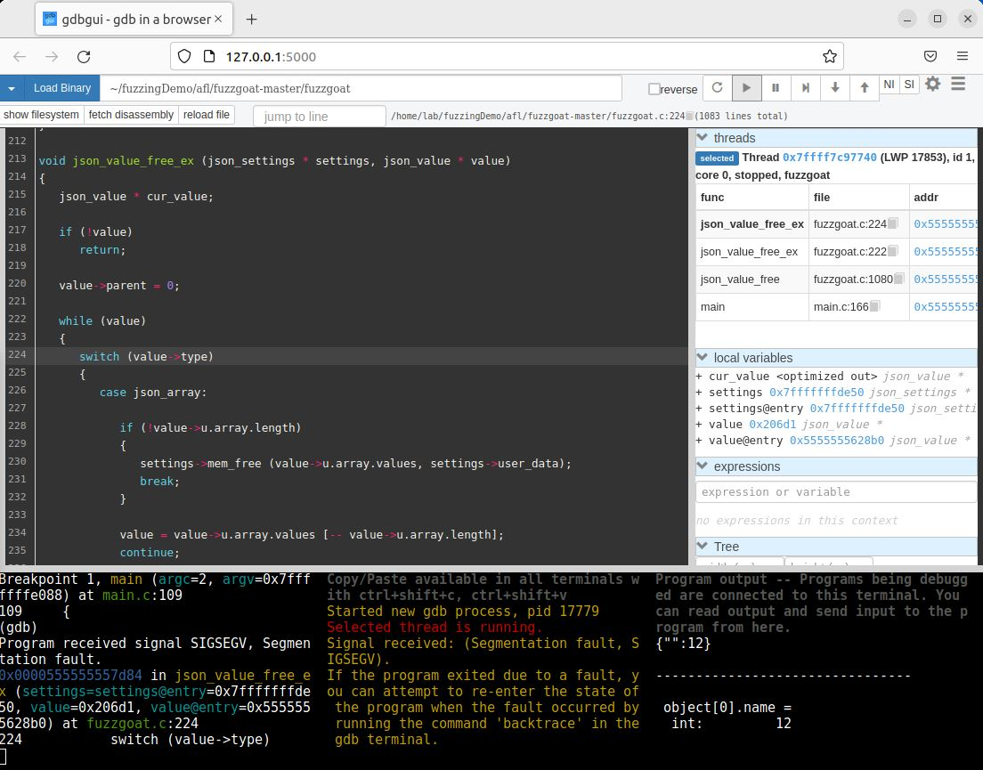
Debugging
When it crashes, it will stop at the line of code that caused the crash

Slide 25
Debugging
You can then investigate what the code did to cause the crash
But that is another massive topic for another presentation

Slide 26
Questions
?

