Slide 1
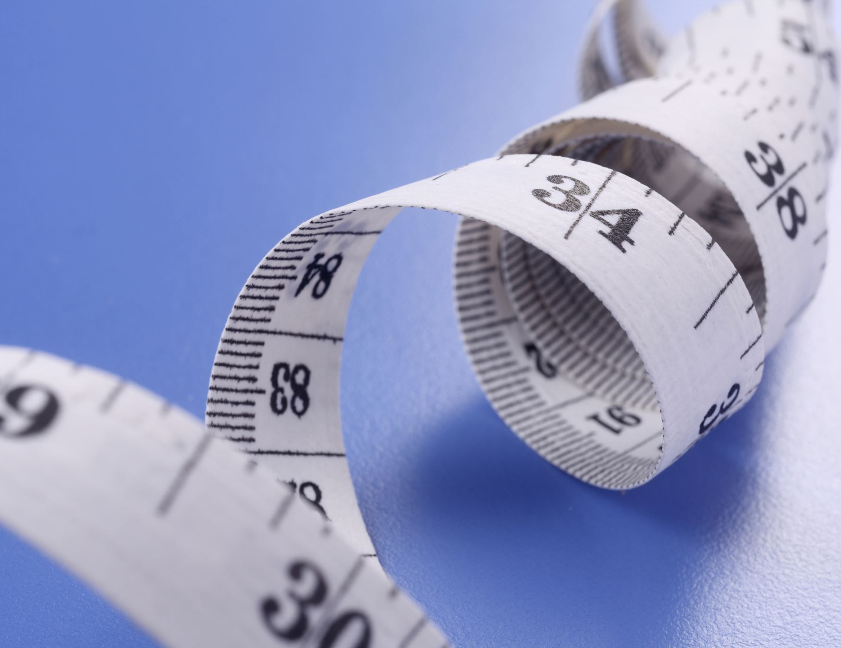

CALORIE INTAKE AND WEIGHT GAIN ANALYSIS
DERRICK NYAGESUKA DATA211 05/01/2025

Slide 2
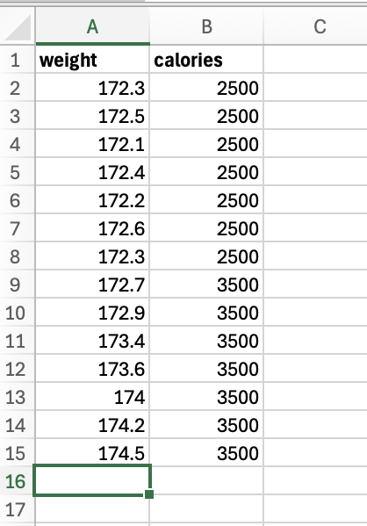
Question asked:
Does increasing calorie intake from 2500 to 3500 calories increase weight gain?
The body weight was the dependent variable.
Calorie intake was the independent variable.

Slide 3
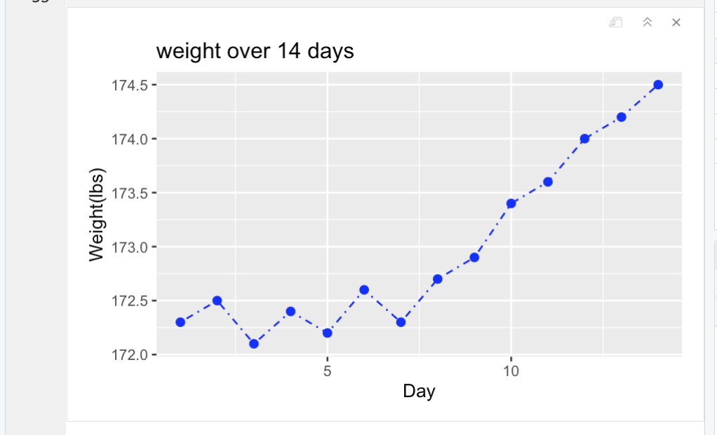
Line graph showing weight gain trend

Slide 4

Hypothesis testing
The question asked in this analysis is, does increasing my daily calorie intake from 2500 to 3500 calories for 7 days result in greater weight gain compared to maintaining 2500 calories for 7 days?
I chose the question as I needed to understand how calorie intake affects weight which is crucial for health and fitness goals and thought that a 1000 calorie surplus would be efficient to note any significant short term weight gain.

Slide 5
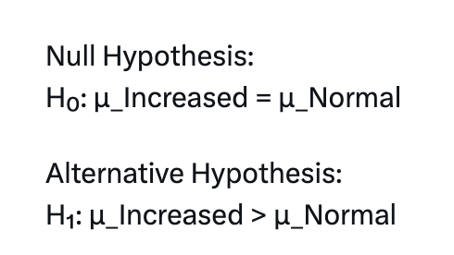
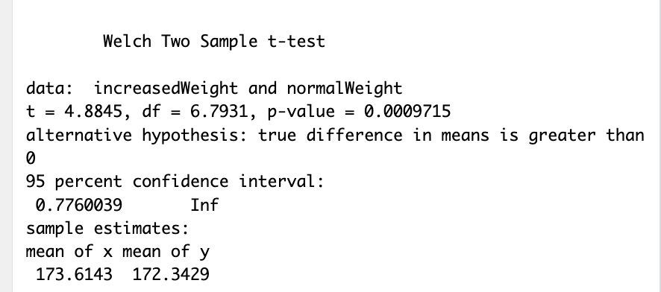

Slide 6
Conclusion
With a p-value of 0.0009715<0.05, at 5% significance level, I have enough evidence to reject the null hypothesis and conclude that increasing my calorie intake from 2500 calories to 3500 calories leads to greater weight gain.

