Slide 1


Mareket Srvice “Find all you need” REST API Service
Made by student of group SPU11 Pavlo Mryhlotskyi

Slide 2



Goals of the project
Exchange of commercial announcements
Sell and buy the items using the announcements exchange
Support business and marketing

Slide 3

Key features of the project
Register new user
Login/logout user
User session support
Add commercial or noncommercial announcements
Find announcements based on the next filters:
City in which seller is based
Category/subcategory which contains this announcement
Keywords, keyword or the part of the keyword which will be searched in: city, category, subject, contact person name, seller name etc
Found data are paged into smaller pieces to allow UI make paginated output of the data

Slide 4



Deployment and scalability
REST Service Docker Container
Installer
Docker based deployment is easy to deploy into very different ways:
Local Server or into the DataCenter
Cloud services like AWS, Google Cloud or Microsoft Azure which all support the Docker technology
On the local machine independently from the OS if it supports the Docker technology
Also it is easy to configure, maintain and publish, i.e. into GitHub VCS
MS SQL Docker Container

Slide 5
API Service structure
API Service
Image Controller
Get images from controllers
Cities Controller
Get cities to filter announcements
Items Controller
Get categories to filter announcements
Add announcement
Delete announcement
Filter and search announcements
Users Controller
Add user
Delete User
Get user preferences

Slide 6

Architecture: Repository
REST API Layer
Calls API endpoint
End User
Uses repositories from Wrapper
CRUD Operations
Repository 1 Repository 2 … Repository N
Calls Repository
Repository
Wrapper
Database

Slide 7


Repository Pattern: pros
Repository pattern splits Controller logic and DB CRUD operations. It gives us next pros:
Easy to maintain. We can easily find what is the root cause of the problem: Controller logic or DB CRUD operations
Easy to scale. Once we want to change the business logic inside of the Controller, we can change appropriate Repository or add new one
It makes a good split for API and CRUD layers.

Slide 8
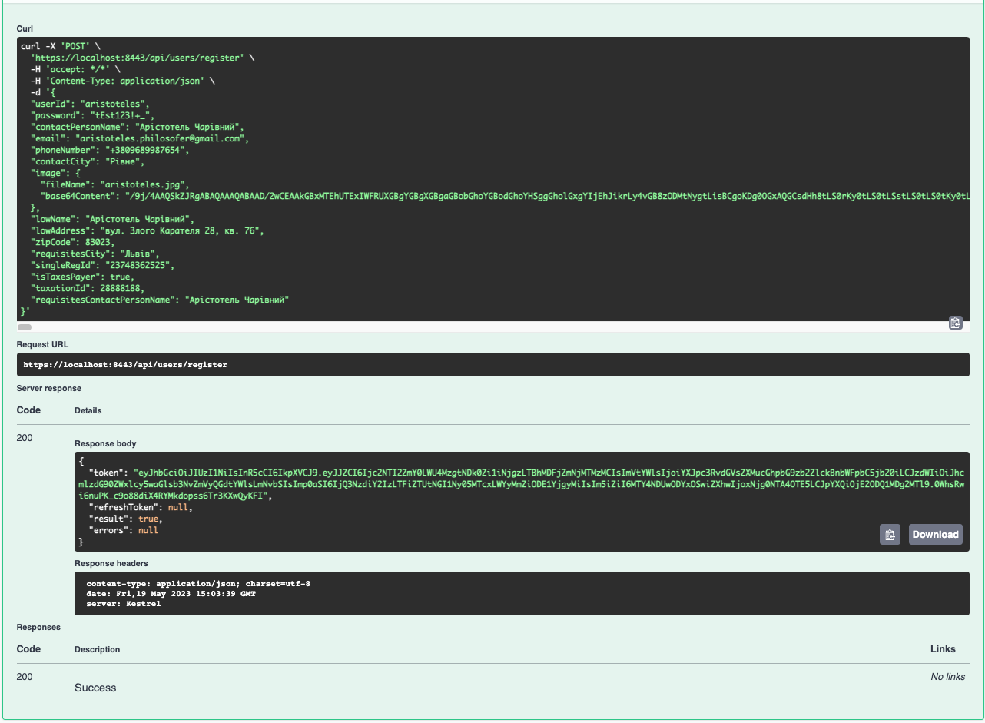
Key features: Create user

Slide 9
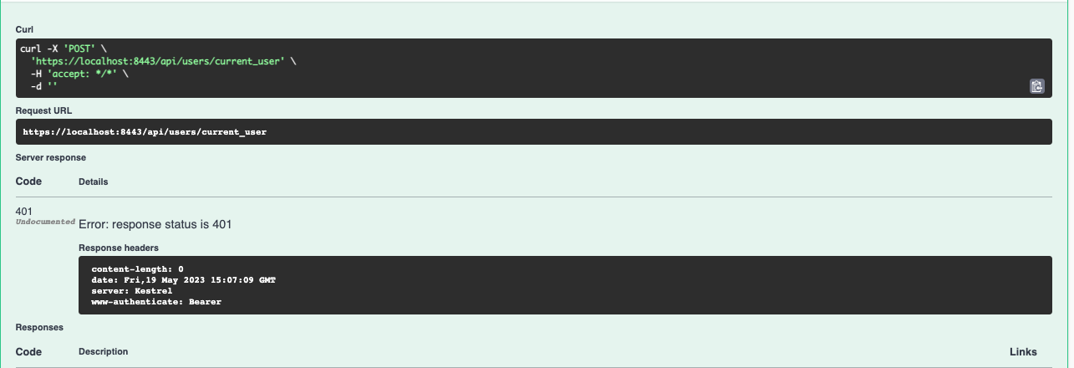
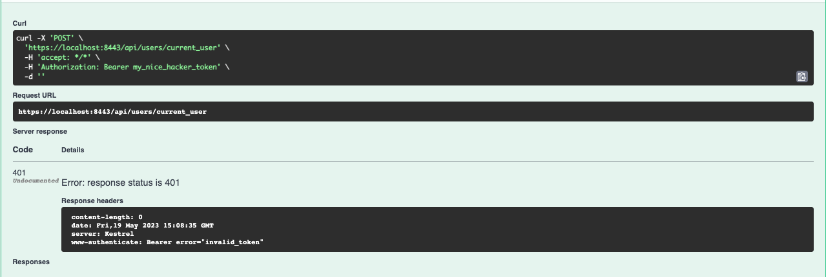
Key feature: User login. Action can be done only by authorized user

Slide 10
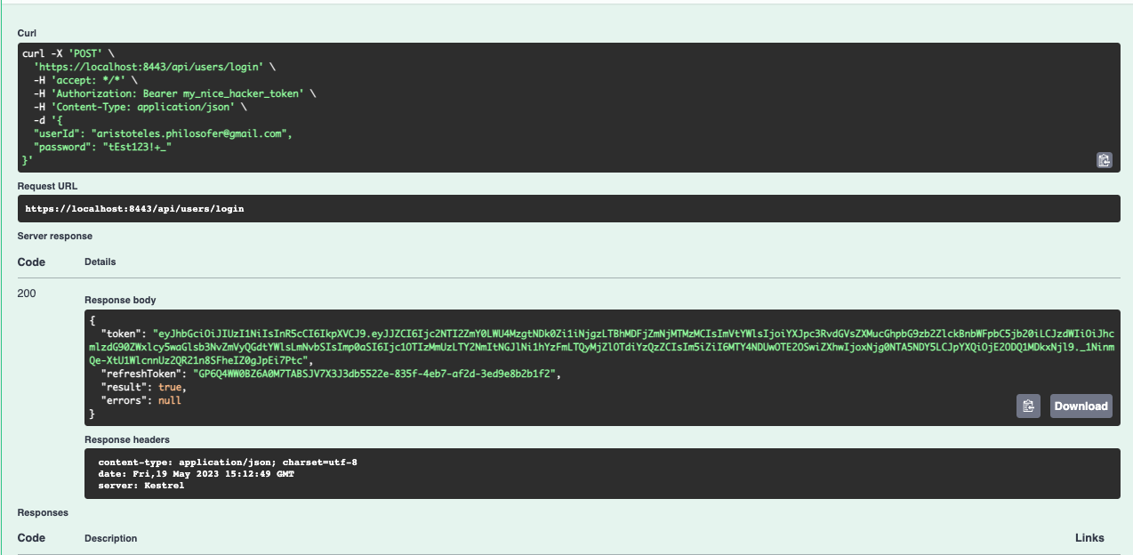
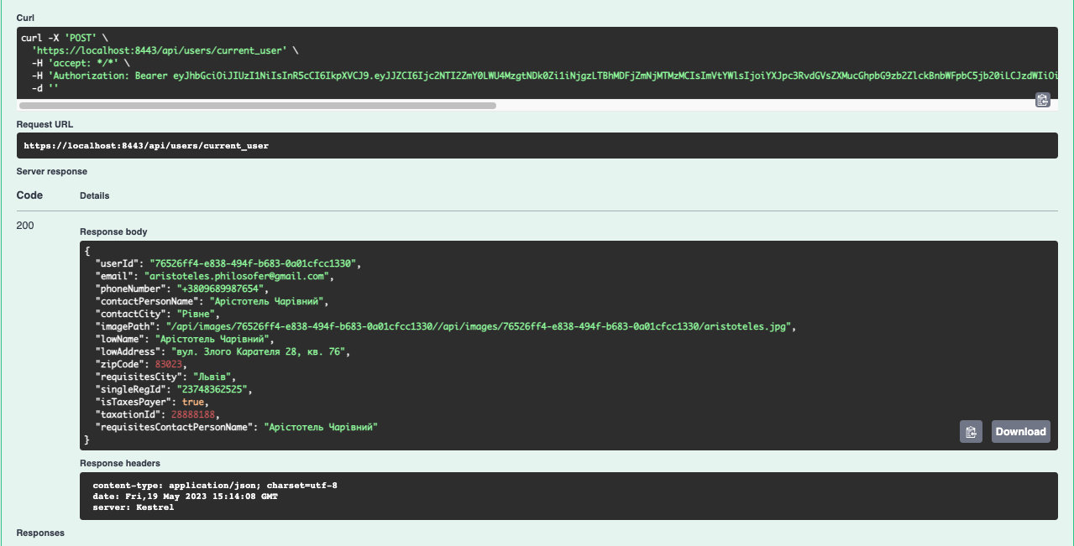
Key feature: User login

Slide 11
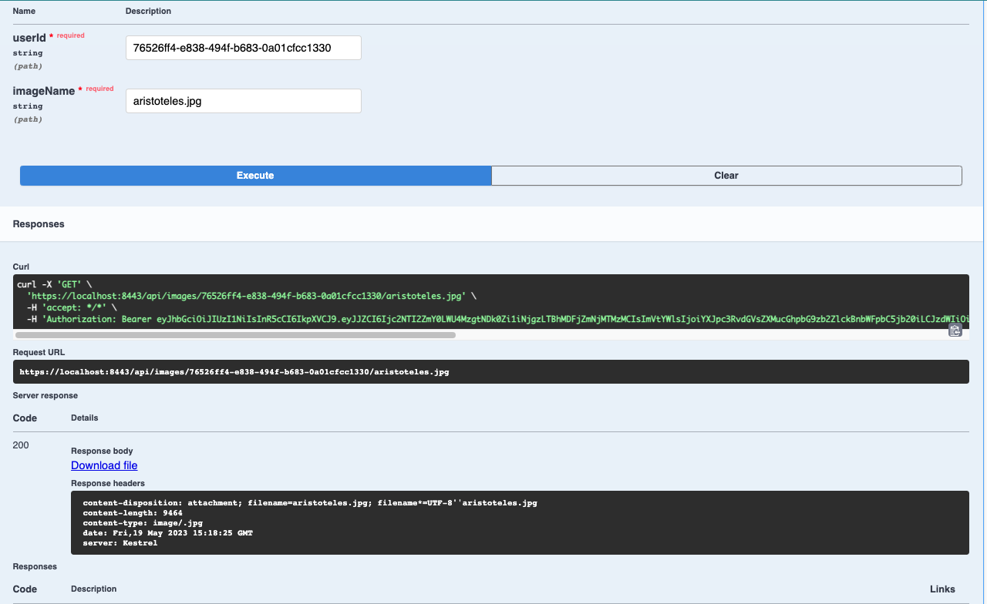
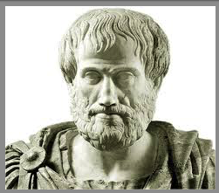
Key feature: Image Layer
After Download file is clicked

Slide 12
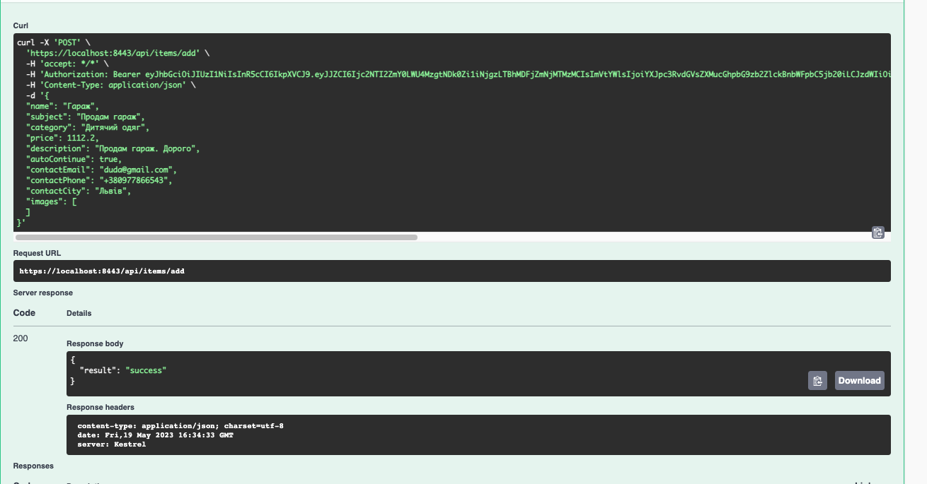
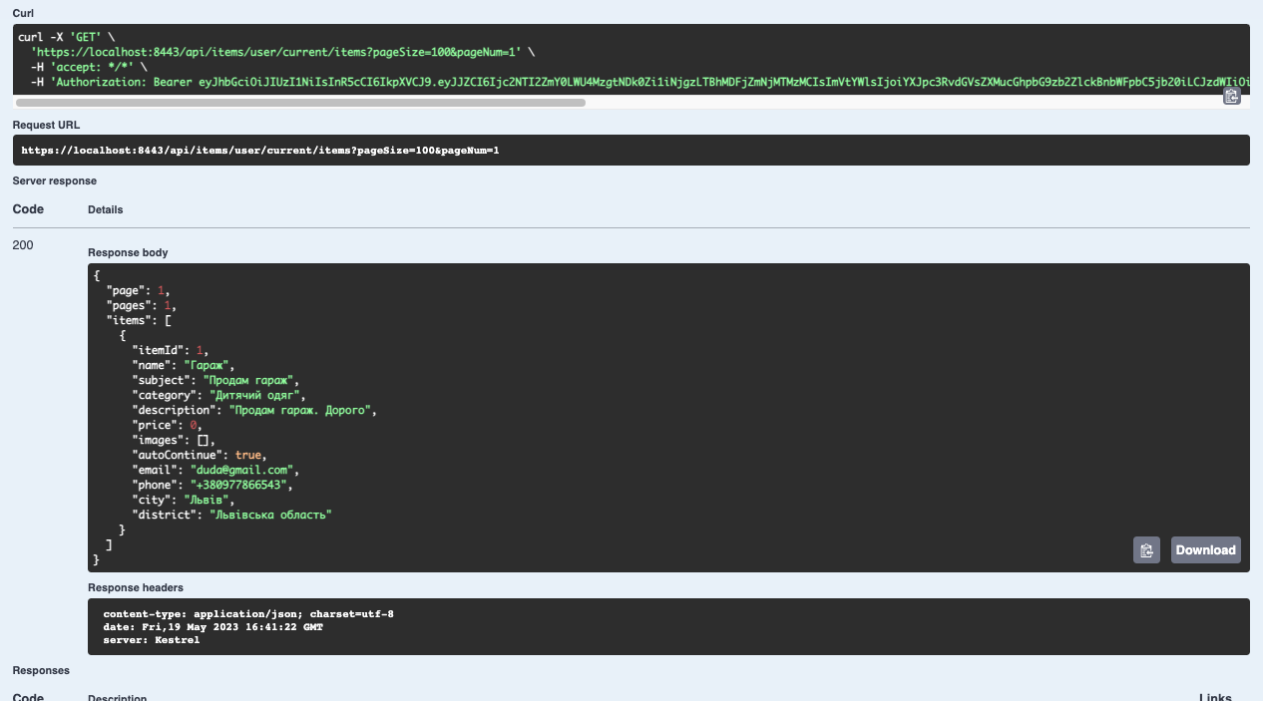
Key feature: Add market announcement

Slide 13
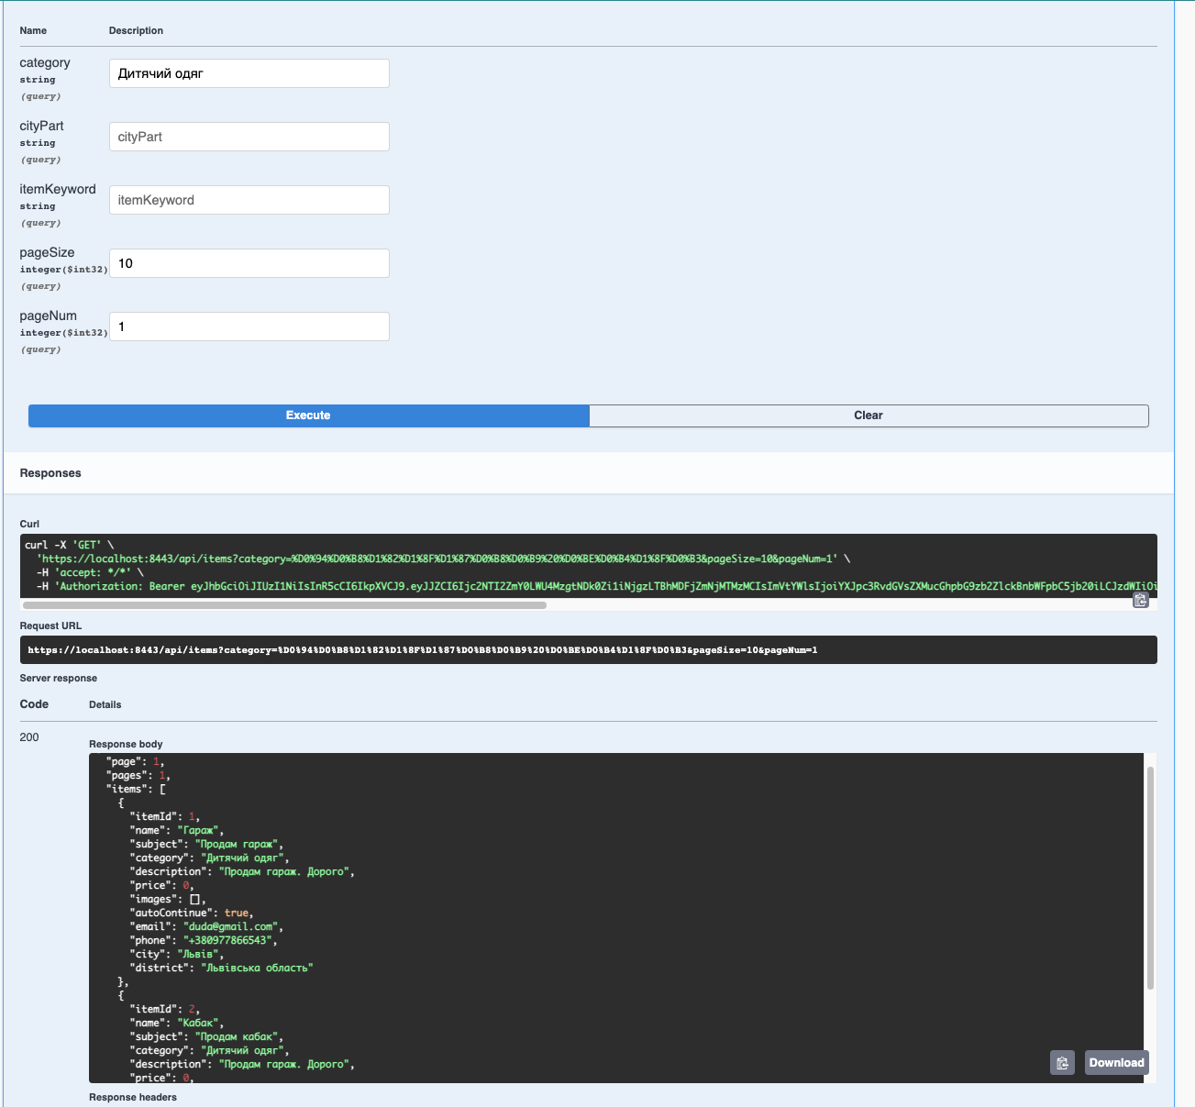
Key feature: Announcement search and filtering

Slide 14
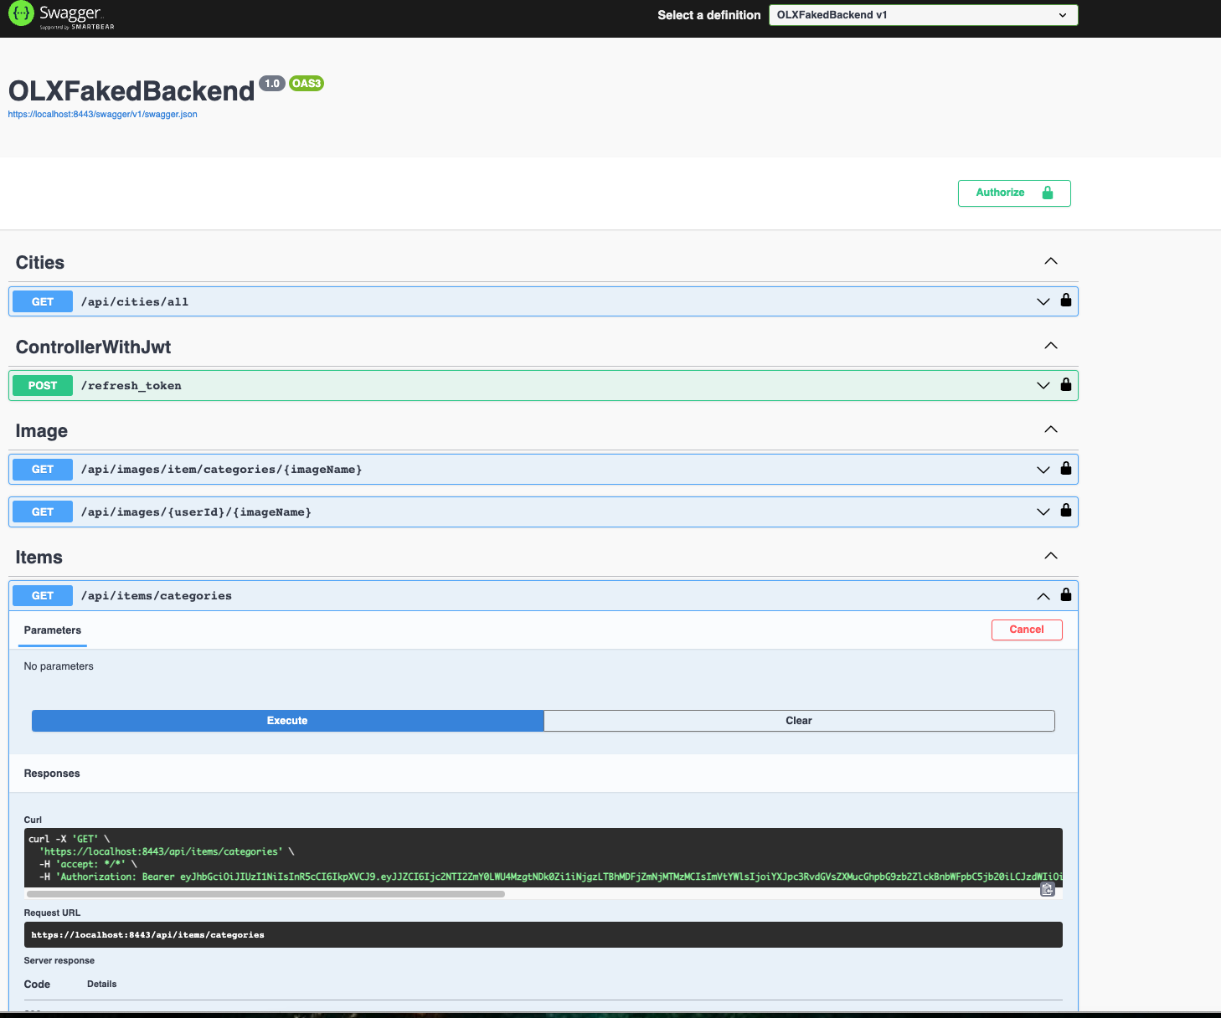
Swagger
After the installation swagger is available on the local machine: Swagger UI

Slide 15
Project GitHub
GitHub: https://github.com/kozakHolota/OLXFakedBackend.git
Documentation: file README.MD and folder Documentation

Slide 16

Q & A

