Slide 1
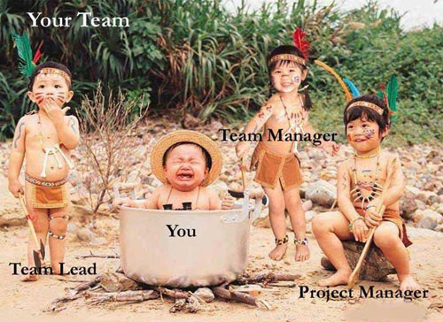
SLHS-SIM PIGS
By
Devika Pradhan
Michael Wu
Taoyue Zhang
Hang Yang

Slide 2
Week Preview
Week 3
Week 4
Week 5
Week 6
Week 9
Week 11
Week 12

Slide 3
Week 3

Slide 4
PROJECT
SLHS-VID started in Fall 2014. It is in partnership with the Speech Language and Hearing Sciences School.
We aim to make videos or modules that administer SLHS approved tests for students with Speech/Language/Hearing disability.
These videos are accompanied with quiz responses that determines the student’s level of understanding.

Slide 5
Issue
We have yet to get a clear picture of what our project partner’s requirements. Breaks in communication is a problem.
We need to determine where the previous group stopped coding so that we can pick up the trail and move on.
There are certain flaws in their project that the past members did point out for us that we need to look into.

Slide 6
Goals
Meet the project partner and get to know their needs
Meet all the previous semester’s team members.
Bring ourselves up to speed with all that has been accomplished in the past semester.

Slide 7
Week 4

Slide 8
PROGRESS
We have interviewed and documented the interviews with two of the past team members and our project partner.
We now have a fair idea of what prototype our project partner is looking for.
The videos should have a user friendly time stamp so that students using the simulation can easily reference earlier sets that is incorporated with an online grading

Slide 9
ISSUES
We need real simulation videos from the administrators.
We don’t have any grading rubric to incorporate in our program. We do have the exam’s scoring sheet – if we integrate this, then adding grading criteria later should be trivial.
We still don’t have a completely clear picture of what our project partner needs and how to implement it. We can, however, work with what they’ve given us and make small tweaks later.

Slide 10
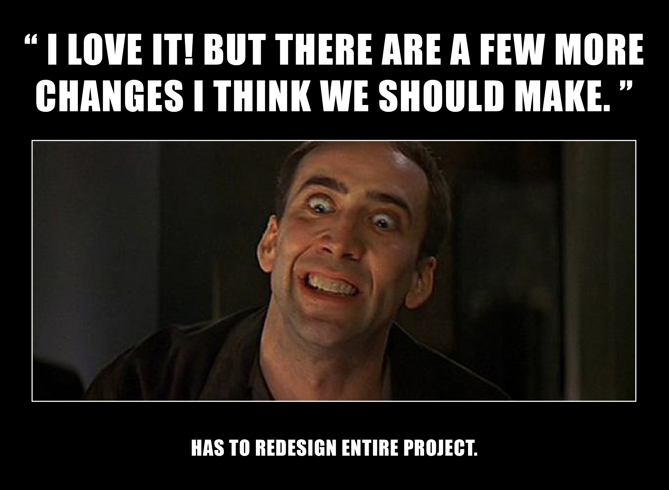

Slide 11
Week 5

Slide 12
GOALS from Week 3
Continue learning Java Script and Jquery
Start working on the designing of the web page. Have a fair idea of prototyping our project partner’s needs.
Continue studying the existing matter that we have.
Learning modules should have still life pictures and words in it. That makes learning a lot easier.

Slide 13
GOALS
Work on a mock grading criteria to determine how the subject fairs at the end of the set.
Prep up for the Design Review.
Get the simulation videos from our project partners.
Continue coding.

Slide 14
PROGRESS
We have started working on coding the pause and resume aspects of the videos by making use of standard functions and templates from the internet.
Finished up understanding what progress the past semester team had made.
Finalized what we are going to do for the design review

Slide 15
ISSUES
Getting a simulation from the SLHS Dept.
Need to find a way to prevent cheating and make the video transition rigid and not entirely user flexible.

Slide 16
Week 6

Slide 17
ISSUES
Last semester’s team left out several necessary prompts for the PPVT-IV test. These mostly consist of pre-test material (practice exam; starting point)
Need to clarify which “mode” of simulation to implement first.
Learning: Invalid student responses are corrected and do not count against student.
Assessment: Invalid student responses are tallied and corrected before moving on.
Due to additional prompts, the function that last semester’s team attempted to implement will need to be modified to deal with the new values.

Slide 18
GOALS
Work on a mock grading criteria to determine how the subject fairs at the end of the exam
For both the student taking the simulation (number of “correct” progression choices) and the subject taking the test (number of incorrect item responses)
Must compare correct student responses to actual student responses
Subject responses are predetermined by the video; however, a results page featuring a graph of the ‘actual’ test results and a graph of how the student scored the subject would be ideal for visual distinction
Complete prompt flow (pretest prompts -> first set -> progression choice -> second set -> … -> test results)
Revise semester project documentation and finish design review presentation

Slide 19
PROGRESS
We have got the tests for our project (some videos and paper tests), which the Fall 2014 SLHS-VID group spent entire semester on doing so
Mild design overhaul of webpage. Prompts are appearing at the correct times.
Started working on our design documentation for design review
Better intra-team organization

Slide 20
Week 9

Slide 21
GOALS
Work on getting the rubric programmed on the web-site.
Running the simulation video on the website we created for design review.

Slide 22
PROGRESS
All the members have viewed the PPVT video from the SLHS department and understand the remaining course of the project
Coding the rubric is under progress

Slide 23
ISSUES
Need to find way to parse set solutions from form, then compare to ‘correct’ set

Slide 24
Week 11

Slide 25
GOALS
Finalize parser, will have to decide on storage once we learn more about MySQL.
Running the simulation video on the website we created for design review.
Creating Database by learning and using MySQL.

Slide 26
PROGRESS
We started our process of learning about database and storing our PPVT-4 simulation video and answer keys (for performance feedback)
Set progression is now fully functional

Slide 27
ISSUES
Will probably have to change some data structures based on MySQL interfacing
Improve communication

Slide 28
Week 12

Slide 29
GOALS from Week 11
Finalize parser, will have to decide on storage once we learn more about MySQL.
Running the simulation video on the website we created for design review.
Creating Database by learning and using MySQL.

Slide 30
PROGRESS
Sorted out technical issues with the test video.
Met with Project Partner to discuss technical issues.
Redid the time stamps.
Database coding for a set of 12 questions for the administered test in MySQL

Slide 31
ISSUES
Spotting and fixing bugs.

Slide 32
Goals for WEEK 13
Making all the afore mentioned changes and replacing the dummy video with the actual video.
Presenting it to our Project partner for a rough feedback.

Slide 33
Week 13

Slide 34
Goals from WEEK 12
Making all the afore mentioned changes and replacing the dummy video with the actual video.
Presenting it to our Project partner for a rough feedback.

Slide 35
PROGRESS
Coding the database is in progress.
Met with Project Partner to discuss the format of questions.
All that remains to complete the basic website (no administration) is to error check the student’s answers and provide real-time feedback. Actual video is in place.

Slide 36
ISSUES
There are tiny issues with the video about displaying the questions, so we need to make a pop-up window at each time stamp or edit the video
A bunch of things need to be done manually.

Slide 37
Goals for WEEK 14
Finish coding with database (will likely need to use node or ajax)
Implement error-checking, visual feedback, charts/graphs
Start preparing for design review

Slide 38
Week 14

Slide 39
Goals from WEEK 13
Finish coding with database (will likely need to use node or ajax)
Implement error-checking, visual feedback, charts/graphs
Start preparing for design review

Slide 40
PROGRESS
Decided to use MySql to code for array/strong storage rather than other languages previously thought.
Doing the code for pop-up picture when the video pauses at each time stamp.
Decided to code only several things into database.

Slide 41
ISSUES
Issues when making pop-up picture
Not really familiar with github

Slide 42
Goals for WEEK 15
Continue coding different features into database
Preparing for design review

