Slide 1
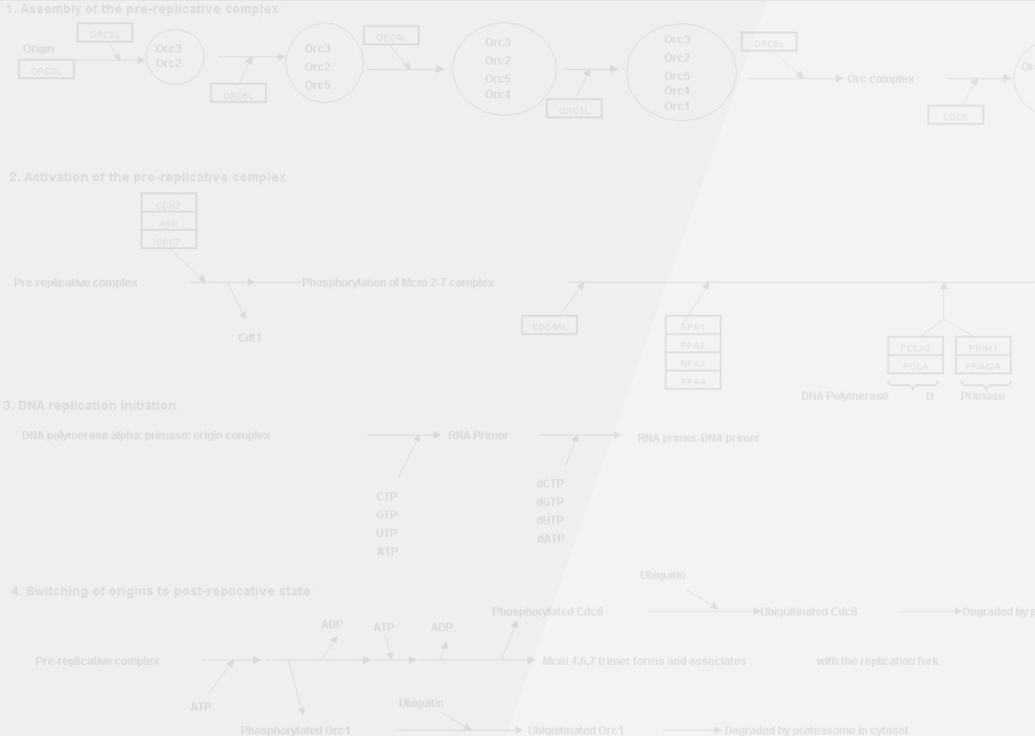
Gmml-Vision
The next generation
GennMapp visualisation tool

Slide 2
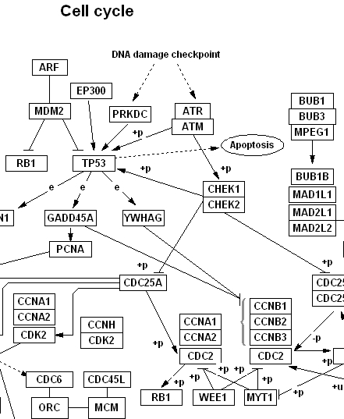
GenMapp
Pathway drawing tool
Written in VB
  Windows only
  Rather slow
Only visual data, no biological information

Slide 3
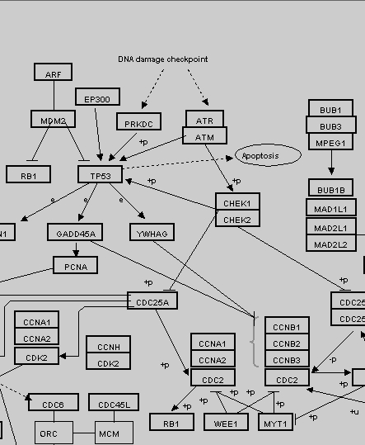
Gmml-Vision
Pathway drawing tool
Written in Java
  Platform independent
  Good with graphics
Will be extended with connections to include biological information
First steps are made to use Reactome data as input

Slide 4
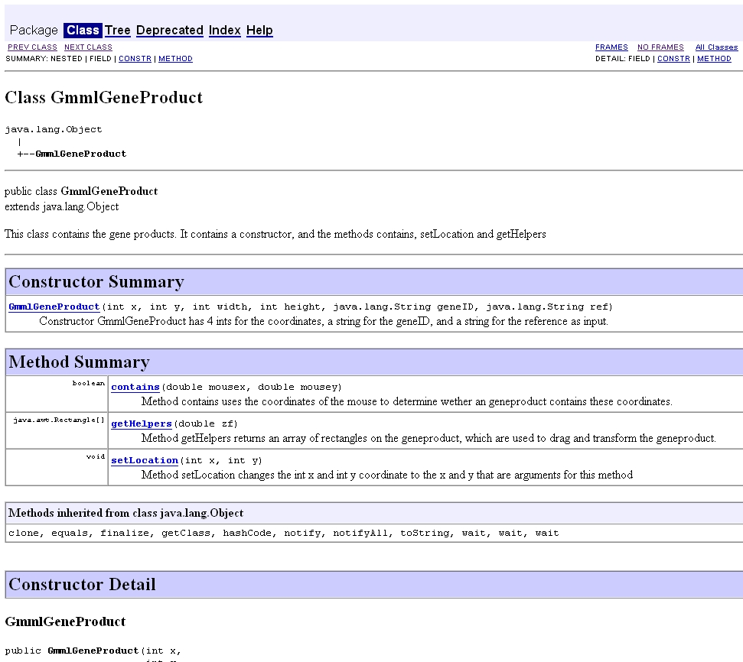
Documentation
Documentation is availabe, this will help with further development by third parties.

Slide 5
To Do
Finish and implement connections
Finish and implement automatic lay-out generation
Implement things like title, author, rotation,…
Including biological drawing conventions

Slide 6
Questions
Are there any questions?

Slide 7
Demonstration
Demonstration of Gmml-Vision mapp
Feel free to try and explore the possibilities of Gmml-Vision

