Slide 2
Biologically inspired algorithms Exercise 1
Ing. Lenka Skanderová, Ph. D.

Slide 3
Content
Objective function
Solution
Global vs. local extreme
Minimization, maximization
Blind search algorithm

Slide 4
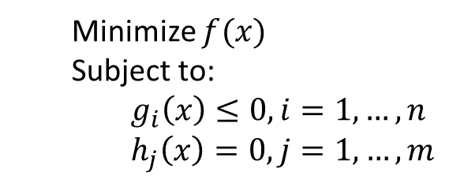
Optimization problems and objective function
Optimization problem
problem, where we are trying to find out the best solution from all feasible solutions
Standard form of the optimization problem:
In our exercises, we will solve unconstrained optimization problems
Minimize $f(x)$
Subject to:
$g_{i}\left(x\right)≤0, i=1, …, n$
$h_{j}\left(x\right)=0, j=1, …, m$
Objective function
Inequality constraints
Equality constraints

Slide 5
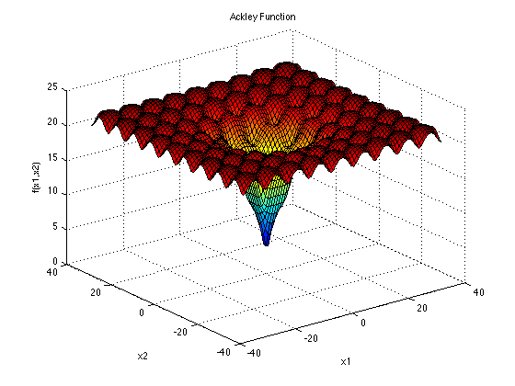
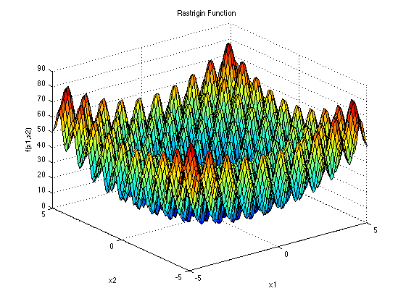
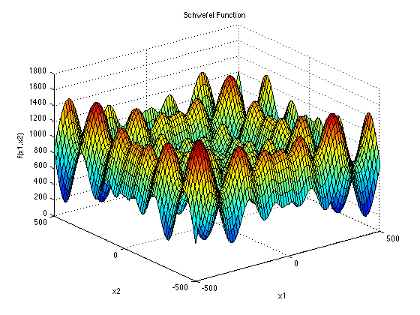
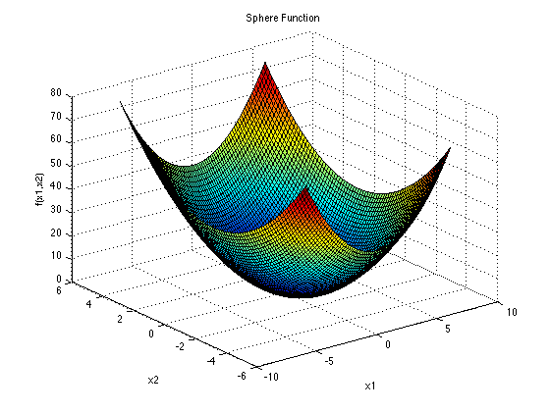
Optimization problems and objective function
Optimization problem
In our exercises, we will work with test functions representing the optimization problems

Slide 6
Optimization problems and objective function
Global vs. local extreme
Local extreme
Global extreme
We always want to find out the global extreme

Slide 7
Optimization problems and objective function
Unimodal vs. multimodal function
Unimodal function
Multimodal function

Slide 8
Optimization problems and solutions
Optimal and suboptimal solution
Each solution in the predefined space of solutions is solution of the problem
Ideally, the best solution equals to the global extreme
With higher dimension of the problem, it is harder to find out the global optimum
Evaluation of the objective function is the most expensive operation
Suboptimal solutions
Optimal solution

Slide 9

Optimization problems and solutions
dimension of problem
Solution representation
parameter of solution
Consider the following objective function:
$$f\left(\vec{x}\right)=\sum_{i=1}^{D}{x_{i}^{2}}$$
Dimension of problem equals to dimension of a solution, usually denoted as $D$
$x_{i}$ is the parameter of the solution, $\vec{x}=\{x_{1},x_{2},…,x_{D}\}$, each parameter has its lower and upper bound
We always search for a global optimum in the predefined space of possible solutions!
objective function
solution

Slide 10
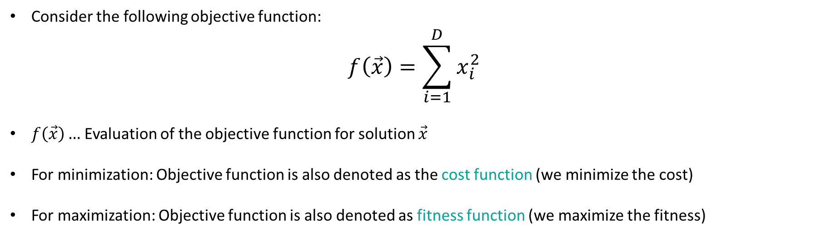
Optimization problems and solutions
Solution representation
Consider the following objective function:
$$f\left(\vec{x}\right)=\sum_{i=1}^{D}{x_{i}^{2}}$$
$f\left(\vec{x}\right)…$Evaluation of the objective function for solution $\vec{x}$
For minimization: Objective function is also denoted as the cost function (we minimize the cost)
For maximization: Objective function is also denoted as fitness function (we maximize the fitness)

Slide 11
Optimization problems and solutions
Solution representation in Python
import numpy as np
class Solution:
def __init__(self, dimension, lower_bound, upper_bound):
self.dimension = dimension
self.lB = lower_bound # we will use the same bounds for all parameters
self.uB = upper_bound
self.parameters = np.zeros(self.d) #solution parameters
self.f = np.inf # objective function evaluation
We will use this class for each algorithm in BIA

Slide 12

Optimization problems and solutions
Function representation in Python
import numpy as np
def __init__(self, name): self.name = name
We will use this class for each algorithm in BIA. The functions represent difficult optimization problems
Difficult optimization problems have usually a lot of parameters $→$ high dimensions
We do not need BIA to find out the solution of the function with 2 parameters

Slide 13
Optimization problems and solutions
Function representation in Python
import numpy as np
class Function:
def __init__(self, name): self.name = name
def sphere(self, params): sum = 0 for p in params: sum += p**2 return sum
Test function is prepared to accept the list of parameters, generally for D dimensions

Slide 14
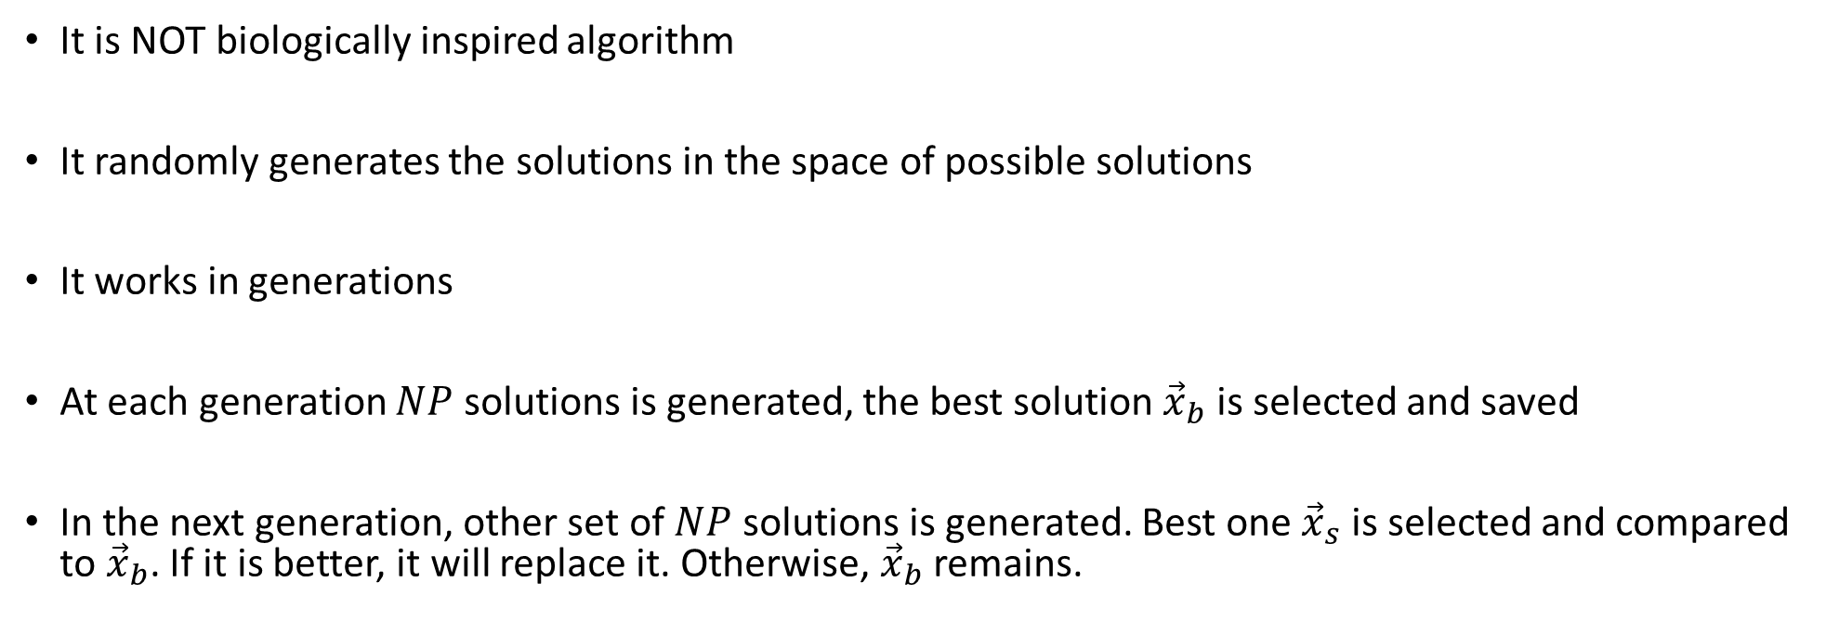
Blind Search
It is NOT biologically inspired algorithm
It randomly generates the solutions in the space of possible solutions
It works in generations
At each generation $NP$ solutions is generated, the best solution ${\vec{x}}_{b}$ is selected and saved
In the next generation, other set of $NP$ solutions is generated. Best one ${\vec{x}}_{s}$ is selected and compared to ${\vec{x}}_{b}$. If it is better, it will replace it. Otherwise, ${\vec{x}}_{b}$ remains.

Slide 15


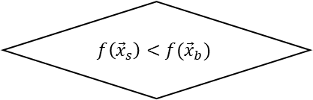




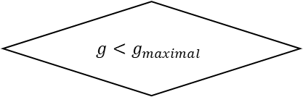
Blind Search - Algorithm
Start
Generate random solution ${\vec{x}}_{b}$
Evaluate solutions
Calculate $f({\vec{x}}_{b})$
Select best solution ${\vec{x}}_{s}$
$$g<g_{maximal}$$
No
$$f\left({\vec{x}}_{s}\right)<f({\vec{x}}_{b})$$
No
Return ${\vec{x}}_{b}$
End
Yes
Yes
Generate $NP$ solutions
$${\vec{x}}_{b}={\vec{x}}_{s}$$

Slide 16
Blind Search - Behavior
There is a lot of objective function evaluations
Lot of solutions are discarded (useless)
There is no communication between solutions
Worse solutions do not contribute to faster convergence
Ineffective even for small dimensions
Please, note the long delay

Slide 17
Task
Implement following functions:
Sphere, Ackley, Rastrigin, Rosenbrock, Griewank, Schwefel, Lévy, Michalewicz, Zakharov
Visualize functions in 3-dimensional space
Implement blind Search algorithm
Visualize the process of search for the global optimum in 3-dimensional space
Figure 1 represents the solution of Task
Figure 1: Blind Search used for Ackley function

Slide 18
Thank you for your attention
Ing. Lenka Skanderová, Ph.D.
EA 407
+420 597 325 967
lenka.skanderova@vsb.cz
homel.vsb.cz/~ska206

