Slide 1
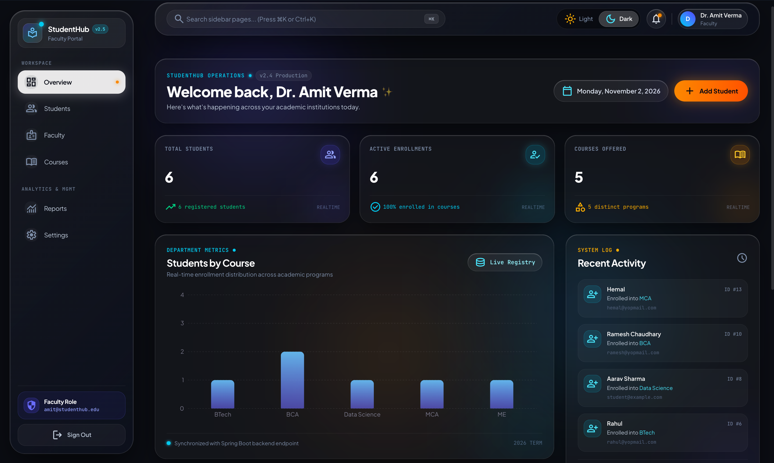
MCA SEMESTER 1 • CORE JAVA PROJECT (CAM5001C)
StudentHub v2.5
Enterprise Student
Management System
A full-stack, role-based academic portal featuring Spring Boot 4, Spring Security stateless JWT authentication, React 18 frontend, PostgreSQL, and deep Core Java Unit 2, 3 & 4 object-oriented integrations.
Stack: Java 25 / Spring Boot 4.1.2 • React 18 + Vite 8 • PostgreSQL • JWT RBAC • Tailwind CSS

Slide 2
ACADEMIC SCOPE & DOMAIN PURPOSE
CORE JAVA CAM5001C
Executive Project Overview
01 / Core Purpose
02 / Key Objectives
03 / Target Stakeholders
Centralized Portal: Engineered specifically for academic institutions to eliminate fragmented paper spreadsheets and legacy desktop registries.
Role Segregation: Provides dedicated administrative workspace for faculty and self-service profile dashboard for enrolled students.
Real-Time Tracking: Instant visibility over matriculation data, departmental faculty lists, and academic course allocations.
Enterprise Security: Stateless JWT token authentication guarding against CSRF, role spoofing, and privilege escalation.
High Scalability: Decoupled client-server architecture with Spring Boot REST API and optimized PostgreSQL relational storage.
Curriculum Alignment: Serves as a real-world exemplar demonstrating advanced Core Java concepts (OOP, multithreading, generics, collections).
Administrative Faculty: Full control to register matriculants, update academic status, query faculty registries, and export CSV reports.
Enrolled Students: Access personal profiles, view registered curriculum tokens, and update authorized contact info with zero risk of tampering.
Academic Evaluators: Audit code quality, OOP principles, exception handling, and enterprise deployment best practices.
StudentHub v2.5 Enterprise Architecture • Silver Oak College of Computer Application
02 / 22

Slide 3
OPERATIONAL & SECURITY DEFICIENCIES
CORE JAVA CAM5001C
Problem Statement: Challenges in Manual Student Records
Data Fragmentation & Inconsistency
Vulnerable Authorization & Privacy Violations
Decentralized Records: Colleges rely on disparate spreadsheets, physical registers, and isolated file drives, causing duplicate entries and desynchronized student profiles.
Lack of Validation: Without schema-level constraints, invalid email formats, mismatched phone numbers, and duplicate enrollments proliferate.
Unrestricted File Access: Shared spreadsheet files allow students to accidentally or maliciously modify grades, attendance, and peer data.
No Audit Logging: No traceability of who modified or deleted a record, posing severe institutional compliance and privacy hazards.
Administrative Overhead & Inefficient Retrieval
Absence of Student Self-Service
Manual Record Auditing: Faculty waste hours manually compiling department enrollments and verifying graduation eligibility lists.
Slow Student Verification: Locating individual student records requires traversing physical binders or multiple digital files without instant search indexing.
Bureaucratic Gatekeeping: Students must visit registrar counters in person even for basic contact updates or enrollment verification requests.
Delayed Communication: Changes in phone numbers or residential addresses take weeks to update in administrative registries.
StudentHub v2.5 Enterprise Architecture • Silver Oak College of Computer Application
03 / 22

Slide 4
STRATEGIC SYSTEM IMPLEMENTATION
CORE JAVA CAM5001C
Proposed Solution: StudentHub v2.5 Architecture
Role-Based Web Platform
Centralized PostgreSQL DB
Modern Cloud Deployment
Strict Role Separation: Dedicated portals for ADMIN (Faculty) and STUDENT. Students can never view or manipulate faculty administrative controls.
Automated Security Guard: Protected React routes mirror Spring Security @PreAuthorize rules, instantly redirecting unauthorized attempts.
ACID Compliance: Neon PostgreSQL handles student matriculation and faculty data with complete transactional integrity.
Hibernate JPA Mapping: Automated schema sync and unique email index preventing duplicate student registrations across departments.
Decoupled Hosting: High-performance React frontend deployed on Vercel Edge; robust Spring Boot backend on AWS EC2.
Secure Nginx Gateway: SSL/TLS termination, reverse proxy routing, and CORS policy enforcement safeguarding all API traffic.
StudentHub v2.5 Enterprise Architecture • Silver Oak College of Computer Application
04 / 22

Slide 5
VERIFIED PRODUCTION CAPABILITIES
CORE JAVA CAM5001C
Implemented Features & Functionalities Matrix
Admin / Faculty Management Module
Student Self-Service Portal
Student Directory & Full CRUD: Create, view, edit, and delete student records with modal dialogs and live confirmation prompts.
Real-time Search & Filter: Filter students instantly by course (MCA, BCA, B.Tech, etc.) and search by name or email.
Faculty Staff Directory: Manage faculty members, departmental assignments, and institutional contacts.
Personalized Dashboard: Displays enrolled degree program, matriculation identifier token, and academic status.
Profile Self-Service: Direct in-place updates for authorized phone and contact fields via /api/students/me.
Credential Security: Self-service password rotation with BCrypt hash verification.
Analytics & Institutional Reporting
Core Java Academic Integrations
Visual Distribution Charts: Recharts-powered enrollment bar/pie charts displaying student distribution across academic streams.
CSV Export Engine: Client-side export utility generating structured CSV reports from matriculation databases.
System Metrics Feed: Live dashboard counter cards for total students, faculty count, and active courses.
Unit 2 OOP Demonstrations: Classes, constructor overloading, 'this'/'super', interfaces, and method overriding.
Unit 3 Multithreading & Exceptions: Custom DuplicateEmailException, thread lifecycle monitoring, and string mutability demos.
Unit 4 Generics & Collections: StudentBox<T> generic container, wildcard bounds, and Map/Set/List data structures.
StudentHub v2.5 Enterprise Architecture • Silver Oak College of Computer Application
05 / 22

Slide 6
FULL-STACK ENGINEERING STACK
CORE JAVA CAM5001C
Complete Technology Stack Specifications
FRONTEND
BACKEND
DATABASE
DEVOPS & CLOUD
• React 18 (Functional Components, Hooks)
• Vite 8 (High-speed HMR Bundler)
• Tailwind CSS + Glassmorphism UI
• React Router DOM v6/v7 (Guards)
• Recharts & React-Toastify Alerts
• Java 25 (LTS compatible 17+)
• Spring Boot 4.1.2 Web MVC
• Spring Security 6.x (Stateless)
• Spring Data JPA & Hibernate ORM
• jjwt 0.12.6 (HMAC-SHA256 Signing)
• Neon PostgreSQL 16 (Serverless Cloud)
• Spring Data JPA Repository Layer
• Automatic Schema DDL Migrations
• Unique Indexes on Email Identifiers
• Connection Pooling via HikariCP
• AWS EC2 (Ubuntu 22.04 LTS)
• Nginx HTTP Reverse Proxy
• Vercel Edge Platform (Frontend)
• Systemd Linux Service Manager
• Let's Encrypt SSL/TLS Certificates
StudentHub v2.5 Enterprise Architecture • Silver Oak College of Computer Application
06 / 22

Slide 7
LAYERED CLIENT-SERVER PIPELINE
CORE JAVA CAM5001C
System Architecture: End-to-End Technical Flow
Client Tier
React 18 SPA
(Vite + Tailwind)
Client State / UI
Security Filter
JwtAuthenticationFilter
Token Extraction
HMAC-SHA256 Check
Controller Tier
REST Controllers
@PreAuthorize Check
DTO Validation
Service Layer
Business Logic
StudentService
FacultyService
Persistence Tier
Spring Data JPA
HikariCP Connection
PostgreSQL 16
Key Architectural Principles
Stateless Authentication: No server sessions (SessionCreationPolicy.STATELESS). Scalable horizontally without sticky sessions.
Encapsulation & DTO Pattern: Direct entity exposure is strictly prevented. Sensitive user password hashes never leak across the REST interface.
Centralized Exception Handling: GlobalExceptionHandler intercepts ResourceNotFoundException and MethodArgumentNotValidException into structured JSON responses.
StudentHub v2.5 Enterprise Architecture • Silver Oak College of Computer Application
07 / 22

Slide 8
USER INTERACTION & ROUTE GUARDS
CORE JAVA CAM5001C
Application Workflow: Role-Based User Journey
Step 1: Portal Entry
User accesses /login.
Choice between Sign In and Student Registration.
Enters email + password.
Step 2: JWT Issuance
AuthService verifies BCrypt hash.
Encodes sub: email and role: ADMIN / STUDENT.
Returns JWT token.
Step 3: Route Guard
ProtectedRoute inspects role claim.
ADMIN directed to /dashboard.
STUDENT routed to /student-dashboard.
Step 4: Operations
ADMIN manages student CRUD, faculty, and reports.
STUDENT views personal profile & updates contact.
Step 5: Session Termination
User logs out.
JWT token purged from localStorage.
Immediate redirect to login portal.
Security & Error Handling During Journey
Automatic Redirection: Logged-in users visiting /login are immediately redirected to their respective dashboard by LoginRoute.
Tamper Resistance: If a STUDENT attempts to manually navigate to /students or /faculty, ProtectedRoute aborts navigation and routes back.
Token Expiration: JWT expiration (24h) is verified on every request. Expired tokens trigger 401 Unauthorized, returning user safely to login.
StudentHub v2.5 Enterprise Architecture • Silver Oak College of Computer Application
08 / 22

Slide 9
POSTGRESQL ENTITY-RELATIONSHIP DESIGN
CORE JAVA CAM5001C
Database Schema: Relational Entity Structure
Table: app_users
Table: students
Table: faculties
id: BIGINT (PK, Auto-inc)
name: VARCHAR(255) NOT NULL
email: VARCHAR(255) UNIQUE NOT NULL
password: VARCHAR(255) NOT NULL (BCrypt)
role: VARCHAR(50) NOT NULL ('STUDENT'/'ADMIN')
id: BIGINT (PK, Auto-inc)
name: VARCHAR(255) NOT NULL
email: VARCHAR(255) UNIQUE NOT NULL
course: VARCHAR(100)
phone: VARCHAR(50)
gender: VARCHAR(20)
birthdate: VARCHAR(50)
id: BIGINT (PK, Auto-inc)
name: VARCHAR(255) NOT NULL
email: VARCHAR(255) UNIQUE NOT NULL
faculty_id: VARCHAR(100) UNIQUE NOT NULL
department: VARCHAR(100) NOT NULL
phone: VARCHAR(50)
Integrity Constraints & Indexing Strategy
Unique Email Invariance: email columns across all three tables carry UNIQUE database constraints preventing duplicate registrations.
Logical Identity Binding: app_users and students/faculties correlate via verified unique email. Students can only update records matching their email.
StudentHub v2.5 Enterprise Architecture • Silver Oak College of Computer Application
09 / 22

Slide 10
SPRING BOOT MODULAR DESIGN
CORE JAVA CAM5001C
Backend Architecture: Spring Boot Layered Hierarchy
Layer Responsibilities
Actual Backend Package Structure
1. REST Controllers: AuthController, StudentController, FacultyController manage HTTP requests and route payloads to service layer.
2. Service Layer: StudentService, FacultyService, AuthService enforce business rules, password encryption, and authorization checks.
3. Repository Layer: Spring Data JPA repositories (StudentRepository, AppUserRepository, FacultyRepository) execute optimized queries.
4. Security & DTOs: JwtAuthenticationFilter validates bearer tokens; request DTOs enforce @NotBlank and @Email validation.
com.studentmanagement.backend
├── config
│ └── FacultyDataInitializer.java (DB Seeder)
├── controller
│ ├── AuthController.java
│ ├── FacultyController.java
│ └── StudentController.java
├── dto
│ ├── auth (Login, Register, ChangePassword)
│ └── faculty (FacultyRequest)
├── exception
│ ├── GlobalExceptionHandler.java
│ └── DuplicateEmailException.java
├── model (Student, Faculty, AppUser)
├── repository (Student, Faculty, AppUser)
├── security (SecurityConfig, JwtService, Filter)
├── service (Student, Faculty, Auth, UserDetails)
└── concepts (Core Java Units 2, 3 & 4 Demos)
StudentHub v2.5 Enterprise Architecture • Silver Oak College of Computer Application
10 / 22

Slide 11
MODULAR COMPONENT ARCHITECTURE
CORE JAVA CAM5001C
Frontend Architecture: React + Vite Component Model
Component Architecture & State
Actual Frontend Folder Structure
Role-Based Routing: AppRoute.jsx configures createBrowserRouter with ProtectedRoute and LoginRoute guard wrappers.
DashboardLayout & Navigation: Shared dashboard shell with responsive Sidebar.jsx, Topbar.jsx with user profile pills, and MobileSidebar.jsx.
Feature-Driven Modularization: Modules segregated into features/ (auth, students, faculty, dashboard, courses, reports, settings).
Modern Glassmorphism UI: Styled using Tailwind CSS with custom glass-panel classes and dark navy palette.
frontend/src
├── app
│ ├── App.jsx & routes.jsx
│ └── Routes
│ ├── AppRoute.jsx (Route definitions)
│ └── ProtectedRoute.jsx (RBAC Guard)
├── components
│ ├── layout (DashboardLayout, Sidebar, Topbar)
│ └── shared (PageHeader, LoadingScreen)
├── features
│ ├── auth (Login.jsx, LoginForm.jsx, authService.js)
│ ├── dashboard (Dashboard.jsx, StudentDashboard.jsx)
│ ├── students (Students.jsx, StudentTable, Dialog)
│ ├── faculty (Faculty.jsx, facultyService.js)
│ ├── courses (Courses.jsx)
│ └── reports (Reports.jsx)
├── services (api.js Axios client with JWT interceptor)
└── styles (globals.css, glassy.css, index.css)
StudentHub v2.5 Enterprise Architecture • Silver Oak College of Computer Application
11 / 22

Slide 12
ENTERPRISE SECURITY IMPLEMENTATION
CORE JAVA CAM5001C
Authentication & Security: Stateless JWT & RBAC
01 / Token Issuance
02 / Request Filtering
03 / Role Authorization
BCrypt Verification: Passwords verified via BCryptPasswordEncoder. Raw credentials never stored.
Cryptographic Signing: jjwt 0.12.6 generates HMAC-SHA256 signature using 256-bit secret key.
Embedded Claims: Token embeds subject (email), role (ADMIN/STUDENT), and 24-hour expiration timestamp.
JwtAuthenticationFilter: Intercepts every HTTP call before UsernamePasswordAuthenticationFilter.
Context Injection: Builds UsernamePasswordAuthenticationToken and populates SecurityContextHolder with authorities.
Stateless Guarantee: SessionCreationPolicy.STATELESS ensures server maintains zero session state.
Method Security: @PreAuthorize("hasRole('ADMIN')") protects /api/students and /api/faculty.
Ownership Verification: In StudentController, authenticated principal email must match record email for student updates.
CORS Whitelisting: Strict CORS permits only authorized localhost and production Vercel frontend origins.
StudentHub v2.5 Enterprise Architecture • Silver Oak College of Computer Application
12 / 22

Slide 13
REGISTRY OPERATIONS & DATA INTEGRITY
CORE JAVA CAM5001C
Student Management Module: Full CRUD Architecture
CREATE (POST /api/students)
READ (GET /api/students)
• Admin fills modal form (Name, Email, Course, Phone, Gender, Birthdate)
• Bean Validation checks @NotBlank and @Email
• StudentRepository.save() persists new matriculant
• Fetches complete matriculation directory
• Frontend allows dynamic search by name/email
• Course filter buttons (All, MCA, BCA, B.Tech, etc.)
UPDATE (PUT /api/students/{id})
DELETE (DELETE /api/students/{id})
• Pre-populates StudentFormDialog with current data
• Ensures immutable email or validates against duplicates
• In-place update with optimistic re-render
• Guarded by ConfirmDeleteDialog modal prompt
• Requires explicit faculty confirmation before mutation
• Irreversible database deletion handled cleanly
StudentHub v2.5 Enterprise Architecture • Silver Oak College of Computer Application
13 / 22

Slide 14
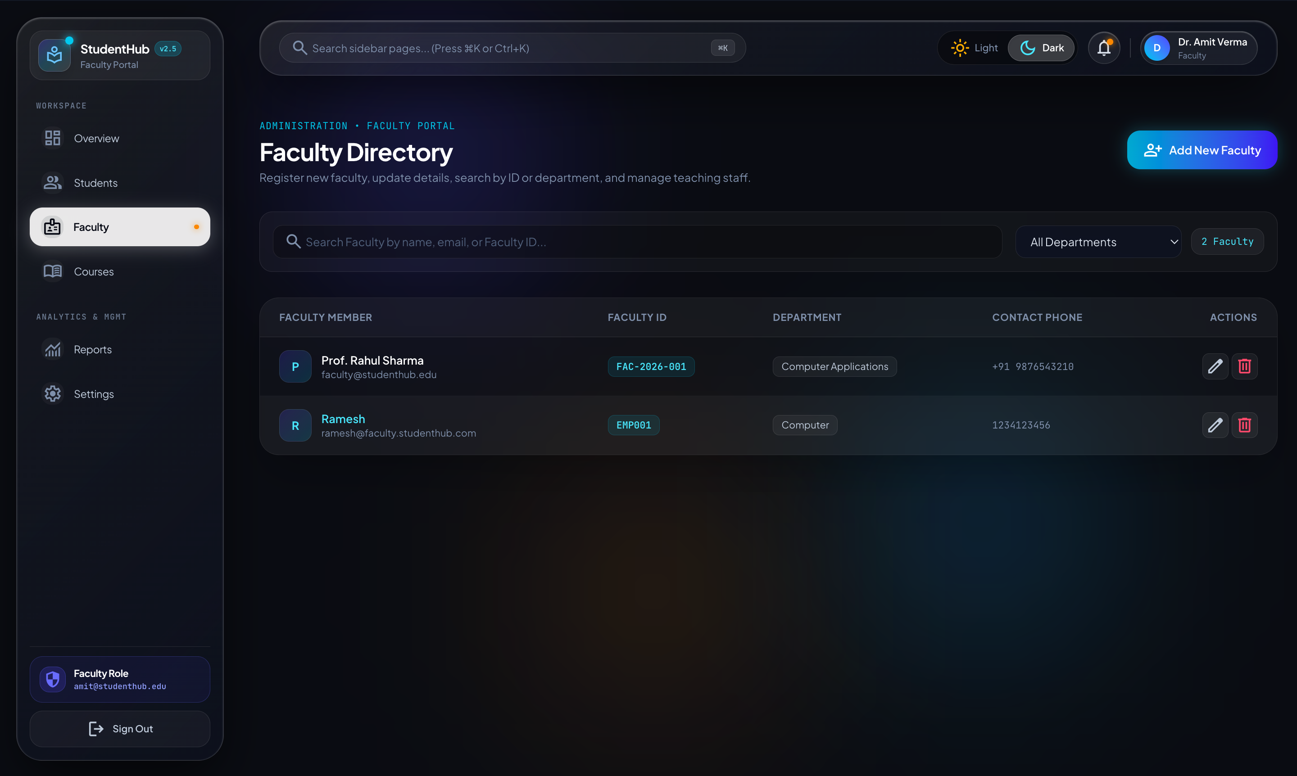
TEACHING STAFF REGISTRY & DEPT MANAGEMENT
CORE JAVA CAM5001C
Faculty Management Module: Academic Staff Operations
Faculty Module Features & Endpoints
Automated Seeding: FacultyDataInitializer seeds default faculty account (Prof. Rahul Sharma, faculty@studenthub.edu) on application startup.
REST API Endpoints: GET, POST, PUT, DELETE /api/faculty all strictly locked under @PreAuthorize("hasRole('ADMIN')").
Departmental Categorization: Tracks faculty members by departmental designations (Computer Applications, IT, etc.).
Faculty Directory UI: Search by faculty ID, filter by department, add new faculty members, and update contact phone numbers.
StudentHub v2.5 Enterprise Architecture • Silver Oak College of Computer Application
14 / 22

Slide 15
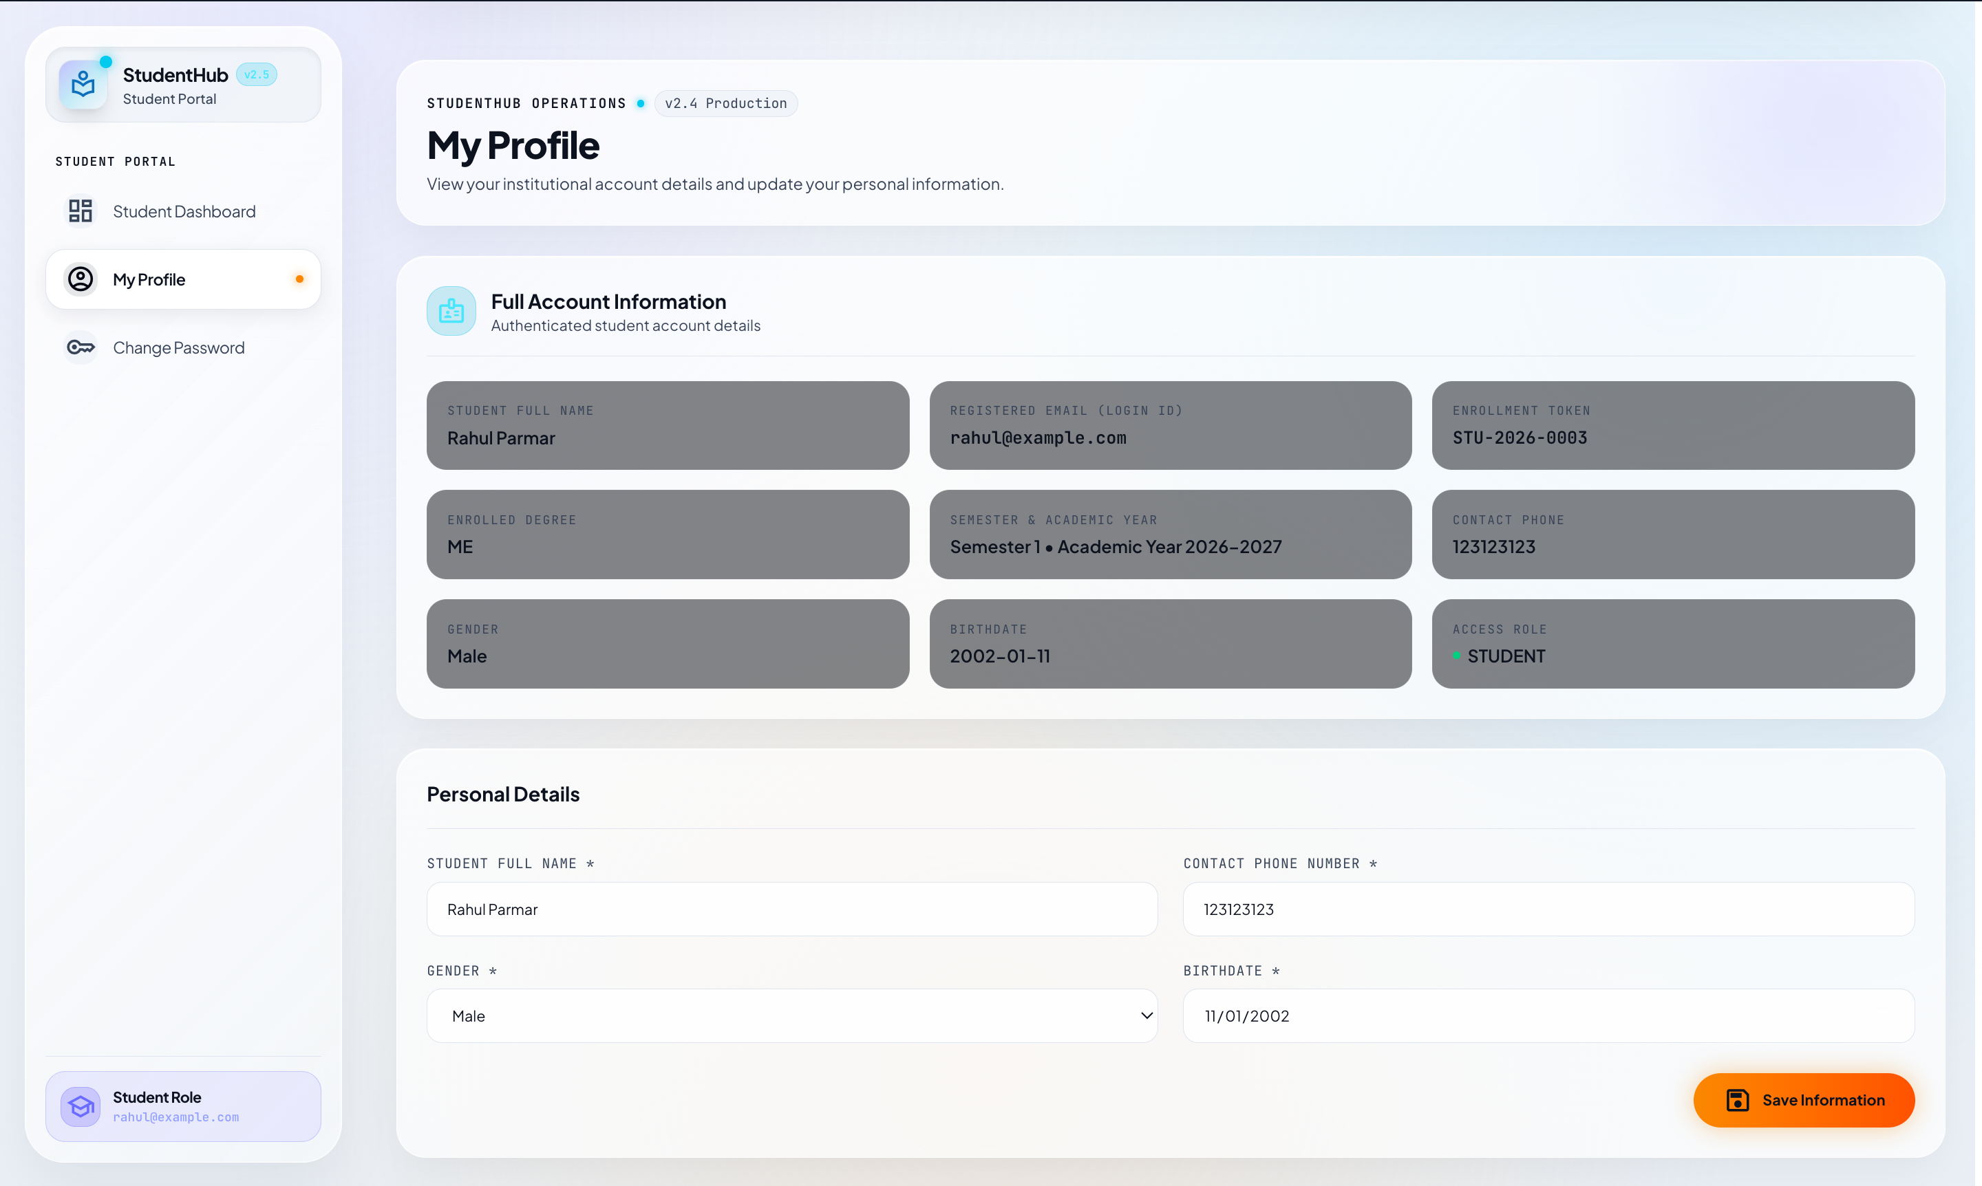
DUAL-PORTAL INTERFACE EXPERIENCE
CORE JAVA CAM5001C
Admin vs. Student Dashboards: Role-Specific UI
Admin Dashboard (Overview & Analytics)
Student Dashboard (Personal Academic Profile)
StudentHub v2.5 Enterprise Architecture • Silver Oak College of Computer Application
15 / 22

Slide 16
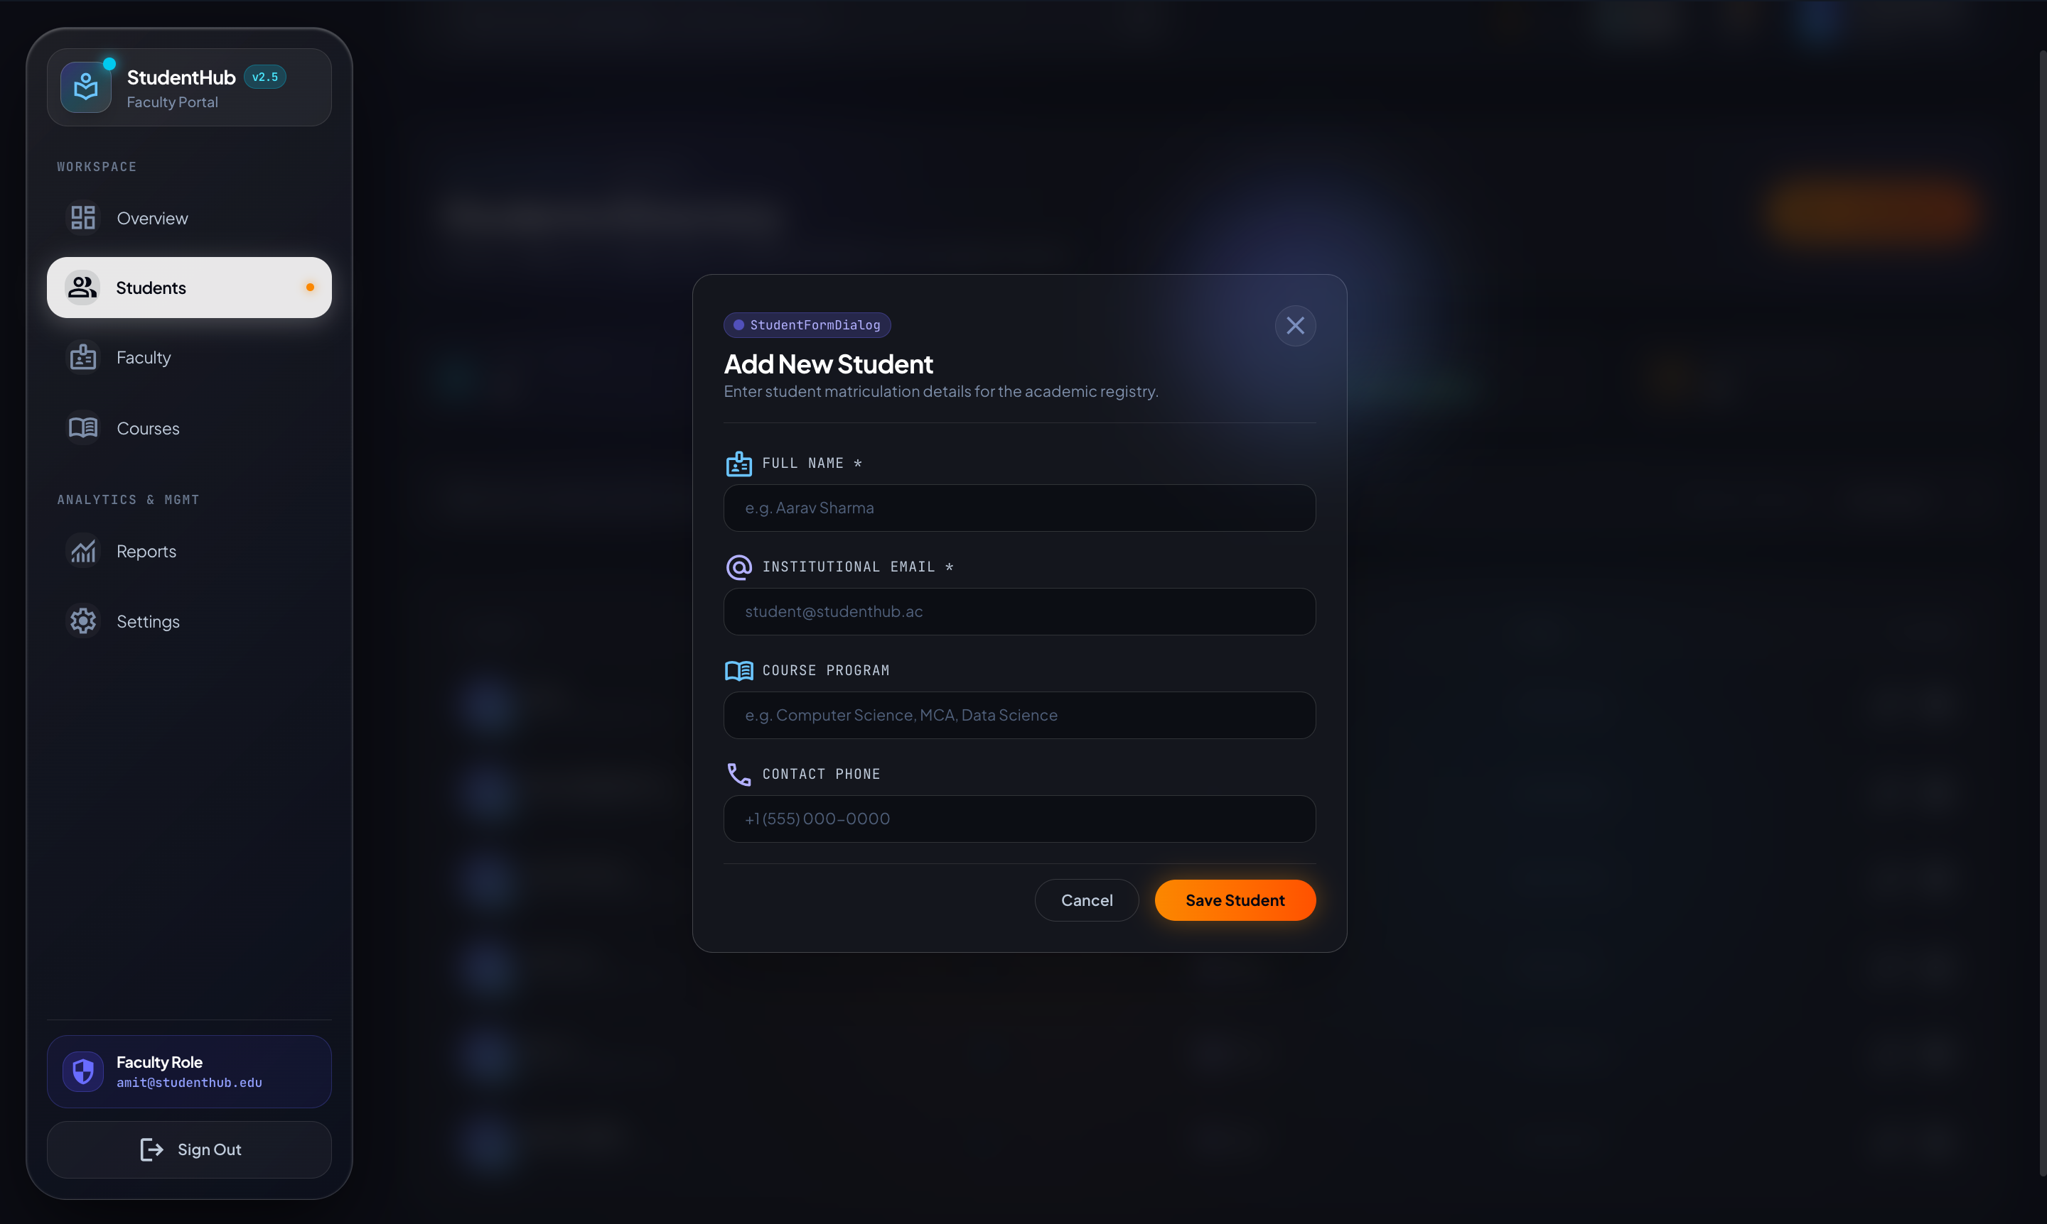
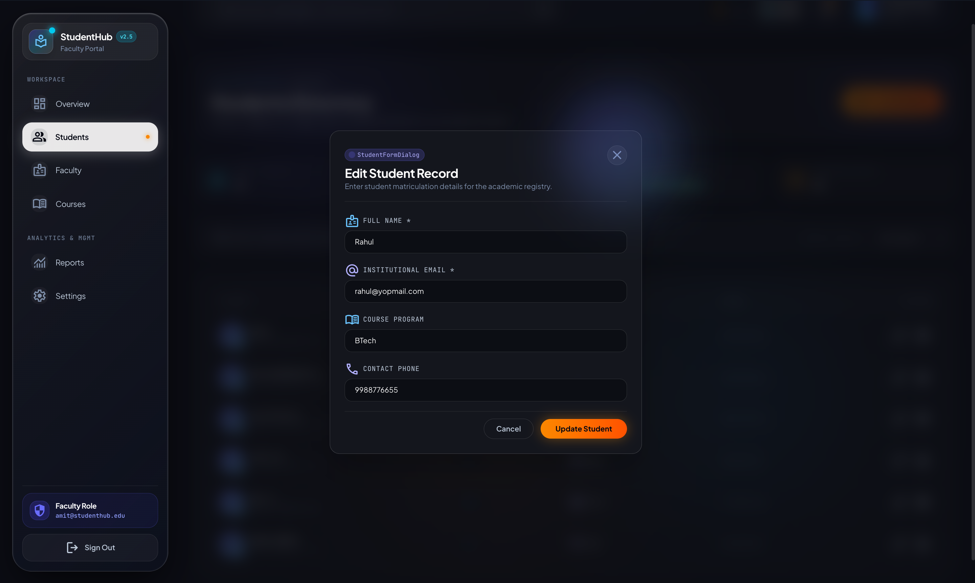
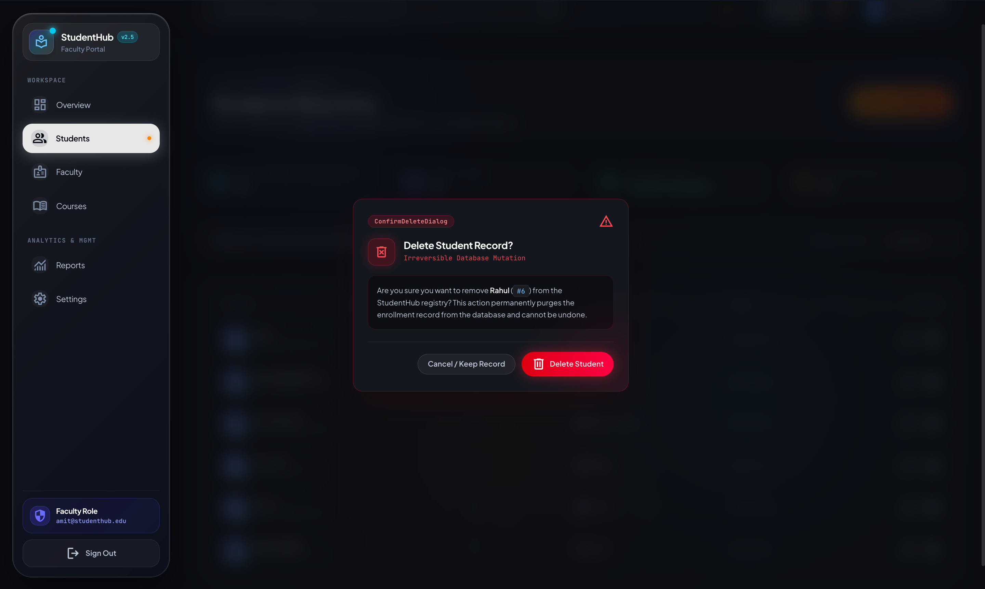
ACTUAL APPLICATION MODAL INTERFACES
CORE JAVA CAM5001C
Interactive Operations: Forms, Modals & Deletions
Add Student Dialog
Edit Student Dialog
Delete Confirmation Dialog
StudentHub v2.5 Enterprise Architecture • Silver Oak College of Computer Application
16 / 22

Slide 17
EXACT BACKEND CONTROLLER ENDPOINTS
CORE JAVA CAM5001C
RESTful API Endpoints & Contract Specifications
API Route & Security Matrix
[POST] /api/auth/login (Public) — Authenticates user credentials; issues HMAC-SHA256 JWT token with role claims.
[POST] /api/auth/register (Public) — Registers new student account; server overrides and forces role = ROLE_STUDENT.
[POST] /api/auth/change-password (Authenticated) — Updates account password securely with BCrypt validation.
[GET] /api/students (ADMIN) — Retrieves complete directory of matriculated student records.
[POST] /api/students (ADMIN) — Persists new student record into PostgreSQL after Bean Validation.
[GET] /api/students/me (STUDENT, ADMIN) — Fetches authenticated user's student profile based on JWT subject email.
[PUT] /api/students/me (STUDENT) — Allows authenticated student to update permitted personal contact fields.
[GET / PUT] /api/students/{id} (ADMIN / Owner) — Fetches or updates student by ID; verifies ownership matching.
[DELETE] /api/students/{id} (ADMIN) — Deletes student record; protected by @PreAuthorize("hasRole('ADMIN')").
[GET / POST / PUT / DELETE] /api/faculty/** (ADMIN) — Full CRUD operations managing institutional faculty staff directory.
StudentHub v2.5 Enterprise Architecture • Silver Oak College of Computer Application
17 / 22

Slide 18
QUALITY ASSURANCE EVIDENCE
CORE JAVA CAM5001C
Testing & Verification: Functional & Security Auditing
Core Java Academic Demos (Units 2, 3 & 4)
Application Functional & Security Validation
Unit 2 OOP Demo: StudentOOPDemo runs polymorphism, constructor chaining, static member counting, and interface contracts.
Unit 3 Exception Demo: StudentExceptionDemo tests custom checked/unchecked exceptions and try-catch-finally propagation.
Unit 3 Multithreading: StudentThreadDemo & StudentThreadLifecycleDemo verify thread execution states (NEW, RUNNABLE, TERMINATED).
Unit 4 Collections & Generics: StudentBox<T> and StudentCollectionDemo validate List, Set, Map, and wildcard bounds (? extends Number).
Authentication Testing: Verified successful login returning valid JWT tokens and rejection of invalid passwords with 401 Unauthorized.
Role Enforcement Checks: Confirmed student accounts attempting administrative endpoints receive HTTP 403 Forbidden.
Duplicate Email Prevention: Attempting duplicate registrations triggers DuplicateEmailException with clean user-friendly alert.
Browser Local Storage Integrity: Confirmed auth token persistence and automatic cleanup upon user logout.
StudentHub v2.5 Enterprise Architecture • Silver Oak College of Computer Application
18 / 22

Slide 19
CLOUD INFRASTRUCTURE TOPOLOGY
CORE JAVA CAM5001C
Production Deployment Architecture
Frontend Cloud
Vercel Edge Platform
• Global CDN Distribution
• HTTPS Let's Encrypt
• React SPA Bundles
Security & Gateway
Nginx Reverse Proxy
• AWS EC2 Ingress Gateway
• SSL/TLS Termination
• Strict CORS Rules
Backend Runtime
AWS EC2 Instance
• Ubuntu 22.04 LTS
• Spring Boot Systemd Daemon
• Port 8080 Service
Managed Database
Neon PostgreSQL
• Serverless Cloud Database
• SSL Enforced Connections
• Automated Backups
Environment Variable Isolation
Zero Secret Exposure: No database passwords or JWT signing keys are committed to source control.
Dynamic Config: Configured via DB_URL, DB_USERNAME, DB_PASSWORD, JWT_SECRET, and FRONTEND_URL in server environment.
Process Reliability: Spring Boot runs under systemd with Restart=always, ensuring uninterrupted uptime across server restarts.
StudentHub v2.5 Enterprise Architecture • Silver Oak College of Computer Application
19 / 22

Slide 20
PROBLEM SOLVING & IMPLEMENTATION INSIGHTS
CORE JAVA CAM5001C
Engineering Challenges & Practical Resolutions
Challenge: CORS Issues During Cross-Origin Deployment
Resolution: Deployed frontend on Vercel communicating with AWS EC2 backend caused pre-flight CORS errors. Resolved by configuring UrlBasedCorsConfigurationSource with explicit allowed origins, methods, and credentials.
Challenge: Privilege Escalation via Registration Payloads
Resolution: Malicious registration requests could attempt to inject 'role': 'ADMIN'. Resolved by omitting role attribute from RegisterRequest DTO and hard-locking user.setRole('ROLE_STUDENT') in AuthService.
Challenge: Duplicate Records Across Concurrent Requests
Resolution: Multiple requests could submit identical student emails simultaneously. Resolved by applying database UNIQUE constraints and catching DataIntegrityViolationException in GlobalExceptionHandler.
Challenge: Dark Mode & Theme Hydration Desynchronization
Resolution: Switching between light and dark modes produced flashing UI elements. Resolved by implementing ThemeProvider with localStorage synchronization and Tailwind class persistence.
StudentHub v2.5 Enterprise Architecture • Silver Oak College of Computer Application
20 / 22

Slide 21
FUTURE EXTENSIONS (CLEARLY SEPARATED FROM IMPLEMENTED SCOPE)
CORE JAVA CAM5001C
Future Roadmap & Planned Enhancements
Phase 1: Attendance & Gradebook
Phase 2: Course Enrollment Engine
• Daily biometric or QR-code based student attendance tracking.
• Faculty grade entry module with semester GPA/CGPA calculations.
• Automated attendance shortage threshold notifications.
• Direct elective course registration by students during enrollment windows.
• Course capacity constraints and prerequisite course verification.
• Automated timetable schedule generator.
Phase 3: Fee Payment Gateway
Phase 4: Mobile Application
• Integration with Razorpay / Stripe for online tuition fee payments.
• Automated institutional receipt generation and fee due alerts.
• Student fee clearance status dashboard for examination entry.
• React Native mobile app for iOS and Android.
• Push notifications for academic announcements and class schedule changes.
• Offline viewing of verified student ID cards.
StudentHub v2.5 Enterprise Architecture • Silver Oak College of Computer Application
21 / 22

Slide 22
MCA SEMESTER 1 CAPSTONE EVALUATION
CORE JAVA CAM5001C
Project Conclusion & Academic Summary
Executive Summary & Core Value Delivered
Enterprise-Ready Engineering: The Student Management System successfully demonstrates end-to-end full-stack software development, integrating Spring Boot, React, and PostgreSQL into a robust, deployed cloud application.
Rigorous Role-Based Security: Zero-trust architecture separating STUDENT and ADMIN faculties ensures complete institutional data integrity and privacy.
Comprehensive Academic Demonstration: Exemplifies MCA Core Java (CAM5001C) curriculum standards through rich OOP hierarchies, robust exception handling, multithreading lifecycle tracking, and generic collection pipelines.
Production Deployed
Live on AWS EC2 & Vercel Edge with SSL/TLS security.
Clean Architecture
Layered Controller-Service-Repository DTO pattern.
Academic Excellence
Demonstrates Units 2, 3, and 4 Core Java competencies.
StudentHub v2.5 Enterprise Architecture • Silver Oak College of Computer Application
22 / 22

