Slide 1
Analytics Advisor
Technical architecture
Two data planes, query routing, and who can reach each part
26 October 2026

Slide 2
What the architecture is for
An officer builds a scheme query without writing SQL
Compose
Pick tables, join keys,
rules, and thresholds
in Query Builder.
Compile
The backend turns that
choice into parameterised
SQL. Values stay bound.
Route
One plain external query
goes direct. Lakehouse,
fuzzy, and joins use Presto.
Protect
Scope hides other
geographies. Audit records
who ran the query.
Example. A Jaipur officer fuzzy-matches a pension name to the lakehouse beneficiary table.
The product returns only Jaipur rows and writes an audit event for the run.
Administrators attach databases. Officers never edit those connections.
Analytics Advisor · Architecture
2 / 10

Slide 3
Logical stack
Browser, frontend, and backend stay separate
Browser
Session token stays in the browser. English and Hindi. Officer or admin screens.
Frontend · Next.js 16 / React 19 · port 3000
Overview, Query Builder, Dashboard, and the admin workspace at /admin456.
Backend · Java 17 / Spring Boot 3.3 · port 8080
Compiles queries, checks the token, applies scope, chooses the database, streams results.
Analytics Advisor · Architecture
3 / 10

Slide 4
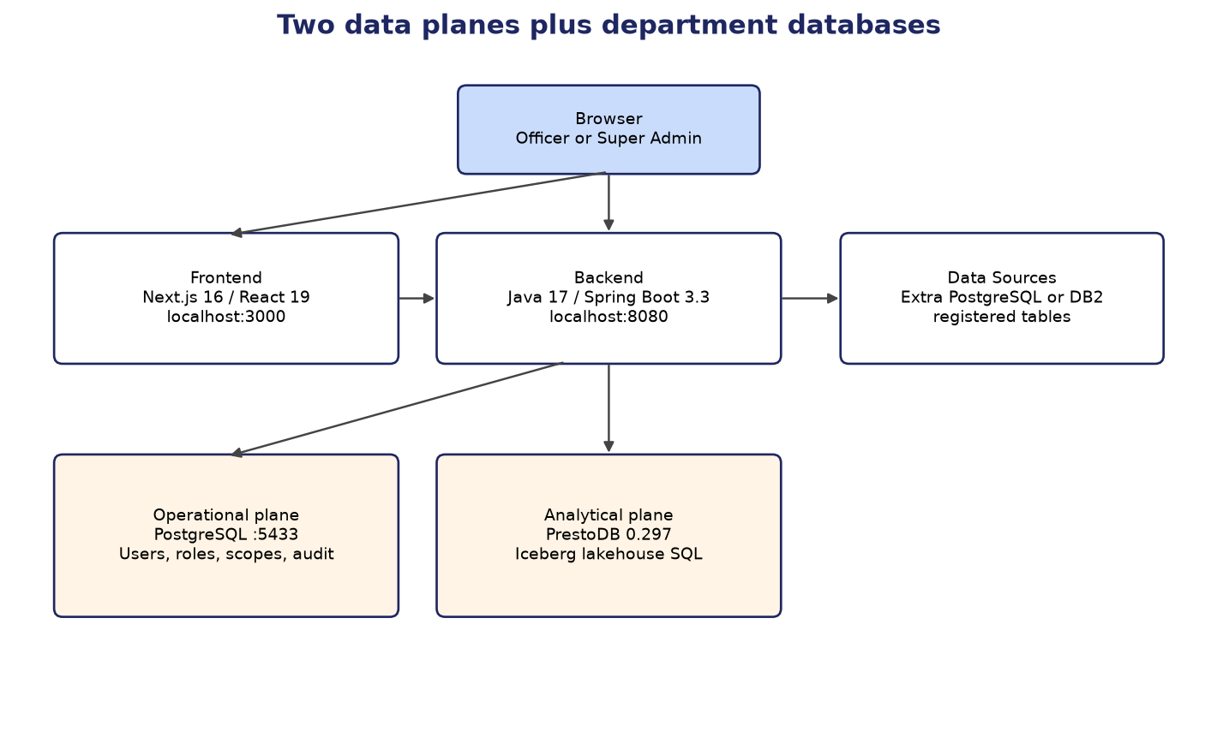
Two data planes
The application store and the query engine are different databases
Operational
PostgreSQL on port 5433.
Users, roles, scopes, audit,
saved queries, registrations.
JPA and Liquibase.
Analytical
PrestoDB 0.297 and Iceberg.
Lakehouse SQL.
Local stack also uses
Hive metastore and MinIO.
Analytics Advisor · Architecture
4 / 10

Slide 5
Connections and Data Sources
Two fixed engines, plus a list of department databases
Connections · always two cards
Operational holds the application itself.
A save is tested, then applied after restart.
Analytical is the Presto URL.
A save is tested and applied immediately.
jdbc:presto://host:8080 is enough.
Each table is catalog.schema.table.
Data Sources · Super Admin list
Add PostgreSQL or IBM DB2.
Test, browse, and register tables.
One plain query goes direct to that database.
A PostgreSQL source can take a Presto alias
so it can join the lakehouse.
DB2 stays on that one database.
Analytics Advisor · Architecture
5 / 10

Slide 6
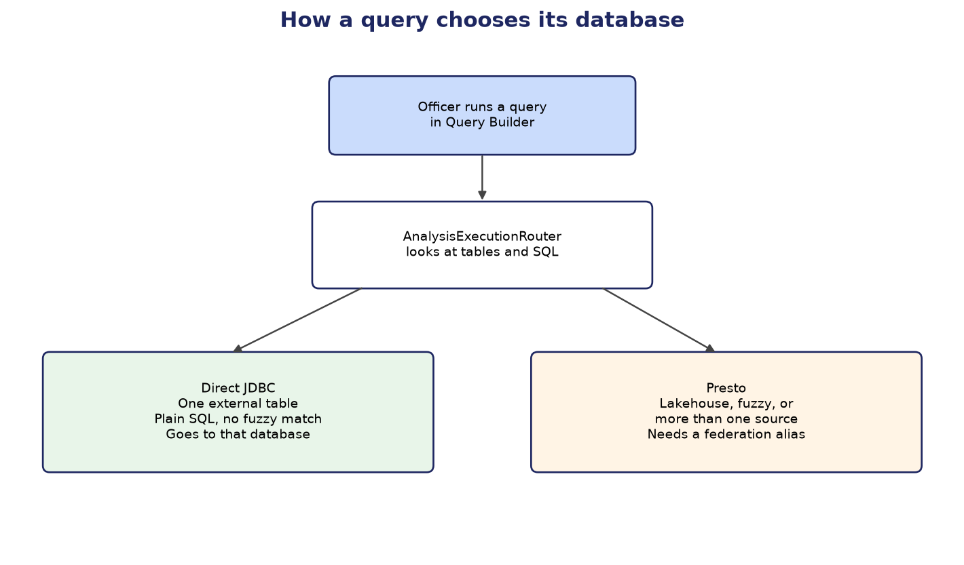
How a query chooses its database
AnalysisExecutionRouter looks at the tables and the SQL
Direct JDBC
One registered external table.
Plain SQL, no fuzzy match.
Example: district filter on
Pension DB alone.
Presto
Lakehouse, fuzzy names, or
more than one source.
Each external source needs
a federation alias.
Analytics Advisor · Architecture
6 / 10

Slide 7
Sign-in and the request path
Local mode uses BCrypt and an eight-hour token
1
Sign in
BCrypt check. Five failures lock the account for 15 minutes.
2
Token
HS256 JWT carries the user, roles, session version, and password-change flag.
3
Scope
The officer’s geography is added to the SQL. No binding means no rows.
4
Stream
Rows stream to the screen. A disconnect cancels the running statement.
5
Audit
The event stores the action, outcome, query shape, and duration.
Analytics Advisor · Architecture
7 / 10

Slide 8
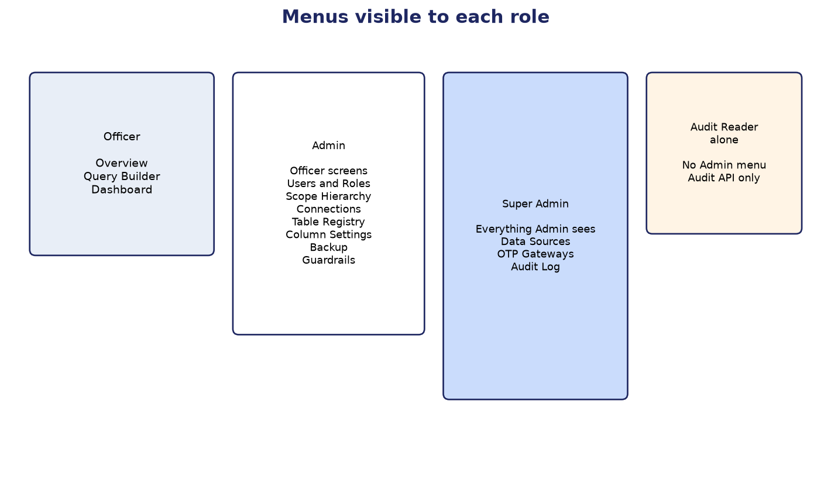
Who can reach which surface
The admin page requires the administrator authority
Role summary
Officer: Overview, Query Builder, Dashboard.
Admin: those screens plus users, scopes,
connections, registry, columns, backup,
and guardrails.
Super Admin: also Data Sources, OTP,
and the Audit Log.
Audit Reader alone: no Admin menu.
Analytics Advisor · Architecture
8 / 10

Slide 9
Architecture limits
What fails when a plane or a connector is missing
Presto down
Lakehouse, fuzzy, and cross-source queries fail. The Analytical card shows the SELECT 1 error.
No DB2 connector
A DB2 data source answers one database only. It cannot join the lakehouse.
Dormant types
Oracle, MySQL, MariaDB, and SQL Server are defined and refused on create.
Audit Reader
Audit-read authority does not open the admin page by itself.
Analytics Advisor · Architecture
9 / 10

Slide 10
Plan for the architecture
Recommended order. This deck does not change the product.
Phase 1
Bring up Presto with MinIO and the Hive metastore. Say clearly when the analytical engine is down.
Phase 2
Enable Oracle on Data Sources, pool external JDBC, and let an Audit Reader open the Audit Log.
Phase 3
Finish RajSewadwar sign-in, explain lockout, and stop repeating full queries for fan-out and comparisons.
Analytics Advisor · Architecture
10 / 10

