Slide 1
Krithika Priya PR
Final Project
4/5/2024 Annual Review

Slide 2
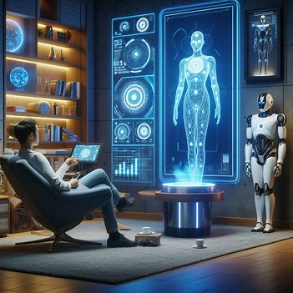
Jarvis - AI Voice Assistant
4/5/2024 Annual Review

Slide 3


AGENDA
Problem Statement
Project Overview
End Users
Solution and Value Proposition
The "Wow" Factor
Modelling and Result
Demo
Future Scope
Conclusion
3/21/2024 Annual Review

Slide 4

PROBLEM STATEMENT
Develop a voice-activated virtual assistant application called "Jarvis AI" that assists users with tasks such as providing the current date and time upon voice command, conducting web searches, responding to queries on various topics, and playing requested songs. The challenge is to create an efficient and user-friendly system that accurately understands user commands, retrieves relevant information, and executes tasks seamlessly, thereby enhancing user productivity and convenience through voice interaction.
4/5/2024 Annual Review

Slide 5
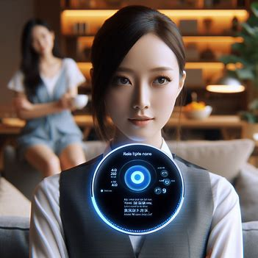
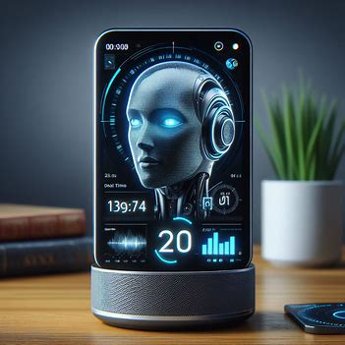



PROJECT OVERVIEW
The project aims to develop an AI voice assistant named Kannamma tailored to the needs of users in diverse settings, with a focus on India.
Voice Interaction Enabling seamless communication and task execution through natural language voice commands.
Real-Time Information Providing users with timely updates on the current date and time, enhancing convenience in daily activities.
Music Playback Allowing users to enjoy their favorite songs with ease through Kannamma's music playback feature.
Web Search Empowering users to fetch information from the web, including details about individuals or topics of interest, using Kannamma's integrated Wikipedia search functionality.
Voice Interaction: Enabling seamless communication and task execution through natural language voice commands.
4/5/2024 Annual Review

Slide 6

WHO ARE THE END USERS?
Kannamma AI voice assistant is designed for:
General Users: Anyone seeking convenient assistance in daily tasks.
Professionals: Executives, managers, and entrepreneurs requiring hands-free assistance.
Elderly Individuals: Seniors benefiting from simplified interaction methods.
People with Disabilities: Those relying on voice commands for accessibility.
4/5/2024 Annual Review

Slide 7
YOUR SOLUTION AND ITS VALUE PROPOSITION
Description: Kannamma is an AI voice assistant designed to provide seamless assistance through natural language voice commands.
Key Features:
Voice Interaction: Intuitive communication for task execution.
Music Playback: Enjoy favorite songs effortlessly.
Real-Time Information: Instant updates on date and time.
Web Search: Access information from the web, including Wikipedia.
Value Proposition of Kannamma:
Convenience: Simplifies tasks with quick access to information and entertainment via voice commands.
Efficiency: Enhances productivity through hands-free assistance, enabling effective multitasking.
Personalization: Tailors responses to individual preferences, providing a personalized experience.
Accessibility: Improves accessibility with a user-friendly interface and voice-based interaction.
Cultural Relevance: Integrates cultural elements for the Indian audience, ensuring relevance and relatability.
4/5/2024 Annual Review

Slide 8

The WOW in Our Solution: Kannamma
Seamlessly integrates advanced machine learning for intuitive communication.
Offers a comprehensive range of functionalities through simple voice commands.
Provides personalized responses, enhancing user engagement.
Bridges technology and culture with culturally relevant elements.
Elevates accessibility with a user-friendly interface, ensuring inclusivity.
3/21/2024 Annual Review

Slide 9
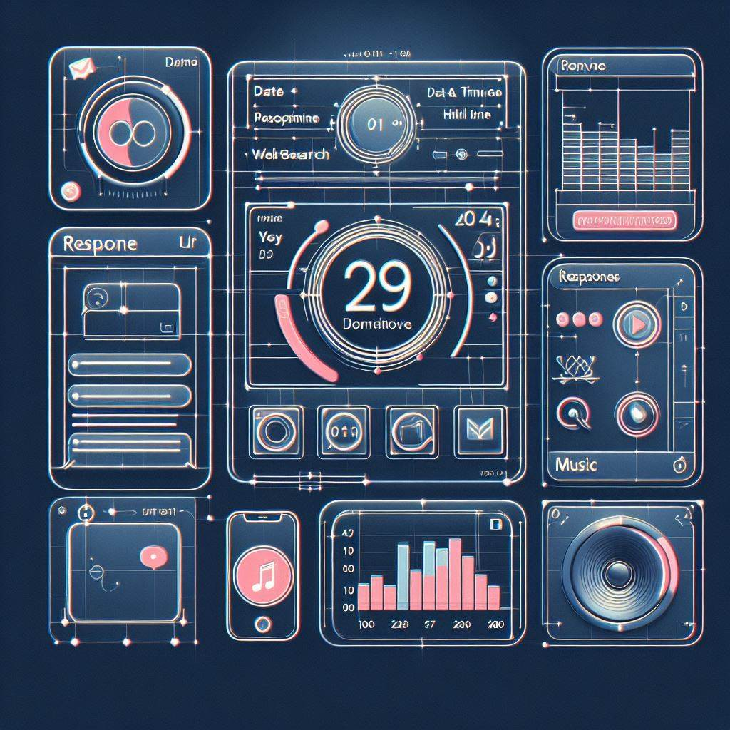
Modelling
Functionality Overview:
Implements a basic voice-controlled virtual assistant.
Utilizes speech recognition, text-to-speech synthesis, and various functionalities like fetching time, date, playing music, and retrieving information from Wikipedia.
Libraries Used:
speech_recognition: for capturing and recognizing speech input.
pyttsx3: for converting text to speech.
pywhatkit: for playing music from YouTube.
datetime: for handling time and date operations.
wikipedia: for fetching information from Wikipedia.
Main Features:
Recognizes voice commands prefixed with "Jarvis."
Can perform actions like playing music, fetching time and date, providing information from Wikipedia, and responding to casual queries.
User Interaction:
Captures user instructions through voice input from the microphone.
Provides auditory feedback using synthesized speech.
Limitations:
Limited to predefined commands and responses.
May have constraints in accurately recognizing complex queries or commands.
Relies on external services like YouTube and Wikipedia for certain functionalities.
Further Development:
Can be expanded with additional functionalities.
Improvements in speech recognition accuracy and natural language understanding.
Enhanced error handling and user feedback mechanisms.
3/21/2024 Annual Review

Slide 10
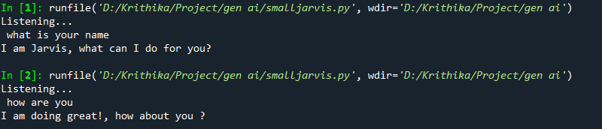

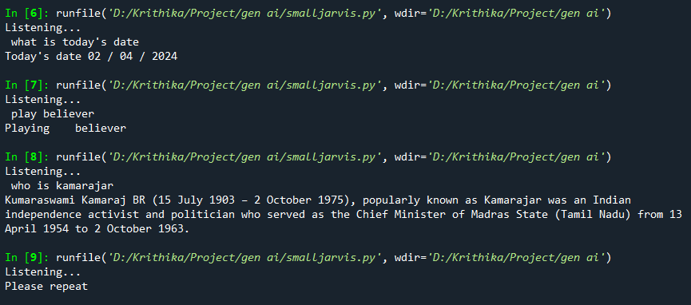
RESULTS
Demo Link
4/5/2024 Annual Review

