Slide 1

SEARCH ENGINE HEURISTICS
VS
MACHINE LEARNING
Karina Palyutina

Slide 2
INTRODUCTION
“Given a web page tell
me how it ranks”

Slide 3
INTRODUCTION
“Given a web page tell
me how it ranks”

Slide 4
INTRODUCTION
“Find which features of the page
affect its ranking most”

Slide 5
INTRODUCTION
“Find which features of the page
affect its ranking most”

Slide 10
Naive Bayes

Slide 12
99% | Static Features
55% | PageRank
3000 | Pages

Slide 13
Support Vector Regression

Slide 14
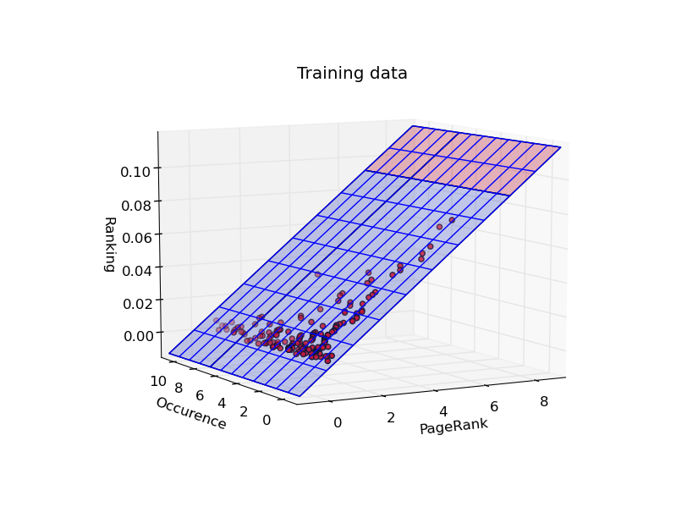

Slide 15
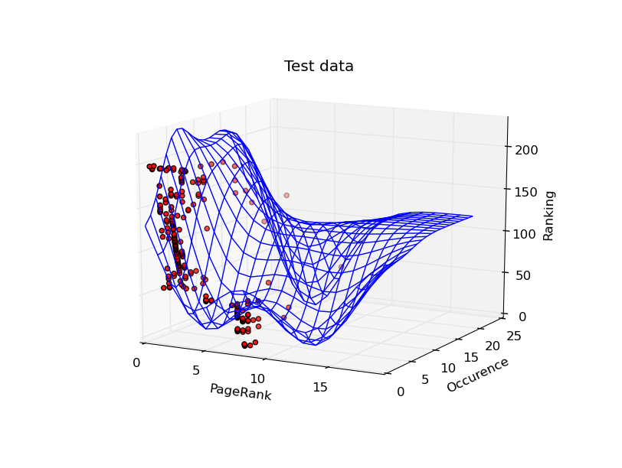
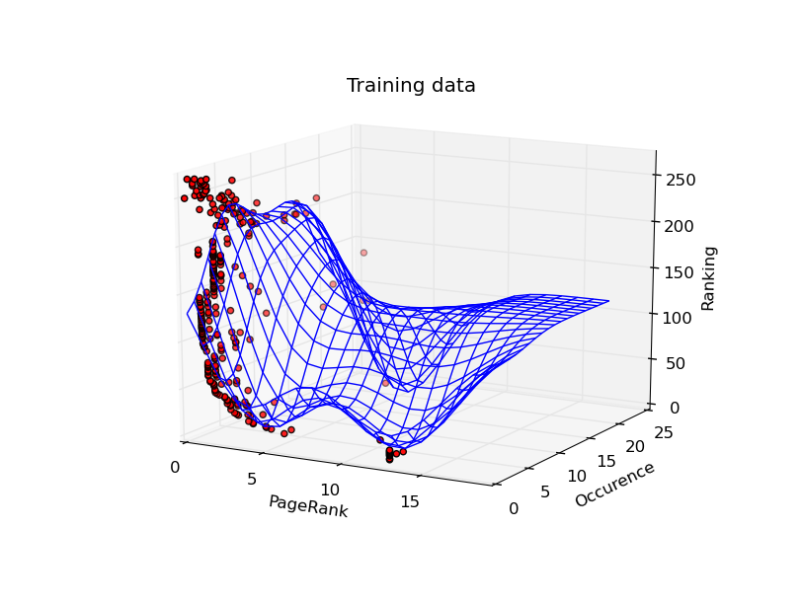

Slide 16
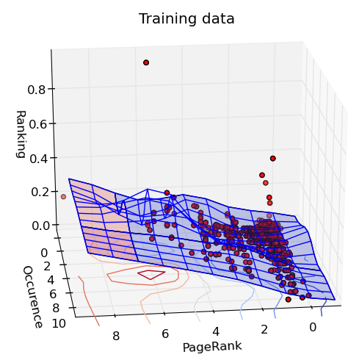
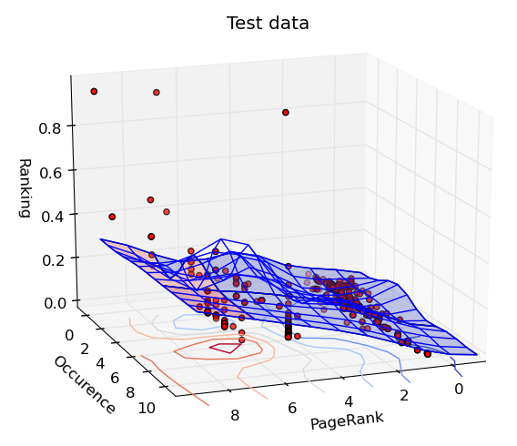

Slide 17
Questions?

