Slide 1
ANALYSIS OF GLOBAL TEMPERATURE RISE
Presented by:
Kuldip Patel
Presented to: Andrew H. Bond
DATA 230 DATA VISUALIZATION

Slide 2
Today’s AGENDA
Introduction
Objective
Data Sources
Analysis
Dashboard
Conclusions

Slide 3
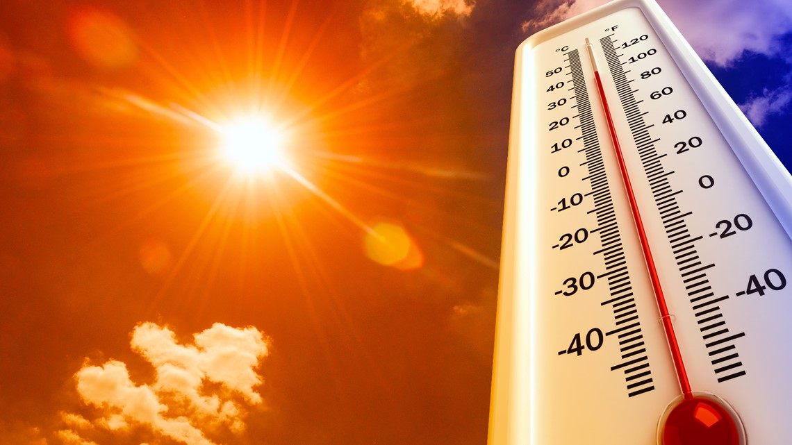
INTRODUCTION
The global warming trend is caused by human activities and the effects of global warming are severe.
The average global temperature has increased by more than 1.4 degrees Fahrenheit since 1880.
By determining the leading causes of global temperature rise, we can take preventive measures, to stop catastrophe from happening.

Slide 4
OBJECTIVE
To analyze the trend of the global temperature rise.
Analyzing which parameter contributes highest to global warming
Speculate what happens if we can/can’t stop this from happening

Slide 5
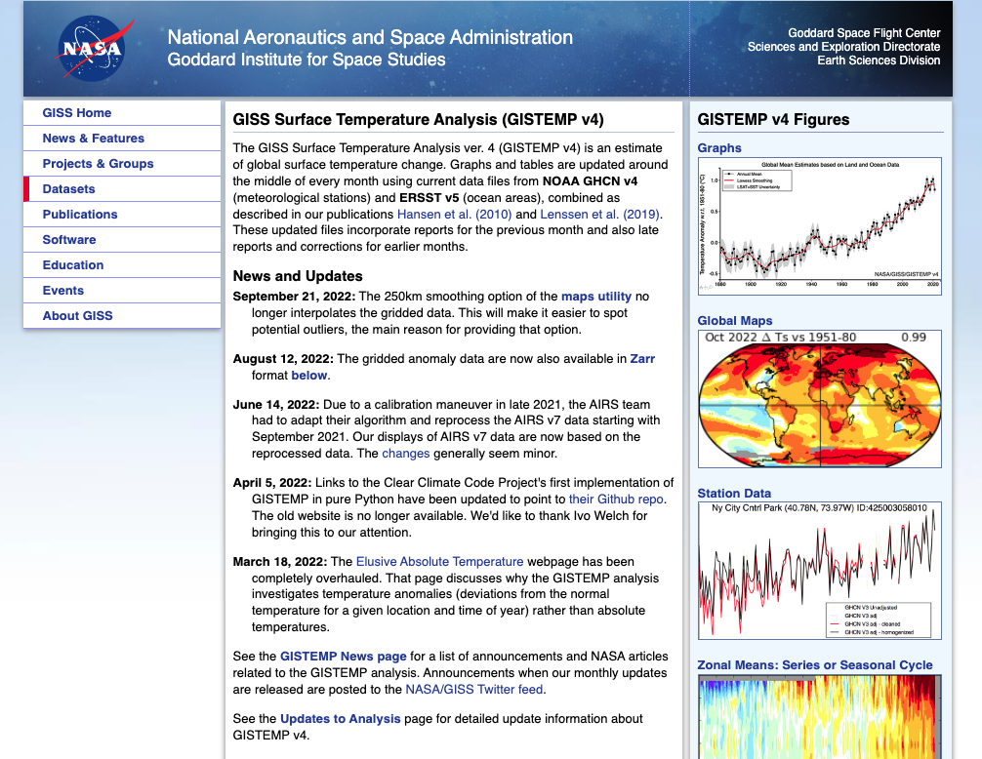
DATA SOURCES
NASA – GISS Surface Temperature Analysis Data - Link
Climate Watch – Co2 Emission Sector Level Data - Link
UNDP– Human Development Index Data - Link

Slide 6
ANALYSIS

Slide 7
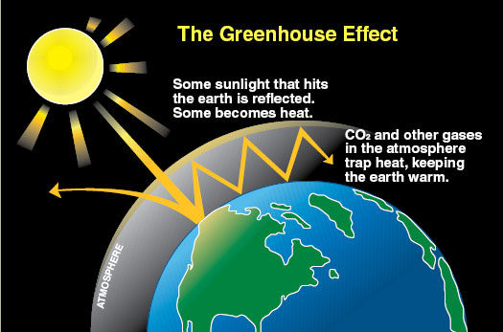
Greenhouse effect
The Earth is surrounded by a thin layer of gasses we call greenhouse gases. These gases are what make up our atmosphere.

Slide 8
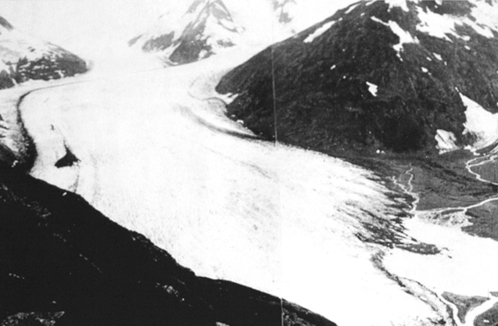
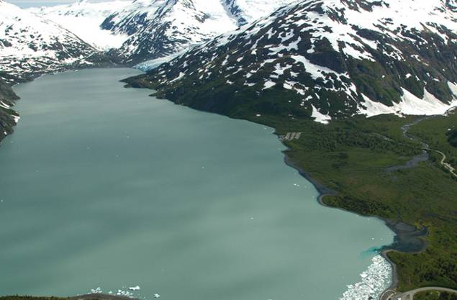
Glaciers are melting
1914
So are ice caps on both North and South poll. Pictured example: Portage Glacier, Alaska
2004

Slide 9
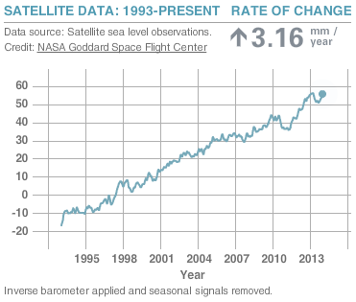
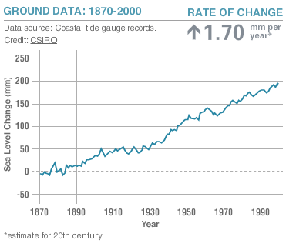
GLOBAL SEA LEVEL RISING
Source: NASA Climate http://climate.nasa.gov/key_indicators#seaLevel

Slide 10
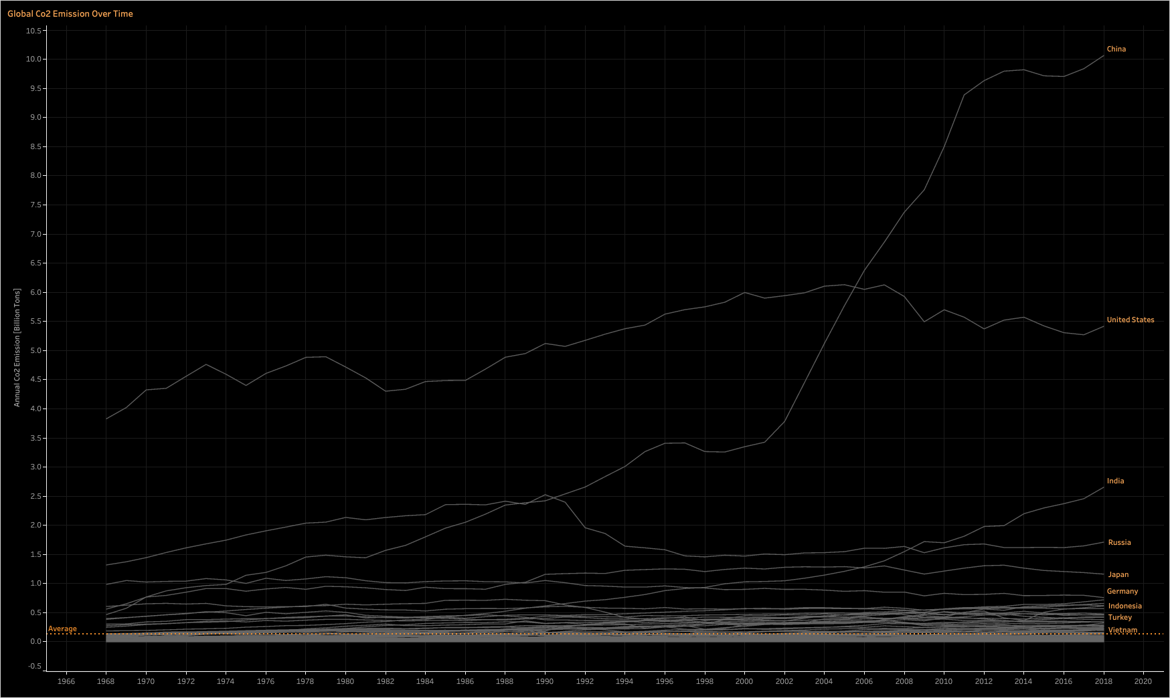
Global CO2 Emission over time

Slide 11
Dashboard

Slide 12
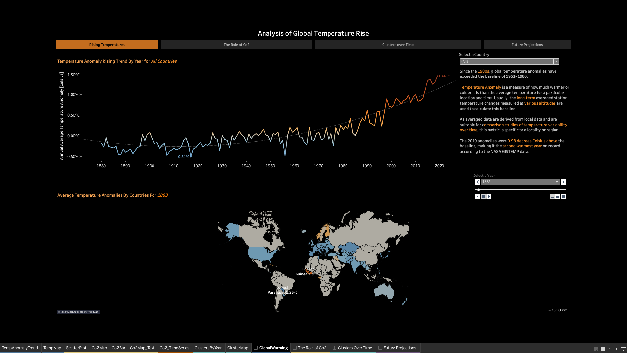
RISING TEMPERATURE

Slide 13
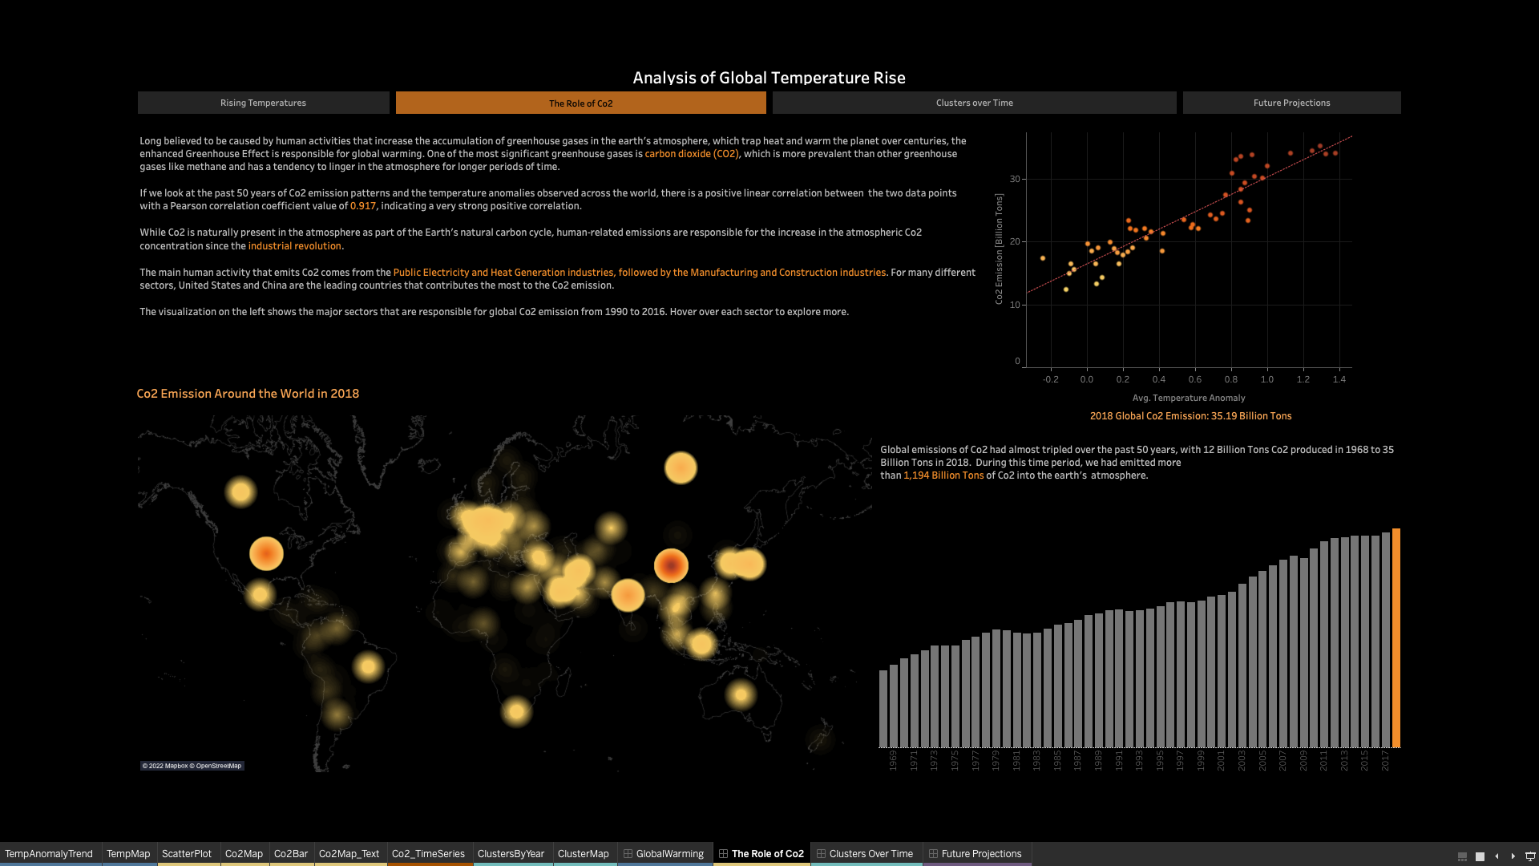
ROLE of CO2

Slide 14
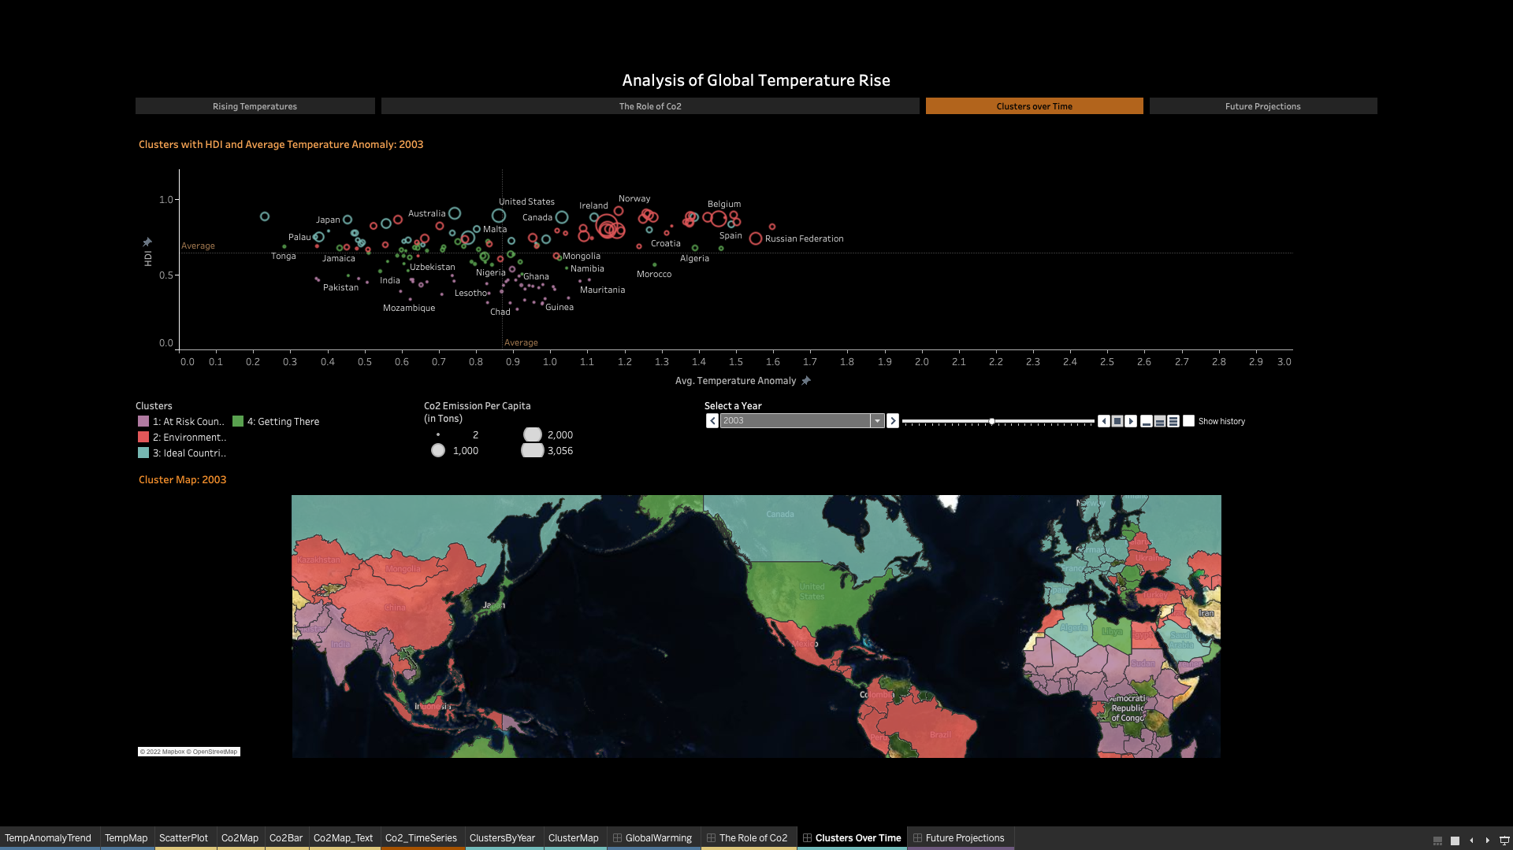
RISK CLUSTERS

Slide 15
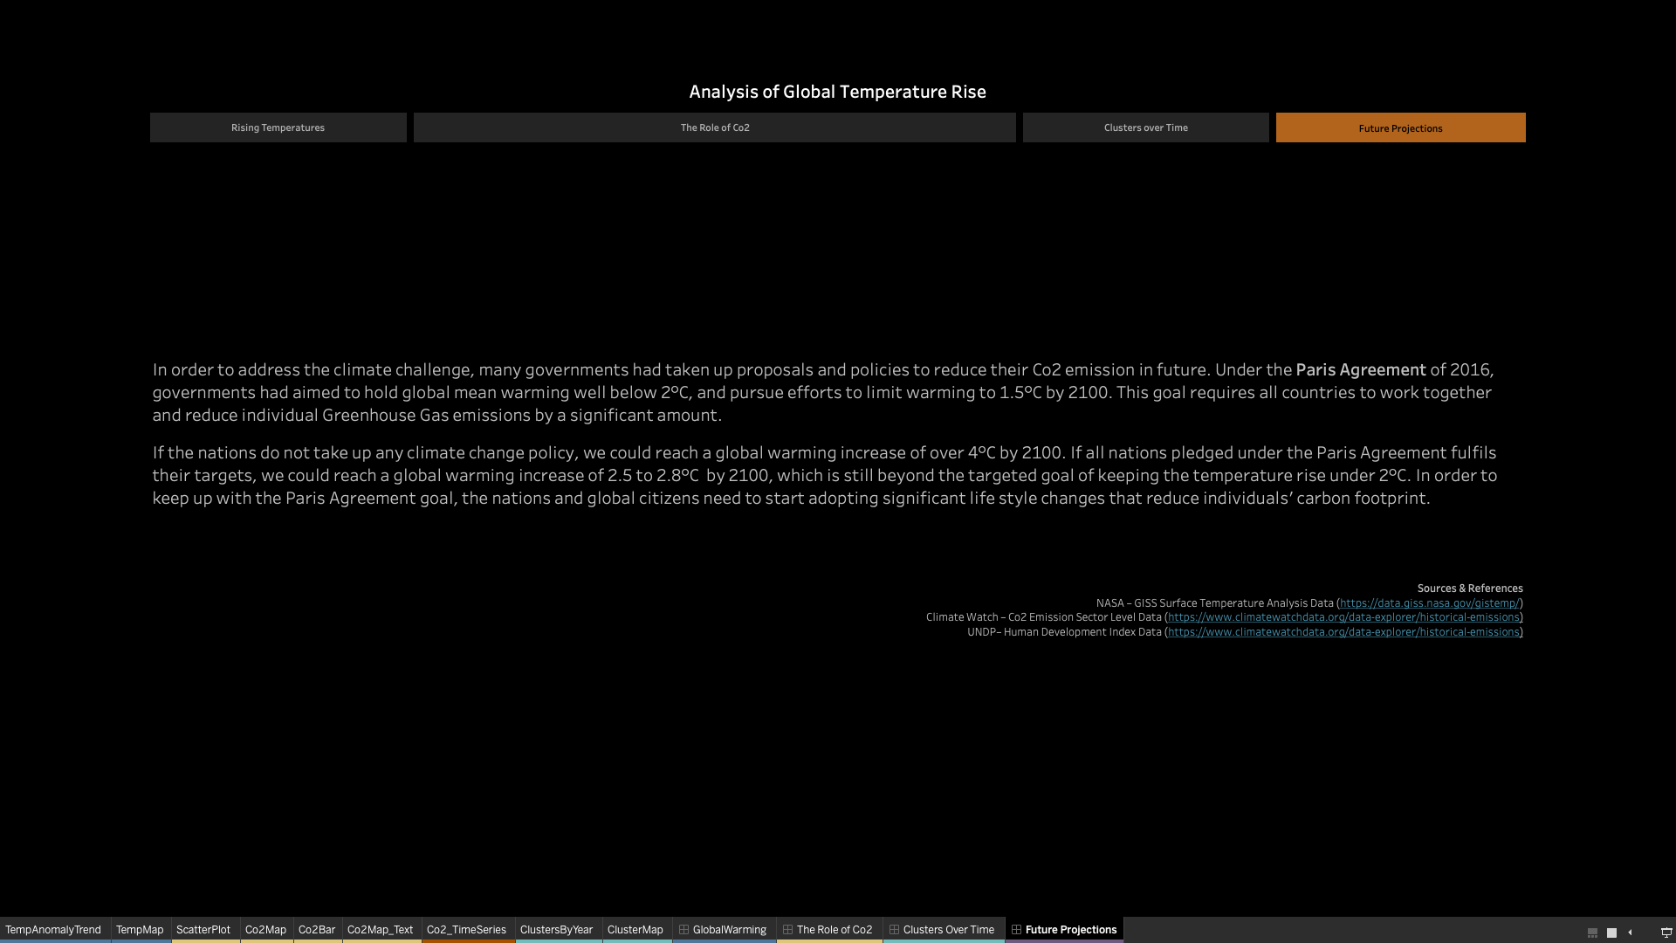
Future Projection

Slide 16
Conclusion
Under the Paris Agreement of 2016, governments had aimed to hold global mean warming well below 2°C, and pursue efforts to limit warming to 1.5°C by 2100
If the nations do not take up any climate change policy, we could reach a global warming increase of over 4°C by 2100
If all nations pledged under the Paris Agreement fulfils their targets, we could reach a global warming increase of 2.5 to 2.8°C by 2100
Global Warming can have devastating effects of on over environment so it must be carb before the no return point

Slide 17
THANK YOU!

