Slide 1
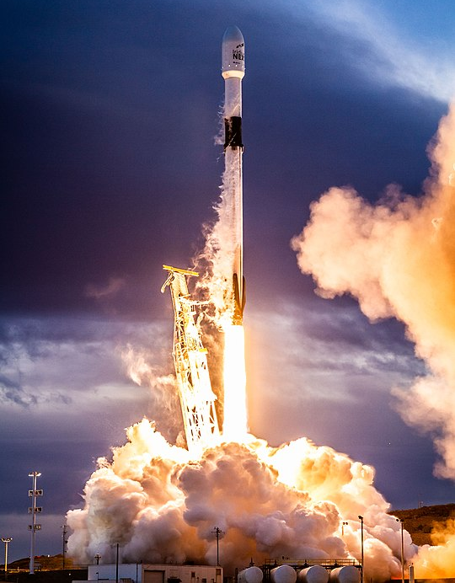
SpaceX Falcon 9 Analysis
Kyle Packer
February 14, 2023

Slide 2


OUTLINE
Executive Summary
Introduction
Methodology
Results
Visualization – Charts
Dashboard
Conclusion

Slide 3

EXECUTIVE SUMMARY
Summary of methodologies
Data collection using webscraping and REST API queries
Data wrangling to classify launches based on success and transform data into standardized format
Exploratory analysis using SQL and visualization packages for Python
Interactive Plotly web app to visualize payload and success launch data at each launch site
Exploring launch sites using Folium interactive maps
Predictive analysis for classification of Falcon 9 landing success
Summary of all results
Exploratory data analysis results
Predictive analysis results

Slide 4

INTRODUCTION
SpaceX advertises Falcon 9 rocket launches with a cost of 62 million dollars
Other providers cost upward of 165 million dollars each
Savings are because SpaceX can reuse the first stage
What we aim to find
Understand Falcon 9 history of success and failures
Predict if Falcon 9 rocket will land successfully

Slide 5

METHODOLOGY
Data collection methodology
SpaceX REST API
Web scraping from Wikipedia
Data wrangling
One hot encoding data fields for ML and data cleaning of null values/irrelevant columns
Exploratory data analysis (EDA)
Interactive visual analytics
Folium maps
Plotly dashboard
Predictive analysis
LR, KNN, SVM, DT models were built and evaluated

Slide 6
Data Collection
SpaceX REST API
Returns data in JSON
Normalize data into DataFrame
GET HTML RESPONSE from Wikipedia
Normalize data into DataFrame
Extract data using Beautiful Soup
Ready for data consolidation and wrangling
https://github.com/kpacks77/IBM_data_capstone/blob/main/Final%20Assignment%20SpaceX.ipynb
https://github.com/kpacks77/IBM_data_capstone/blob/main/Web%20Scraping%20Lab.ipynb

Slide 7
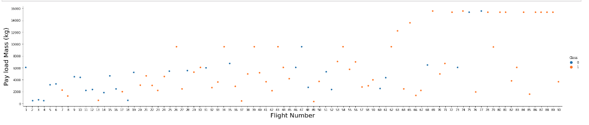
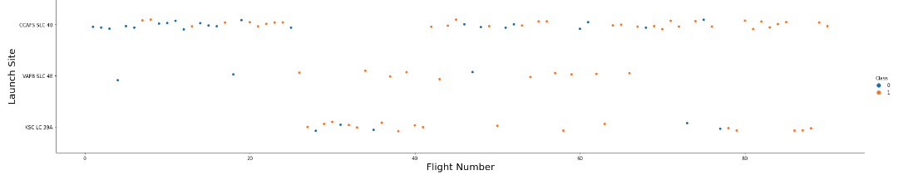
Data Visualization
As Flight Number increases, so does the Payload Mass which appears to have a positive correlation with mission success.
SLC40 has limited success in the beginning whereas SLC4E and LC39A have maintained a high success rate. In later flights (after flight 40)SLC40 begins to achieve higher mission success.

Slide 8
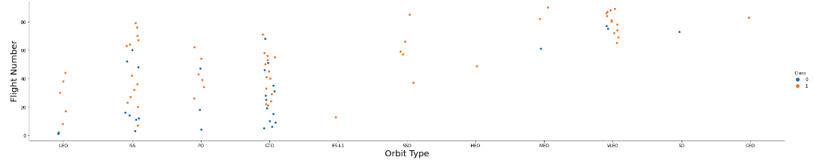
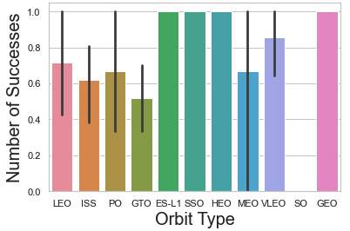
Data Visualization
GEO, SO, HEO, ESL-1 each only have one flight and therefore an assessment cannot be made as to the efficacy of its flight success. VLEO has achieved a high success rate in the later flights whereas LEO and ISS also have higher average success throughout all flights.

Slide 9
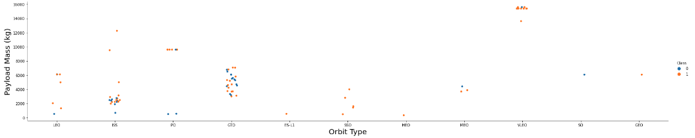
Data Visualization
LEO, SSO, and ISS tend to only launch smaller payloads achieving high mission success. GTO on the other hand launches heavier payloads but has seen more mission failure. VLEO almost exclusively launches the heaviest payloads and achieves a very high mission success. The key takeaway: VLEO orbits are very likely to be heavy payloads whereas lighter payloads will be in SSO, LEO, or ISS save a few exceptions.

Slide 10
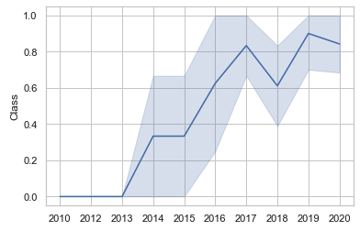
Data Visualization
There is a positive trend of mission success in the years beyond 2013. There was a negative trend in 2017 and a slight dip in 2019 though the overall trend of mission success has been upward.

Slide 11

EDA with SQL

Slide 12
IBM DB2 SQL Query
Display the names of the unique launch sites in the space mission
Display 5 records where launch sites begin with the string 'CCA'
Display the total payload mass carried by boosters launched by NASA (CRS)
Display average payload mass carried by booster version F9 v1.1
List the date when the first successful landing outcome in ground pad was achieved
List the names of the boosters which have success in drone ship and have payload mass greater than 4000 but less than 6000
List the total number of successful and failure mission outcomes
List the names of the booster versions which have carried the maximum payload mass
Rank the count of successful landing outcomes between the date 04-06-2010 and 20-03-2017 in descending order
https://github.com/kpacks77/IBM_data_capstone/blob/main/jupyter-labs-eda-sql-coursera_sqllite.ipynb

Slide 13
Maps with Folium
Used Latitude and Longitude coordinates of given launch sites to add markers and labels
Assigned launch outcome (success/failure) from the data frame to classes 1 and 0 respectively and assigned the class ‘Green’ and ’Red’ markers to marker clusters grouped by launch site
Measured minimum distances of launch sites to:
Cities
Highways
Coastlines
Railways
It was determined that launch sites are within proximity to railways, highways, and coastline. Launch sites are within 50km of a city.
https://github.com/kpacks77/IBM_data_capstone/blob/main/lab_jupyter_launch_site_location.ipynb

Slide 14
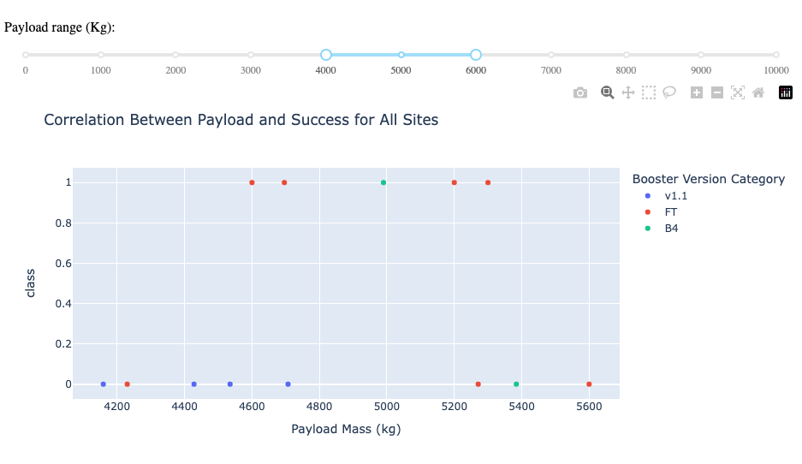
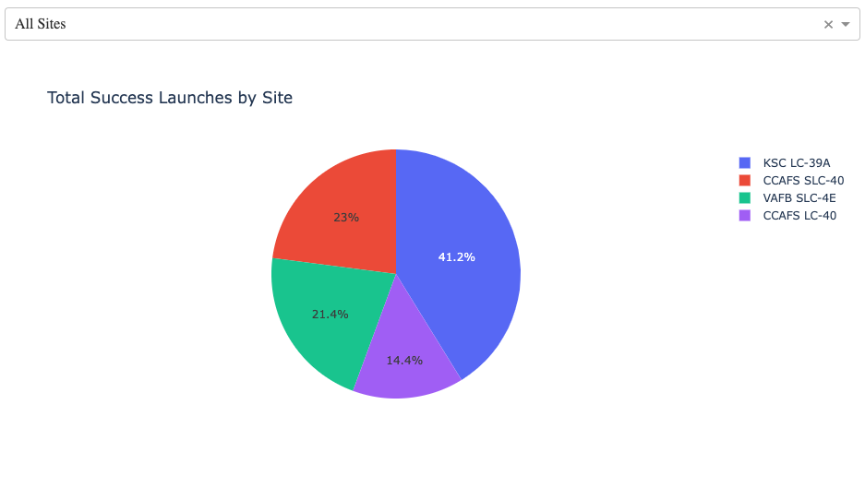
Build Plotly Dashboard
Make an interactive web app to visualize launch data
Include pie chart to visualize launch landing success by launch site
Include scatter plot of payload mass vs. landing success rate color coded bby booster version
https://github.com/kpacks77/IBM_data_capstone/blob/main/spacex_dash_app.py

Slide 15

Predictive Analysis
Build
Transform data
Split data into Training and Testing Sets
Use ML algorithms to use for classification (KNN, Decision Tree, SVM, Logistic Regression)
Use Grid Search and Cross Validation to find best tuning parameters
Evaluate
Check accuracy of each model
Plot Confusion Matrix
Improve
Feature Engineering
Algorithm Tuning
Select
Model with best accuracy score is chosen on best model
This Photo by Unknown Author is licensed under CC BY-SA-NC
https://github.com/kpacks77/IBM_data_capstone/blob/main/SpaceX_Machine%20Learning%20Prediction_Part_5.ipynb

Slide 16
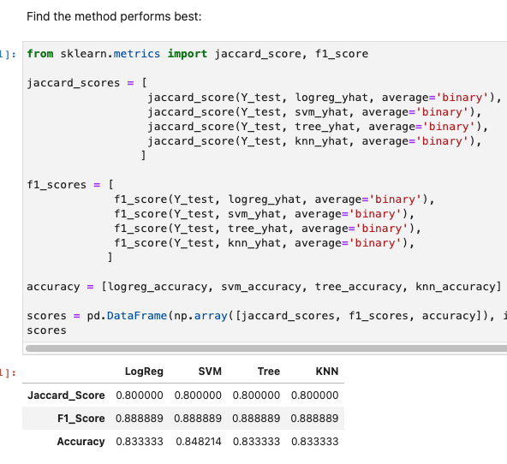
ML Method
After performing analysis on logistic regression, SVM, tree, and KNN methods it was noted that SVM had the highest accuracy and would be used for modeling and prediction
https://github.com/kpacks77/IBM_data_capstone/blob/main/SpaceX_Machine%20Learning%20Prediction_Part_5.ipynb

Slide 17

CONCLUSION
Low weighted payloads perform better than heavier payloads on the Falcon 9 rocket system except when in VLEO orbit
Success rates for SpaceX launches display a positive linear trend indicating that success rates of Falcon 9 rocket systems are increasing
KSCLC 39A has the most success of all the sites by a large margin
GEO, SO, HEO, ESL-1 only have one launch and data is inconclusive to their efficacy. VLEO has demonstrated success.

Slide 18
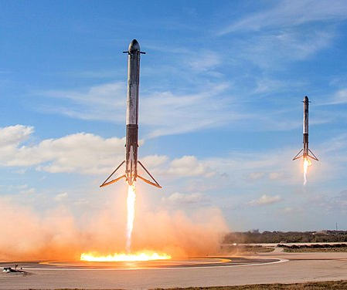
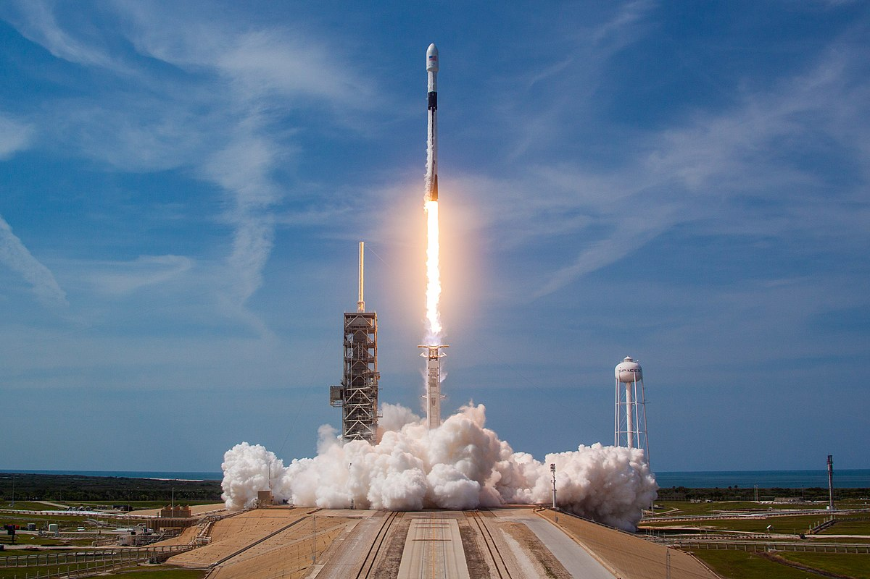
Thank you!
This Photo by Unknown Author is licensed under CC BY-SA
This Photo by Unknown Author is licensed under CC BY-SA

