Slide 1
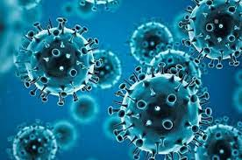
COVID-19 Data Analysis
Aditya Kandarpa
PGCP DSML Batch #3

Slide 2
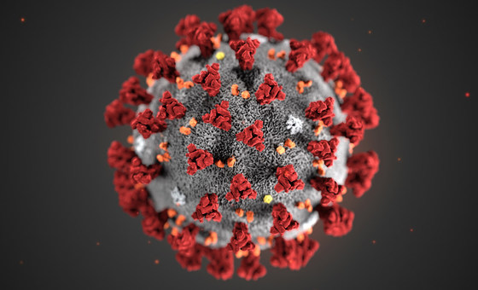
Agenda
Analyze COVID-19 data
Perform data cleaning
Generate various reports
Generate insights and Recommendation

Slide 3
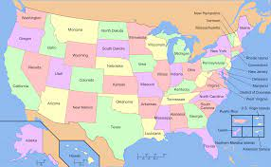
Analyzing Data
us_census_data
164 columns
3193 rows
Numeric codes for county and state are of no use.
State name in Title case should be converted to uppercase
Census data from 2010 to 2018 should be ignored and 2019 data to be used.
It needs to be extrapolated to find data for 2020 and 2021

Slide 4
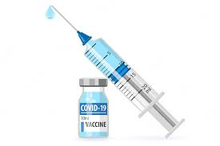
Analyzing Data
vaccines_janssen, vaccines_moderna, vaccines_pfizer
Jurisdiction column
It corresponds to county name for most of the records
For few records, it corresponds to state name e.g. California
For some records, state name does not exist e.g. “Federal Entities”, “U.S. Virgin Islands” etc…
For Chicago, the state name should be Illinois and county name should be “Cook County”, There is no way to derive this

Slide 5

Data Cleaning
Get rid of invalid columns
Derive valid state name and state code and add them to all other data, so that the state link can be established.
Get rid of invalid rows, where state name does not exist.

Slide 6
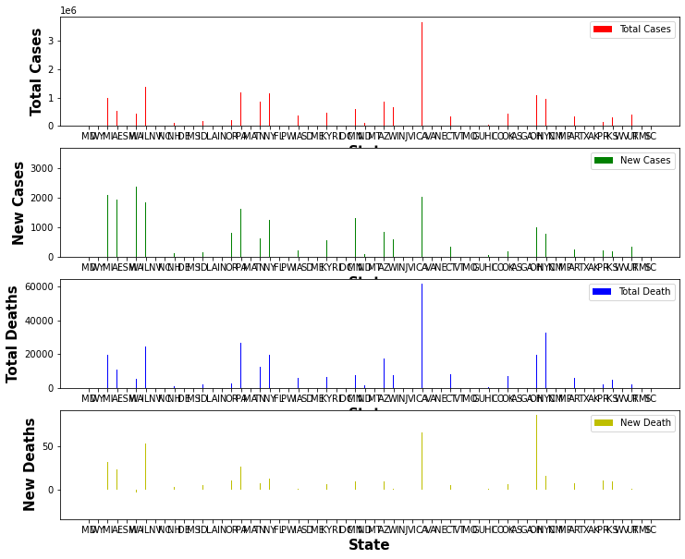
Covid-19 Total Cases as on latest date 14-MAY-21
State CA tops the number of cases list
State OH and FL have high number of new deaths.
State NE and WA have negative new deaths. This might be inaccuracy in data capture

Slide 7
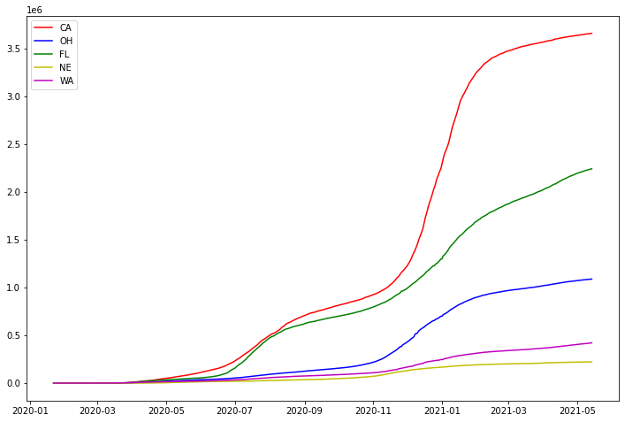
Total cases over time
The graph shows the total number of cases are rising for all states till May 2021
CA state has much higher cases compared to all other states

Slide 8
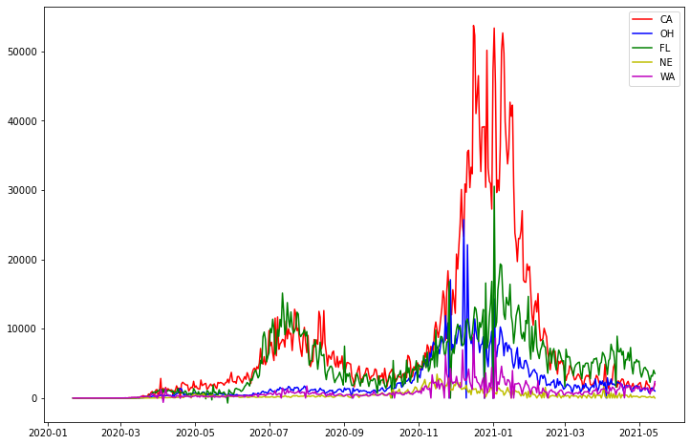
New cases over time
We have a first wave around July-August 2020
The second wave is much stronger around Jan-2021
We have a lighter third wave around April-2021 (This could be because of vaccination)

Slide 9
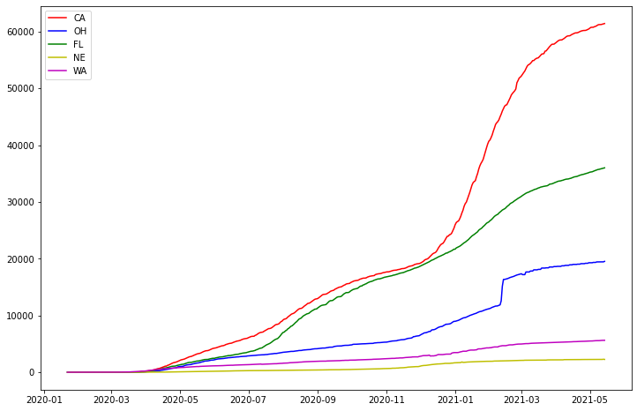
Total Deaths over time
There is a sudden rise in number of deaths in OH state around Feb 2021.
The trend is almost similar to Total cases

Slide 10
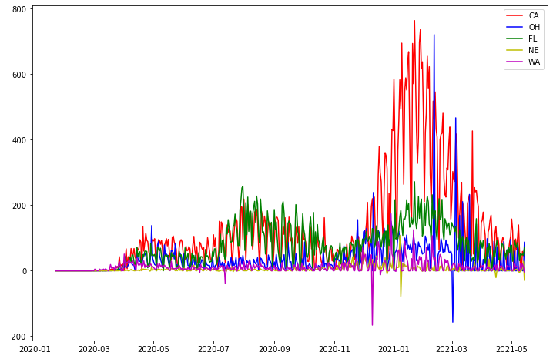
New Death over time
New death trend is almost similar to new cases.

Slide 11
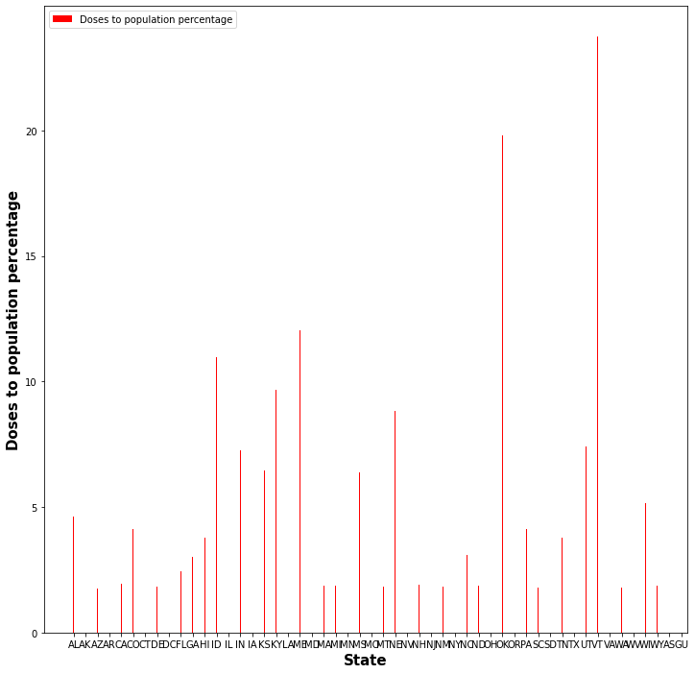
Janssen Dose to percentage of population
Janssen was allocated maximum in WV state (34% of population)
Top 4 state percentage of population wise are WV, VT, OK, MO
Top 4 state number of dose wise CA, TX, MO, NY

Slide 12
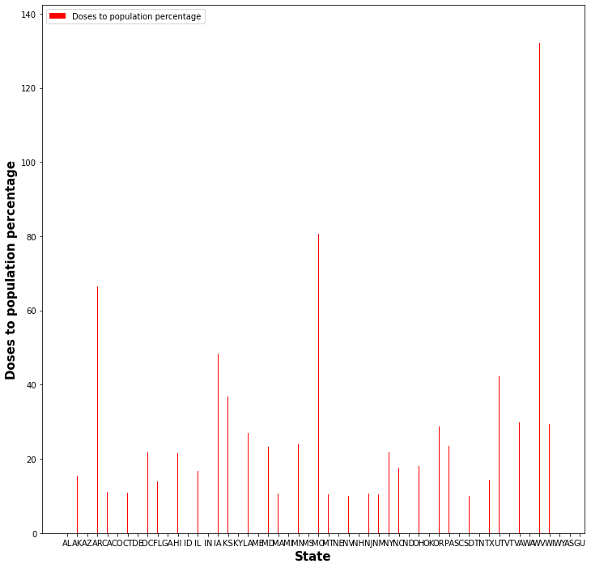
Moderna Dose to percentage of population
Moderna was allocated maximum in WV state
Top 4 state percentage of population wise are WV, VT, OK, MO
Top 4 state number of dose wise CA, TX, MO, NY

Slide 13

Pfizer Dose to percentage of population
Pfizer was allocated maximum in VT state
Top 4 state percentage of population wise are VT, WV, OK, MO
Top 4 state number of dose wise MO, OK, CA, NY

Slide 14
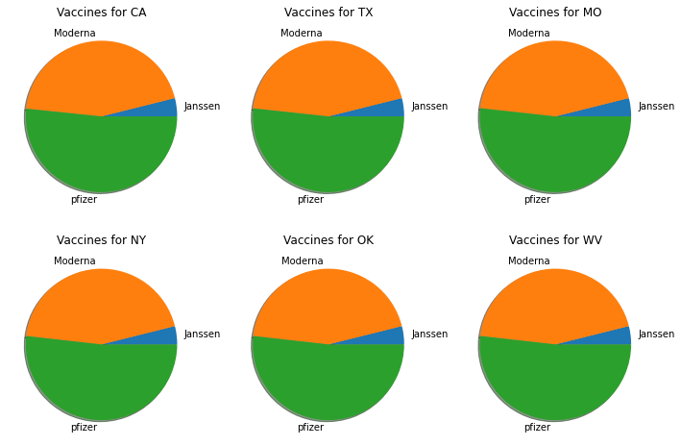
Vaccine percentage by state
Pfizer was allocated more than 50% in almost all the states.
The next highest is Moderna.
Janssen is administered to very few people in almost all the states.

Slide 15
Conclusions and recommendations
Pfizer was allocated more than 50% in almost all the states.
The next highest is Moderna.
Janssen is administered to very few people in almost all the states.
Vaccine should be allocated based on population percentage.
Some of the densely populated states have higher number of cases and higher number of deaths.

