Slide 1


Sentiment Analysis of Social Media Data using LLM
Presented by:
Prasanna Aditya Kandarpa
CSU ID: 2896149
CIS 660: Data Mining Section 1
Under guidance of Dr. Sunnie S Chung

Slide 2
Table of Contents:
What is Sentiment Analysis
Introduction to the Project
System Setup
Understanding the Input Data
Data Preprocessing
Feature Engineering
Sentiment Mapping
Baseline Model (XGBoost)
Hyperparameter Optimization
Transformer-Based LLM (BERT)
K-fold Cross-validation
Metrics Comparison

Slide 3
What is Sentiment Analysis:
Sentiment Analysis, also known as Opinion Mining, is a natural language processing (NLP) technique used to determine the emotion behind the body of a text.
- The aim is to identify and classify sentiments expressed as Positive, Negative, or Neutral, and sometimes more granular emotions like anger, joy, or sadness.

Slide 4
Introduction to the Project:
This project performs Sentiment Analysis using a dataset containing social media posts with 15 columns, which include textual data, sentiment labels, timestamps, usernames, social media platforms, hashtags and other demographic information.
The primary goal is to classify each record’s sentiment label into one of the three major categories: Positive, Negative, or Neutral. I train and predict the classification using transformer-based Large Language Models (LLMs) like BERT or GPT-4.o.

Slide 5
System Setup:
Platform:
Google Colab (T4 and A100 GPUs)
Programming Language Used:
Python
Frameworks used in Python:
pandas, re, google.colab, datetime, random, collections, sklearn, xgboost, scipy,…….

Slide 6
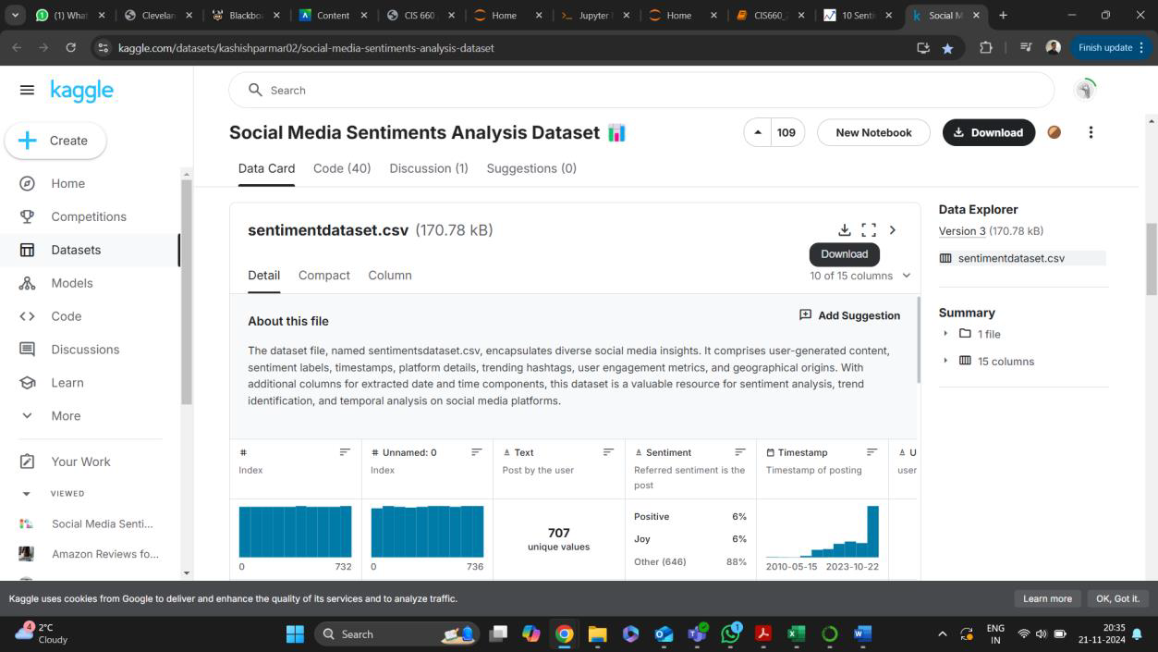
Understanding the Input Data:
Platform: Kaggle (sentimentdataset.csv)
https://www.kaggle.com/datasets/kashishparmar02/social-media-sentiments-analysis-dataset

Slide 7
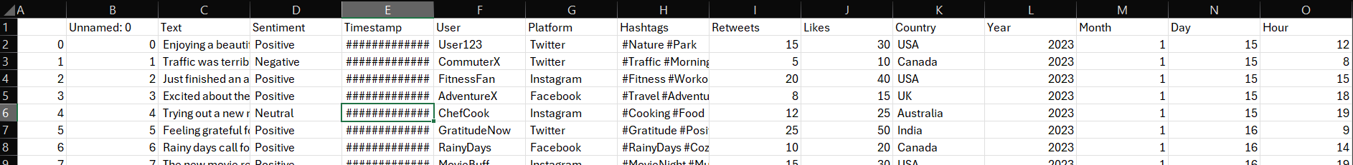
- Input Dataset Size:
15 Columns
732 Records
Covers a variety of characteristics related to the Social Media Posts
Text,
Sentiment Label,
Timestamp,
User,
Platform,
Country,
Hashtags,
Likes,
Retweets

Slide 8
But just 732 records are not sufficient to train the LLM!!
Generate 100000 Synthetic records via Bootstrapping
- Restore Column names
Select a Random row and modify:
Alter the Text column by randomizing the words
Keep Sentiments, Hashtags, Platform and Country same
Generate new timestamps by applying random offset.
Generate Random User ids.
Add small random offset to Likes and Retweets.
Extract the Year, Month, Day and Hour from the modified timestamps

Slide 9
Data Processing:
Drop unnecessary columns (Unnamed:0.1 and Unnamed:0)
Clean the Text Column
- Remove URLs
- Remove Special Characters
- Remove Single characters surrounded by Spaces.
- Remove Extra whitespaces
- Convert to lowercase

Slide 10
Feature Engineering:
Timestamp-based features (is_weekend, post_season)
User-based features (user_post_count)
Platform-based features (platform_encoded)
Hashtag-based features (global_hashtag_frequency, tf-idf features)
Engagement-based features (engagement_score, is_viral)
Country-based features (country_post_count)

Slide 11
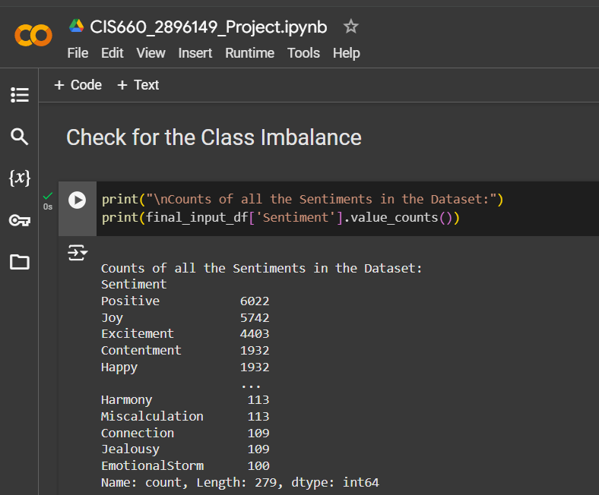
Sentiment Mapping:
279 Unique Sentiment Labels
Mapped into 3 main Labels:
Positive, Negative, Neutral
Simplification of Sentiment Categories
Consistency in Labels
Easier to Interpret
Focus on High Level Trends
Model Simplicity and Performance
Stability across Applications

Slide 12
Final Input Dataset:
100732 Rows
718 Columns

Slide 13
Dataset Split:
Training Dataset (70%)
Validation Dataset (15%)
Test Dataset (15%)

Slide 14
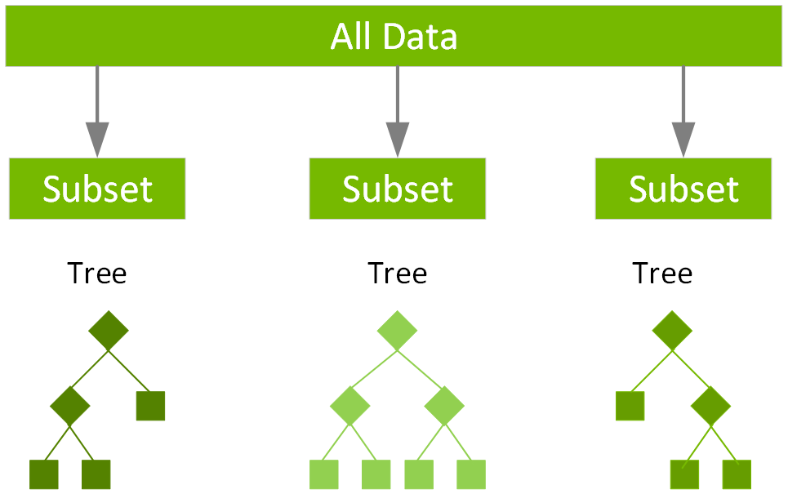
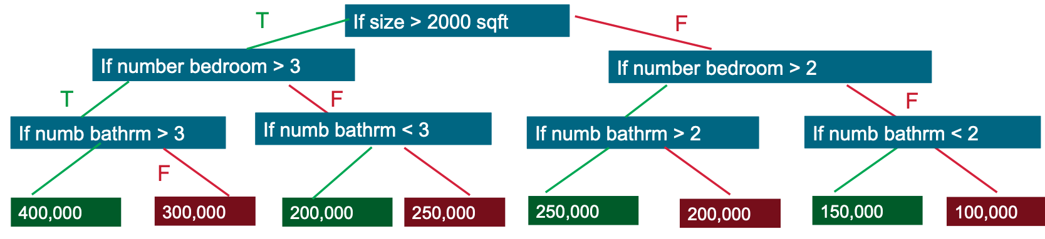
XGBoost Model:
Extreme Gradient Boosting
Supervised Machine Learning Algorithm
Distributed Gradient Boosted Decision Tree (GBDT) model

Slide 15
Why XGBoost:
Efficient Handling of Structured Data
Scalability and Speed
Feature Importance
Robust Performance
Interpretability

Slide 16
XGBoost Algorithm Parameters:
n_estimators=300: Number of trees.
max_depth=5: Maximum depth of each tree.
learning_rate=0.05: Shrinks the weight of each tree during updates.
subsample=0.8: Fraction of training samples used for each tree.
colsample_bytree=0.8: Fraction of features used for each tree.
tree_method='hist': Efficient histogram-based splitting.
random_state=42: Ensures reproducibility.

Slide 17
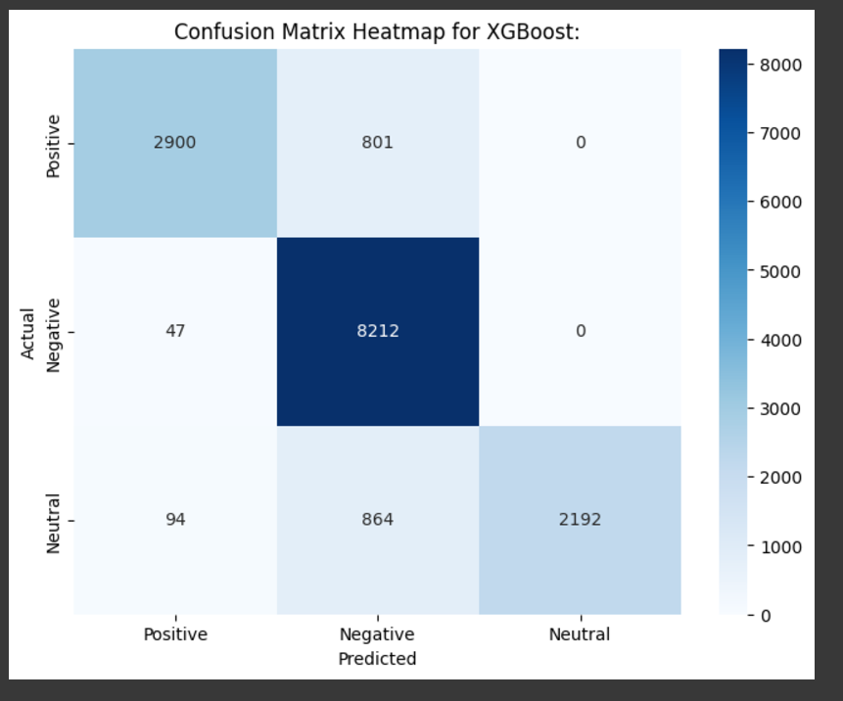
Performance Metrics for XGBoost:
Accuracy of the Model: 88%
Precision of the Model (Positive: 0.95, Negative: 0.83, Neutral:1.00)
Recall of the Model (Positive: 0.78, Negative: 0.99, Neutral:0.70)
F1-score of the Model (Positive: 0.86, Negative: 0.91, Neutral:0.82)

Slide 18
Hyperparameter Optimization:
To improve Model Performance and Efficiency
By Training the model for different parameter settings
Achieve Best Accuracy for a set of Parameters
'n_estimators': [100, 200, 300],
'max_depth': [4, 5, 6],
'learning_rate': [0.01, 0.05, 0.1],
'subsample': [0.8, 1.0],
'colsample_bytree': [0.8, 1.0]
Best Parameters for XGBoost for the input Dataset:
'colsample_bytree': 0.8, 'learning_rate': 0.1, 'max_depth': 6, 'n_estimators': 300, 'subsample': 0.8
Best Accuracy Score for XGBoost for the input Dataset:
0.9947384842296346 (99%)

Slide 19
BERT (BIDIRECTIONAL ENCODER REPRESENTATIONS FROM TRANSFORMERS)
Open-source deep learning framework developed by Google for NLP tasks.
Uses Bidirectional Transformer Encoder to represent words in a sentence.
Why BERT?
Goal:
To Provide a generalized and improved fine-tuning framework for NLP Tasks.

Slide 20
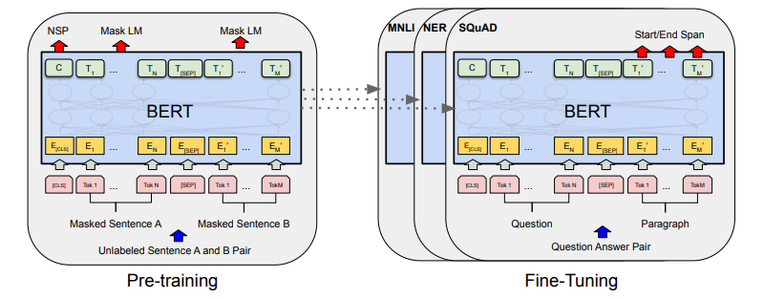
BERT Architecture:

Slide 21
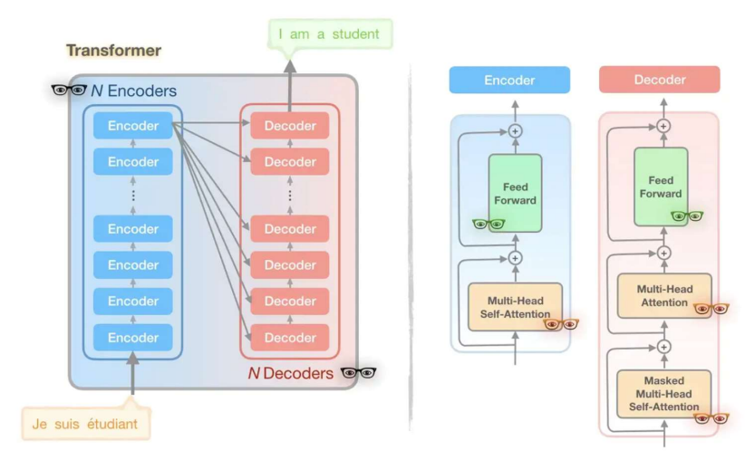
Transformer:

Slide 22
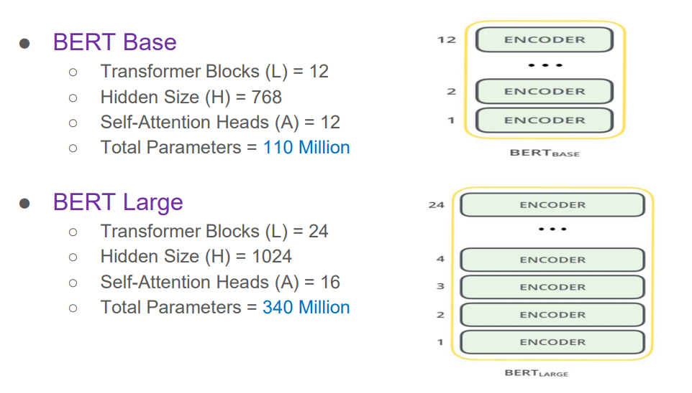
BERT Models:

Slide 23
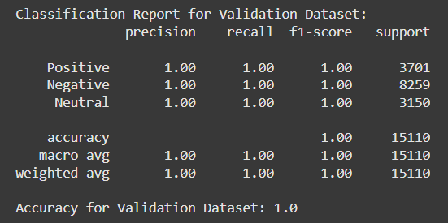
BERT Performance on Validation Set:
100 % accuracy!!!!

Slide 24
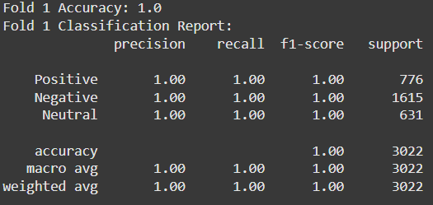
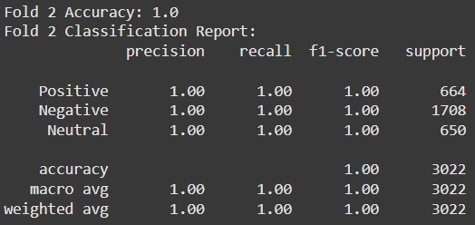
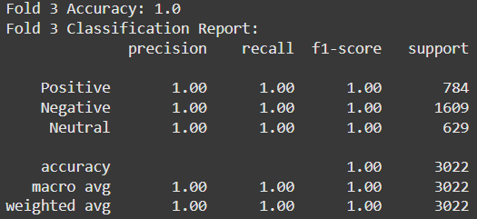
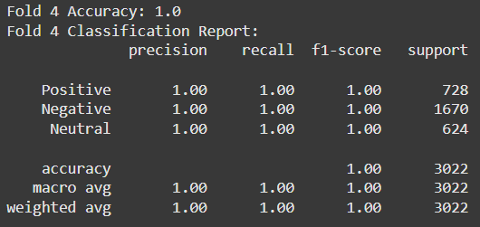
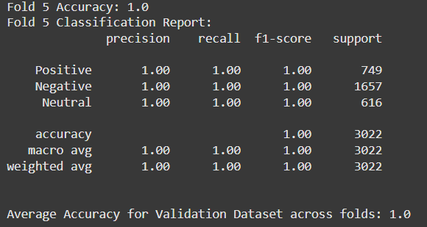
K-fold Cross validation on Validation Dataset:
100 % accuracy!!!!

Slide 25
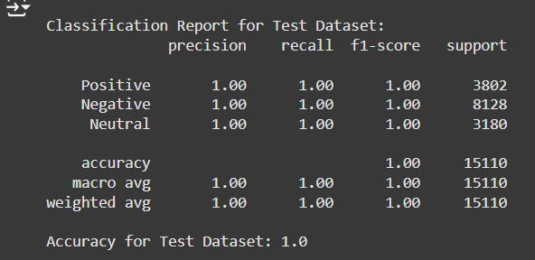
Evaluating BERT Performance on Test Dataset:
100 % accuracy for the Test Dataset!!!!

Slide 26
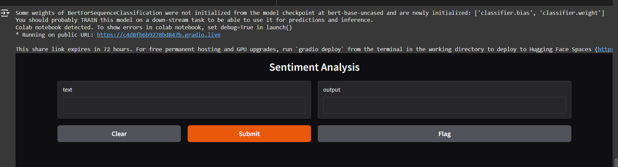
Visualize the model prediction on a UI App:

Slide 27
XGBoost vs BERT:
- Model Architecture (Tree –based vs Transformer-based)
- Feature Representation (TF-IDF vectors vs pre-trained language model)
- Training Strategy (trains from scratch vs pre-trained on huge datasets)
- Bidirectional Contextual Understanding (non-bidirectional vs bidirectional approach)
- Dataset Complexity (medium datasets vs huge complex datasets)
- Interpretability (more transparent vs black box interpretation)
- Fine-tuning (needs hyperparameter tuning vs fine-tuned within the task)

Slide 28
Challenges Faced:
Training the model was consuming because of the input Size (100732x718)
Training the BERT model was taking infinite amount of time in Jupyter notebook. So switched to Google Colab GPU.
Had to re-run the models several times to cross-check the metrics.

Slide 29
Conclusion:
Goal:
Successfully implemented a sentiment analysis system to classify text data into Positive, Negative, and Neutral sentiments.
Explored both XGBoost and BERT models to analyze their effectiveness for the task.
Key Learnings:
XGBoost:
Delivered 88% accuracy using TF-IDF features and structured data.
Suitable for structured/tabular data but has limited capacity to understand text semantics or contextual relationships.
BERT:
Achieved 100% accuracy, leveraging its pre-trained contextual understanding of language.
Highly effective for sentiment analysis tasks but computationally expensive.
Model Insights:
XGBoost performed well for simple patterns in the dataset but struggled with nuanced sentiments due to its reliance on TF-IDF features.
BERT captured complex linguistic nuances, making it the superior choice for sentiment analysis of textual data.
Key Outcomes:
Built a robust BERT-based sentiment analysis system with outstanding accuracy, validated on real-world data.
Created a gradio web application to make the model accessible for real-time sentiment prediction.
Future Scope:
Fine-tuning BERT to avoid potential overfitting and validate its performance on unseen datasets.
Integrating additional structured features (e.g., time-based trends or user demographics) to enhance model insights.
Deploying the application on cloud platforms (e.g., AWS, GCP) for scalability and global accessibility.
Exploring other transformer-based models for efficiency and performance balance.

Slide 30
THANK YOU

