Slide 1

AI
TOOLS
ANALYSIS
Ajay K P

Slide 2

AI Tool Usage Analysis with SQL
OVERVIEW :-
This project analyzes ai tool usage trends, performance, and user engagement using sql. The dataset contains information about AI tools, users, and interactions, including: ✔ AI tool names and their performance metrics (queries, response time, ratings). ✔ User data (unique users, subscription types, and engagement levels). ✔ Usage patterns across different time periods.

Slide 3
Problem Statement
With the growing adoption of AI tools, businesses need to optimize performance and user engagement. The goal is to: 🔹 Identify the most frequently used AI tools based on total queries. 🔹 Determine the fastest AI tools by analyzing response times. 🔹 Evaluate user engagement levels based on queries and ratings. 🔹 Compare AI tool usage across different subscription types (Free, Premium, etc.). 🔹 Track AI tool trends over time for strategic decision-making.
My Task
✔ Extracted and analyzed AI tool usage data using SQL queries. ✔ Performed aggregations, filtering, and joins to derive key insights. ✔ Identified AI tool popularity, response times, and engagement metrics. ✔ Used CTEs and HAVING clauses to refine data analysis. ✔ Provided data-driven recommendations to enhance AI tool performance and user satisfaction.

Slide 4
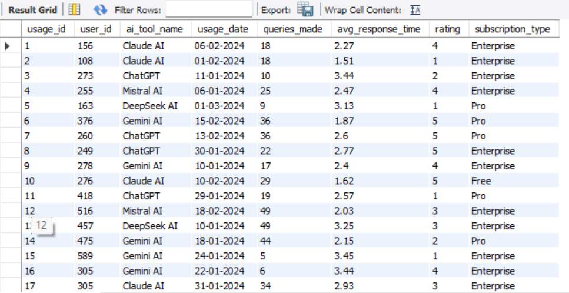
Q1. Show The Entire Table Details ?
OUTPUT

Slide 5
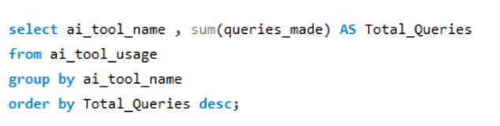
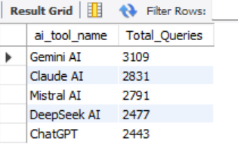
Q2. Find the Most Popular AI Tool (Total Queries) ?
OUTPUT

Slide 6
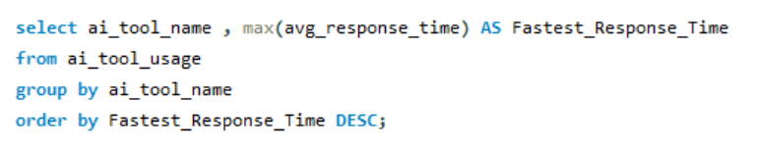
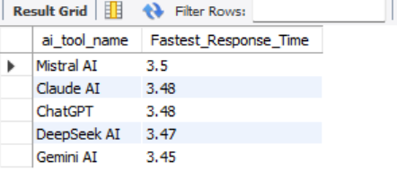
Q3. Find the AI Tool with the Fastest Response Time ?
OUTPUT

Slide 7
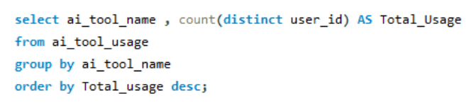
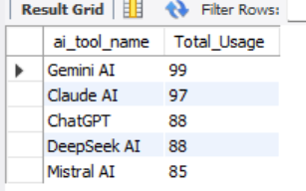
Q4. Count Total Users Who Used Each AI Tool ?
OUTPUT

Slide 8
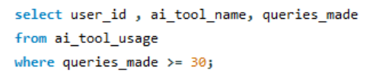
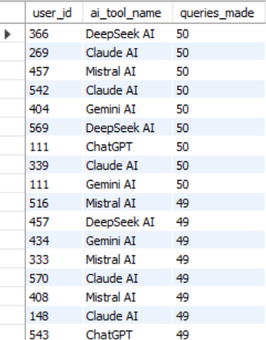
Q5. Find Users Who Have Made More Than 30 Queries from highest to lowest ?
OUTPUT

Slide 9
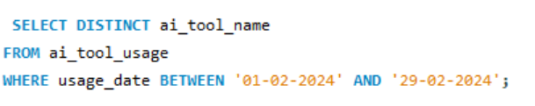
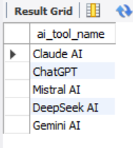
Q6. Find AI Tools Used in February 2024 ?
OUTPUT

Slide 10
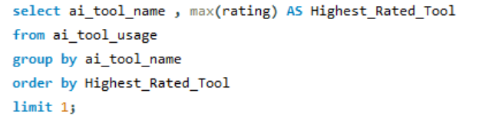

Q7. Find the Highest Rated AI Tool ?
OUTPUT

Slide 11
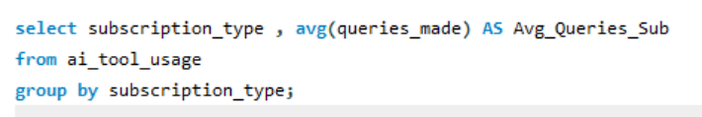
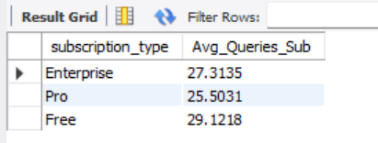
Q8. Show Average Queries Made by Subscription Type ?
OUTPUT

Slide 12
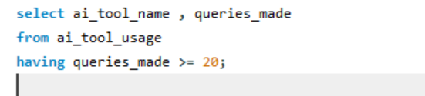
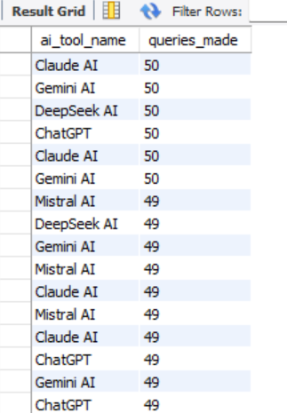
Q9. Find AI Tools with More Than 20 Queries?
OUTPUT

Slide 13
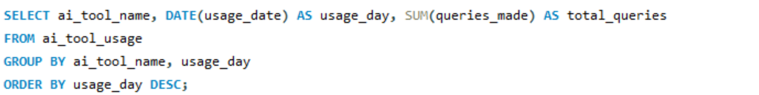
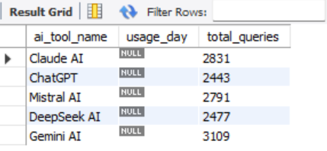
Q10. Show AI Tool Usage Trends Over Time (Using DATE Functions) ?
OUTPUT

Slide 14
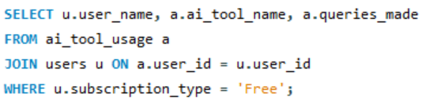
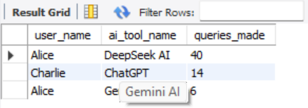
Q11. Show AI Tools Used by Free Users ?
OUTPUT

Slide 15
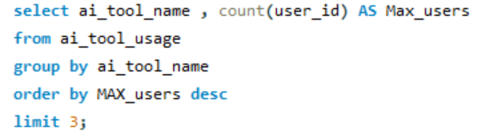
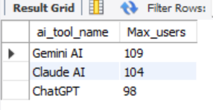
Q12. Find Top 3 AI Tools with the Most Users ?
OUTPUT

Slide 16
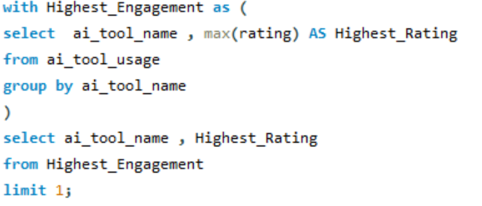

Q13. Find AI Tool with the Highest Engagement ?
OUTPUT

