Slide 1

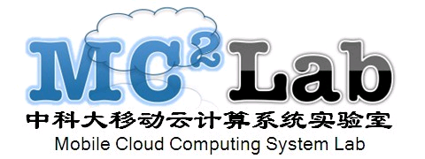
Introduction to DevOps
中科大移动云计算系统实验室
孟宁

Slide 2
Agenda
Introduce DevOps
DevOp Patterns
How to Start Adopting DevOps
Page ▪ <number>

Slide 3
How the DevOps Movement Took Place
The origins of the DevOps movement took place around 2009:
  “10+ Deploys Per Day: Dev and Ops Cooperation at Flickr” presentation.
“Infrastructure as code".
The Lean Startup.
Continuous Integration.
Cloud and Platform as a Service (PaaS) technologies.
Page ▪ <number>

Slide 4
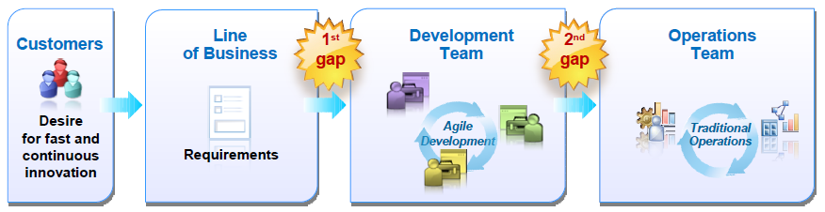
Delivery Challenges
Today’s business and technical needs are pushing traditional delivery approaches to the breaking point
Technical Challenges:Scale Complexity Time Pressures
Technical Trends: SoLoMo
Page ▪ <number>

Slide 5
Reduce Delivery Gaps
Design and Deployment Planning
  Integrate and automate deployment planning processes across development & operations
  Ensure asset & configuration details are shared and synchronized across asset stores.
Environment Setup, Testing,Deployment and Monitoring
  Leverage integrated tools for discovery & accelerating provisioning of test lab & production environments.
  Improving test performance by replicating “real world” environments - faster testing & problem resolution
Issue Identification and Resolution Management
  Resolving problems quicker by sharing problem & ticket information
  Ensuring tracking tools for production problems and application fixes remain synchronized
Page ▪ <number>

Slide 6
DevOps Typical Stories
Software Delivery Lifecycle (Integrated Development and Operations Lifecycles)
Story 0: Dev and Ops collaborate to develop environment definitions
  Value: Ensures that Dev understands and deals with production-like environments; avoids architectural miscommunications
Story 1: Dev continuously delivers application changes to a realistic environment for testing
  Value: Shared technology ensures testable environments and script reuse for repeatable delivery; Test org always has known good builds,properly deployed.
Story 2: Release Applications from Test /Staging to production
  Value: Shared technology and automation ensures no gratuitous differences between dev/test and prod.
Story 3: Collaborative incident management
  Value: ensures an integrated process for reproducing and resolving defects and issues between dev, test,and ops.
Story 4: Dev and Ops use the same analysis and instrumentation in dev, test,
and ops
  Value: Ensures a common understanding of quality and performance (and no fingerpointing)
Story 5: Manage the entire delivery pipeline with end-to-end visibility and dashboards
  Value: Enables end-to-end delivery metrics and visibility into bottlenecks.
Page ▪ <number>

Slide 7
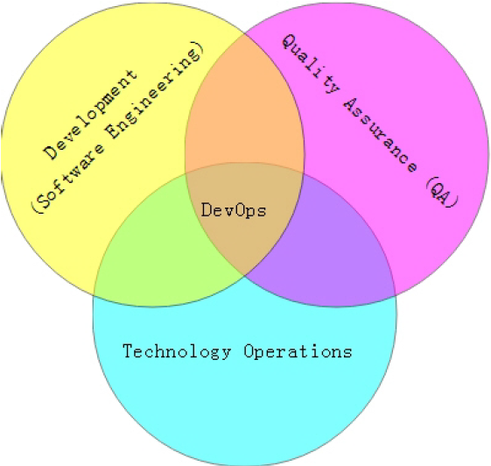
What is DevOps?
DevOps = development & operations
A Methodology of Continuous Delivery
A software development method that stresses communication, collaboration and integration between development and IT professionals.
“Streamlining release process” .
Page ▪ <number>

Slide 8
The adoption of DevOps is being driven by factors:
Use of agile and other development processes and methodologies
Demand for an increased rate of production releases from application and business unit stakeholders
Wide availability of virtualized and cloud infrastructure from internal and external providers
Increased usage of data center automation and configuration management tools
Page ▪ <number>

Slide 9
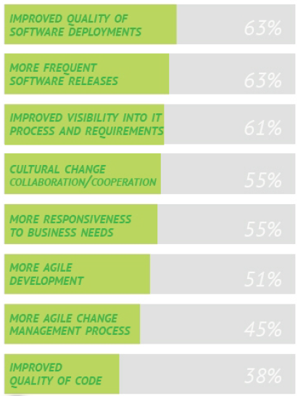
DevOps Benefits
Key benefits identified by the organizations that implement DevOps
Page ▪ <number>

Slide 10
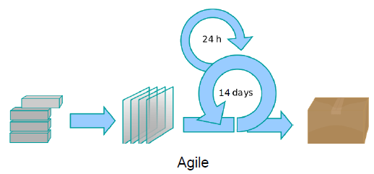
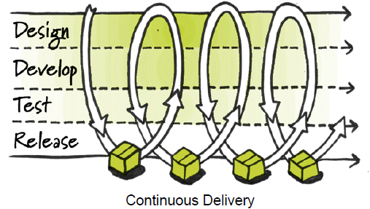
DevOps vs. Agile
DevOps is especially complementary to the Agile software development process.
  extends and completes the continuous integration and release process by ensuring that code is production ready and will provide value to the customer
DevOps enables a far more continuous flow of work into IT Operations.
  If development delivers code every two weeks but it's deployed only every two months, customers don't get value and the deployments often result in chaos and disruption.
Page ▪ <number>

Slide 11
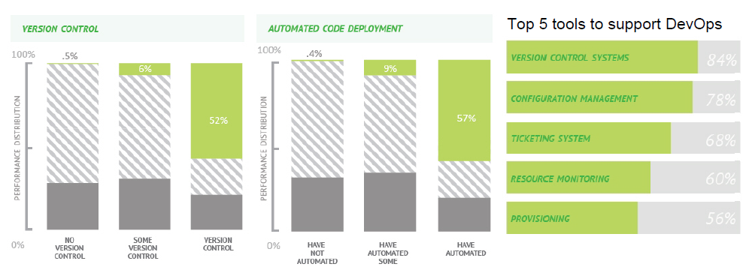
Supporting Tools
Git,Gerrit,Jenkins,Zuul,Devstack Gate,IRC bots,Puppet etc.
Page ▪ <number>

Slide 12

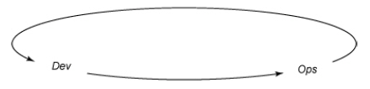

DevOps 3 Basic Principles
System thinking
Amplify feedback loops
Culture of continual experiment and learning
Page ▪ <number>

Slide 13
Deployment Pipeline
DevOps is enabled through the Deployment Pipeline:
  – Build
  – Deployment
  – Test
  – Release
The purpose of the deployment pipeline:
  – Visibility: All aspects of the delivery system are visible to all team members promoting collaboration.
  – Feedback:Team members learn of problems as soon as they occur so that issues are fixed as soon as possible.
  – Continually Deploy: Through a fully automated process, you can deploy and release any version of the software to any environment.
Page ▪ <number>

Slide 14
DevOps Patterns
TODO
Page ▪ <number>

Slide 15
How to Start Adopting DevOps?
Start Small: Start from experiments implementing small enhancements.
Create Champions: Get executive sponsors; Give credit to people.
Build Confidence: Identify KPIs to support the changes.
Celebrate Success.
Page ▪ <number>

Slide 16
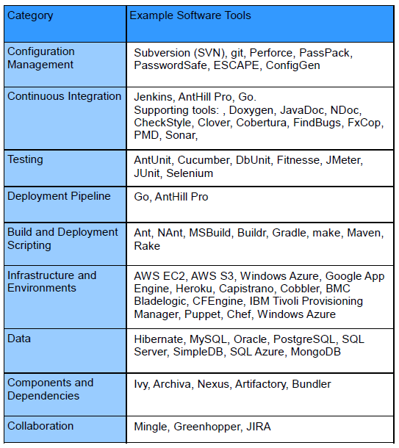
Tools for Adopting DevOps
Page ▪ <number>

Slide 17
Common Attributes of Successful Cultures
Infrastructure As Code
  Full Stack Automation
  Commodity Hardware and/or Cloud infra
  Reliability in software stack
  Datacenter or Cloud Infrastructure APIs
  Core Infra Services
Application As Services
  Service Orientation
  Lightweight Protocols
  Versioned APIs
  Software Resiliency (Design for Failure)
  Database/Storage Abstraction
Dev/Ops/All As Teams
  Shared Metrics/Monitoring
  Incident Management
  Service Owners On-call
  Tight integration
  Continuous Integration
  Continuous Deployment
  GameDay
Page ▪ <number>

Slide 18
Acknowledgement
Jun Guan,IBM China
John Allspaw & Paul Hammond,Flickr.com
Puppet labs
OpenStack Project
etc.
Page ▪ <number>

Slide 19

感谢各位
孟宁
中科大移动云计算系统实验室
mengning@ustc.edu.cn

