Slide 1

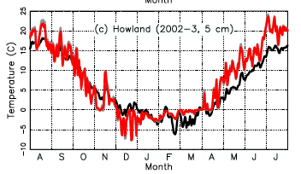
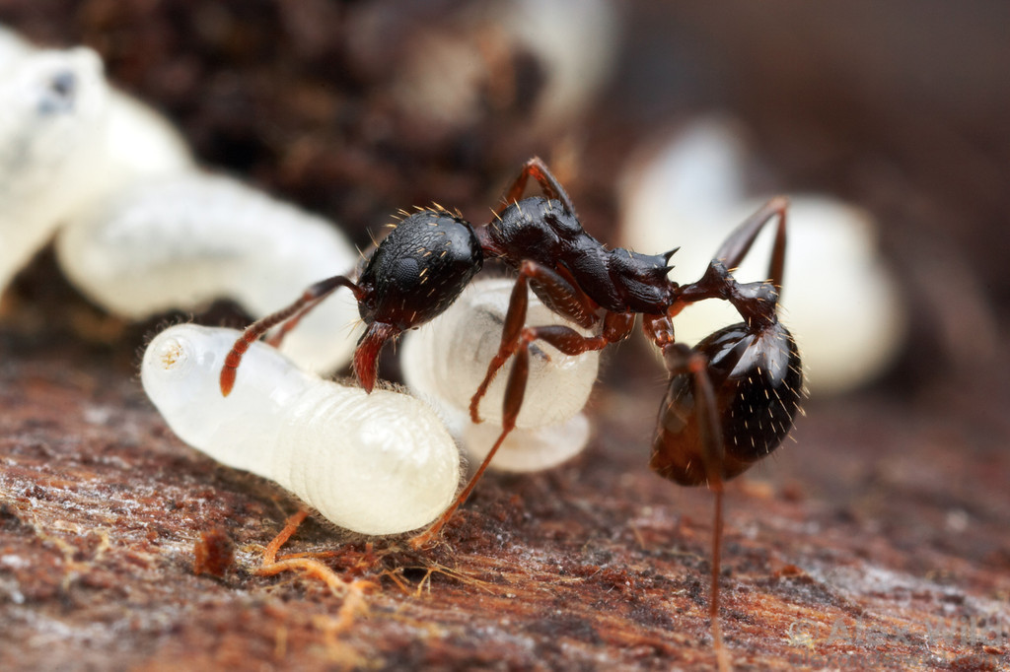
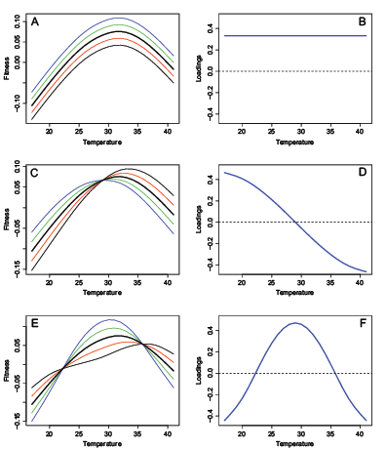
Ants living at the edge face thermal constraints
Andrew D. Nguyen¹, Megan Brown², Jordan Zitnay², Nicholas J. Gotelli^{1,} Sara Helms Cahan¹, Amy Arnett², Aaron M. Ellison³
¹ Deptartment of Biology, University of Vermont;²Department of Biology, Unity College;³ Harvard Forest, Harvard University
Common woodland ants (Aphaenogaster picea) experience thermally stressful environments!
Temperature and Seasonality most likely limits their northern distribution
Colder, more seasonal
A
B
C
Thermal stress over long and short term (Shaefer et al. 2009)
D
E
Q1: What determines their distribution at their northern range?
Fig1. Classification Tree Analysis displaying four important bioclim variables (out of 19) that best predict the presence and absence of A. picea with a 86% accuracy!
Fig2. Each panel displays the cutoffs at each node in figure 1. Circles and triangles were empirical presences and absences.
Splits based on the classification tree are colored.
Q2: Are they physiologically constrained?
Colonies from cold places cannot extend their cold tolerances
Evaluating thermal constraints
Yes, evidence for hotter-cooler trade-off
Performance curves
PCA loadings
Performance curves
PCA loadings
Vertical Shifts
Hotter-cooler variation
Generalist-specialist variation
Fig4. Clinal variation in cold tolerance (red line) and hardening(difference between red and blue. There is a significant pre-treatment X Tmin interaction (ANCOVA, p<0.001).
Fig5. We explored three possible ways A. picea cold tolerance metrics can vary. (Kingsolver et al. 2015, AmNat, see methods )
Fig6. Performance curves(left) and PCA decomposition of G matrix(right)
Fig3. Overview of physiological testing for cold tolerance and hardening (short term cold responses). For each colony, 2-4 workers followed each line.
Methods summary: Presence and absence values were collated from previous field surveys and a survey done in the summer of 2015. In this survey, Megan and Jordan visited 80 sites! They did most-all of the work on this project. Physiological tests were performed on 20 lab acclimated (25 °C at least 1 month) ant colonies collected from Maine and Burlington, VT. We used an ANCOVA to test the effect of pre-treatment (factor), Tmin (continuous), and their interaction on chill coma recovery time. The variance covariance matrix was constructed from a MANOVA, manova(traits ~ Colony). To examine correlated responses among pre-treatments, we decomposed the variance-covariance matrix (broad sense G) with a PCA.
Acknowledgements: This project was supported by a Broadening Participation REU supplement to NSF award DEB-1136644 (N. Sanders, A. Ellison, R.R. Dunn, N.J. Gotelli, S. Helms Cahan & B. Ballif). Please visit http://www.alexanderwild.com/ for awesome ant photos.

