Slide 1
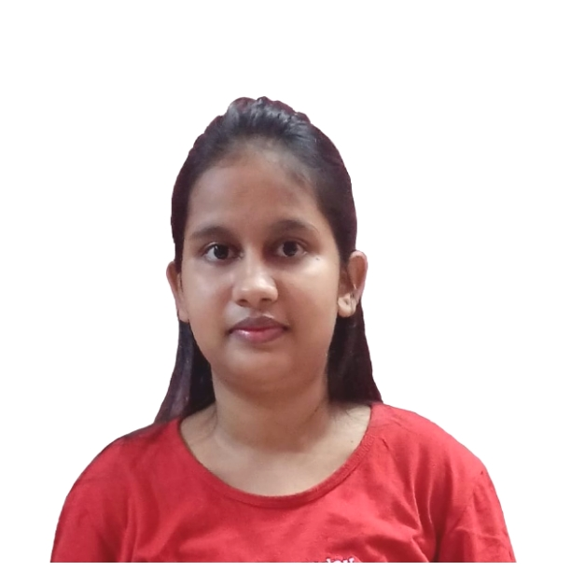


PALLAVI KUMARI
Analyst/Software Engineer
Bachelor of Technology –
Information &Technology : 2017- 2021
CGPA:8.32
Certification
Agile software Development
Associate cloud Engineer
Core Java
Skills
Apigee API Management
Google Cloud Platform
Java 8
Spring Boot
JPA CRUD
Database
SQL database – MySQL,
Postgres SQL
Web Technologies
HTML5
CSS3
JavaScript
Bootstrap
Add-ons
Maven
Postman
Additional Details
Leadership
Good Communication Skills
Team management
Noida
Pallavi.b.kumari@capgemini.com
8083918626
A4
Associate Cloud Engineer
Full Stack Developer
Hands on experience in developing web pages using HTML5, CSS3, Object Oriented Java script, ES6, JSON, XML.
Eager to work in a team of dedicated people and serve a key role in the enhancement and development of the project.
Has working knowledge on React , Java Development using Spring framework on an intermediate level.
Software Engineer who is Strong in design and integration with intuitive problem-solving skills. Passionate about implementing and launching new projects.
Employee Management system
Completed end to end case study of Employee Management system with the help of Spring boot and Postgres SQL database, React framework used for user interface.
Designed Static and Dynamic Web Pages
Employee Management system allows to Create and maintain employee & department information. Provision for mapping employees to their departments.
Developed website with HTML5 and CSS3 along with React to make website interactive and colorful.
Check out my work on GitHub & Video Profile

