Slide 1


„jirator“
Get your data from Jira to REDMINE

Slide 2
Need
Data is „trapped“ in Jira at the customer site
Data may not contain „secret“ information (hours billed vs. hours spent)
Manual export from Jira to CSV and manual import from CSV to Redmine is possible but tedious if done often
Data may change often during working-hours

Slide 3
Workflow
Jira CSV export
Automatic export issues per pre-defined filters
Jira CSV parser/converter for Redmine
Date and time data gets converted to datetime objects
Redmine CSV import
Synchronize data to existing Redmine tickets based on the Jira key (Custom field in Redmine)
Create non-existing Redmine issues on the fly and populate them with the Jira data
Generate CSV data as if the user would export it from Jira (compatibility & portability)
Rename data fields to match Redmine names (e.g. „Summary“ from Jira → „subject“ in Redmine)
Replace data (e.g. some usernames are different in Jira and Redmine)

Slide 4



Communication / data flow
Accessible via REST API
https://github.com/pycontribs/jira
https://jira.readthedocs.io/en/master
Executable / Python script
Accessible via REST API
https://github.com/maxtepkeev/python-redmine
https://python-redmine.com/
Communication between components is done via HTTPS
Jira API can be reached from internal BMW network using qx-user account or from partner network using B2B account
Redmine API can be reached from anywhere
Redmine API authentication based on user‘s API token

Slide 5
jirator components
config.json
Configuration file for defining Jira and Redmine parameters
Contains the pre-defined filters for the Jira CSV export
auth_helper
jiraconnector
jiracsvparser
csvtoredmine
jirator
Save user credentials for unattended usage
Get Jira CSV data from JQL filter
Prepare Jira CSV data for further usage
Does the heavy lifting to get the CSV data into Redmine
Executable which can be scheduled to run every hour/day/week using Windows task scheduler

Slide 6
Operations
batch
Get Jira ticket(s) for all defined filters and synchronize them with Redmine
filter
query
Get Jira ticket(s) for a single filter and synchronize them with Redmine
Get Jira ticket(s) for a custom JQL query and synchronize them with Redmine

Slide 7
Setup jirator
Extract the ZIP to a convenient location on your machine
Edit config.json with a text editor

Slide 8
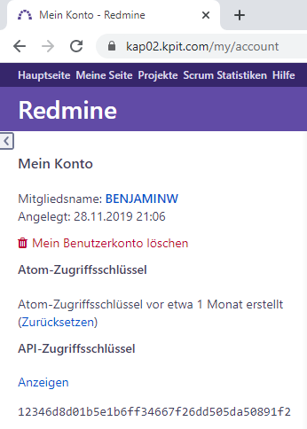
Setup config.json - RMApiKey
Go to https://kap02.kpit.com/my/account
Click Show below API access key
Copy the key
Paste it into the config file
1
2

Slide 9
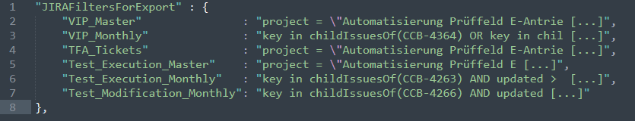
Setup config.json – JIRAFiltersForExport
Add or change filters as needed.
The first value is the filter name (choose your own)
The second value is the JQL query
“name“ : “JQL query“
Seperate the filters with ,
No , at the end of the last filter
Escape quotes within the JQL query with \

Slide 10
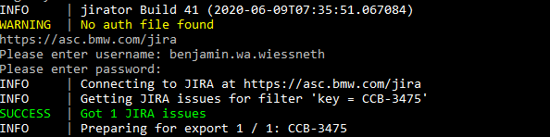
Setup authentication
The file auth.pickle holds the credentials for authorization with Jira
If you want to change those credentials either delete the file auth.pickle or run the enter_password.bat
You will be prompted to enter your login data
The script will try to get a Jira issue
If you see the SUCCESS message your credentials are good

Slide 11
jirator – Use case 1
Set up a scheduled task to export data for a filter from Jira every hour and synchronize it with Redmine
Create filter called „use_case“ and save it in config.py
Create task, define triggers and actions as shown

Slide 12
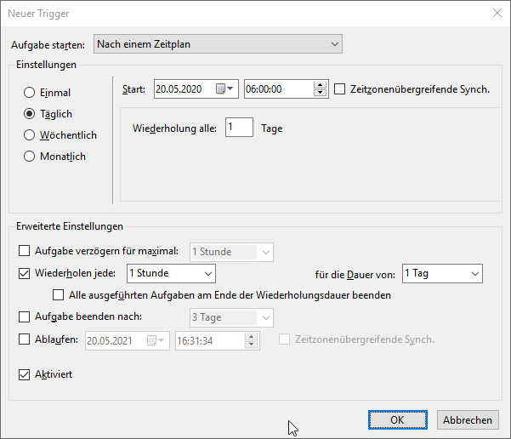
jirator – Use case 1
Define triggers as follows:
Daily
Repeat every 1 hour

Slide 13
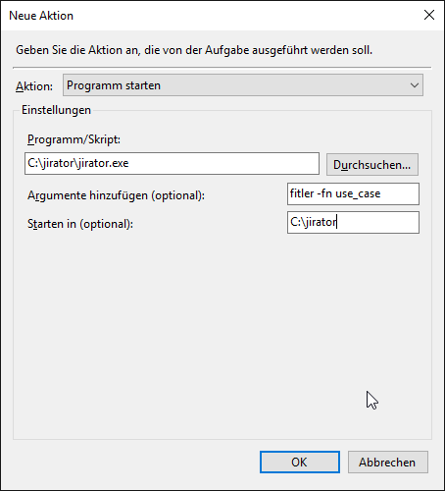
jirator – Use case 1
Configure the task as shown
Argument: filter -fn use_case --ignore-gooey

Slide 14
jirator – Use case 2
Set up a scheduled task to export data for all defined filters from Jira every hour and synchronize it with Redmine
Create one or multiple filters in config.py
Create task, define triggers and actions as shown

Slide 15
jirator – Use case 2
Define triggers as follows:
Daily
Repeat every 1 hour

Slide 16
jirator – Use case 2
Configure the task as shown
Argument: batch --ignore-gooey

Slide 17
jirator – Use case 3
Import specific Jira issues by key

Slide 18
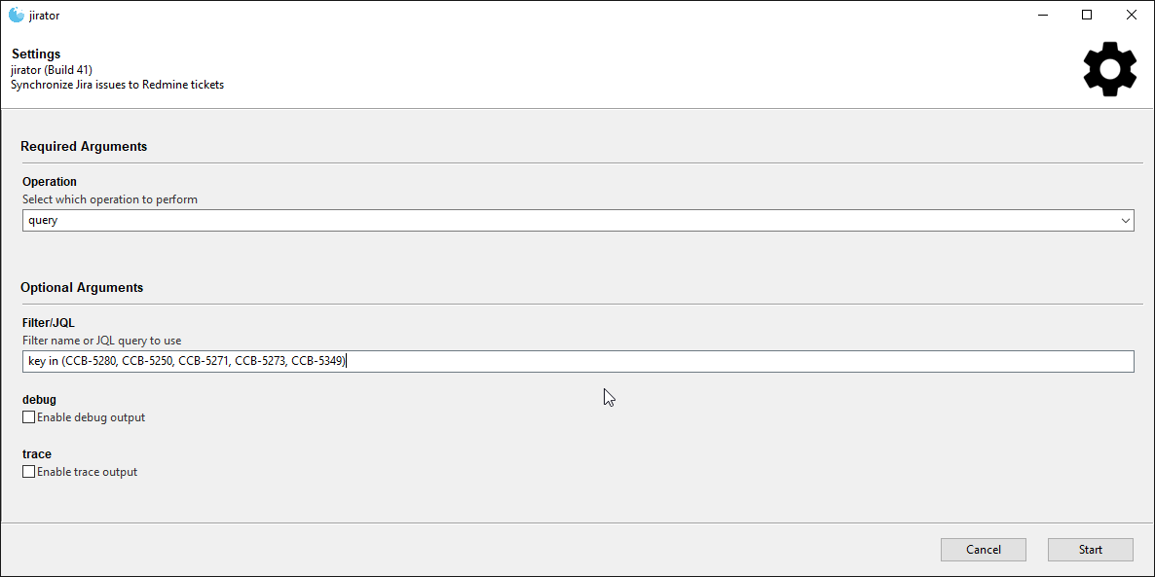
jirator – Use case 3
Operation: query
Filter/JQL: key in (CCB-5280, CCB-5250, CCB-5271, CCB-5273, CCB-5349)

