Slide 1
The Design and Implementation RISC-V based Instruction Set Architecture
By Aditya Tumsare (805643566) Kushan Parikh (805654738)

Slide 2
Contents
Introduction.
Related Work and Background Research.
Instruction Set Architecture
RISC-V
RISC V Base ISA
Methods and tools
Future work and Conclusion.

Slide 3
Introduction
In this project emphasis is given on designing of CPU based on RISC-V instruction set and implement it on Field Programmable gate array (FPGA).
The main motivation behind the designing of CPU is to learn how data path and unit for a processor is built from the scratch using hardware description language.
The processor is developed and simulated using VHDL language.
The designed processor will be implemented on Basys 3 FPGA board manufactured by Xilinx.
The simulations were carried on Xilinx Vivado Suite.
The functional simulation of RISC-V was successfully carried out.

Slide 4
Related Work and Background Research.
RISC-V is a recently developed technology
7th workshop for RISC-V organized by RISC-V foundation concluded recently in NOV 2017
Reviewed different books to get a thorough knowledge about RISC-V ISA and VHDL.
Read research papers to gain knowledge about the constraints in designing the processors.

Slide 5
Instruction Set Architecture
The instruction Set Architecture is a well-defined interface between hardware and software.
It stores the functional definition of instruction operation , instruction modes and how the instructions are stored on the hardware along with the information to invoke them.
The instruction set architecture does not give any information about the power and time required for any instruction to execute or how a instruction is implemented.
The ISA should not be ambiguous.

Slide 6
Instruction Set Architecture
Mainly two types of ISA which are RISC (Reduced Instruction Set Computing) and CISC (Complex Instruction Set Computing).
The ISA should be easy to implement for techniques such as pipelining, out-of-order execution.
ISA should not be incremental.

Slide 7
RISC-V
RISC-V is open source free Instruction set architecture.
Its future does not depend on the fate of any company as it belongs to non-profit organization.
RISC-V is not incremental.
RISC-V is a modular ISA.

Slide 8
RISC-V
The underlying principles and tradeoffs in the design RISC-V ISA are
Cost
Performance
Simplicity
Isolation of architecture from implementation
Room for growth
Program space
Ease of program compiling and linking

Slide 9
RISC V Base ISA
There are three different base instruction architecture of RISC-V which are RV32I, RV32E and RV64I.
The RV31I is base 32-bit ISA with 47 instructions.
RISC-V is a load-store architecture.
RV32I has six basic instruction formats.
All the instructions are 32 bits long.
it has three register operands filed unlike the one which is shared between source and destination.

Slide 10
Methods and tools
Processor can process a single instruction or a multicycle processor.
Single cycle processor.
Multi-cycle processor
Superscalar processor
Data path and control unit designed for multicycle data path.
VHDL model for processor.

Slide 11
Methods and tools
Simulations were taken on Xilinx Vivado Tool.
implementation was done on Xilinx Basys 3 FPGA.

Slide 12
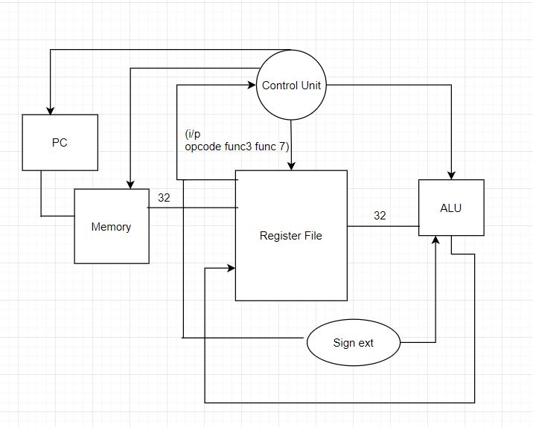
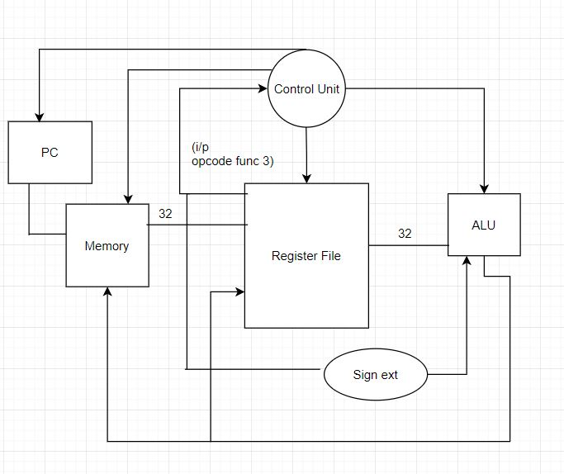
Results and implementation
For R – type Instruction
For I – type Instruction

Slide 13
Results and implementation
This figure shows the simulation of the processor determined from the data-path.

Slide 14
Future work and Conclusion
RISC-V RV32I is the base ISA; its data-path creation and multicycle implementation is first step in developing the latest RISC architecture.
The multicycle implementation of the data path can be improved and be extended to implement parallel pipelining.
The designed data path can be extended for superscalar processor.

