Slide 1
Conway’s Game of life

Slide 2
Team members:
KRUSHAN PATEL (LEADER)
RAJ JASANI
KARAN PARIKH
HARSH PATEL

Slide 3
DEMO PROGRAM:
http://codd.cs.gsu.edu/~kparikh2/home.html

Slide 4
Rules of the game:
Any live cell with fewer than two live neighbors dies, as if caused by under population.
Any live cell with more than three live neighbors dies, as if by overcrowding.
Any live cell with two or three live neighbors’ lives on to the next generation.
Any dead cell with exactly three live neighbors becomes a live cell.

Slide 5
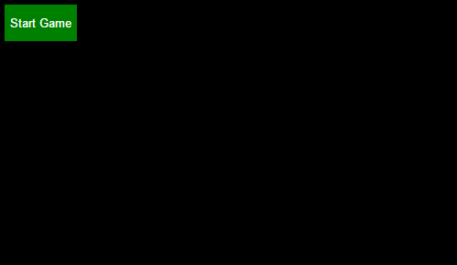
Starting the game!

Slide 6
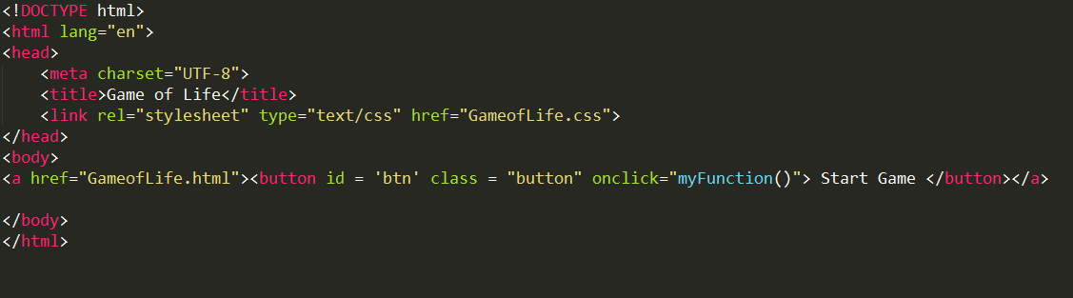
Code snippet:

Slide 7
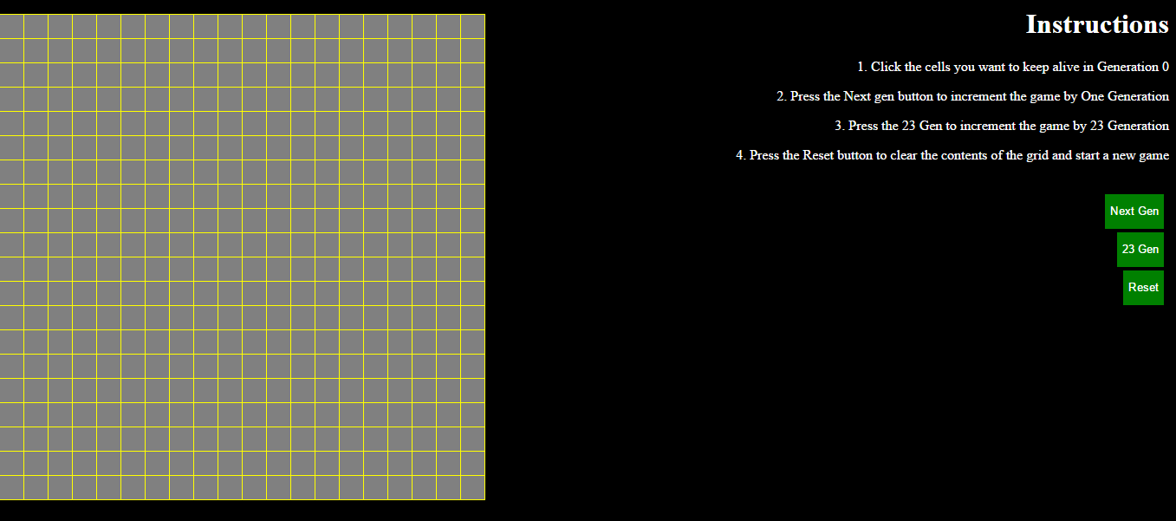
The game!

Slide 8
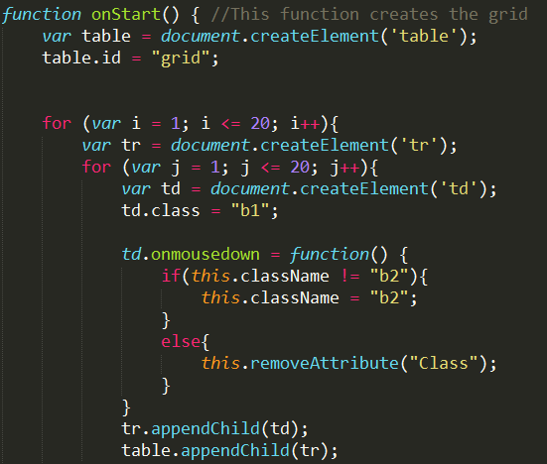
Creating the grid:
The function onStart() creates the initial grid layout.

Slide 9
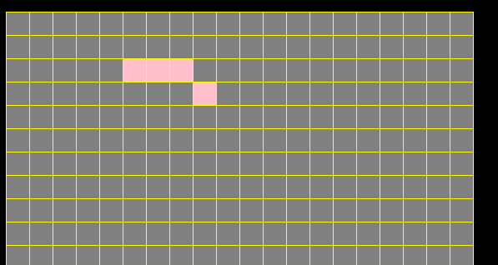
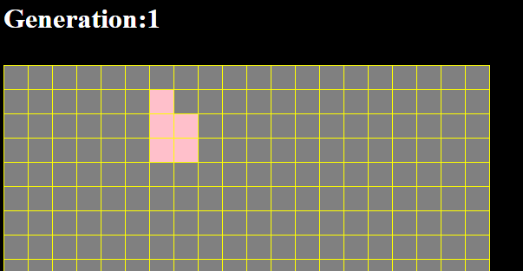
Incrementing 1 generation:
INITIAL:
AFTER 1 GENERATION

Slide 10
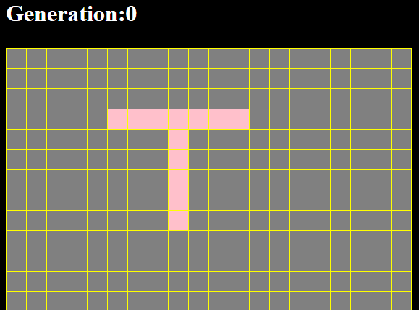
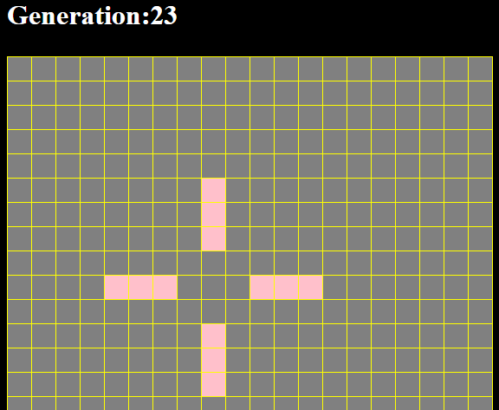
Incrementing 23 generation:

Slide 11
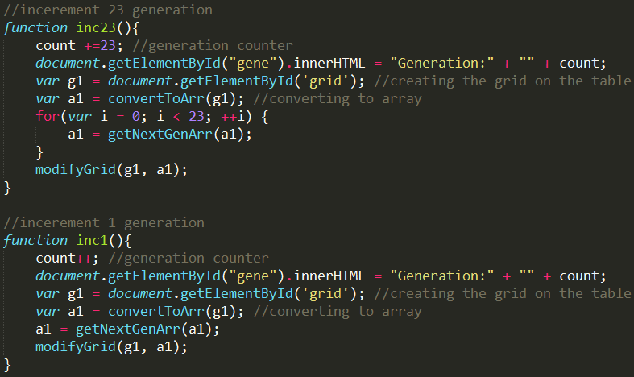
Code for INc1() and INC23()

Slide 12
Incrementing 1 and 23 generation
The 23 generation function is same as the 1 generation with addition to a for loop which runs 23 times and then displays the result.

Slide 13
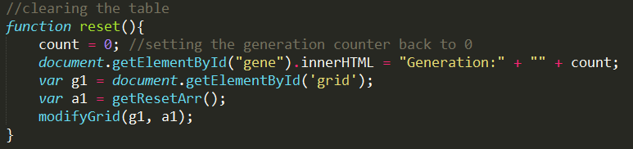
Reset function:
The reset function will clear the table and display a brand new table.

Slide 14
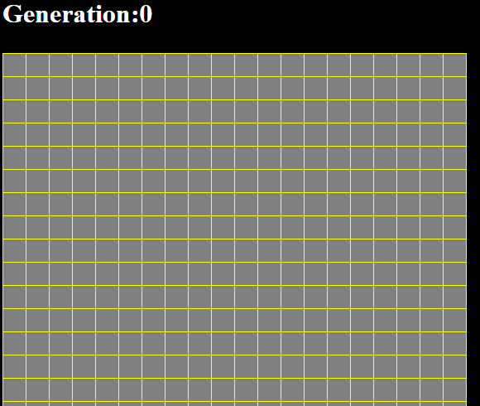
Reset cont.

Slide 15
The End
Thank you

