Slide 1
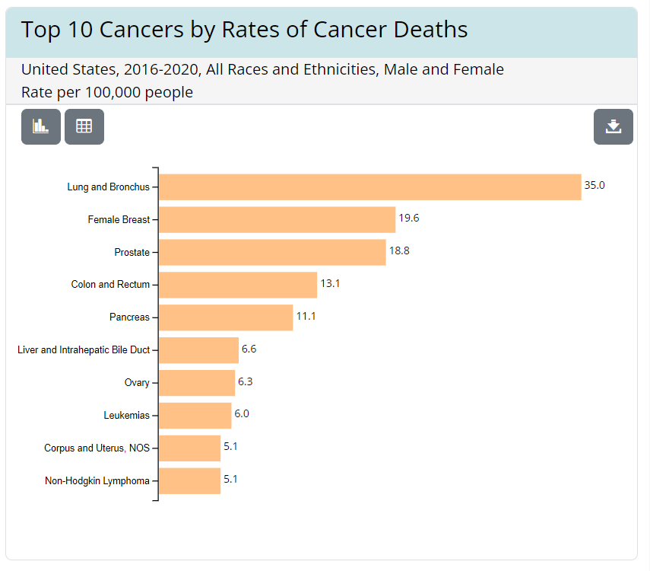
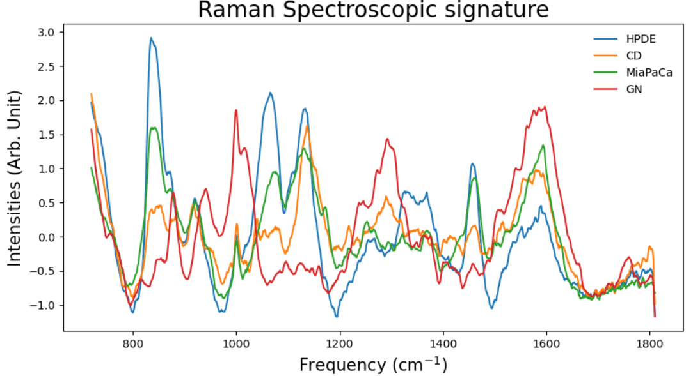
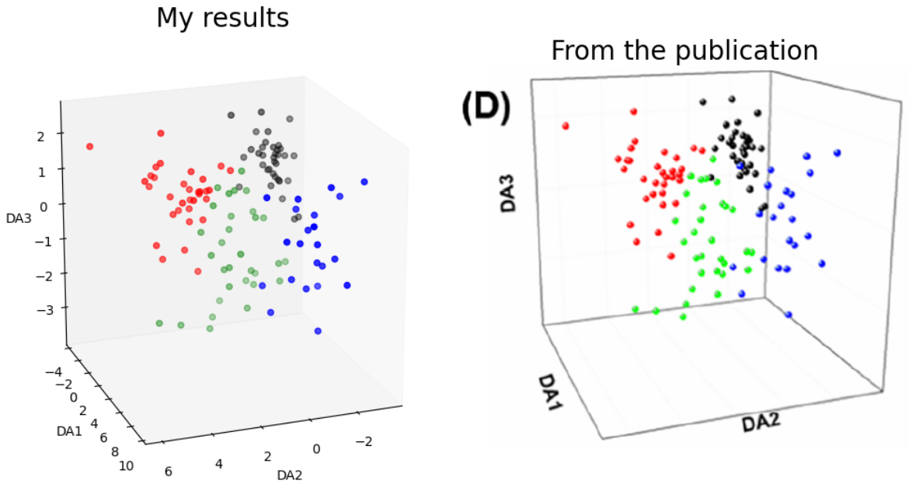
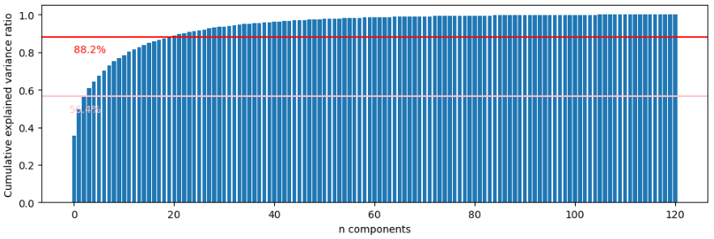
Detection of pancreatic cancer through Raman Spectroscopy and machine learning
Kiman B. Park
Outline:
War on cancer
MLops
Results
Summary

Slide 2
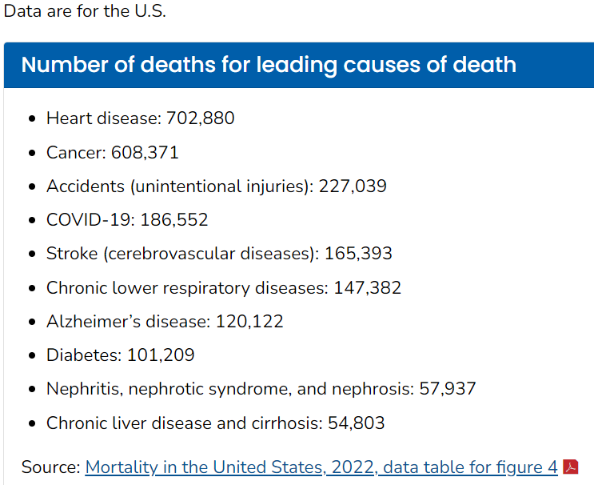
War on cancer
Cancer is #2 leading disease in the country
https://gis.cdc.gov/Cancer/USCS/#/AtAGlance/
https://www.cdc.gov/nchs/fastats/leading-causes-of-death.htm
Pancreatic cancer has the #5 highest mortality rate among all cancers

Slide 3
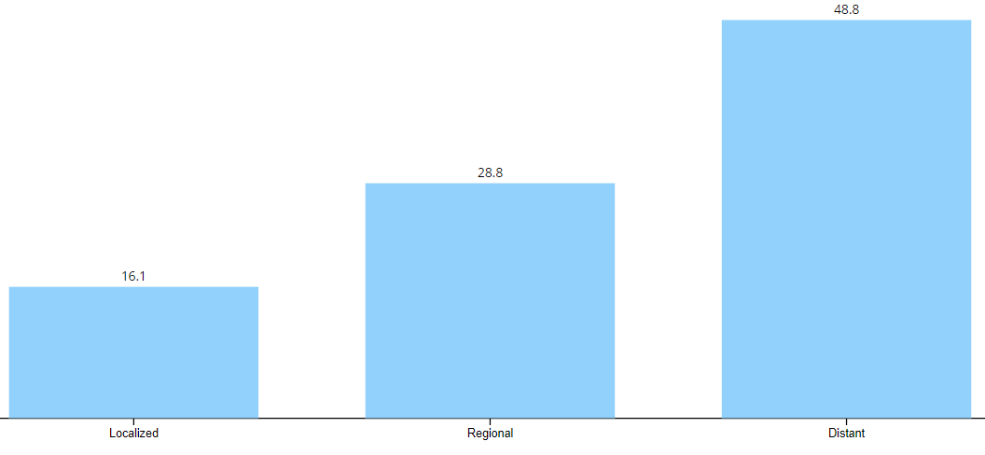
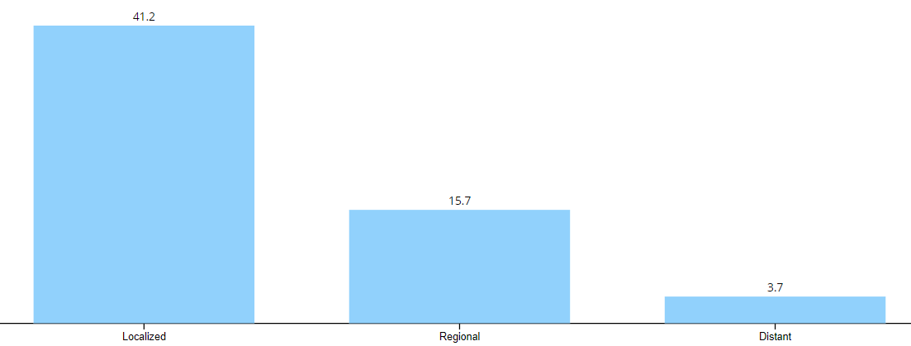
War on cancer
Mostly diagnosed at Distant stage, which has spread throughout the body
Survival rates are the highest when the disease is caught early and localized
https://gis.cdc.gov/Cancer/USCS/#/AtAGlance/

Slide 4
War on cancer
There are diagnostic techniques that verify pancreatic cancer.
Imaging tests
Endoscopic ultrasound (EUS)
Computed Tomography (CT) scan
Magnetic Resonance Imaging (MRI) scan
Positron Emission Tomography (PET) scan
Biopsies
During EUS, samples are obtained through a special tool
Fine-needle aspiration can be used as well, which is done by inserting a needle through a skin to collect a sample
Blood tests
Genetic tests
Expensive
Expensive
Cheap
Expensive
https://www.mayoclinic.org/diseases-conditions/pancreatic-cancer/diagnosis-treatment/drc-20355427#:~:text=Imaging%20tests%20used%20to%20diagnose,and%20nearby%20organs%20and%20tissues.

Slide 5
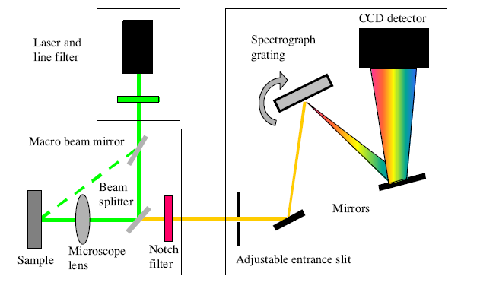
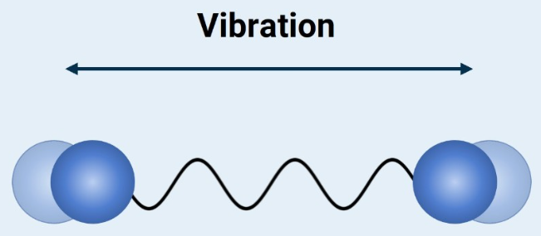
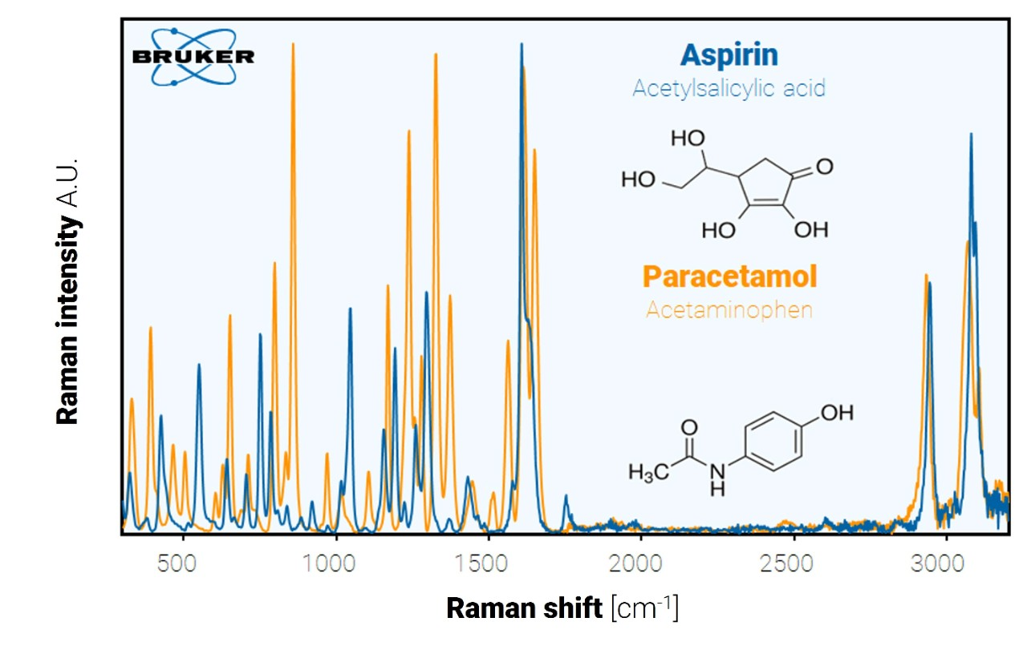
Raman spectroscopy for detection
In the blood test, serum-based cancer markers are a promising area, where exosomes are targeted to detect pancreatic cancer
Raman Spectroscopy offers a non-invasive, non-destructive, and cheap technique to pursue.
It measures the vibrational properties of materials that can be used as a fingerprint.
Furthermore, Surface-Enhanced Raman Spectroscopy (SERS) provides better scattering efficiencies, which will amplify the signal and detect extremely small amounts of materials.
https://www.sas.upenn.edu/~crulli/TheRamanSpectrophotometer.html
https://www.bruker.com/en/products-and-solutions/infrared-and-raman/raman-spectrometers/what-is-raman-spectroscopy.html

Slide 6
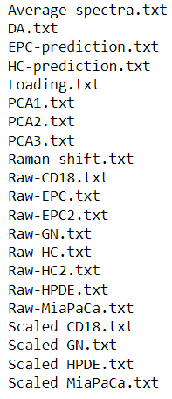
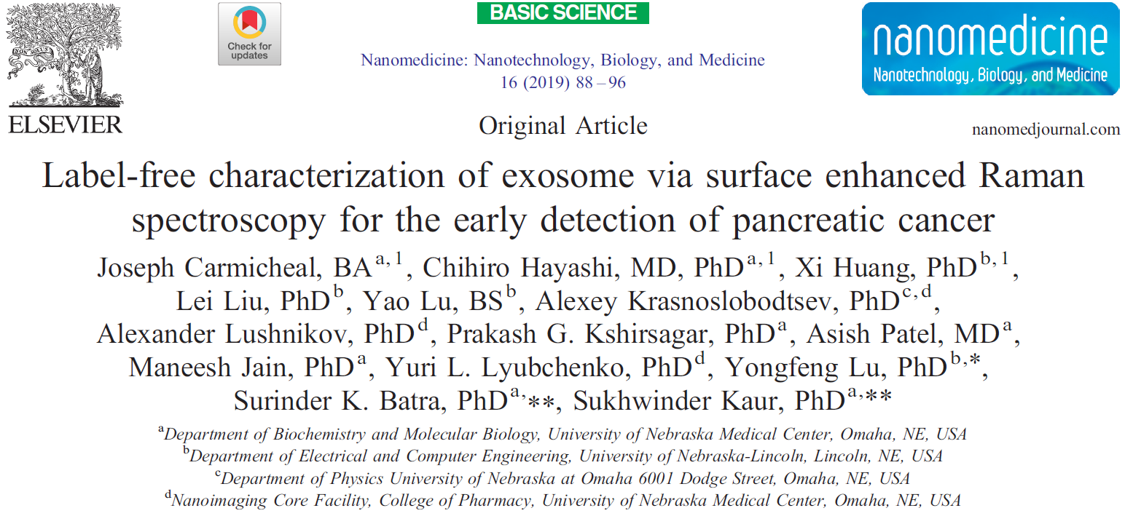
Literature search and data collection
We will utilize machine learning methods to further the advancement of cancer detection methods!!!
We look at this article to benchmark our results
We obtained the data through https://data.mendeley.com/datasets/f5hfzmy78z/1

Slide 7
Data description
There are three exosomes of interest
CD18/HPAF – we will simply call this CD
HPDE
MiaPaCa
The control
GN – This represents Gold Nanoparticle (for SERS method)
Cancer
Healthy
Keys | n samples | x features
CD | 33 | 1014
HPDE | 35 | 1014
MiaPaCa | 31 | 1014
GN | 22 | 1014
Total of 121 samples with 1014 features

Slide 8
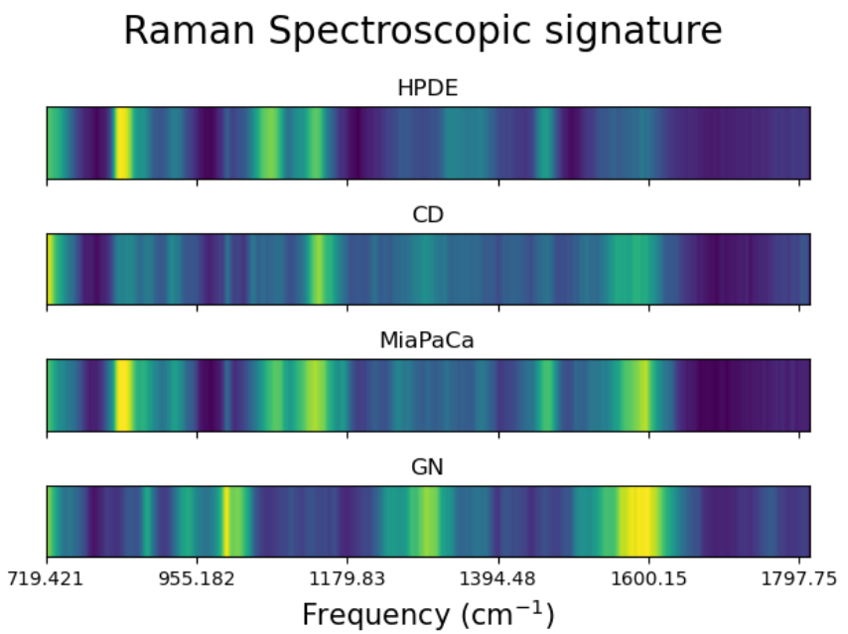
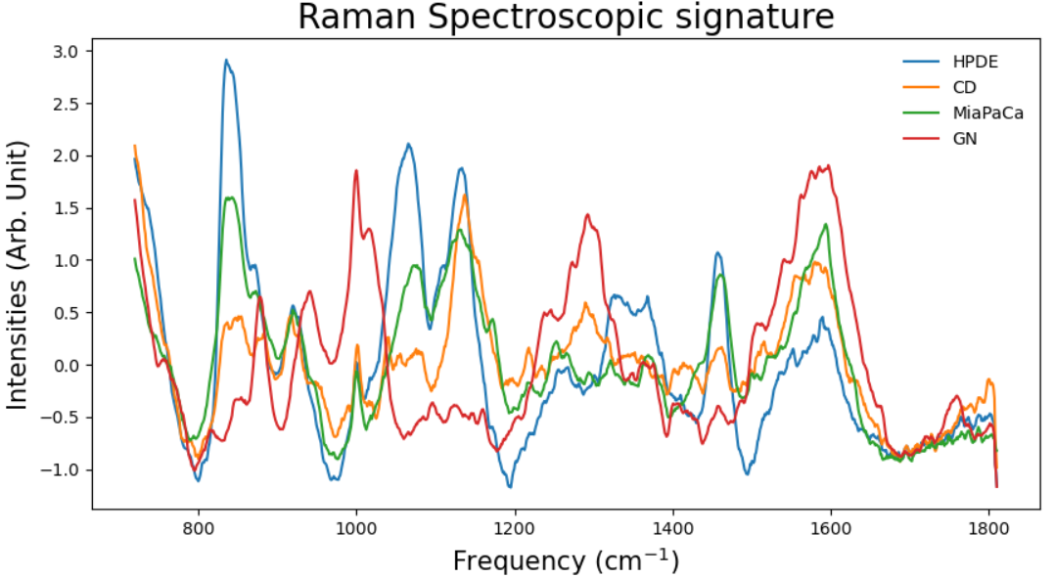
Raman Spectroscopic response
As you can see, Raman spectra provide a fingerprint of markers, displaying clear differences among these four spectra

Slide 9
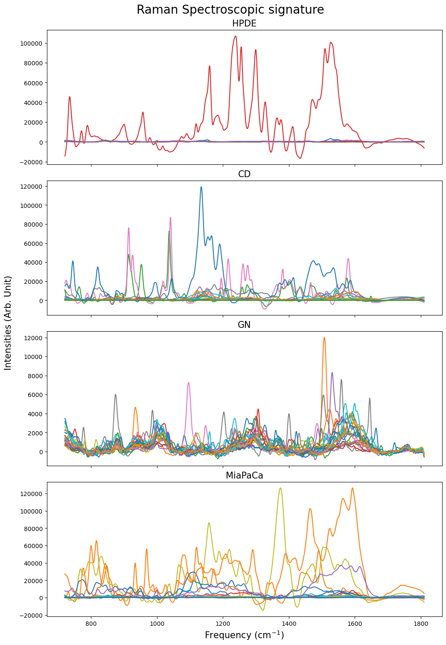

Raw spectra

Slide 10
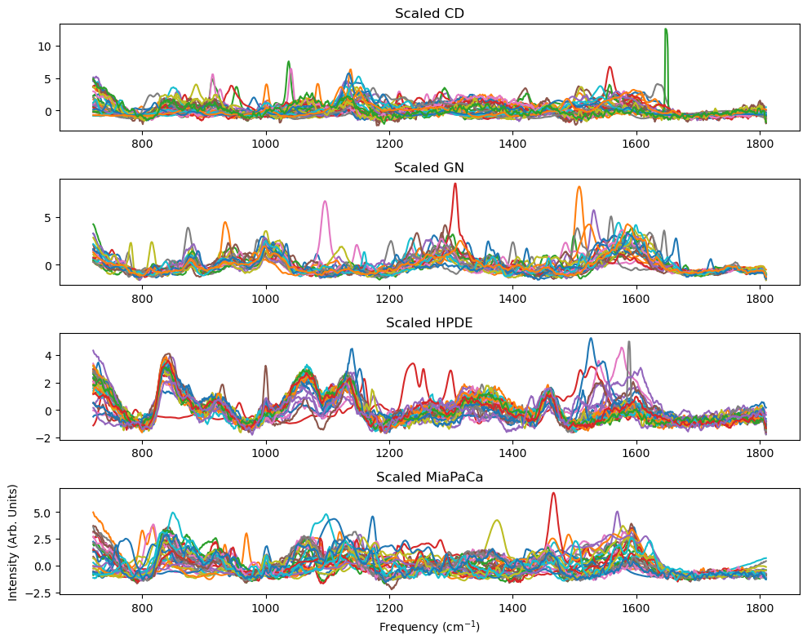
Transformed spectra (feature engineering)
Vancouver Raman algorithm was used to remove fluorescence by fitting the polynomial regression.
Also, there are modified Vancouver Raman algorithms to denoise, correct baseline (fitting the fluorescence), and so on.
Furthermore, normalization of the spectra was performed as well.

Slide 11
Machine learning methods
Train and test split (70/30) accuracy score
Cross-validation (k=21,24,25)
Principal Component Analysis (PCA)
Yes
No
Results:
Accuracy
Specificity
Sensitivity
Confusion Matrix
Linear Discriminant Analysis (LDA)
Random Forest Classifier (RFC)
Multilayer Perceptron (MLP)

Slide 12
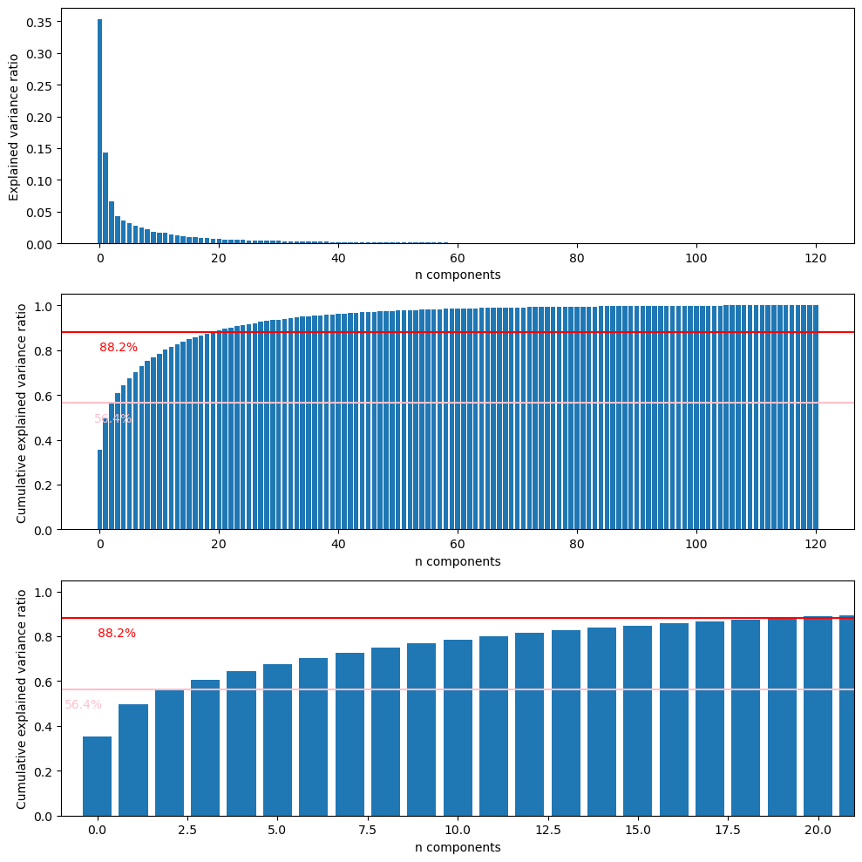
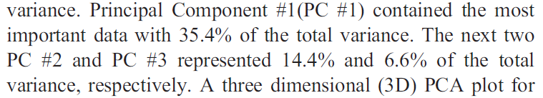
Principal Component Analysis (PCA)

Slide 13
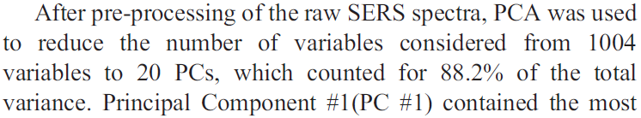
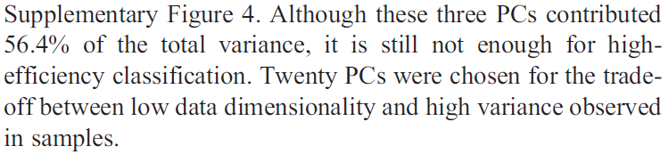
Principal Component Analysis (PCA)

Slide 14
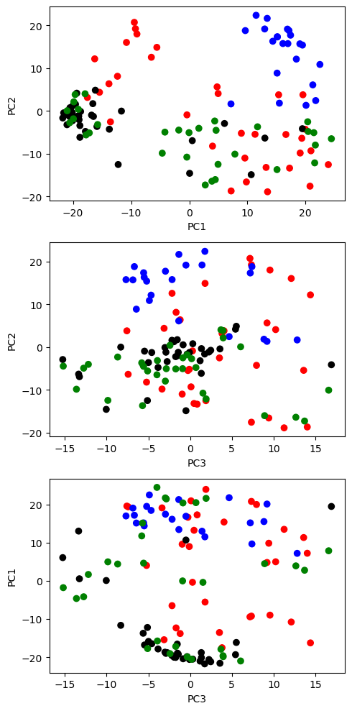
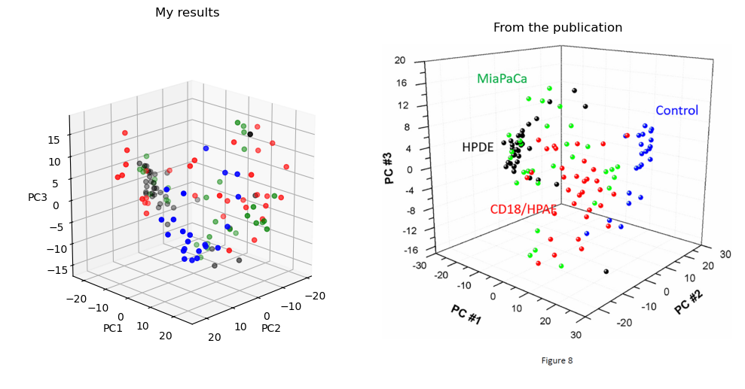
Principal Component Analysis (PCA)

Slide 15
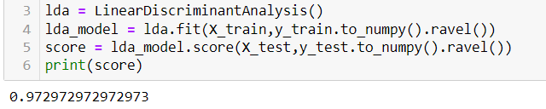
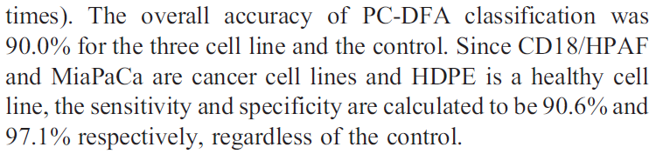
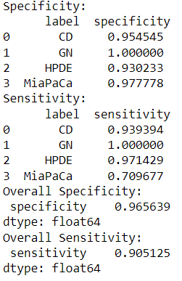
Linear Discriminant Analysis (LDA)

Slide 16
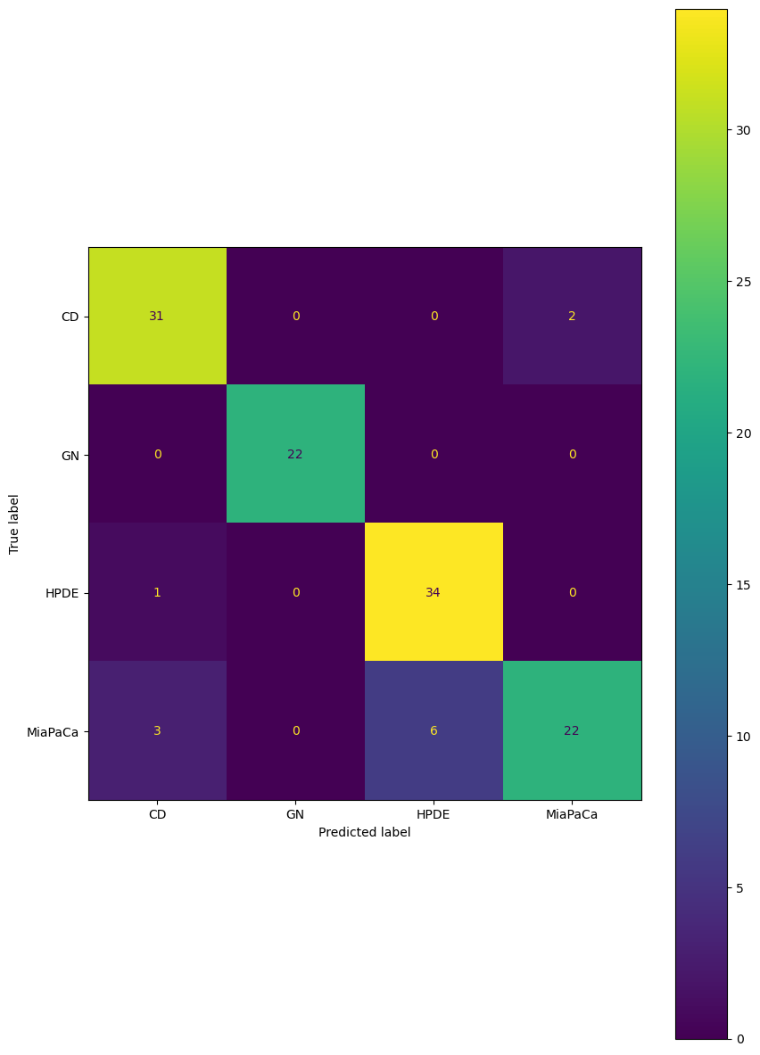
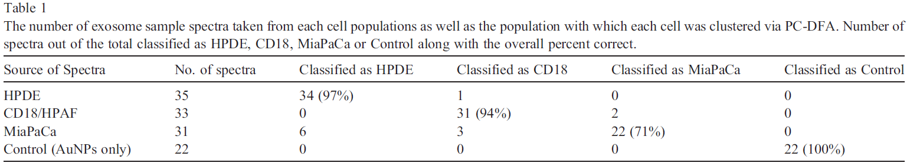
Linear Discriminant Analysis (LDA)

Slide 17
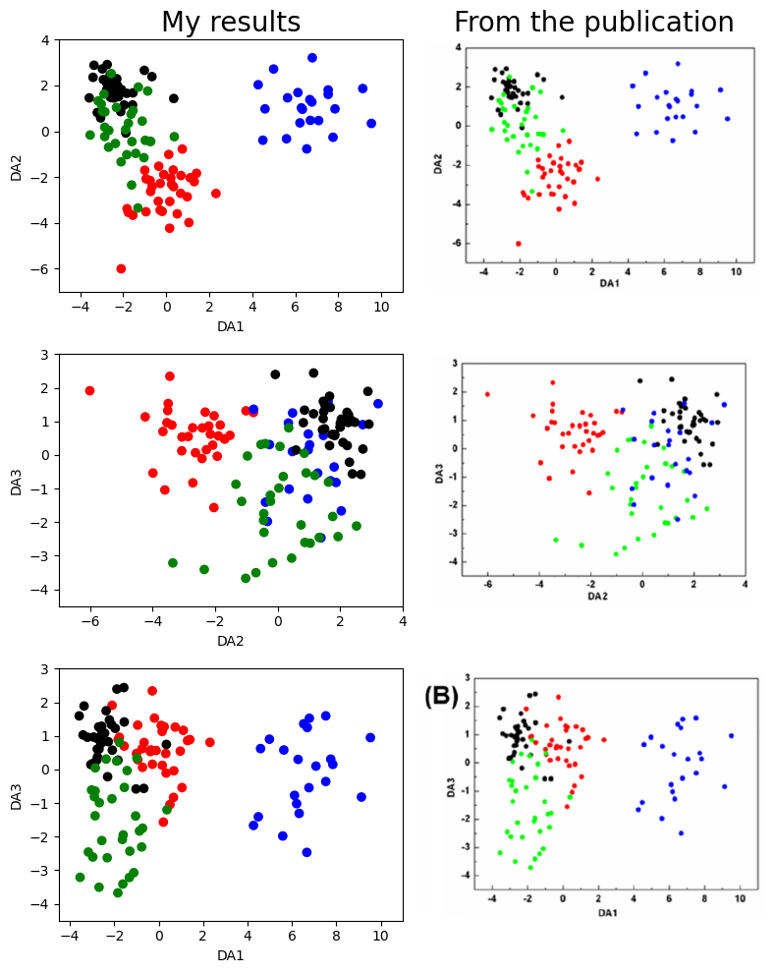

Linear Discriminant Analysis (LDA)

Slide 18
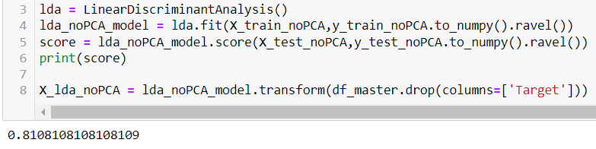
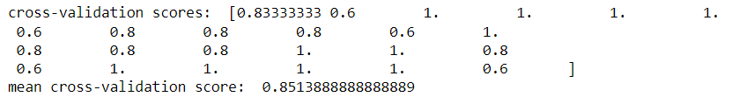
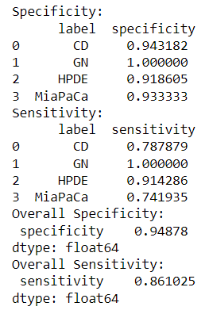
Linear Discriminant Analysis (LDA)
w/o PCA
PCA

Slide 19
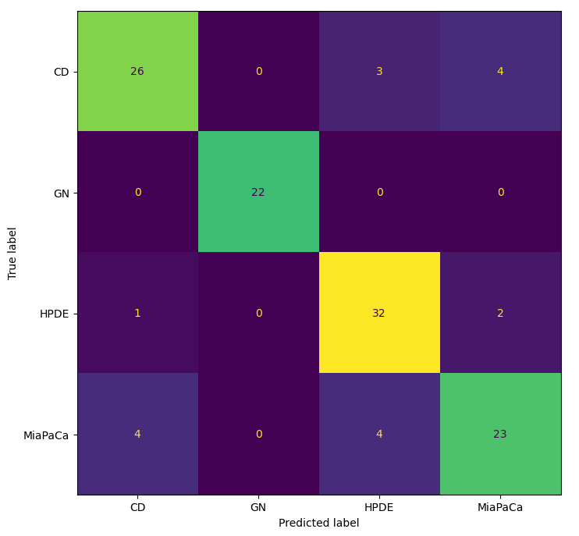
Linear Discriminant Analysis (LDA)
PCA
w/o PCA

Slide 20
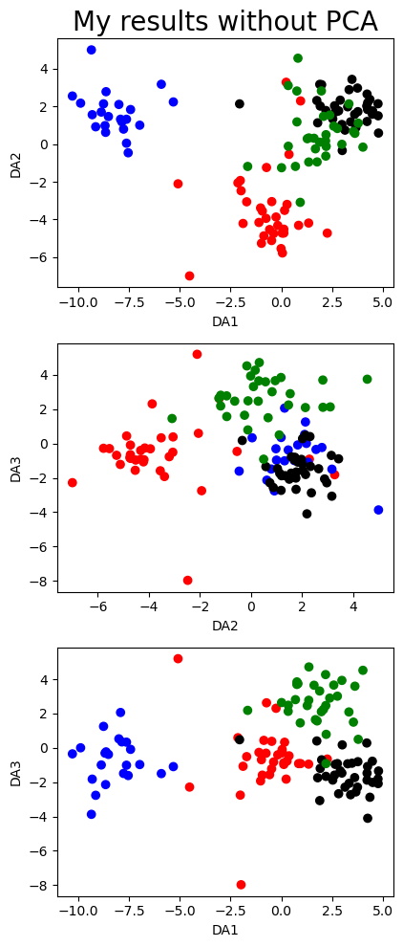
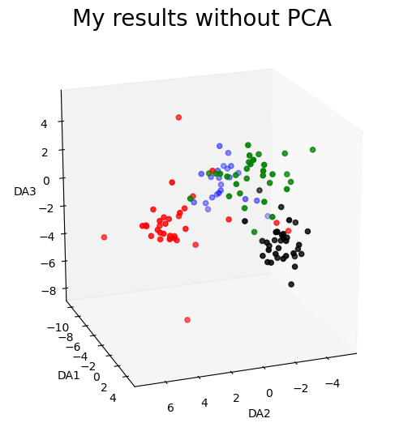
Linear Discriminant Analysis (LDA)
PCA
w/o PCA

Slide 21
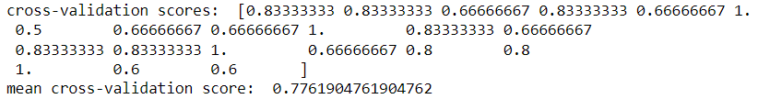
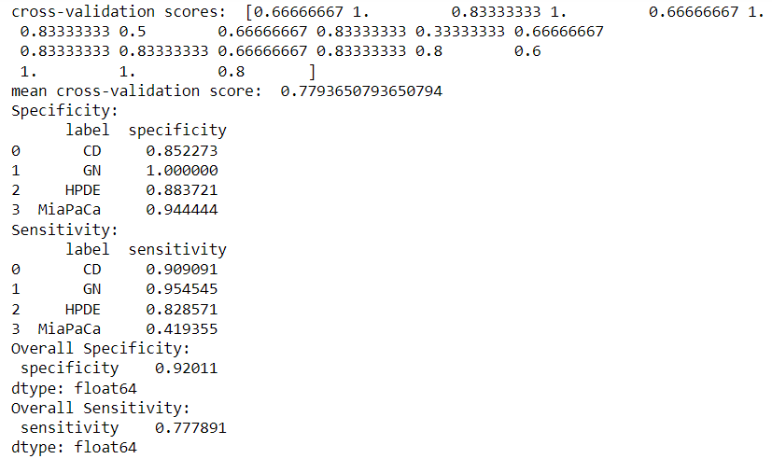
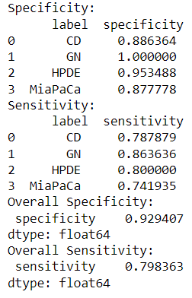
Random Forest Classifier
PCA
w/o PCA
Train, test split (70/30) score:
Train, test split (70/30) score:

Slide 22
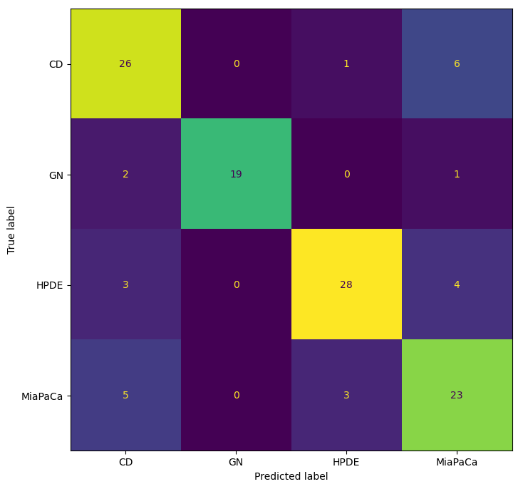
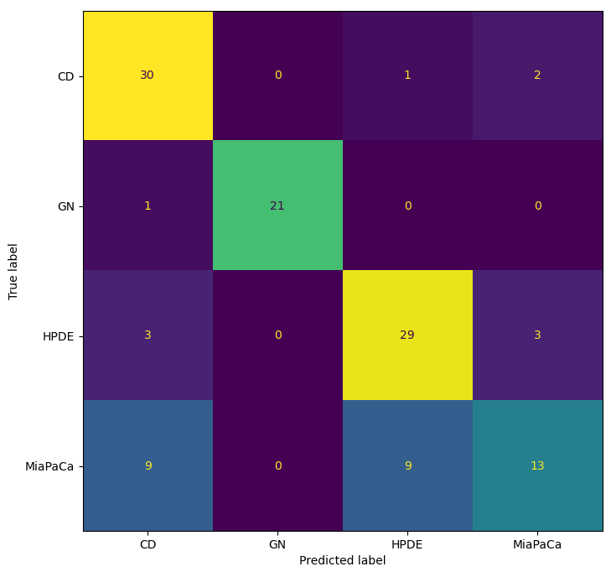
Random Forest Classifier
PCA
w/o PCA

Slide 23
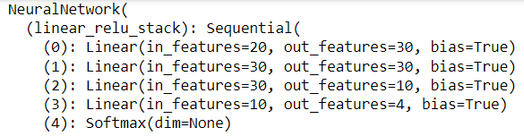
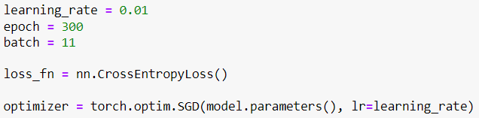
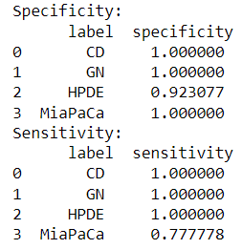
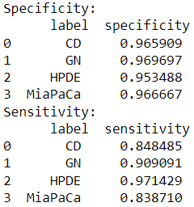



Multilayer Perceptron (MLP)
Train/test split w/ PCA
Cross-validation w/ PCA

Slide 24
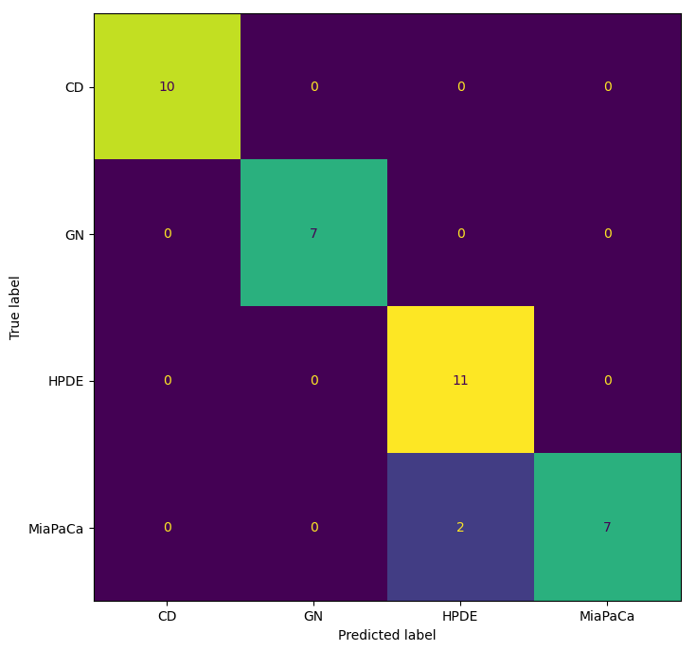
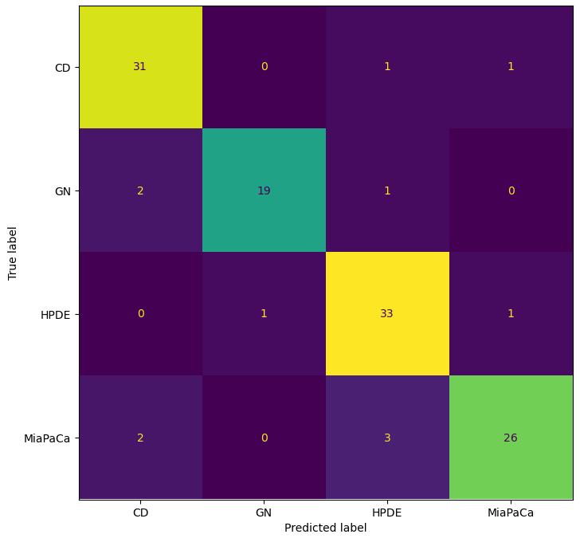
Multilayer Perceptron (MLP)
Train/test split w/PCA
Cross-validation w/ PCA

Slide 25
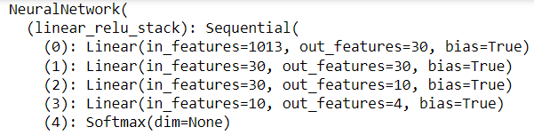
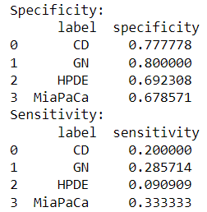
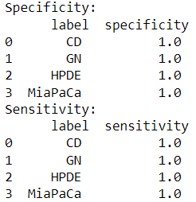



Multilayer Perceptron (MLP)
Train/test split w/o PCA
Cross-validation w/o PCA

Slide 26
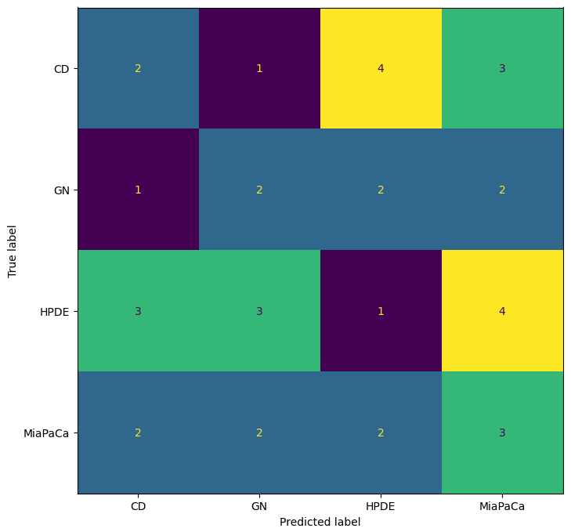
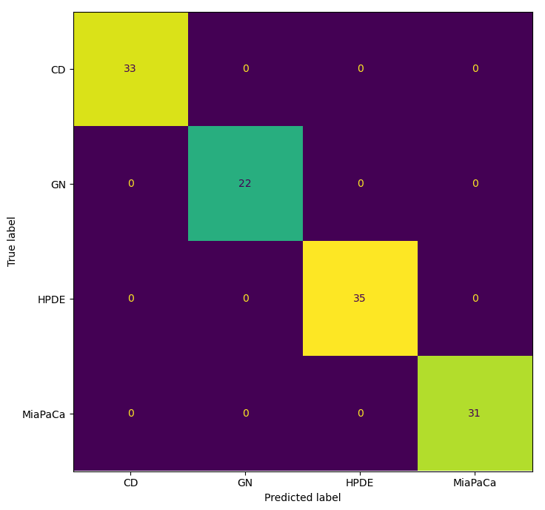
Multilayer Perceptron (MLP)
Train/test split w/PCA
Cross-validation w/ PCA

Slide 27
Summary

Slide 28
Thank you for listening!

