Slide 1
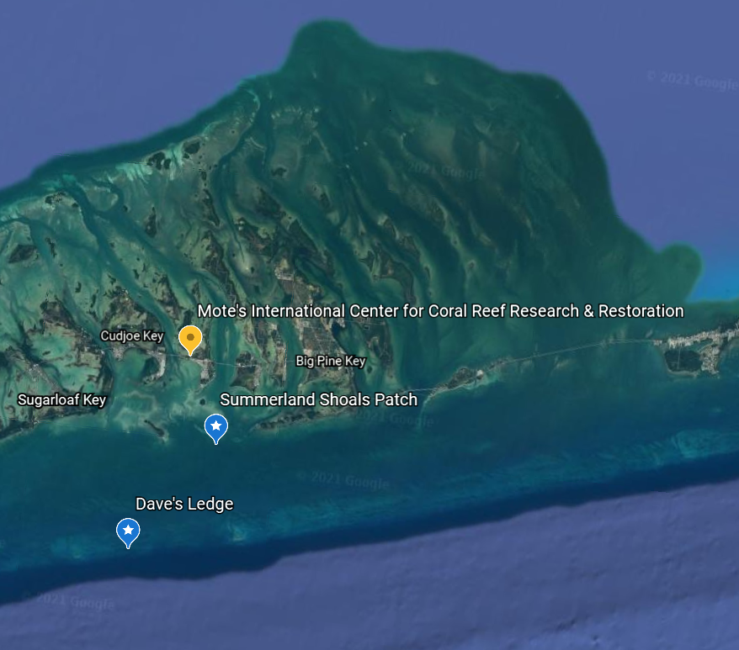
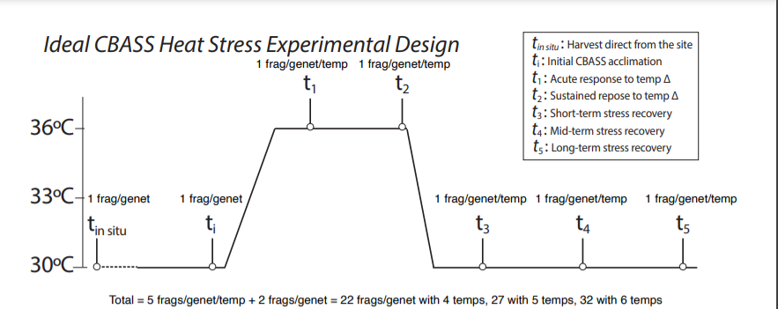
Quick Experiment Recap:
A. cervicornis
8 genotypes, 22 fragments/genotype
P. astreoides
5 genotypes, 22 fragments/genotype/site

Slide 2
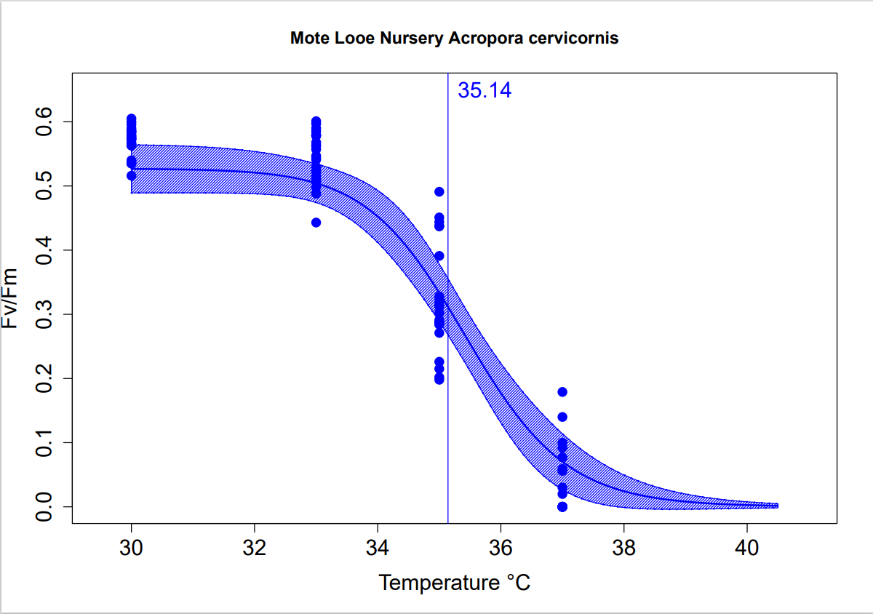
Acropora cervicornis
Ross: 35.94
Courtney: 33.86 (Not all genotypes included)
*From T3, T4, & T5 samples @T3 Sampling Timepoint

Slide 3
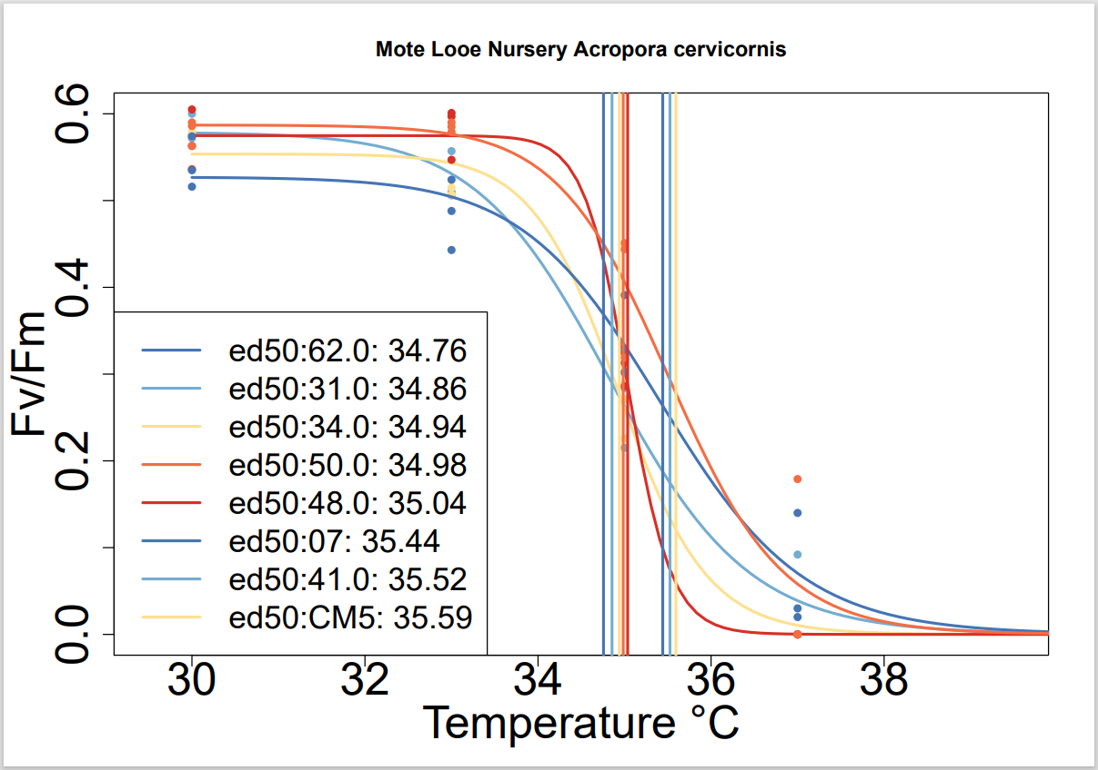
Acropora cervicornis
Ross:
Lowest: 48, ED50 = 35.32
Highest: 34, ED50 = 36.42
Courtney:
Lowest: 31, ED50 = 34.08
Highest: 07, ED50 = 34.66
*From T3, T4, & T5 samples @T3 Sampling Timepoint

Slide 4
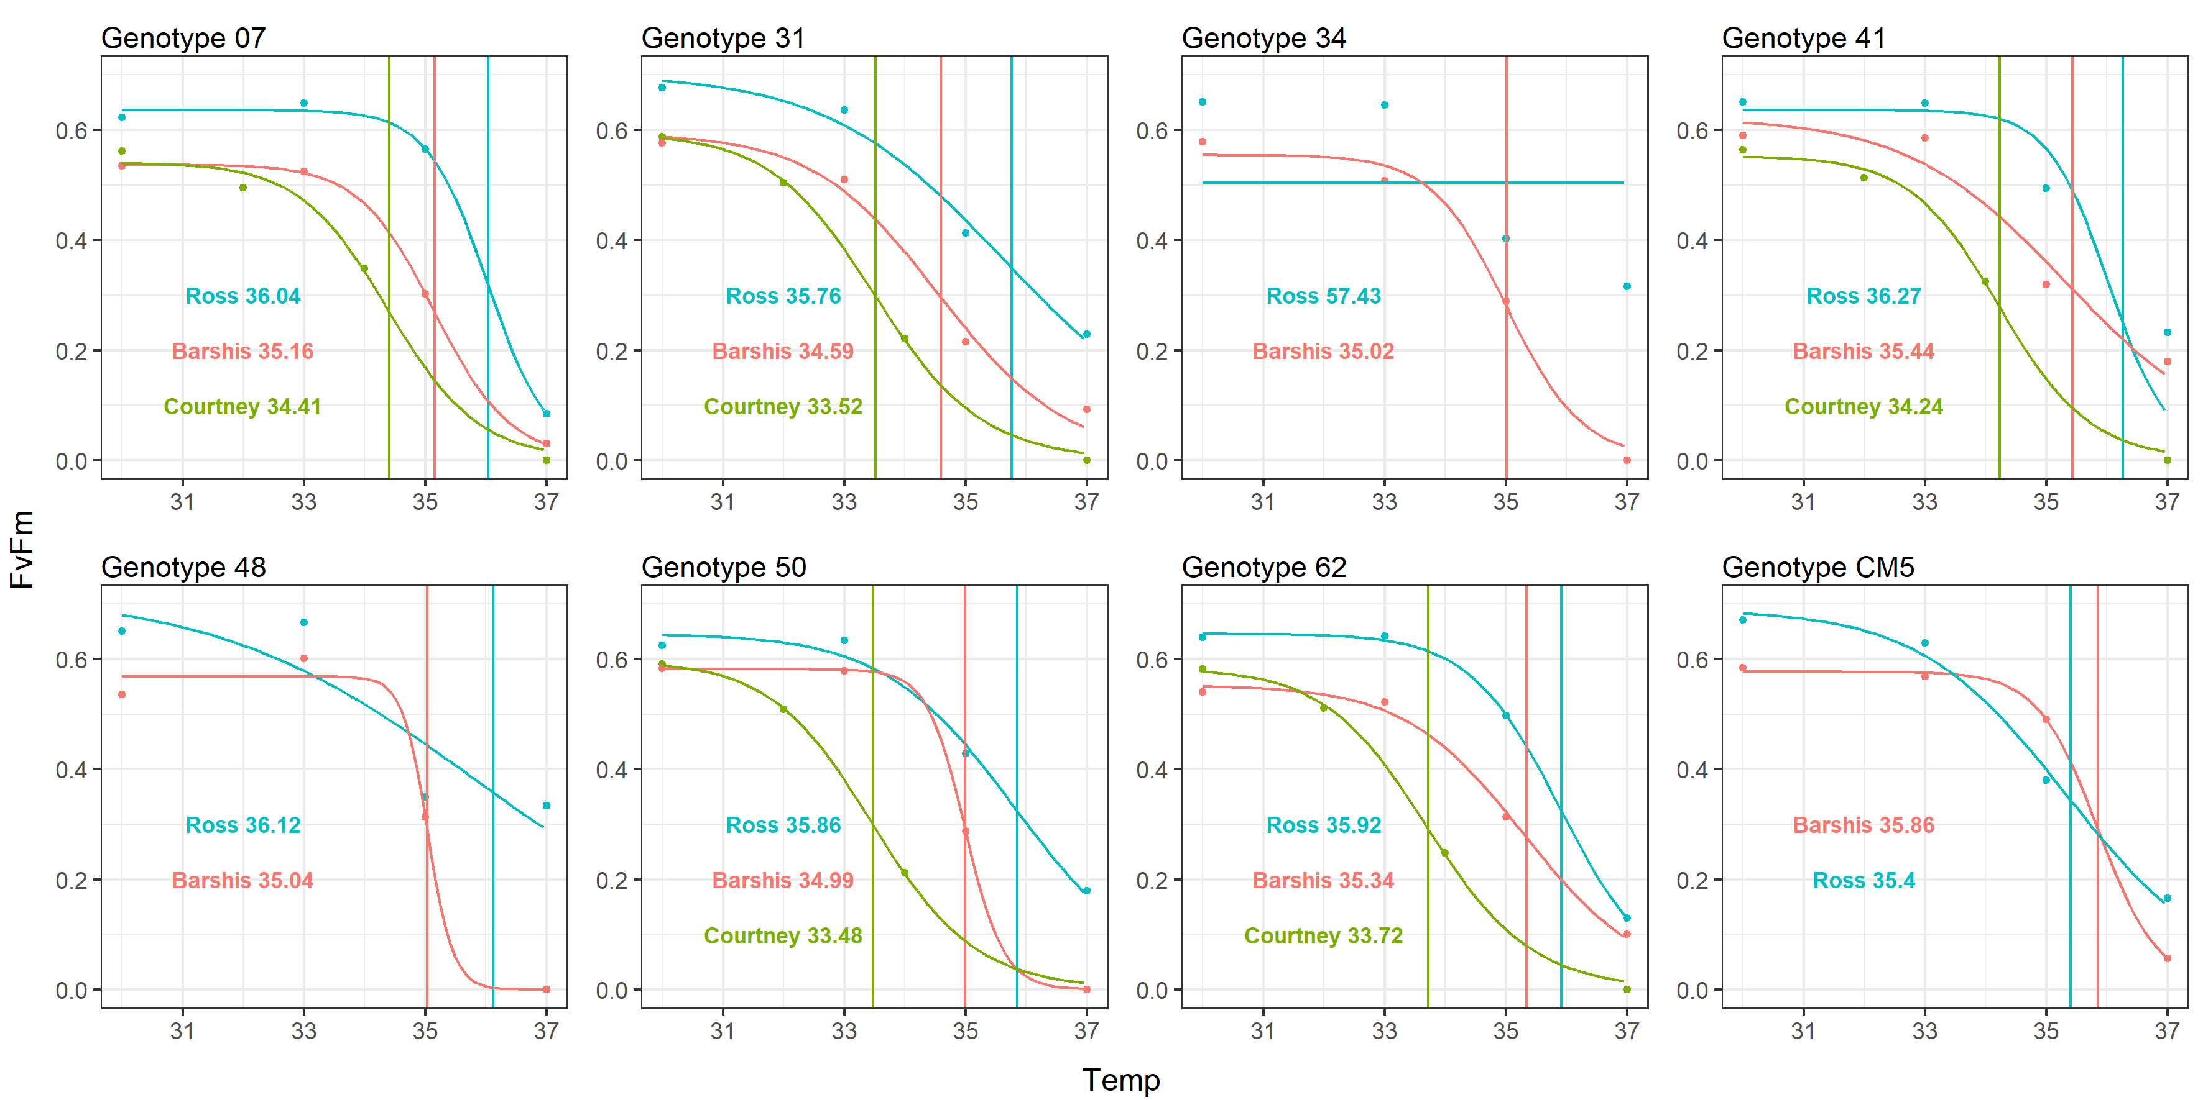
Acropora cervicornis
Temperature (°C)

Slide 5
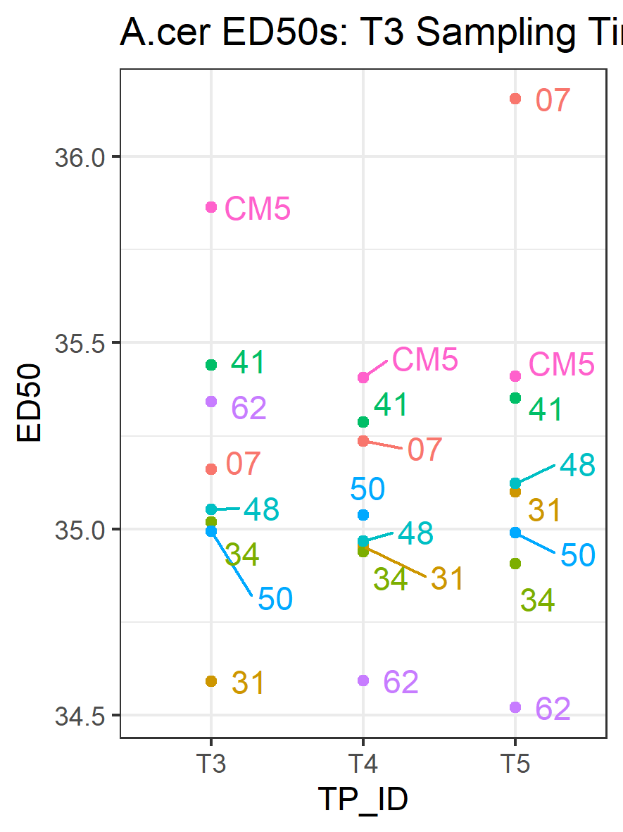
Acropora cervicornis
ED50s from T3 Sampling
How consistent is the response between coral fragments from the same genet?
Fragment Timepoint

Slide 6
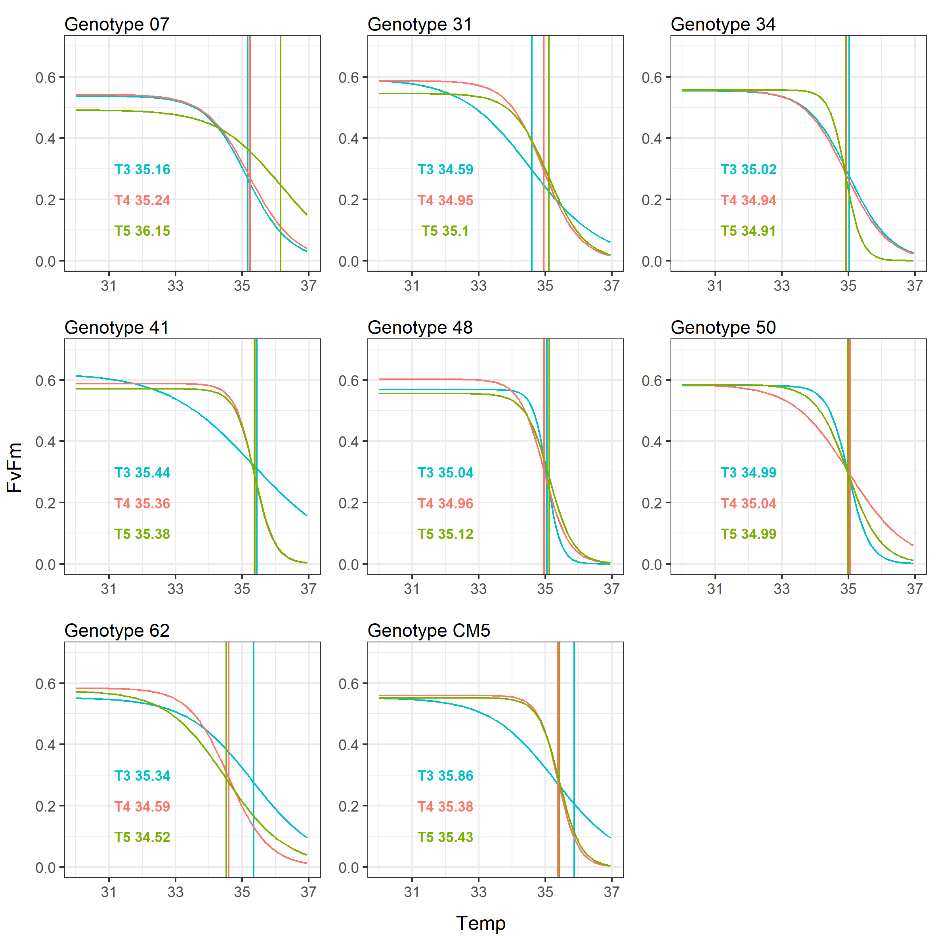
Acropora cervicornis
ED50s from T3 Sampling
Fragment Timepoint
Temperature (°C)

Slide 7
Acropora cervicornis
Rank | Combined | Just T3 Samples
1st | CM5 | CM5
2nd | 41 | 41
3rd | 07 | 62
4th | 48 | 07
5th | 50 | 48
6th | 34 | 34
7th | 31 | 50
8th | 62 | 31
Temperature (°C)

Slide 8
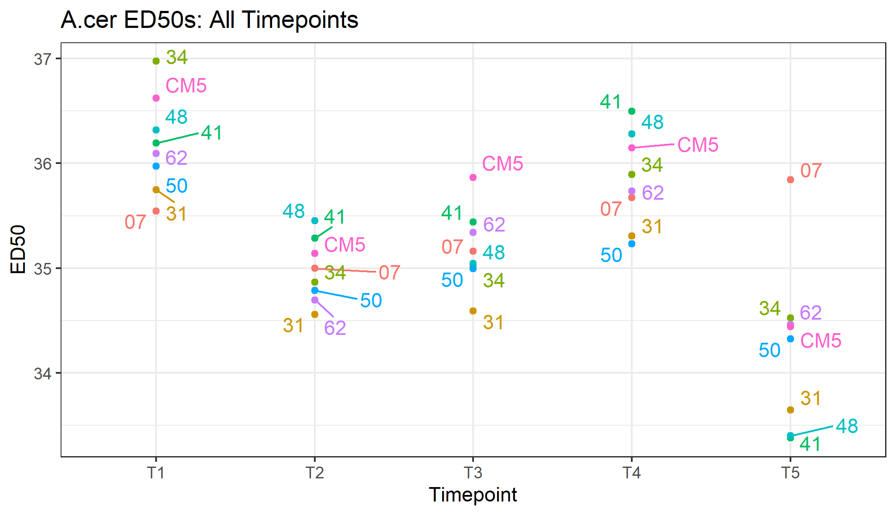
Acropora cervicornis
How do the genets compare to one another throughout all timepoints?
Seems like the best performer isn’t the best all the time.

Slide 9
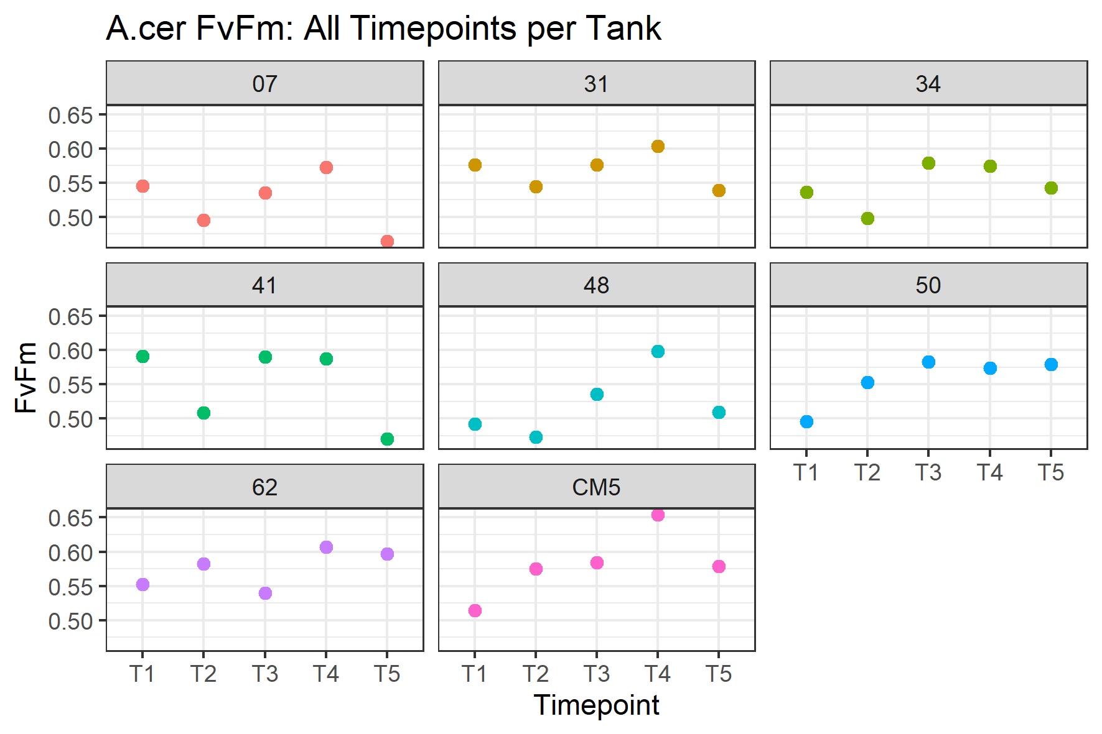
Acropora cervicornis
How do the genets compare to one another throughout all timepoints?

Slide 10
Acropora cervicornis
How do the genets compare to one another throughout all timepoints?
Similar ranking.
Inverse ranking.

Slide 11
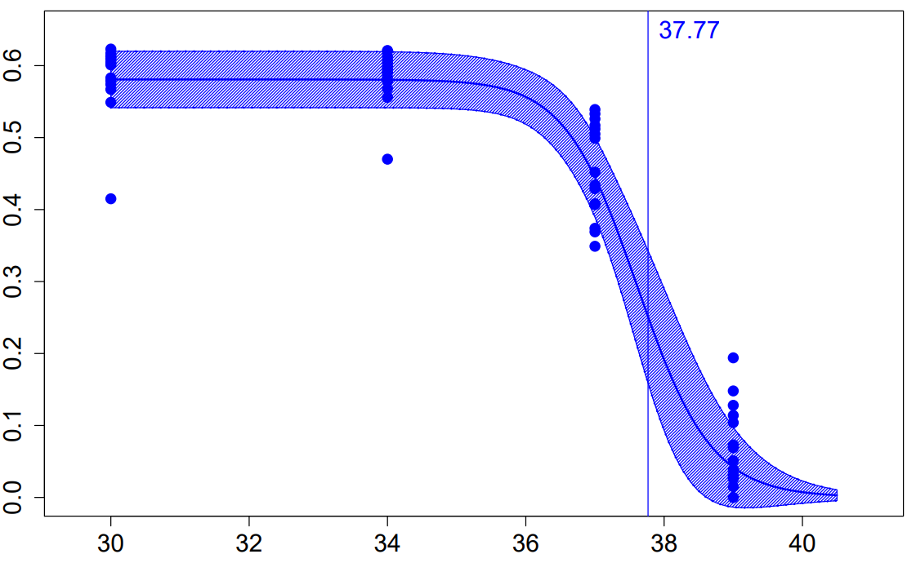
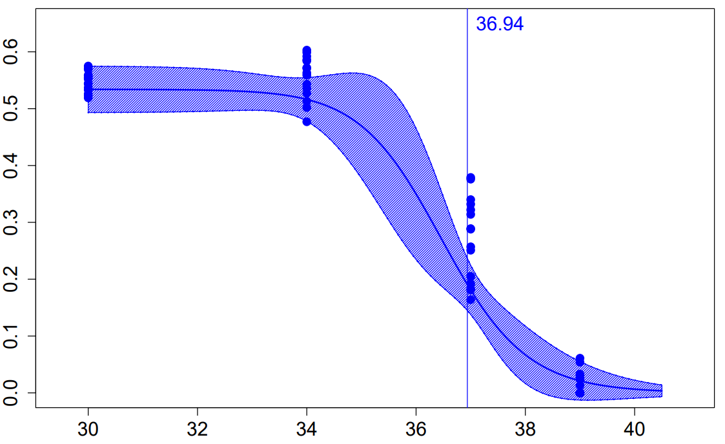
Porites astreoides
Inshore
Offshore
Fv/Fm
Temperature (°C)
0.83°C between inshore and offshore population
Aligns with Carly Kenkel’s results at these sites
*From T3, T4, & T5 samples @T3 Sampling Timepoint

Slide 12
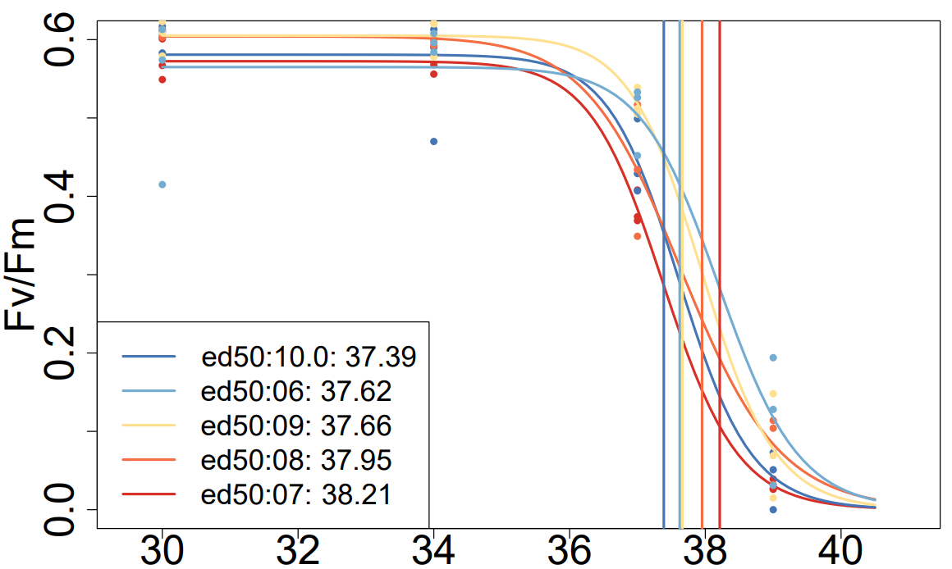
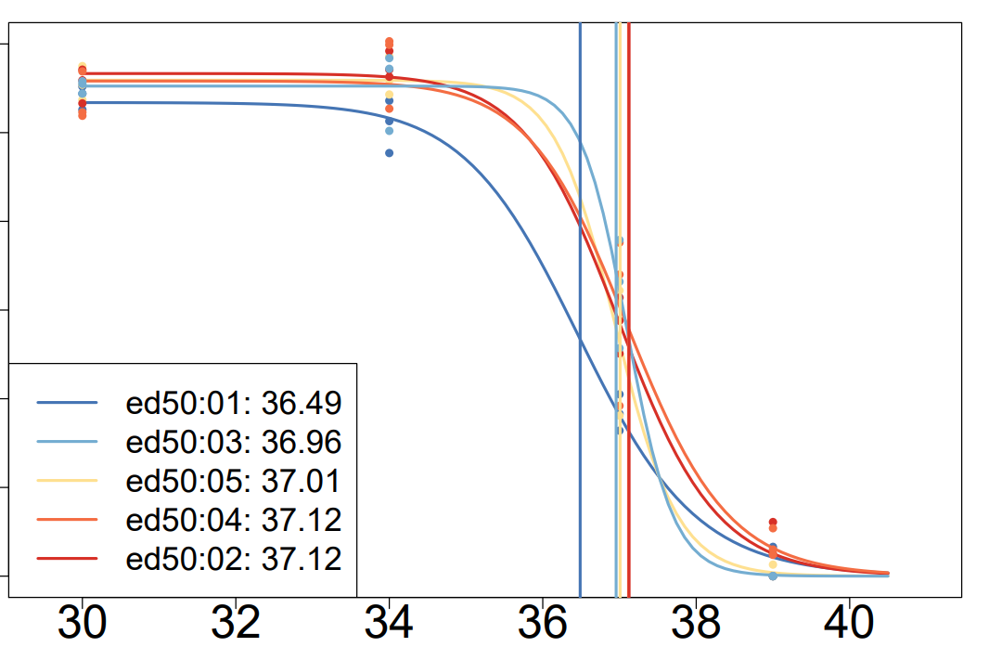
Porites astreoides
Inshore
Offshore
Temperature (°C)
*From T3, T4, & T5 samples @T3 Sampling Timepoint

Slide 13
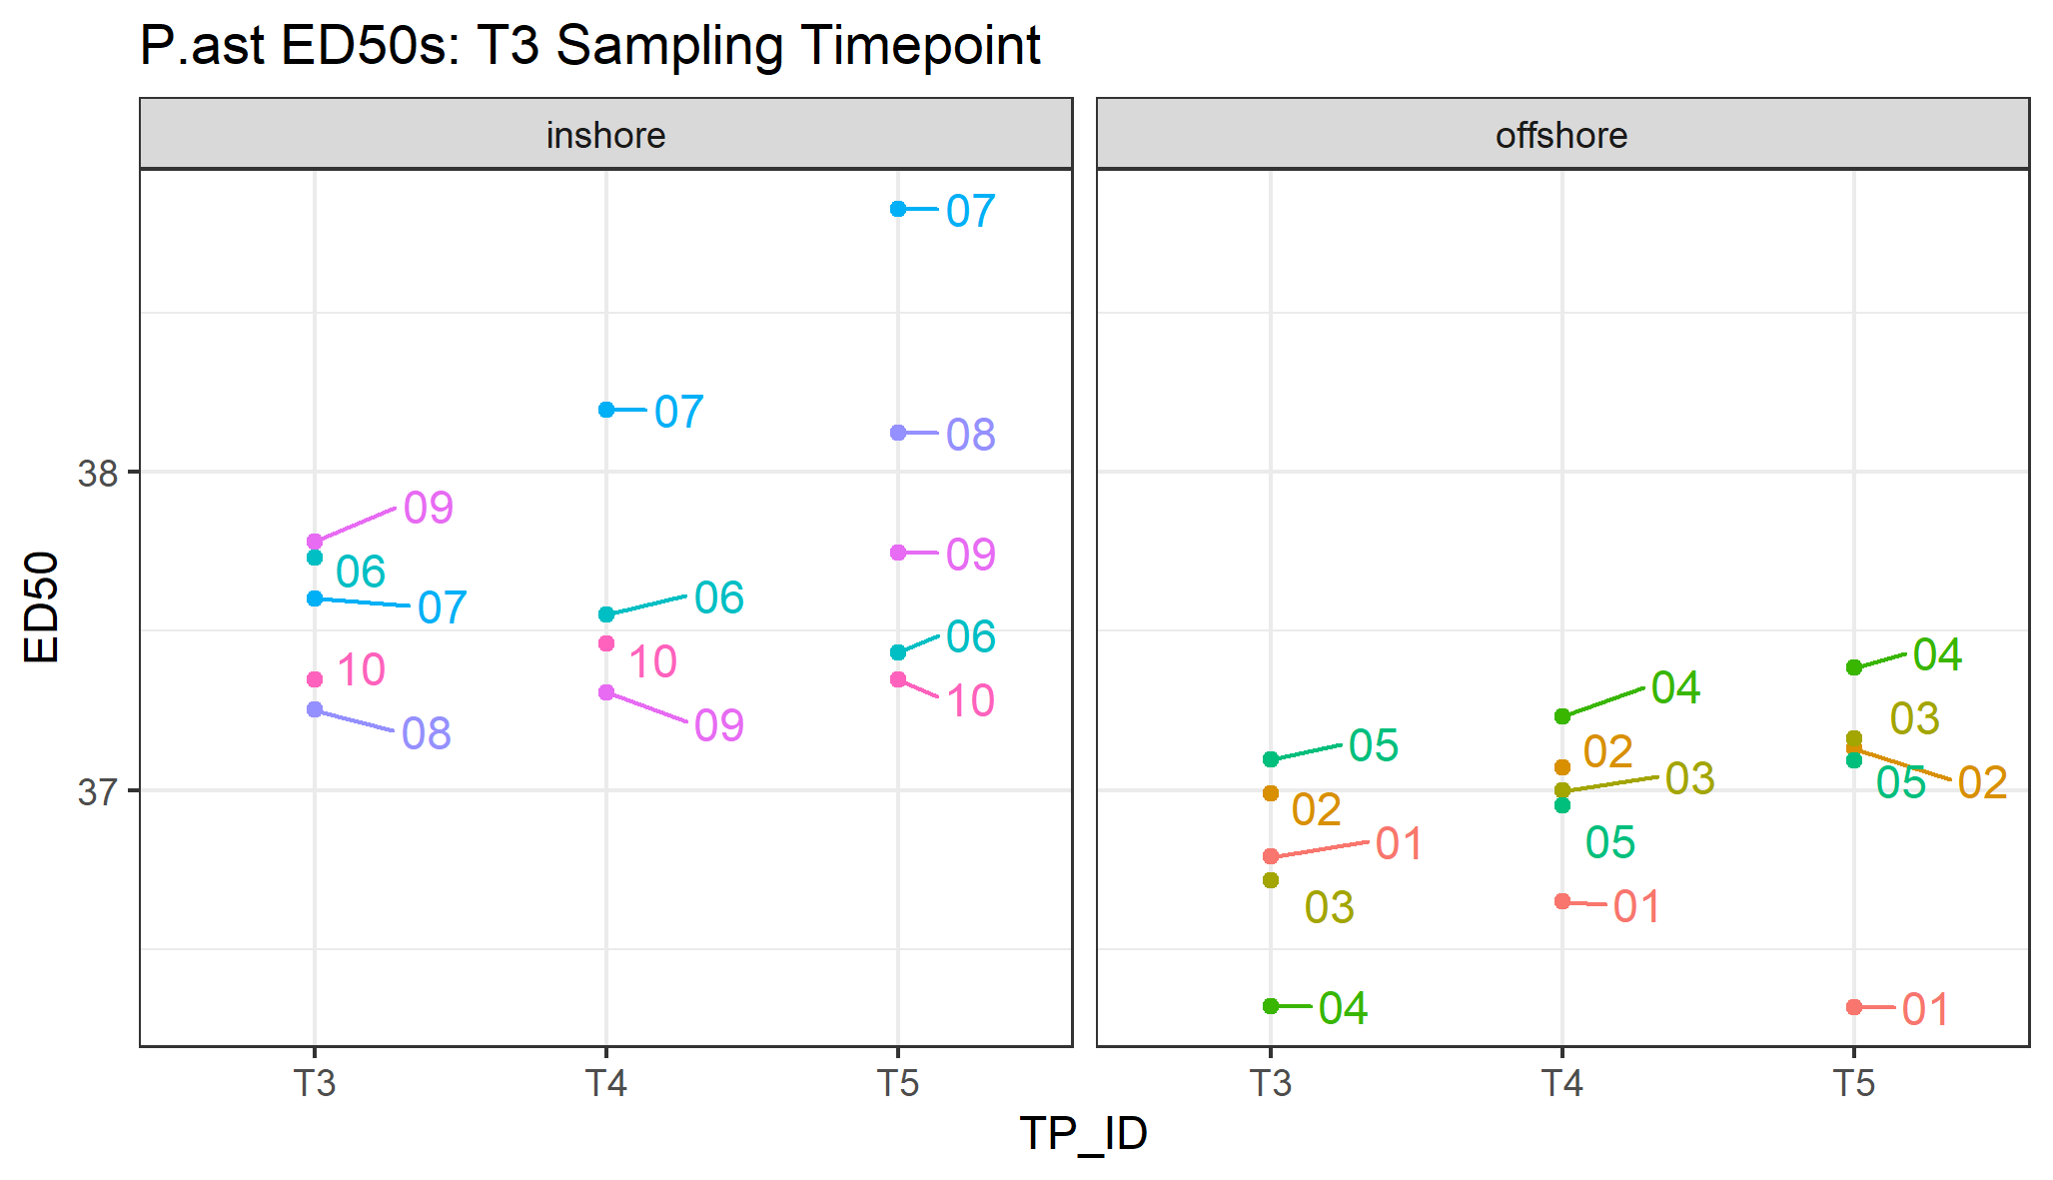
Porites astreoides

Slide 14
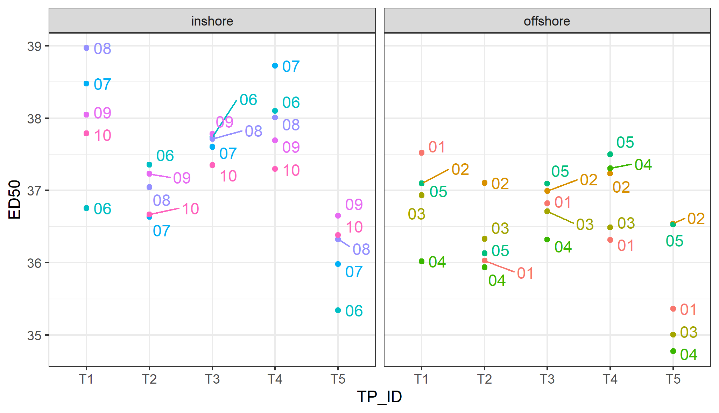
Porites astreoides
P.ast ED50s all Timepoints

