Slide 1
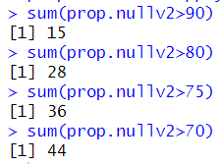
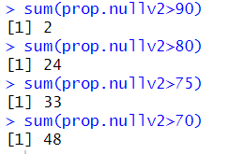
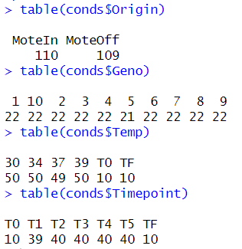
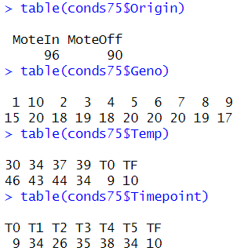
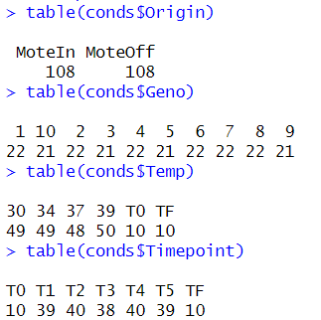
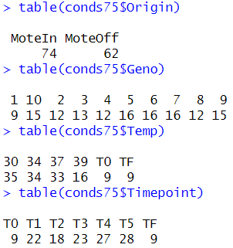
Dedup
Original

Slide 2
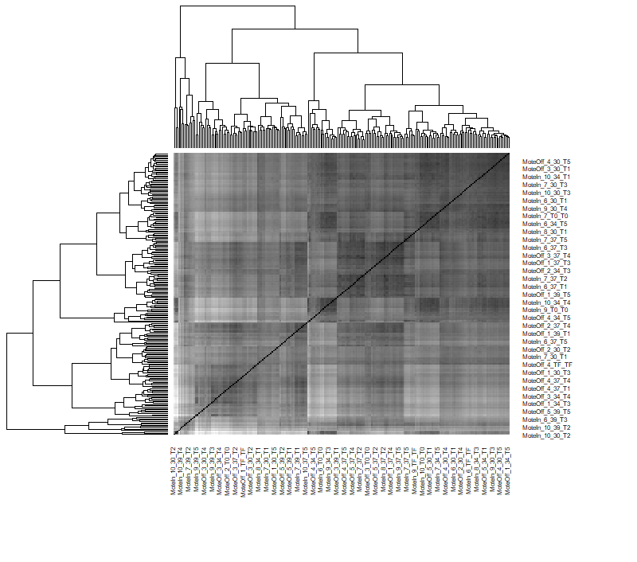
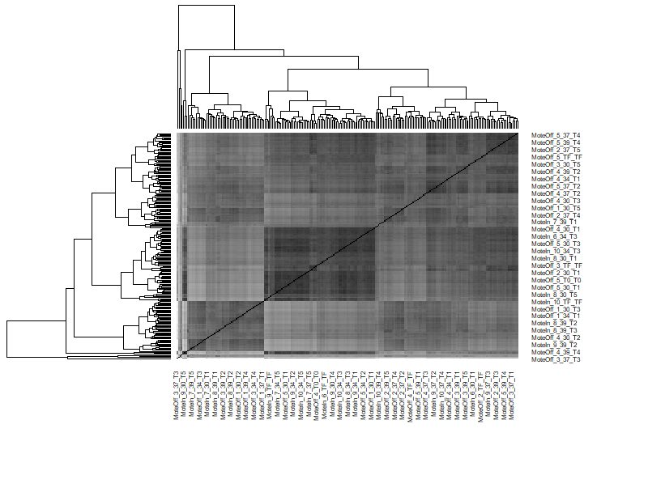
Original
Dedup

Slide 3
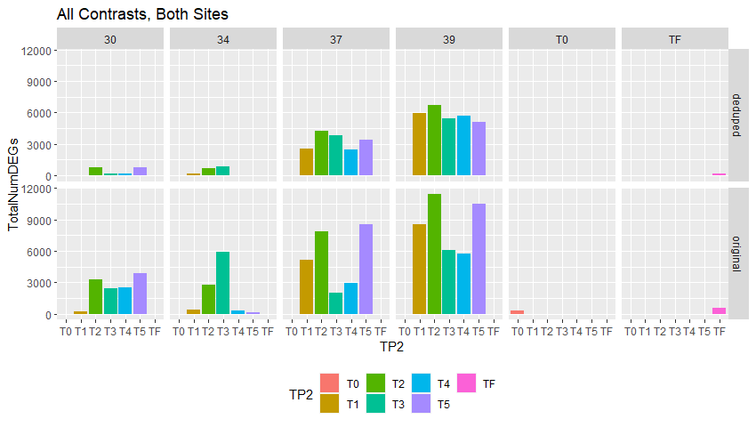

Slide 4
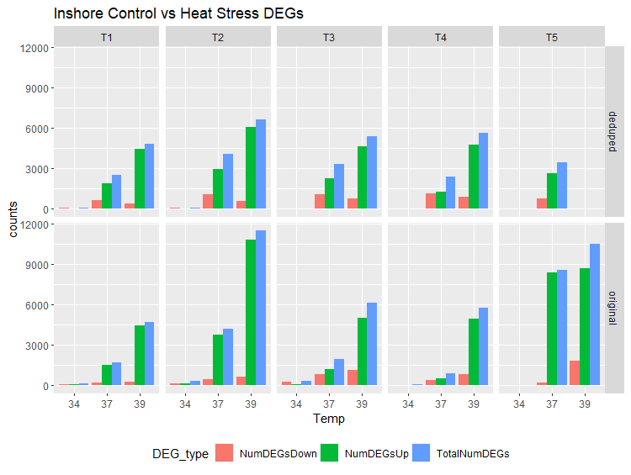
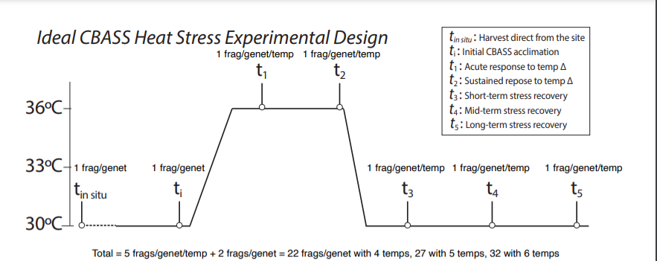

Slide 5
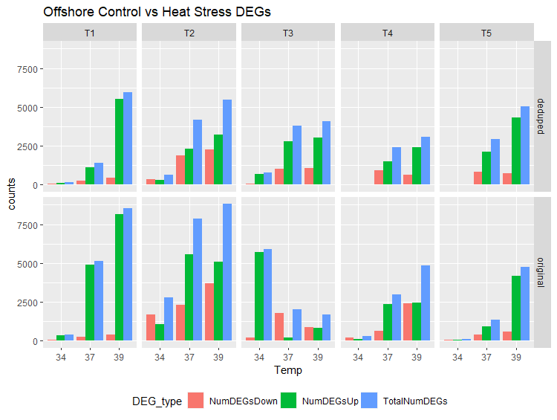
Change scale to match inshore

Slide 6
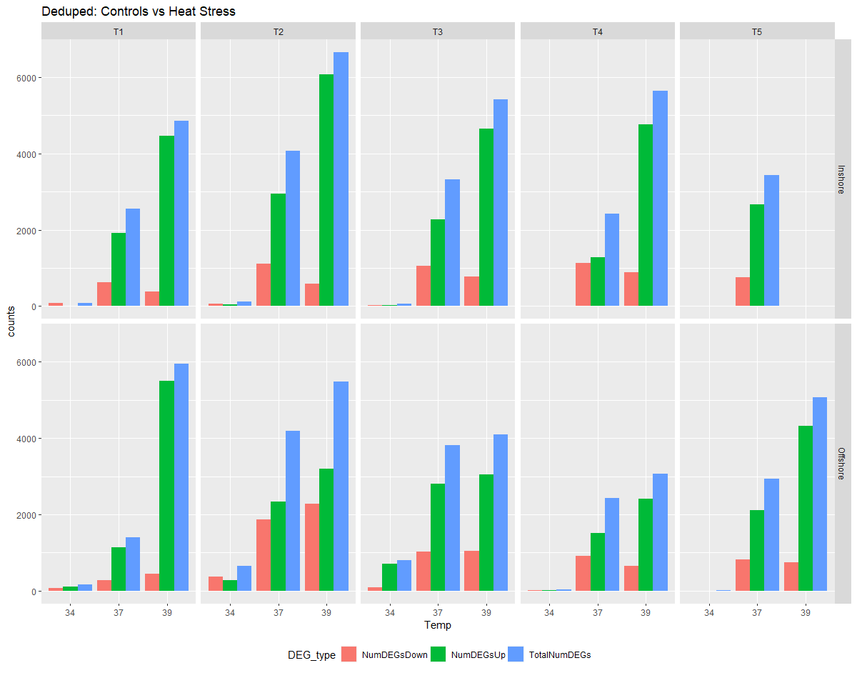

Slide 7
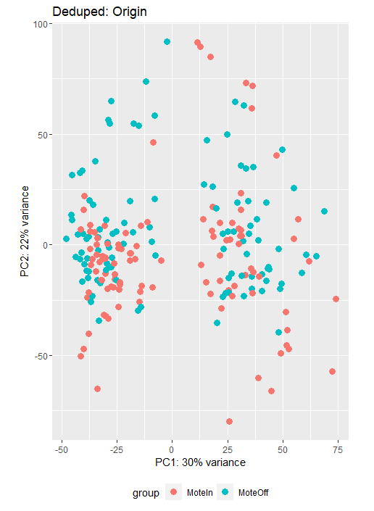
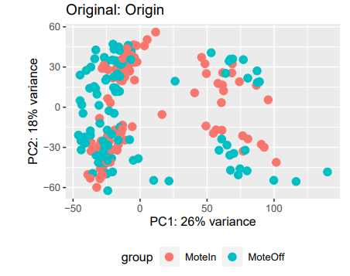

Slide 8
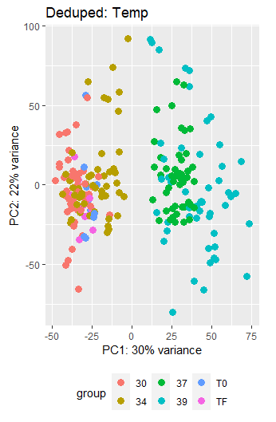
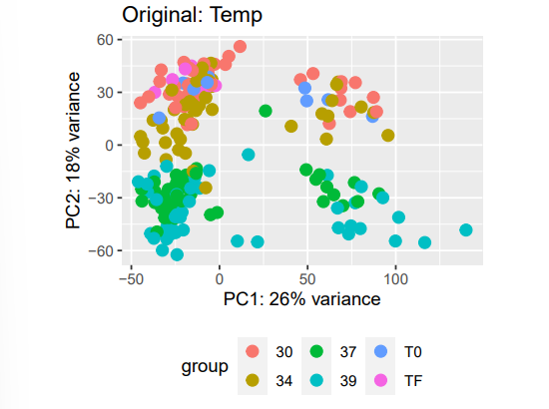

Slide 9
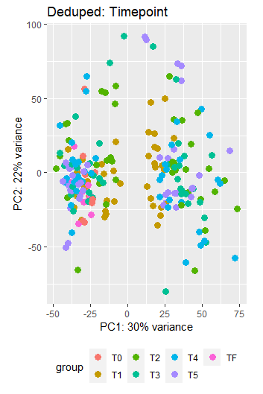
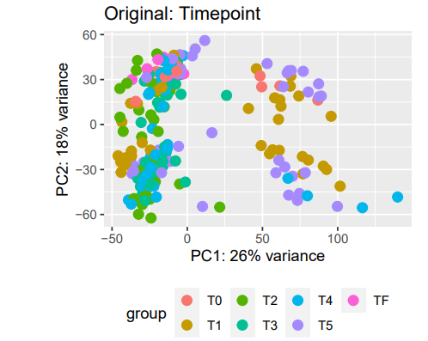

Slide 10
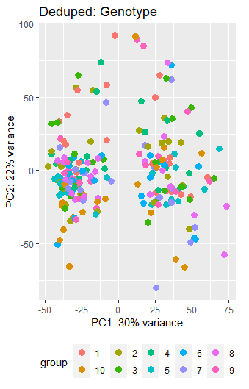
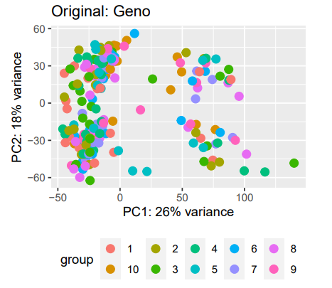

Slide 11
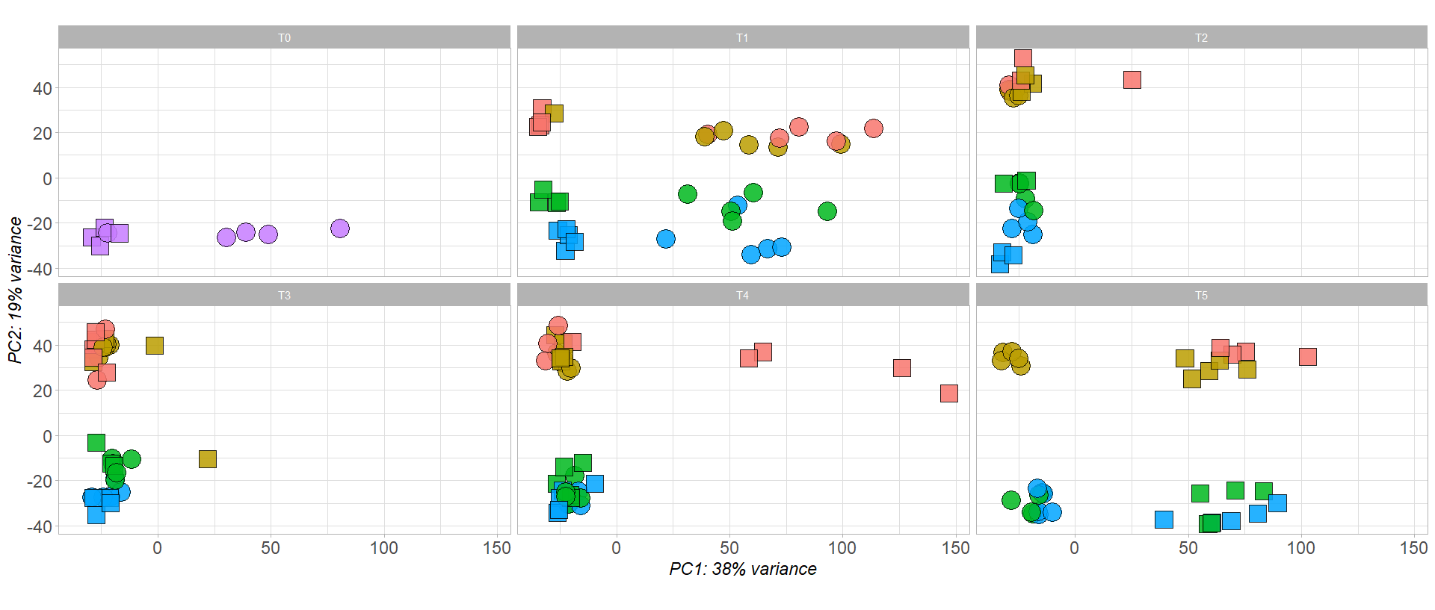
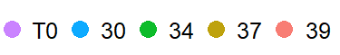
First Pass: Expression by Timepoint
Temperature
Origin
Inshore
Offshore

Slide 12
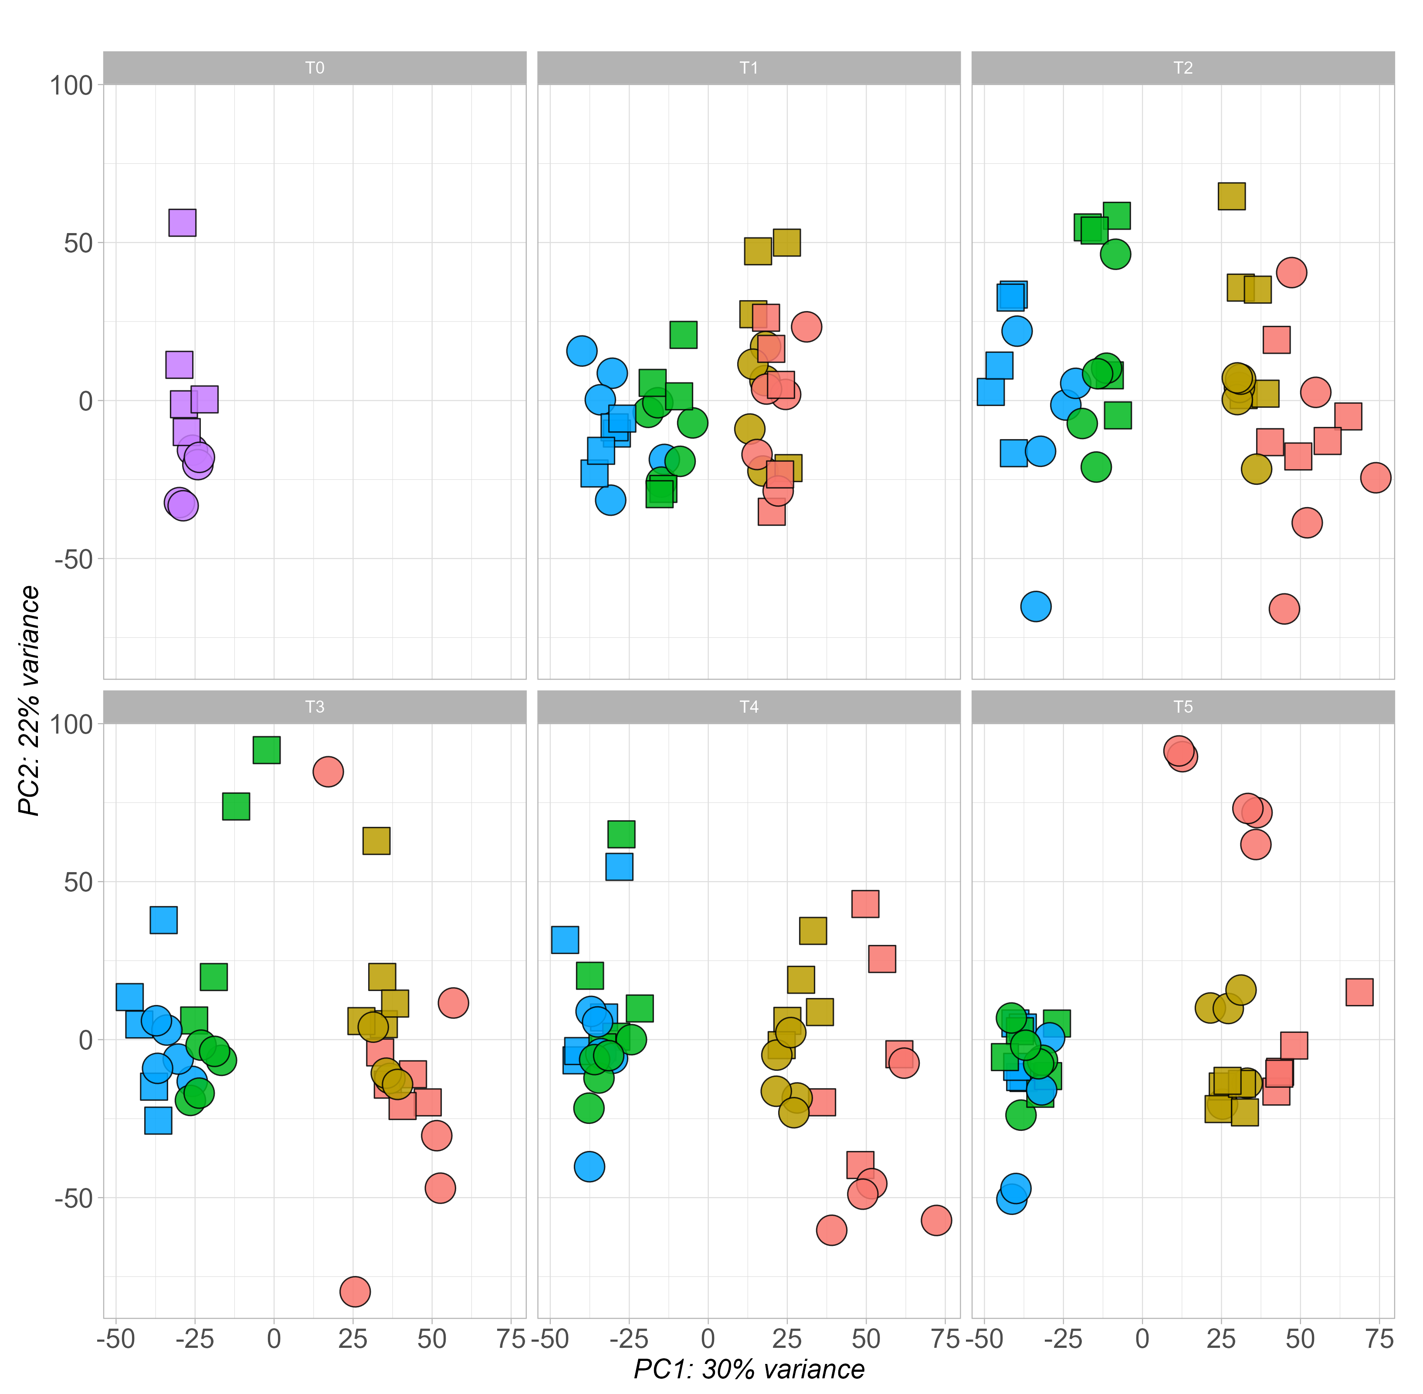
Deduped: Expression by Timepoint
Temperature
Origin
Inshore
Offshore
*Remake separated by site
Calculate pairwise difference between points, come up with average distance
High level, maybe inshores respond faster and recover faster?
Sub lethal both pushed over edge, maybe differences at 37 to define
What is the timing and intensity of response, # of DEGs at different timepoints
Functional enrichment with goseq
Anywhere possible put them on the same scale

Slide 13
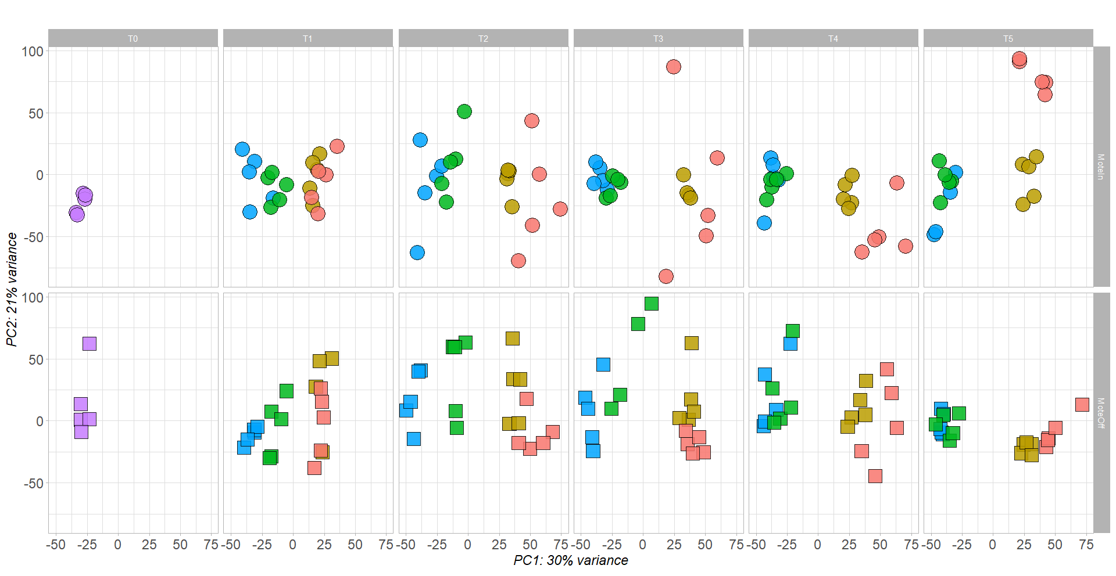
Temperature

Slide 14
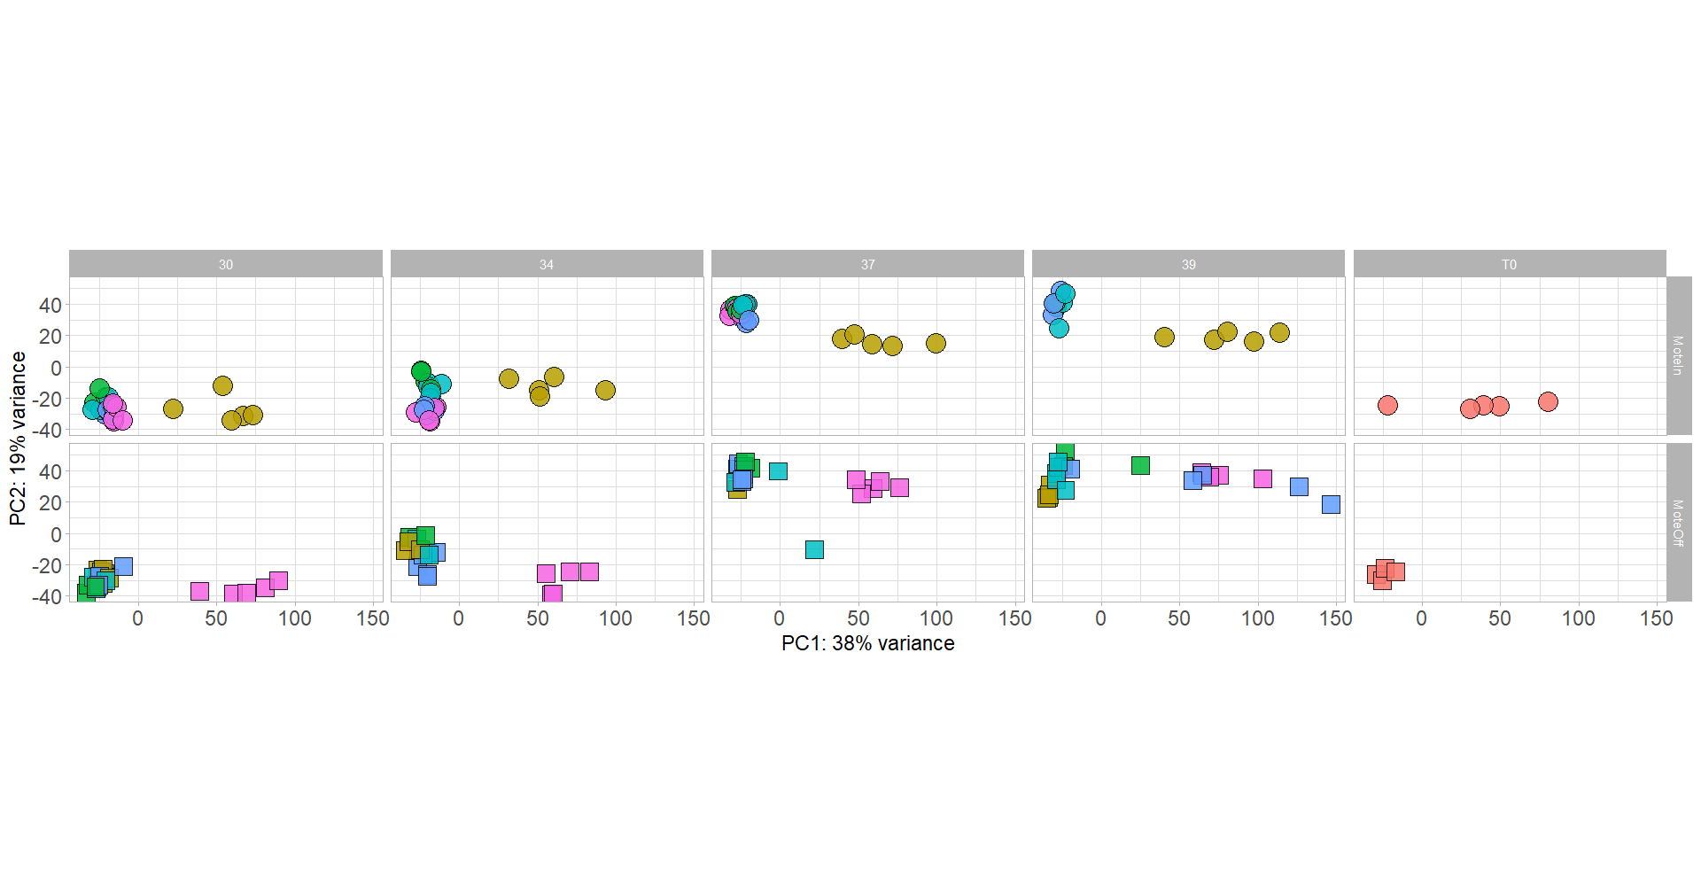
First Pass: Expression by Temperature
Origin
Timepoint
Origin
T0
T1
T2
T3
T4
T5
Inshore
Offshore
T0
T1
T2
T3
T4
T5
Inshore
Offshore

Slide 15
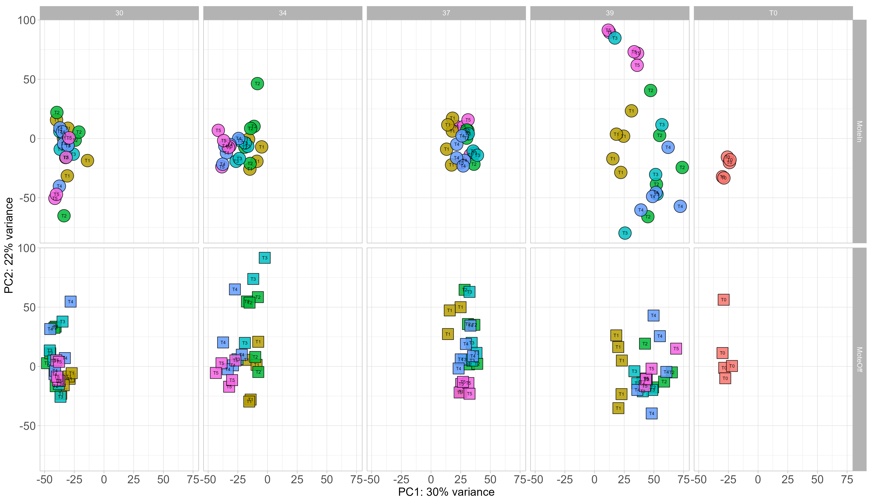
Deduped: Expression by Temperature
Timepoint
Origin
T0
T1
T2
T3
T4
T0
T1
T2
T3
T4
T5
Inshore
Offshore

