Slide 1
Dart Scoring System Concept
Kevin Parlak

Slide 2
Concept Description
Computer vision-based scoring system for steel tipped dart boards
Nvidia Jetson Nano will be used for CV/ML of dart positions and associated score
Raspberry Pi 3B+ will be used for database hosting and control of user display
Will communicate with Jetson Nano via Ethernet for dart position update
Will communicate with home router with Wi-Fi for accessibility
Android/iOS app will be developed to view game statistics and scores
Will communicate with home router to access database hosted on Raspberry Pi
Capabilities:
Ability to add new players to database
Live hit map display
Limitations:
Tracking of a single set (3 darts) – no tracking of red vs black tailed darts will be considered
Host two games (one score game and one knockout game)
Two player limit (normal dart rule)

Slide 3
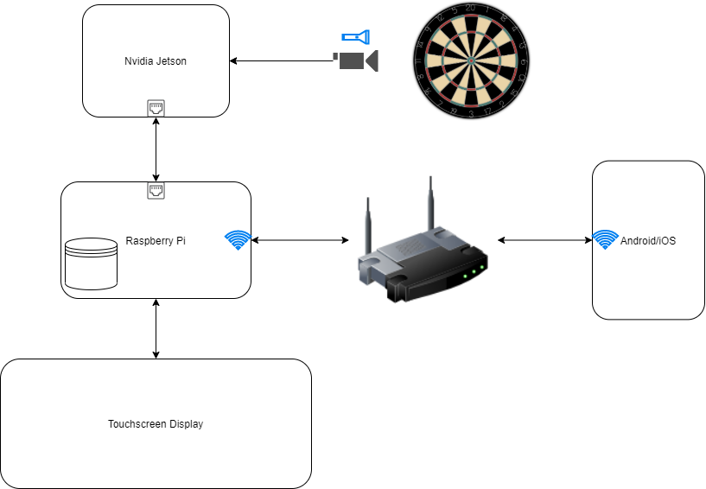
Concept Diagram
Jetson will use CV to produce dart position and score
User can use mobile app to view statistics and current score
Pi will receive message from Jetson when position has been identified
User will select player when ready to throw

