Slide 1
“Sequence of events” analysis
CS 6350 : BIG DATA MANAGEMENT AND ANALYTICS
Karthik Pasagada
Maleeha Koul
Meghna Kurup
Vikram Gopali

Slide 2
Overview
Given a certain sequence of CAMEO (Conflict and Mediation Event Observations) events, we have to tell whether they resemble a previously happened event scenario and do prediction task on the outcome of that event.
Studying political activities and interaction between different entities is gradually becoming a prominent field of research for both the social science and computer science researchers.
The focus of this project is to analyze these encoded political activities/events in Source-Action-Target (SAT) format and predict the action part of the event based on previously seen event data.

Slide 3
Project Outline
Data extraction
Data format
Exploratory Data Analysis
Pre-processing
Feature Engineering
Model Selection and training
Testing and Validation
Conclusion

Slide 4
DATA EXTRACTION AND LOADING
Input data set is the real-time and historical event data that is obtained from the REST API endpoint that exposes Cameo Event Data generated by SPEC Framework hosted on the UTD Server (http://eventdata.utdallas.edu/api/data)
Data extraction script in python generates JSON format data scraped from the above server
The script takes an input month and year, frames a MongoDB query which writes the data to an output file

Slide 5
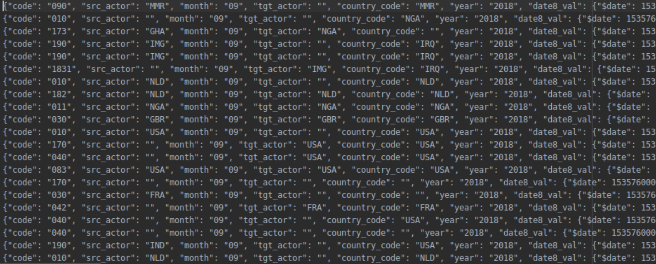
DATA EXTRACTION AND LOADING
Data combiner: In order to combine all the data that is extracted, another .py script is used which takes a list of file names as input and combines the data from input
Generates the output file in JSONL format that can be easily consumed by spark

Slide 6
DATA FROM MULTIPLE TIME FRAMES
Data used from the year 2018
Over different months for training and testing different models
~65k records from September to December 2018
Chosen randomly for sequence analysis

Slide 7
DATA DEEP DIVE
Data format and description:
|-- country_code: string (nullable = true) //All codes representing the country
|-- geoname: string (nullable = true) //The location of the event
-- goldstein: double (nullable = true) //a # from -10 to +10 representing level of conflict or cooperation
|-- month: string (nullable = true) //month of the event
|-- code: string (nullable = true) // encoded action
|-- root_code: string (nullable = true) // base of the encoded action
|-- source: string (nullable = true) // source of event
|-- src_actor: string (nullable = true) // source actor of the event
|-- src_agent: string (nullable = true) // source agent of the event
|-- src_other_agent: string (nullable = true) // source other actor of the event
|-- target: string (nullable = true) // target of the event
|-- tgt_actor: string (nullable = true) // target actor of the event
|-- tgt_agent: string (nullable = true) // target agent of the event
|-- tgt_other_agent: string (nullable = true // target other agent of the event

Slide 8
|-- _id: string (nullable = false) //mongodb document id
|-- url: string (nullable = true) //url of the event
|-- quad_class: string (nullable = true) //supplementary action information
|-- date8: date (nullable = false) //date of the event
|-- source_text: string (nullable = true) //news source of the event
|-- latitude: double (nullable = true) //latitude of the event
|-- longitude: double (nullable = true) //longitude of the event
|-- year: string (nullable = true) //year of the event

Slide 9
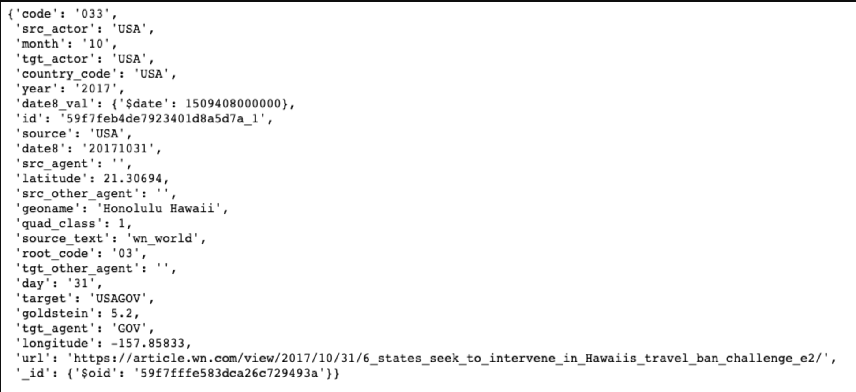
Sample of one record / event

Slide 10
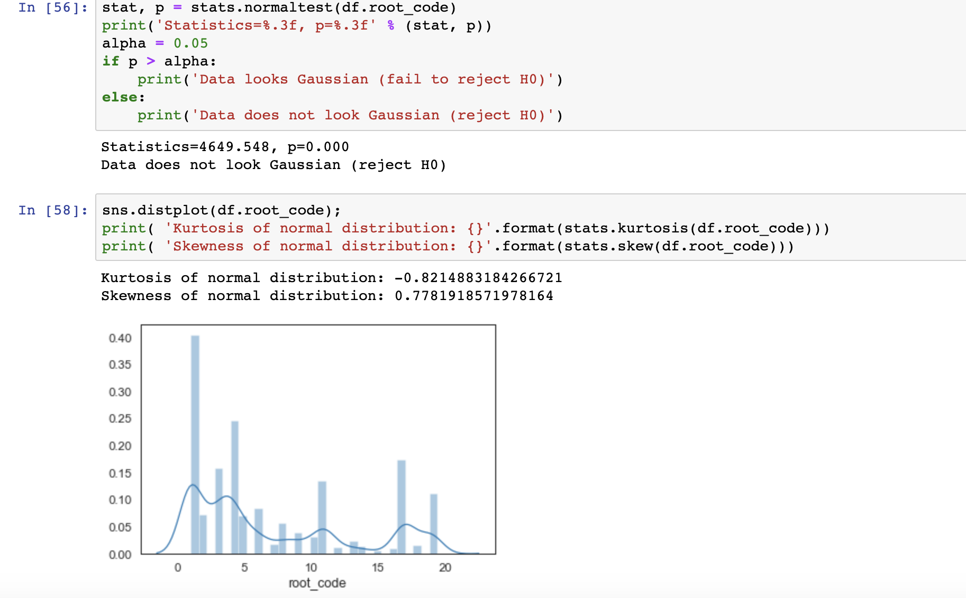
Exploratory Data Analysis

Slide 11
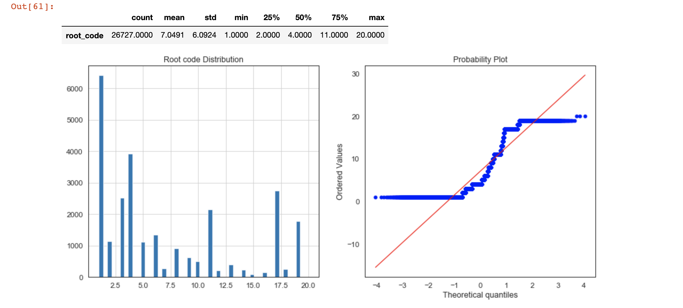

Slide 12
Pre-processing
Removed unnecessary columns
Date8_val , _id, url, code etc.
Dropped rows which had one or more NULL values (NA)
Dropped rows with no geographical information
Imputated source and target columns which had NULL values

Slide 13
Feature Engineering Techniques used
String Indexers
One Hot Encoding
Standard Scaler
Date time stamp
Vector Assembler
Chi-Square Selector

Slide 14
Model Selection and training LSTM
Using Keras
Time series analysis is the collection of data at specific intervals over a period of time, with the purpose of identifying trends, cycles, and seasonal variances to aid in the forecasting of a future event.
Modelled sequences of data according to the date stamp
Time based predictions
Long short-term memory (LSTM) is an artificial recurrent neural network (RNN) architecture used in the field of deep learning
Poor accuracy : Time buckets not well defined

Slide 15
Model Selection and training Random Forest Classifier Logistic Regression
Using Spark ML
Obtained training accuracy between 40-50% and testing accuracy between 20-25%
Used random forest with 10 trees and max depth of 20
Used logistic regression with regularization parameter of 0.3 and elastic net parameter of 0.8 with 100 maximum iterations

Slide 16
Model Selection and training Decision Tree Classifier Support Vector Machine
Using Spark MlLib
Used a subset of features selected intuitively after analysis.
Features include : 'country_vec'(Vector of country codes encoded as numbers) 'goldstein value', 'latitude', 'longitude', 'quad class’
Predict the root_code after training on 70% of the data.
Accuracy:
Decision Tree: 85.45% with the above features
Support Vector Machines: 75.44% with the above features

Slide 17
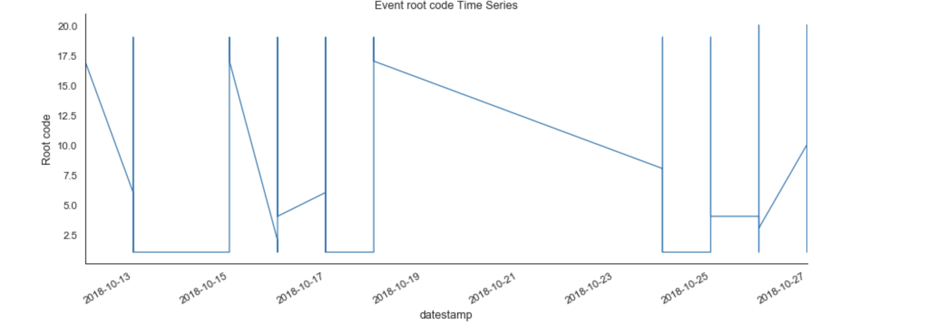
LSTM Screenshots

Slide 18
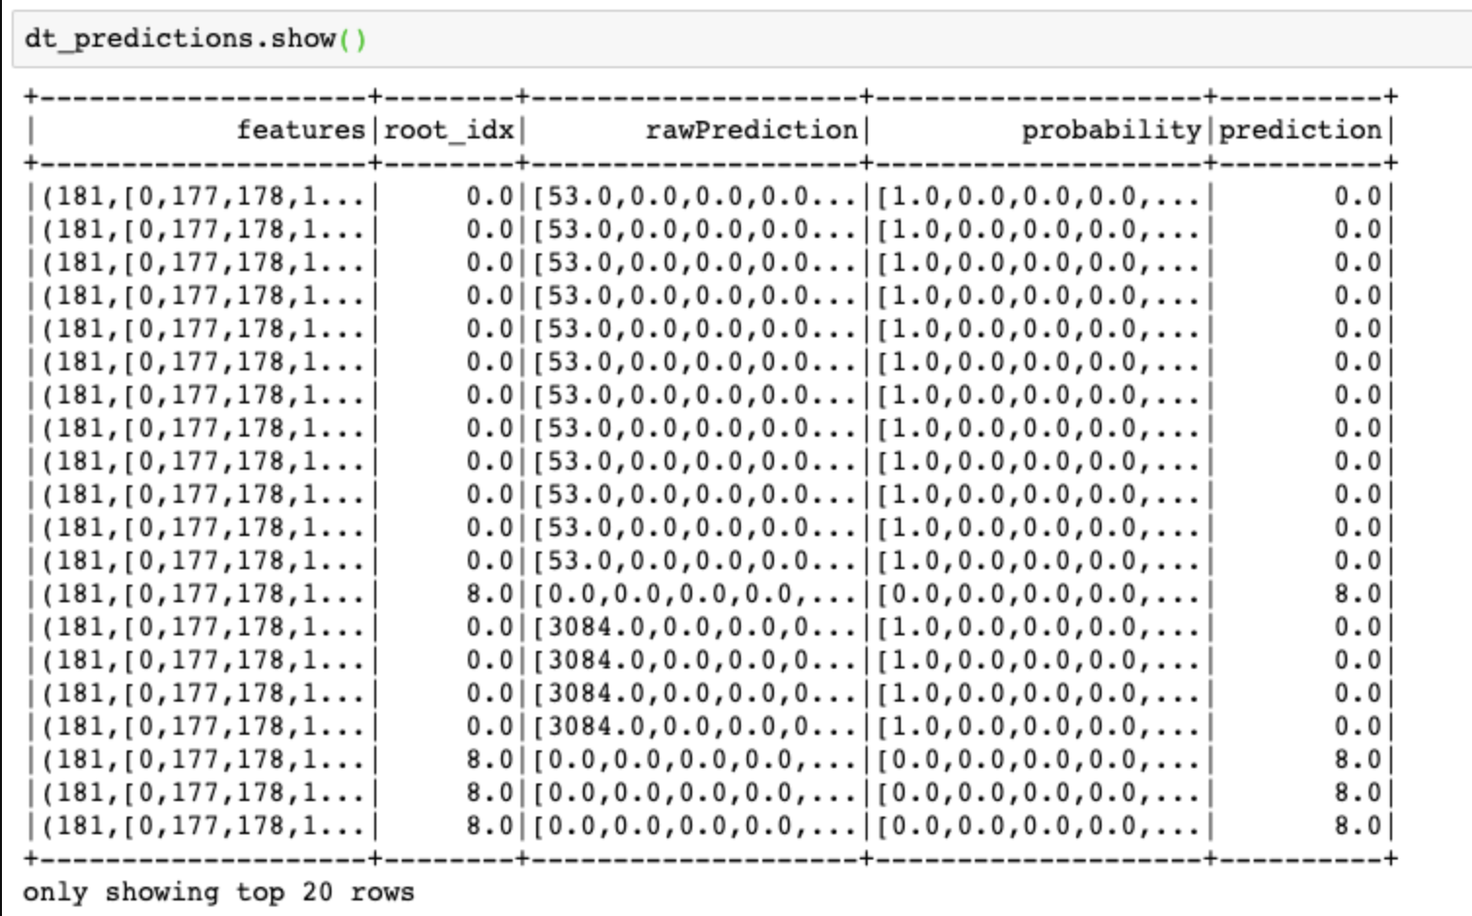
SUPERVISED MODELS SCREENSHOTS

Slide 19
CONCLUSION
Efficient implementation of the techniques could help us identify a future event by predicting its root code
Improvements :
Test with different combination of features
Test with data from different years / variety of data / larger volumes of data

Slide 20
Future work
Kafka and real time streaming
This work can be extended to making predictions in real time by setting up a Kafka server for streaming continuous event data
Use Kibana to analyze and visualize the predicted events

Slide 21
Technologies Used
Python 3
PySpark
Tensorflow and Keras
Pandas
Spark
Jupyter Notebook
PyCharm

