Slide 1

Restaurant/Café POS System
Developed By:
Akshat Gandhi
Kartik Patel
Sukrut Modak
Guide:
Mr. Upanish Doshi,
Director, Samay Softwares.
Trident Complex,
Vadodara.
(2012-2013)

Slide 2
About Company
Samay Software is a Baroda IT based company which provides various services, some of them are listed below :
Web Application Development
Software Maintenance
Software Integration and Migration
Product Management
Network Application Development
The major products of the company are :
Computer Network Monitoring System.
Real Estate Software.

Slide 3
Purpose
In order to effectively run a restaurant/cafe, cost and time saving are essential. Minimizing time by a few seconds for each table can speed up order processing, increase efficiency and boost profits.
The biggest hurdle most restaurants/cafe face is the migration from a paper-pencil system to a completely automated touch-screen system. Most retail establishments choose to use a point-of-sale system (herein referred to as POS) to handle their transactions.
The purpose of this project is to develop the automated touch-screen POS system to track customer orders, in a restaurant/cafe.

Slide 4
Scope of System
The Project is divided into two components.
First part consists of the android application installed in all the android tablets. Tablets can be possessed by the waiters who will record the customers order in the application or the tablets can be placed on the table so that the customers can themselves place the order. Customers also have a facility to add comments and advices in preparing the dish for them. The customers are also allowed to browse the internet from within the android app itself.
And the other part consists of the Admin part, that deals with aspects like tracing the customers orders, managing tables, etc. The manager of the restaurant/café handles the customers orders through the application’s interface on the web browser. Orders are send to the kitchen by displaying them on the screen through the application.

Slide 5
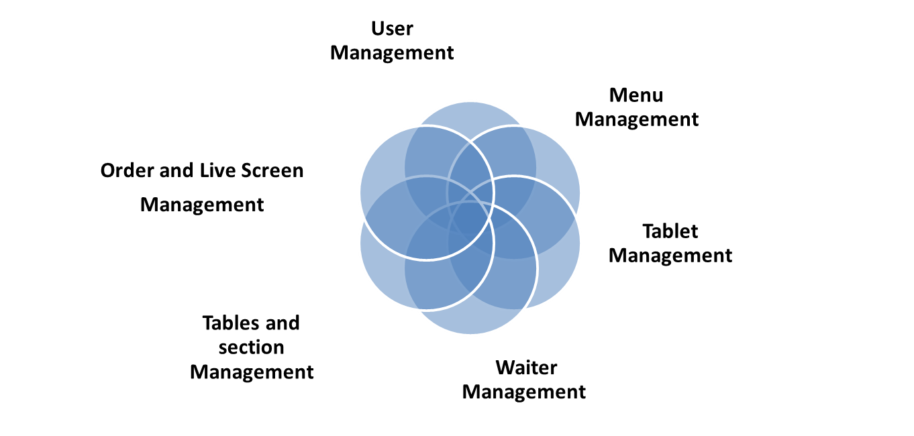
System Functionalities (MODULES)

Slide 6
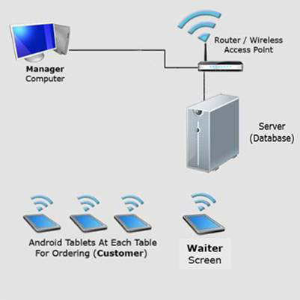
Tools & Technologies
HTML with PHP, Javascript and Jquery
MySQL
Android API

Slide 7
categoryID
E – R Diagram
CategoryID
ItemID
name
Name
Description
Category
1
M
description
contains
Items
parentID
M
price
Image
price
M
Images
Name
has
userID
timestamp
quantity
address
user
1
OrderID
idtype
1
places
M
M
tableId
isadmin
Order
price
has
M
1
has
status
waiterid
tableId
userlogID
yposition
1
M
1
places
quantity
userlog
table
Generated for
sectionID
M
1
userID
xposition
timestamp
contains
timestamp
yposition
Assigned to
waiterID
invoiceid
1
M
1
invoice
section
Assigned to
customername
1
sectionID
xposition
waiter
adminID
devicename
1
createdtime
1
device
age
deviceID
Name
notes

Slide 8
Use Case Diagram
Place order
<<includes>>
<<includes>>
<<includes>>
Order approval
Waiter
Browse and select menu items
<<extends>>
Send to kitchen
Update order details and device log
Customer
Browse internet
<<includes>>
login
<<includes>>
<<extends>>
registration
Update user log
<<includes>>
<<includes>>
I-Card details
add user details
Manager
System boundary

Slide 9
Use Case Diagram
Call waiter
Pay bill
<<includes>>
<<extends>>
Cash/card payment
Customer
Create invoice
Manager
<<includes>>
Add invoice details
System boundary

Slide 10
Use Case Diagram
Update menu card
<<includes>>
Add/modify/ delete items details
Update waiter details
<<includes>>
Add/modify/ Delete waiter details
Update Tablet details
Manager
<<includes>>
Add/modify/ Delete tablet details
Update Section layout details
<<includes>>
<<includes>>
Add/modify/ Delete Section Layout Details
Update table layout details
<<includes>>
Add/modify/ Delete Section Layout Details
System boundary

Slide 11
Class & Class Association Diagram
MenuItems
LiveScreen
Table
Itemname : String
Subcategoryid : int
ImageUrl : String
Description : String
Prepration : String
Notes : String
Price : float
CurrentOrders : Orders[]
Tablename : String
Sectionid : int
Xposition : int
Yposition : int
Device
Devicename : String
Waiter id: int
tableid : int
Notes : String
Reloadorders()
Updateorder()
Addtable()
Updatetable()
Deletetable()
Fetchtable()
Additem()
Updateitem()
Deleteitem()
Fetchitem()
Fetchitems()
Addnewdevice()
Updatedevice()
Deletedevice()
Fetchdeviceinfo()
Assigndevice()
Logdevice()
<<use>>
<<use>>
Waiter
Database_Config
Waitername : String
Age : int
Notes : String
<<use>>
servername : String
username : Stirng
password : String
Databasename: String
<<use>>
<<use>>
Addwaiter()
Updatewaiter()
Deletewaiter()
Fetchwaiter()
<<use>>
<<use>>
<<use>>
getConnection()
User
Orders
firstname : String
lastname : String
password : String
IsAdmin : boolean
Emailid : stirng
Address : string
Contactnumber: int
Identity type : string
Identitycode : string
Documents : string
<<use>>
Itemids : int[]
Price : int[]
Tableid : int
Waiterid : int
Timestamp : time
Status : string
Createdtime : time
Servedtime : time
Acceptedtime : time
Billedtime : time
notes : string
<<use>>
Category
invoce
Categoryname : String
Description : String
Parentcategory : String
ImageUrl : string
Section
Orderid :I nt
Customer name : string
Customer addr : string
Createdtime : time
Items : MenuItems[]
Sectionname : String
Xposition : int
Yposition : int
Adduser()
Updateuser()
Deleteuser()
Fetchuser()
loguser()
validateuser()
Addorder()
Updateorder()
Deleteorder()
Fetchorder()
Addcategory()
Deletecategory()
Updatecategory()
Fetchcategory()
Createinvoice()
Deleteinvoice()
Fetchinvoice()
Addsectioon()
Updatesection()
Deletetsection()
Fetchsection()

Slide 12
Category
MenuItems
Itemname : String
categoryid : int
ImageUrl : String
Description : String
Prepration : String
Notes : String
Price : float
Categoryname : String
Description : String
ParentcategoryID : int
ImageUrl : string
Waiter
invoce
0..*
1..*
1
Waitername : String
Age : int
Notes : String
Orderid :I nt
Customer name : string
Customer addr : string
Createdtime : time
Items : MenuItems[]
Addwaiter()
Updatewaiter()
Deletewaiter()
Fetchwaiter()
Addcategory()
Deletecategory()
Updatecategory()
Fetchcategory()
1
Additem()
Updateitem()
Deleteitem()
Fetchitem()
Fetchitems()
Createinvoice()
Updateinvoice()
Fetchinvoice()
1
1
1
0..1
1..*
Device
1..*
1..*
Devicename : String
Waiter id: int
tableid : int
Notes : String
Orders
Itemids : int[]
Price : int[]
Tableid : int
Waiterid : int
Timestamp : time
Status : string
Createdtime : time
Servedtime : time
Acceptedtime : time
Billedtime : time
notes : stringUserdetailid : int
Addnewdevice()
Updatedevice()
Deletedevice()
Fetchdeviceinfo()
Assigndevice()
Logdevice()
1
1
1..*
User
1
firstname : String
lastname : String
password : String
IsAdmin : boolean
Emailid : stirng
Address : string
Contactnumber: int
Identity type : string
Identitycode : string
Documents : string
0..1
Table
0..1
1..*
1
Tablename : String
Sectionid : int
Xposition : int
Yposition : int
Addorder()
Updateorder()
Deleteorder()
Fetchorder()
Adduser()
Updateuser()
Deleteuser()
Fetchuser()
loguser()
validateuser()
1
Addtable()
Updatetable()
Deletetable()
Detchtable()

Slide 13
User
InternetAccess
firstname : String
lastname : String
password : String
IsAdmin : boolean
Emailid : stirng
Address : string
Contactnumber: int
Identity type : string
Identitycode : string
Documents : string
Userid : int
Section
Table
Sectionname : String
Xposition : int
Yposition : int
1
Tablename : String
Sectionid : int
Xposition : int
Yposition : int
Login()
Browseinternet()
Signout()
Loguser()
1..*
Addsectioon()
Updatesection()
Deletetsection()
Fetchsection()
Addtable()
Updatetable()
Deletetable()
Fetchtable()
Adduser()
Updateuser()
Deleteuser()
Fetchuser()
loguser()
validateuser()
Display Order
Orders
MenuItems
LiveScreen
Itemids : int[]
Price : int[]
Tableid : int
Waiterid : int
Timestamp : time
Status : string
Createdtime : time
Servedtime : time
Acceptedtime : time
Billedtime : time
notes : string
Items : menuitems[]
Theme : themeobj
Itemname : String
Subcategoryid : int
ImageUrl : String
Description : String
Prepration : String
Notes : String
Price : float
Orders : Orders[]
loadmenu()
loadtheme()
Searchitems()
Placeorder()
Additemstoorder()
Checkout()
Reloadorders()
Updateorder()
Additem()
Updateitem()
Deleteitem()
Fetchitem()
Fetchitems()
Addorder()
Updateorder()
Deleteorder()
Fetchorder()

Slide 14
Actor : Customer
Sequence Diagram
:displayorder
:menuitems
:order
:livescreen
:invoice
:database_config
fetchitems()
connect()
return(menuitems[])
return()
browseitems()
return()
return()
additemstoorder()
return()
return()
placeorder()
addorder()
connect()
neworderrequest()
return()
connect()
reloadorders()
return()
return(orderstatus)
return()
return()
If (orderstatus=not approved)
Modifyorder()
upateorder()
connect()
return()
return()
return(orderstatus)
checkout()
upateorder()
reloadorders()
return()
connect()
return(bill)
generateinvoice()
return(bill)
Page Break
return(bill)
return()

Slide 15
Actor : Customer
Sequence Diagram
:Userlogin
:user
:internetaccess
:userlog
:database_config
login()
validate()
connect()
return()
return()
If (user is valid)
enableaccess()
loguser()
connect()
return()
browseinternet()
return()
return()
signout()
loguser()
connect()
return()
return()
return()

Slide 16
Actor : Administrator
Sequence Diagram
:login
:category
:menuitems
:database_config
Login()
connect()
If (user is valid)
return()
displaycategories()
connect()
return()
return()
return()
browsecategory()
browse()
Additem()
return()
Addnewitem()
Saveitem()
return()
connect()
return()
return()
return()
Page Break

Slide 17
Activity Diagram – Admin management
Add category/subcategory details
no
Add item details
If category/ subcategory exists
yes
Add section & tables details
Add user details
Add device details
Add waiter details

Slide 18
Activity Diagram – order processing
Browse menu items
Add to order list
Place order
Update live screen
If order approved
Modify order list
Notify customer about the inconvenience
no
yes
Update order status
yes
If order status is “checkout”
If order served
no
yes
checkout

Slide 19
State Diagram – Order
Created
Entry – user orders selected items
Exit – order is displayed to admin
Seen
Entry – admin sees the order
Exit – Admin approve/disapprove order
Disapproved
Entry – admin disapproves the order
Exit – order is being modified
Approved
Entry – admin approves the order
Exit – order is being served
Terminated
Entry – Payment of bill
Exit – order
Served
Entry – Order is served
Exit – new item is ordered / checkout

Slide 20
Thank you….!!

