Slide 1

A PYTHON CLASS PROJECT
Stock Insight Analyzer
An educational tool for understanding stock behavior
Presented by Kush, Kinjal, Hanna, Omar, Seyfi
Python | yfinance | pandas | matplotlib

Slide 2

The Problem
Yet for beginners, three barriers remain:
62%
Data is scattered across dozens of sites
Indicators (MA, RSI, volatility) sound technical
of U.S. adults own stock — directly or through retirement accounts.
Most apps push trades, not understanding
The gap: participation without the vocabulary to explain what's happening on the chart.
Source: Gallup, 2024
Stock Insight Analyzer
2 / 14

Slide 3


Project Objective
Build a Python program that takes a stock ticker and returns simple, explainable insight into how that stock has been behaving — without telling the user what to buy.
Simple
Visual
Honest
Rule-based scoring, not a black box.
Every recommendation can be explained.
A price chart with moving averages
makes trends obvious at a glance.
Always labels itself as educational.
Never promises returns.
Stock Insight Analyzer
3 / 14

Slide 4




Tools & Technologies
Python 3.14
yfinance
Core language for the whole project
Downloads live stock history from Yahoo Finance
pandas + NumPy
matplotlib
Data manipulation, time-series math, indicator calculations
Renders the 1-year price chart with moving averages
Git / GitHub
VS Code
Version control and code hosting
Editor and running environment
Stock Insight Analyzer
4 / 14

Slide 5

Project Architecture
Input → Processing → Output
INPUT
PROCESSING
OUTPUT
User types a ticker
e.g. AAPL, TSLA, MSFT
yfinance pulls 1 yr of data
Clean & validate data
Moving averages (20, 50)
RSI, volatility, returns
Rule-based scoring
Formatted summary (CLI)
Labeled PNG price chart
Plain-text report file
Recommendation + reasons
Stock Insight Analyzer
5 / 14

Slide 6
Module Breakdown
Each file has one clear job
File
Responsibility
main.py
Entry point, handles user input and orchestrates the flow
fetch_data.py
Downloads stock history and company info via yfinance
indicators.py
Computes MA20, MA50, RSI, volatility, 1-month & 6-month returns
analyzer.py
Rule-based scoring engine that produces the recommendation
visualizer.py
Builds the 1-year price chart with matplotlib
utils.py
Input normalization, console formatting, saves text report
Stock Insight Analyzer
6 / 14

Slide 7
How the Analysis Works
Explainable rules, not a black box
Indicators used
Three possible labels
Moving Averages (20 & 50 day)
Long-term investing
Smooths out daily noise to reveal the trend
Healthy trend, moderate risk
Annualized Volatility
How much the stock swings — higher = riskier
Short-term trading
Active movement, moderate risk
1-month & 6-month Return
Short- and medium-term performance
Use caution
RSI (14-day)
Weak trend or high volatility
Above 70 = overbought, below 30 = oversold
Stock Insight Analyzer
7 / 14

Slide 8
Scoring Rules
Each signal adds or subtracts points — the final score picks the label
Signal | Points
Current price above 50-day MA | +2 / -2
20-day MA above 50-day MA | +2 / -1
6-month return > 10% | +2
6-month return > 0% | +1
6-month return negative | -2
Volatility < 25% (moderate) | +2
Volatility > 40% (high) | -2
RSI in 30–70 (balanced) | +1
RSI > 70 (overbought) | -1
Score ≥ 5 long-term • 2–4 short-term • < 2 caution
Stock Insight Analyzer
8 / 14

Slide 9
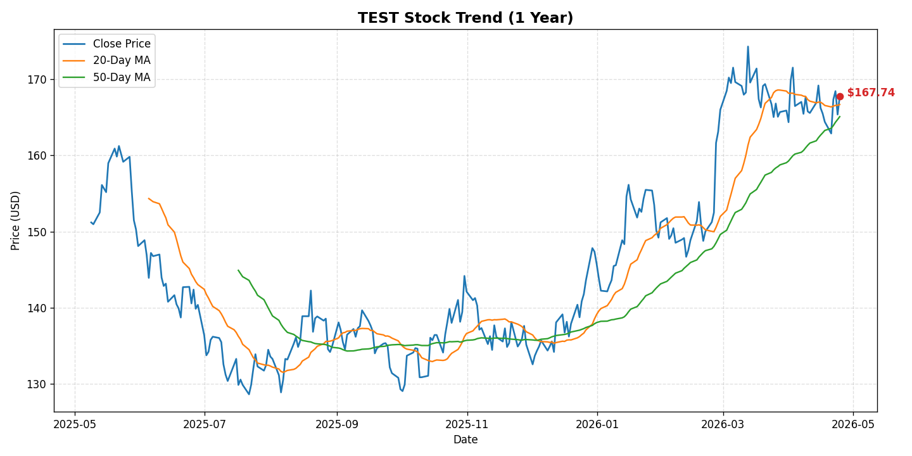
Example Output | Healthy Trend
RESULT
Long-term
investing
Signal Score
+9
Risk Score
3 / 10
Volatility 23%
Stock Insight Analyzer
9 / 14

Slide 10
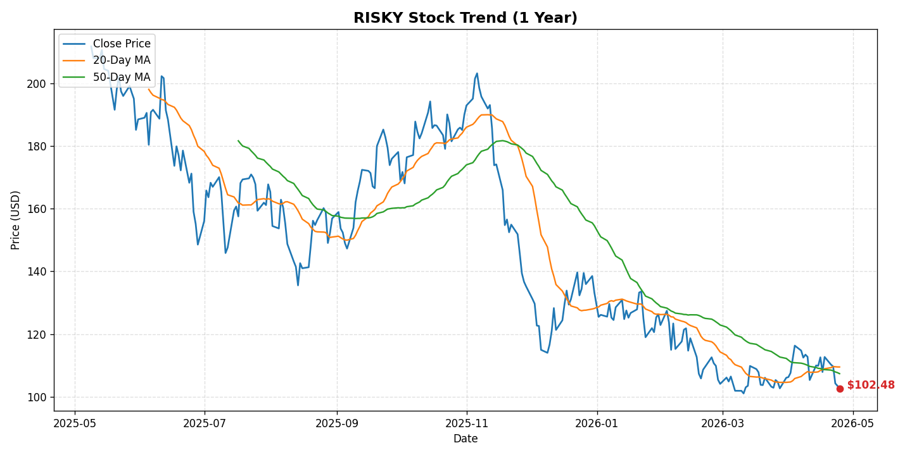
Example Output | Risky Stock
RESULT
Use caution
Signal Score
-3
Risk Score
8 / 10
Volatility 53%
Stock Insight Analyzer
10 / 14

Slide 11

Testing & Error Handling
Every user-facing failure is caught with a friendly message
Valid ticker
Invalid ticker
Full metrics + chart + report saved
Friendly message: "ticker may be invalid or delisted"
Empty input
Network failure
Short prompt: "ticker cannot be empty"
Caught, prints: "check your internet connection"
Short history (new IPO)
Unexpected exception
Falls back to earliest available date
Caught by outer handler, program exits cleanly
Stock Insight Analyzer
11 / 14

Slide 12

Challenges & Key Learnings
Challenges
Key Learnings
Teammates left partway through — project had to be finished solo
yfinance .info can be slow or unreliable; had to wrap in try/except
Handling short price histories (new IPOs) without crashing
Designing rules that are explainable in plain English
Modular code (one file = one job) makes debugging fast
Rule-based logic is easier to defend than black-box ML
Always fail gracefully — the demo only has one shot
pandas time-series windows (rolling, pct_change) are powerful
Stock Insight Analyzer
12 / 14

Slide 13
DEMO
Live Demo
Let's run the program on a real ticker.
1
Open terminal inside the project folder
2
Run: python main.py
3
Enter a ticker (AAPL, MSFT, or TSLA)
4
Review metrics, chart, and recommendation
Stock Insight Analyzer
13 / 14

Slide 14

Q & A
Thank You
Questions welcome.
Python Class Project

