Slide 1

CNN (Spatial)
Image and visual feature learning
Deep Learning Applications
RNN (Sequential)
Text and time-series modeling
Convolutional Neural Networks (CNN) & Recurrent Neural Networks (RNN)
Deep Learning Architectures for Spatial and Sequential Data
CNN
RNN
Audience
Spatial feature learning for images and visual data
Temporal dependency modeling for sequences and text
B.Tech AI/ML — foundational deep learning curriculum

Slide 2
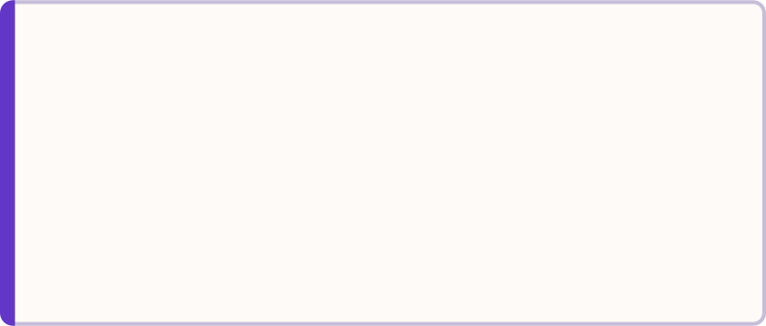

Why Specialized Neural Networks?
Standard fully connected networks treat every input neuron independently — they are computationally expensive, prone to overfitting, and destroy the inherent structure of spatial and sequential data. Specialized architectures are designed to exploit that structure.
The Core Problem
The Specialized Solution
Fully Connected Limitations
Millions of redundant parameters for high-dimensional inputs
No awareness of local pixel correlations in images
No awareness of word order or time ordering in sequences
CNN — Spatial Data
RNN — Sequential Data
Exploits local pixel correlations via weight sharing. Learns hierarchical features: edges → shapes → objects.
Maintains a hidden state across time steps. Captures temporal dependencies in text, speech, and time series.
Key Insight: Architecture should always match data structure. Forcing the wrong architecture wastes computation and loses critical structural information.

Slide 3
CNN Fundamentals
The convolution operation is the engine of a CNN. A small learnable filter slides across the input, computing element-wise products and summing them into a single value — detecting a local feature at each position.
Core Concepts
Output Size Formula
Filters / Kernels
Formula
Small learnable matrices (e.g., 3×3, 5×5) that detect specific features such as edges, corners, or textures. Each filter produces one feature map.
Stride
Step size of filter movement across the input. Stride = 1 moves one pixel at a time; Stride = 2 skips every other position, halving spatial dimensions.
W
F
Input width/height
Filter size
Padding
Zero-padding added around the input border. Preserves spatial dimensions and ensures border pixels contribute equally to learning.
P
S
Padding amount
Stride value
Example: Input 32×32, filter 3×3, padding 1, stride 1 → Output = (32 − 3 + 2) / 1 + 1 = 32×32 (same size preserved).

Slide 4

CNN Architecture Pipeline
A complete CNN stacks multiple functional layers into a pipeline. Early layers detect low-level features; deeper layers combine them into progressively abstract representations before a classification head produces the final output.
Input Image
Convolution
ReLU
Pooling
Repeat Blocks
01
01
Input Image
Repeat Blocks
Raw pixel values — e.g., 224×224×3 tensor for a color RGB image.
Stack Conv-ReLU-Pool blocks. Depth increases, spatial dimensions shrink — hierarchy emerges.
02
02
Convolution + ReLU
Flatten
Apply N filters; apply ReLU: f(x) = max(0, x) to introduce non-linearity.
Convert the final 3D feature volume into a 1D vector for the classification head.
03
03
Pooling Layer
FC Layers → Output
Max or average pooling reduces spatial size, retains dominant features, adds translation invariance.
Fully connected layers map features to class scores. Softmax outputs class probabilities summing to 1.

Slide 5








CNN Example: Image Classification & Applications
Feature Hierarchy: Cat vs. Dog
Real-World Applications
CNNs learn progressively abstract representations layer by layer. Each stage builds upon the previous, transforming raw pixels into semantic class labels.
Medical Imaging
X-ray and CT scan diagnosis; tumor detection with radiologist-level accuracy.
Layer 1 — Edges
Horizontal, vertical, and diagonal edge detectors
Facial Recognition
Identity verification in security systems, smartphones, and access control.
Layer 2 — Textures
Object Detection
Fur patterns, skin, repeated structural motifs
YOLO, R-CNN for real-time detection in autonomous vehicles and surveillance.
Layer 3 — Parts
Popular Architectures
Eyes, nose, ears — recognizable anatomical components
LeNet / AlexNet
Layer 4 — Objects
VGG / ResNet
Cat face vs. dog face — full semantic classification
EfficientNet / MobileNet

Slide 6


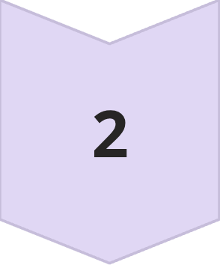
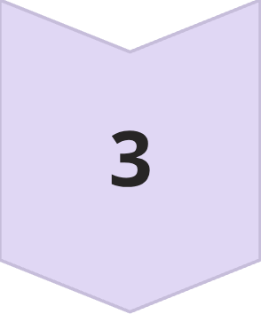
RNN Fundamentals
Recurrent Neural Networks introduce a feedback loop — the output of the hidden layer at time step t is fed back as input at time step t+1. This creates a form of memory that enables the network to process sequences where order is critical.
Why Recurrence?
Unfolded View — Information Flow
An RNN "unrolled" across time shows how information propagates through the sequence:
Sequential Data
Text, time series, speech, and video frames all have ordering that carries meaning. Shuffling inputs destroys that meaning.
t = 1
x₁ → h₁ → y₁
Hidden State ht
t = 2
A vector that acts as the network's running memory. It accumulates information from all previous time steps.
x₂ + h₁ → h₂ → y₂
t = T
Weight Sharing
xT + hT−1 → hT → yT
The same weight matrices Wx, Wh, Wy are reused at every time step — drastically reducing parameters versus a separate network per step.
Each hidden state carries context from all prior inputs — enabling the network to answer "what came before?" at every step.

Slide 7

RNN Architecture & Equations
At every time step, an RNN applies the same transformation to combine the current input with the accumulated memory from the past. Backpropagation Through Time (BPTT) unrolls this computation graph to compute gradients across all steps.
Core Equations
Backpropagation Through Time (BPTT)
Hidden State Update
Output Computation
1
Unroll the network
Expand the recurrent graph across all T time steps into a feedforward computation DAG.
2
Compute loss
Weight Matrix Roles
Calculate loss at each output yt; total loss is the sum over all time steps.
Matrix | Role
Wx | Input-to-hidden: maps current input xt into hidden space
Wh | Hidden-to-hidden: propagates memory from ht−1 to ht
Wy | Hidden-to-output: maps hidden state to output prediction
3
Backpropagate
Gradients flow backward through time — through every unrolled step — to update Wx, Wh, Wy.
The tanh activation squashes hidden state values to [−1, 1], providing non-linearity and a bounded memory signal at each step.

Slide 8

Problems with Basic RNNs
Basic RNNs suffer from fundamental training instabilities that severely limit their practical utility on long sequences. These are not implementation bugs — they are structural properties of the architecture itself.
Core Failure Modes
Solutions: Gated Architectures
Vanishing Gradient
LSTM
GRU
During BPTT, gradients are multiplied by Wh at every step. When |Wh| < 1, gradients shrink exponentially toward zero — the network forgets dependencies beyond 10–20 time steps.
Long Short-Term Memory — introduces three gates controlling information flow:
Gated Recurrent Unit — simplified LSTM with only two gates:
Forget gate: what to erase from cell state
Input gate: what new information to store
Output gate: what to expose as hidden state
Reset gate: how much past to forget
Update gate: blend of old and new state
Exploding Gradient
Fewer parameters than LSTM — trains faster, competitive performance on many tasks.
When |Wh| > 1, gradients grow exponentially — training diverges. Mitigated practically by gradient clipping (cap gradient norm at a threshold).
Cell state provides a gradient highway that carries information across hundreds of steps.
Sequential Computation
Each time step depends on the previous — no parallelization across time. Training on long sequences is inherently slow compared to CNNs or Transformers.

Slide 9



CNN vs RNN: Side-by-Side Comparison
Choosing between CNN and RNN depends entirely on whether your data has spatial structure (images, video frames) or sequential/temporal structure (text, time series, speech). The table below captures the essential architectural differences.
Dimension | CNN | RNN / LSTM / GRU
Best For | Spatial data — images, video, volumetric data | Sequential data — text, time series, speech
Typical Input | 2D / 3D image tensors (H × W × C) | 1D sequences of variable or fixed length
Main Mechanism | Convolution + pooling for local feature extraction | Recurrent connections + hidden state update
Memory | No explicit sequence memory; receptive field grows with depth | Hidden state acts as temporal memory across steps
Parallelization | Highly parallelizable — all spatial positions computed simultaneously | Sequential by design — each step depends on previous
Common Variants | LeNet, AlexNet, VGG, ResNet, EfficientNet, MobileNet | Vanilla RNN, LSTM, GRU, Bidirectional RNN, Deep RNN
Real-World Examples | Face recognition, medical imaging, autonomous driving | Machine translation, sentiment analysis, stock prediction
CNN Strength
RNN Strength
Hybrid CNN-RNN
Translation invariance through shared weights — the same edge detector works anywhere in the image.
Order sensitivity — "dog bites man" and "man bites dog" produce very different hidden states.
Image captioning and video analysis combine both: CNN extracts spatial features, RNN generates the sequence.

Slide 10


Key Takeaways
SUMMARY
The Decision Framework
Core Principles to Remember
CNNs for Spatial Data
Choose Variant
Learn hierarchical visual features through convolution and weight sharing. Go-to architecture for images and computer vision tasks.
ResNet/EfficientNet or LSTM/GRU
Select Architecture
RNNs for Sequential Data
CNN for spatial, RNN for sequential
Identify Data Type
Capture temporal dependencies through recurrent connections and hidden state. Essential for text, speech, and time series.
Spatial or sequential data
Use Advanced Variants
Data Type → Architecture → Application
LSTM and GRU solve the vanishing gradient problem. ResNet and EfficientNet address CNN depth and efficiency. Always prefer these over vanilla architectures.
Hybrid Approaches Exist
CNN-RNN combinations power image captioning, video analysis, and visual question answering — the real world rarely fits one paradigm cleanly.
Practical Checklist
Task Type
Data Structure
Classification, detection, translation, generation?
Spatial, sequential, or both?
Compute Budget
Lightweight (MobileNet, GRU) vs. high-accuracy (ResNet, LSTM)?

